Slide 1

ENES and EUDAT Collaboration
https://verc.enes.org/

Slide 2


EUDAT: A truly pan-European Infrastructure
EUDAT offers common data services to both research communities and individuals through a network of 35 European organisations.
EUDAT wants to enable European researchers from any discipline to preserve, find, access, and process data in a trusted environment, as part of a Collaborative Data Infrastructure.
European infrastructures
Technology Providers
Research Communities

Slide 3

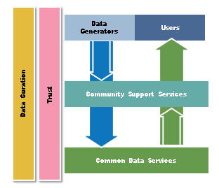
EUDAT Vision & Mission
Vision: Data is shared and preserved across borders and disciplines thereby enhancing the value and quality of research at large.
Mission: To enable data stewardship within and between European Research Communities through a Collaborative Data Infrastructure, a common model and service infrastructure for managing data spanning all European research data centres and community data repositories.

Slide 4
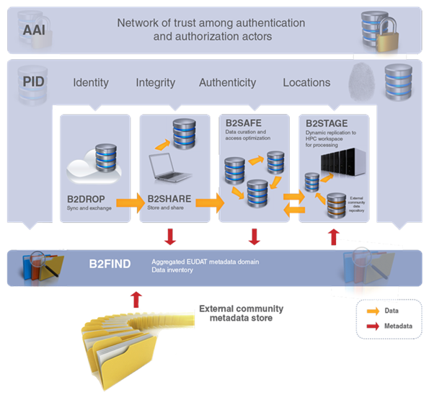










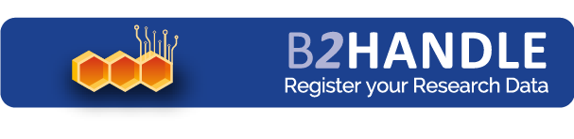



B2 Service Suite
Covering both access and deposit, from informal data sharing to long-term archiving, and addressing identification, discoverability and computability of both long-tail and big data, EUDAT services seek to address the full lifecycle of research data
https://www.eudat.eu/services
Notes:
B2FIND
stores metadata as well through other EUDAT services such as B2SHARE to provide access to data object within the EUDAT CDI
is used in inter-service use cases, e.g. to select links to data to be transferred to HPC platforms through B2STAGE

Slide 5
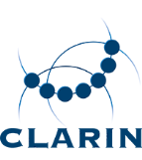





Building solutions with the communities
EUDAT services (B2 Service Suite) are designed, built and implemented together with user communites.
Common Language Resources and Technology Infrastructure (CLARIN)
European Network for Earth System Modelling (ENES)
Distributed infrastructure for life-science information (ELIXIR)
European Plate Observing System (EPOS) - Solid Earth sciences Research Infrastructure
Integrated Carbon Observation System (ICOS) to quantify & understand greenhouse gas balance
Long-Term Ecosystem Research (LTER) in Europe

Slide 7

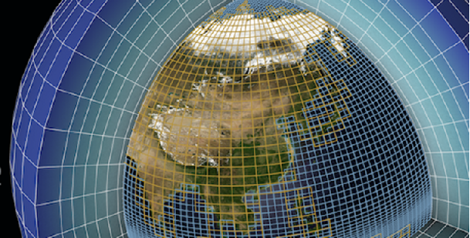
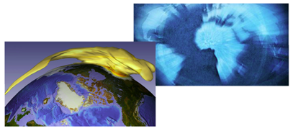
ENES: European Network for Earth System Modelling
ENES is intended
to help in the development and evaluation of state-of-the-art climate and earth system models
to facilitate focused model intercomparisons in order to assess and improve these models
to encourage exchanges of software and model results
to help in the development of high performance computing facilities dedicated to long high-resolution multi-model ensemble integrations.

Slide 8
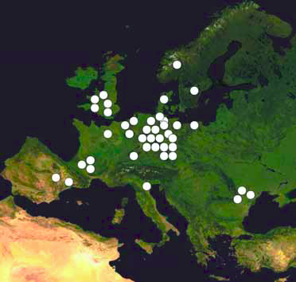
Status of ENES
Approx. 50 partners
  Universities
  Research Organizations
  Industry
In terms of IT ENES is a very mature community: HPC, Extreme Data, Network
international research and infrastructure projects.
Earth System Grid Federation (ESGF) is the proven and operational data infrastructure

Slide 9



ENES & EUDAT
ENES is one of the core communities of EUDAT
ENES partners involved
  Max-Planck-Institute for Meteorology
  Centre Européen de Recherche et de Formation Avancée en Calcul Scientifique (CERFACS)
  Deutsches Klimarechenzentrum GmbH (DKRZ)

Slide 10

ENES & EUDAT Service Uptake Plan
Policy-based prefix & PID management (B2HANDLE)
        Planned ENES data information tool with PID and versioning support using B2HANDLE library.
        Dependency on standardized PID types and may also display provenance information

Slide 11


ENES & EUDAT Service Uptake Plan
Sharing Research Data (B2SHARE)
        DKRZ is interested to run an EUDAT repository for shareable digital objects (B2SHARE) for ENES users
Data staging (B2STAGE)
        Using B2STAGE to bring data to HPC centres

Slide 12

Certification
DKRZ aims at DSA certification of its long tail repository for shareable digital objects (B2SHARE).
Vision of EUDAT is to enable European researchers from any discipline to preserve, find, access and process data in a trusted environment.
One important element to build trust is the certification of community repositories.

Slide 13
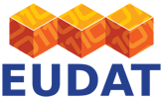
For More Information
http://www.eudat.eu/
https://verc.enes.org/

