Slide 1

ICOS & EUDAT Collaboration
https://www.icos-ri.eu/

Slide 2


EUDAT: A truly pan-European Infrastructure
EUDAT offers common data services to both research communities and individuals through a network of 35 European organisations.
EUDAT wants to enable European researchers from any discipline to preserve, find, access, and process data in a trusted environment, as part of a Collaborative Data Infrastructure.
European infrastructures
Technology Providers
Research Communities

Slide 3

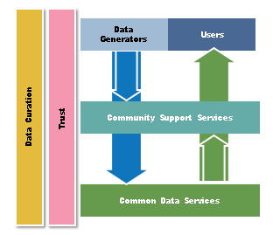
EUDAT Vision & Mission
Vision: Data is shared and preserved across borders and disciplines thereby enhancing the value and quality of research at large.
Mission: To enable data stewardship within and between European Research Communities through a Collaborative Data Infrastructure, a common model and service infrastructure for managing data spanning all European research data centres and community data repositories.

Slide 4
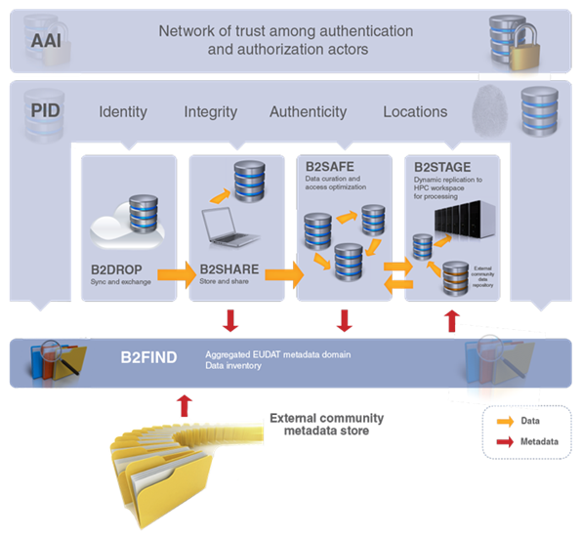










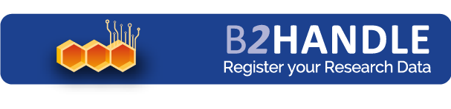



B2 Service Suite
Covering both access and deposit, from informal data sharing to long-term archiving, and addressing identification, discoverability and computability of both long-tail and big data, EUDAT services seek to address the full lifecycle of research data
https://www.eudat.eu/services
Notes:
B2FIND
stores metadata as well through other EUDAT services such as B2SHARE to provide access to data object within the EUDAT CDI
is used in inter-service use cases, e.g. to select links to data to be transferred to HPC platforms through B2STAGE

Slide 5
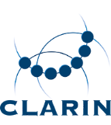





Building solutions with the communities
EUDAT services (B2 Service Suite) are designed, built and implemented together with user communities.
Common Language Resources and Technology Infrastructure (CLARIN)
European Network for Earth System Modelling (ENES)
Distributed infrastructure for life-science information (ELIXIR)
European Plate Observing System (EPOS) - Solid Earth sciences Research Infrastructure
Integrated Carbon Observation System (ICOS) to quantify & understand greenhouse gas balance
Long-Term Ecosystem Research (LTER) in Europe

Slide 7

What is ICOS?
Integrated Carbon Observation System
  “A pan-European research infrastructure for quantifying and understanding the greenhouse gas balance of the European continent and adjacent regions”
ICOS brings together 3 greenhouse gas research communities: Atmospheric, Ecosystem and Oceanic
In November 2015, ICOS is an ERIC (European Research Infrastructure Consortium)
11 European countries have signed (as of April 2016), several more “in the pipeline”
Now in the implementation phase 2015-2016
High-quality & high-precision measurements using standardized protocols
Strong commitment to ensure long-term monitoring

Slide 8
What is ICOS about?
The primary missions of ICOS are:
To collect high-quality observational data relevant to the greenhouse gas budget of Europe
To make the ICOS data freely available to all interested parties
To promote the use of the ICOS data for further scientific study, e.g. by supporting greenhouse gas & climate modelling activities

Slide 9
Data flow in ICOS
Data is collected at the ICOS measurement stations - ca 120 sites in 11 countries...
The “raw” data are stored in a safe repository as soon as possible, before being sent to a Thematic Center (TC). EUDAT PID services are used to register all files.
The TCs take care of & process the observation data following standardized procedures. Quality-controlled data are then delivered to the Carbon Portal (CP).
The CP is the “one-stop shop” for all ICOS data products, and offers services for advanced search, visualization and data download. It also operates the ICOS Repository, which stores all data & metadata.
The Repository is based on B2SAFE. The ICOS data catalogue will be searchable via B2FIND, and all ICOS data sets can be replicated & staged using B2STAGE.

Slide 10
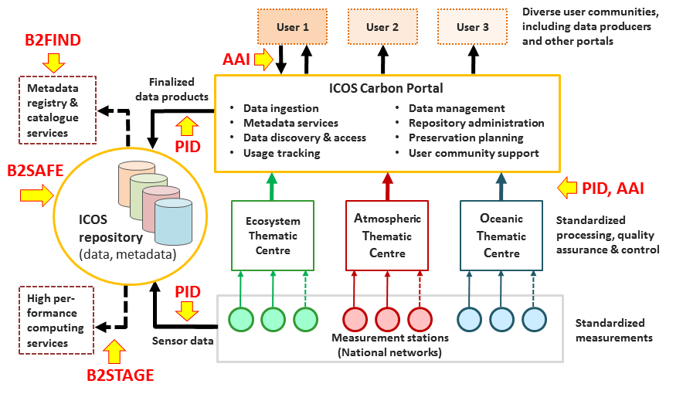
ICOS Data flowchart
For more info, see https://www.icos-cp.eu/node/84

Slide 11


EUDAT Service Uptake by ICOS
Data replication and long term preservation (B2SAFE)
Data Staging (B2STAGE)
      Set up automated migration of daily sensor data streams of “unique, non-reproducible” observational data
      Use for long-term storage of higher-level (processed) ICOS data products, including data sets from modelling activities
      Know location of all replica’s for access optimization
      Set up pathways to allow fast and efficient data transfer to and from high-performance computing platforms such as EGI cloud

Slide 12

EUDAT Service Uptake by ICOS
Multi-disciplinary joint metadata catalogue (B2FIND)
Policy-based prefix & PID management (B2HANDLE)
      Implement automated metadata upload for all ICOS data objects (not just those stored into the data replication and long term preservation service-B2SAFE).
      Uses EUDAT brokered PIDs and is looking for special PID policies allowing explicit data verifiability.

Slide 13

EUDAT Service Uptake by ICOS
Authentication & Authorisation (B2ACCESS)
Data Type Registry (DTR)
      Federated and multi protocol: Development of an AAI service to be used also outside of EUDAT data centers, to manage user authentication, authorization and identification needs
      Using a Data Type Registry.

Slide 14
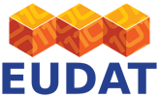

For More Information
http://www.eudat.eu/
https://www.icos-ri.eu/

