Slide 1
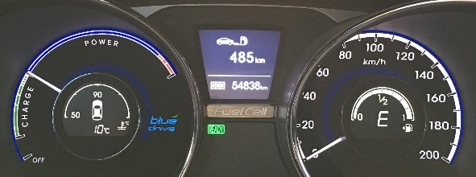
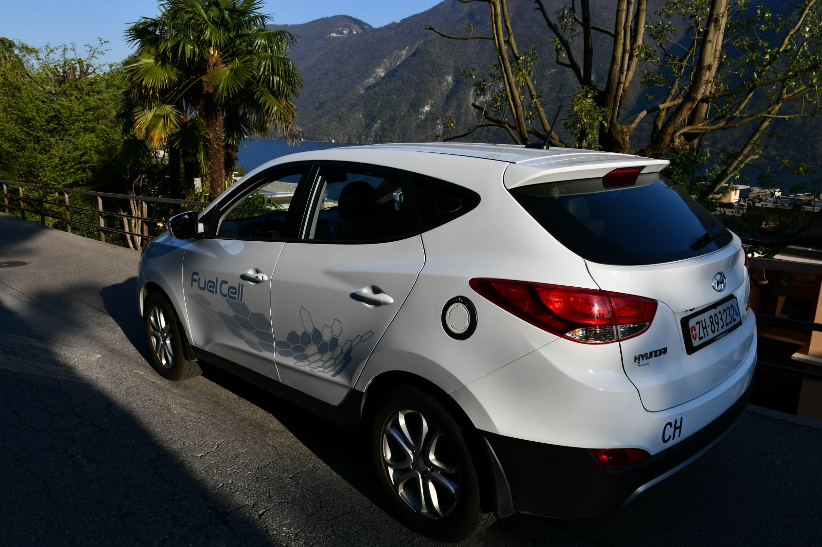
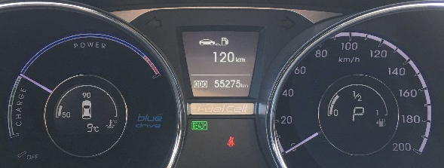
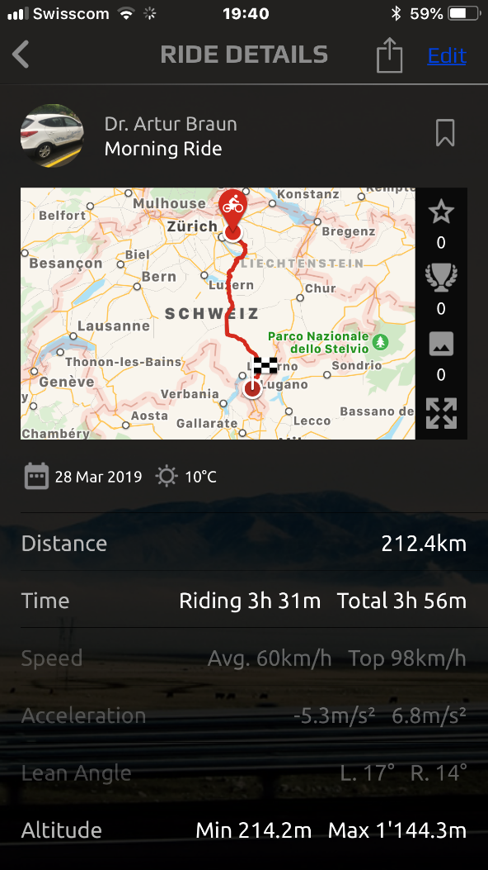
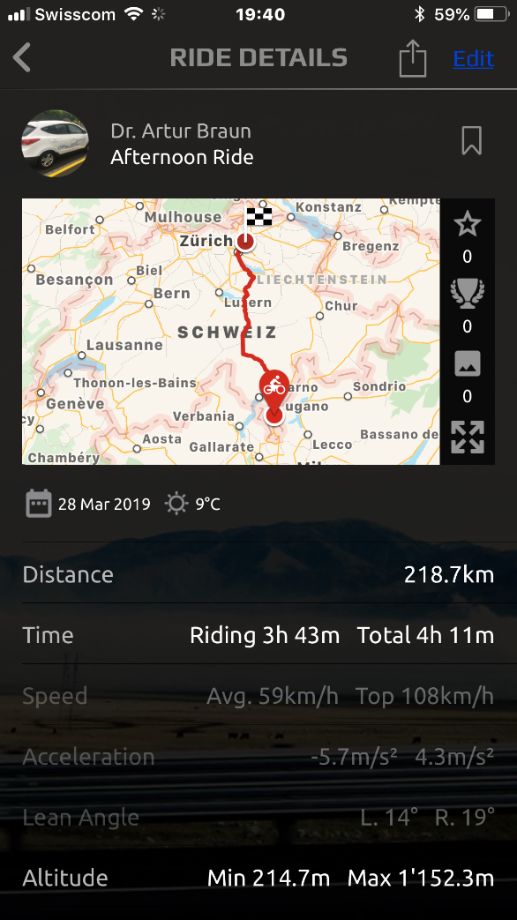
H₂ Expedition Hyundai ix35 FuelCell 28 March 2019 Zürich - Lugano (Sentiero dell'olivo) - Zürich
437 km transalpine with 3.60 kg H₂ fuel consumption. No CO₂ generation.
There is no H2 gas filling station between Zürich and Lugano. 5.64 kg H2 full tank capacity. 3.60 kg H2 used for Zürich-Lugano-Zürich. 2.04 kg H2 still available after trip with range still 120 km available according to on-board computer. 54838 km at start; 55275 km at finish. Total Distance 437 km with 3.60 kg H2. Average 121.39 km/kg H2. Calculated range 684 km with one full tank. Financial support from European Commission Grant Agreement H2020-FETFLAG-2018-2020 no° 816336 «SUNRISE» and Empa Abt. 201, and «move».

