Slide 1

B2SAFE
How to replicate your data using EUDAT’s B2SAFE
This work is licensed under the Creative Commons CC-BY 4.0 licence.
Attribution: EUDAT – www.eudat.eu
Version 3
November 2015
Notes:
This presentation will give an introduction to one of the core EUDAT Services, B2SAFE by explaining apart of its necessity, how you may actually replicate your Data. There are some main topics that we will discuss:
B2SAFE: What, Who, How ..
B2SAFE: Safe Replication in EUDAT Step by Step
B2SAFE: B2SAFE Example: The EPOS Community
Β2SAFE: What’s next?

Slide 2
B2SAFE is…
B2SAFE is a robust, safe and highly available service which allows community and departmental repositories to implement data management policies on research data across multiple administrative domains in a trustworthy manner
Notes:
B2SAFE: B2SAFE is a robust, safe and highly available service which allows community and departmental repositories to implement data management policies on research data across multiple administrative domains in a trustworthy manner.

Slide 3
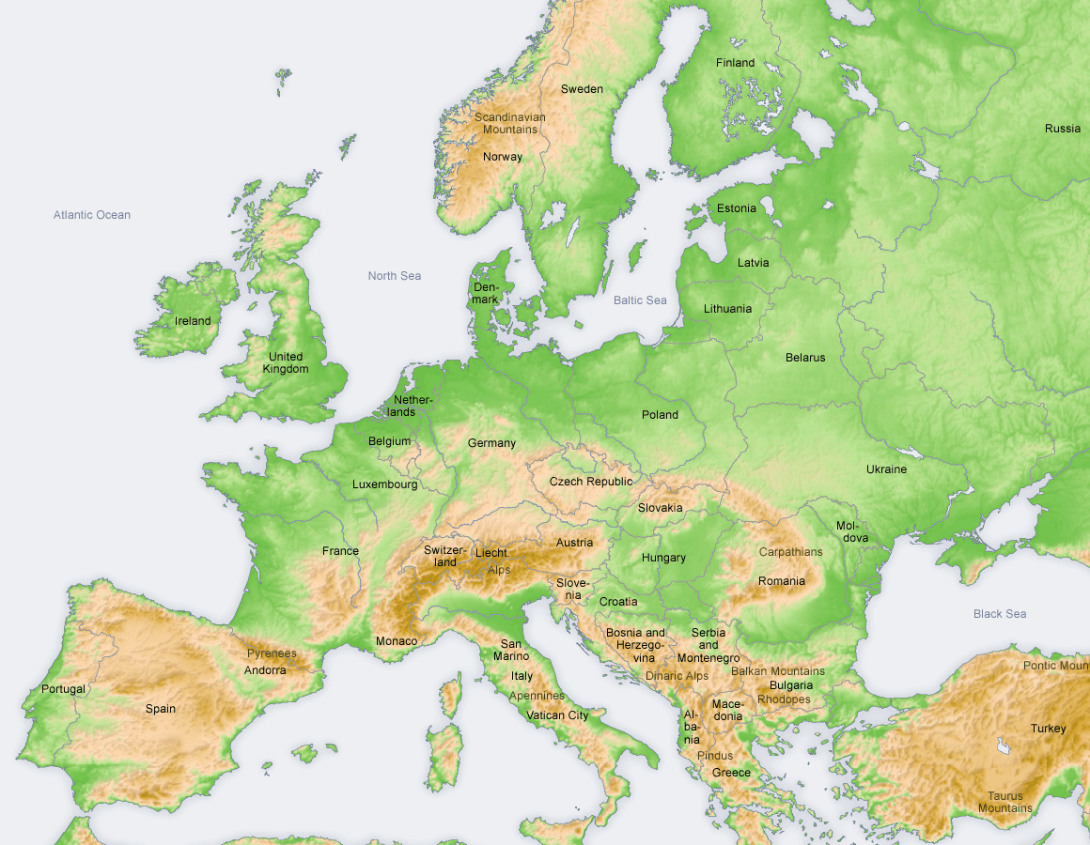


B2SAFE is part of EUDAT...
a pan-European initiative building a sustainable cross-disciplinary and cross-national data infrastructure providing a set of shared services for accessing and preserving research data
supporting multiple research communities by working closely with them to deliver these technical services as part of the EUDAT Collaborative Data Infrastructure (CDI)
Notes:
B2SAFE is part of EUDAT: (slide data)

Slide 4
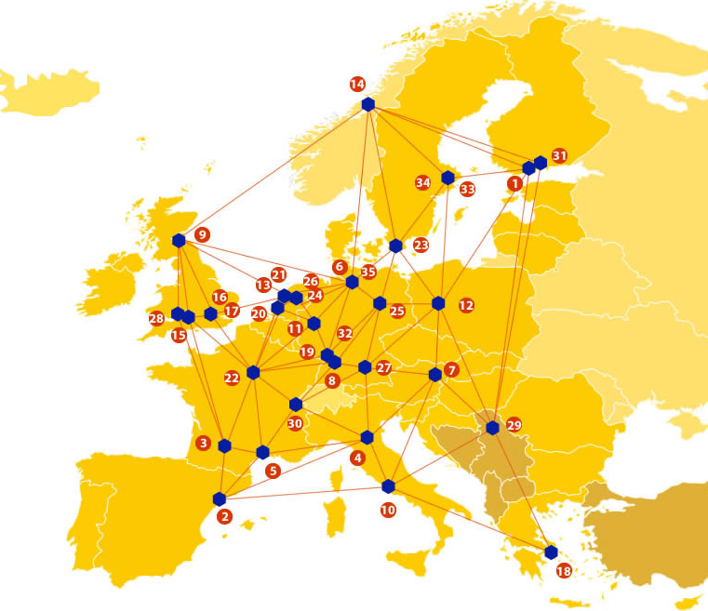
A truly pan-European Infrastructure
EUDAT offers common data services to both research communities and individuals through a network of 35 European organisations.
Our vision is to enable European researchers from any discipline to preserve, find, access, and process data in a trusted environment, as part of a Collaborative Data Infrastructure.
European infrastructures
Technology Providers
Research Communities
Notes:
A truly pan-European Infrastructure: B2SAFE is one of the services offered by EUDAT, the pan-European Infrastructure. EUDAT offers common data services, supporting multiple research communities as well as individuals, through a geographically distributed resilient network connecting general purpose data centres and community-specific data repositories. EUDAT wants to enable European researchers from any discipline to preserve, find, access, and process data in a trusted environment, as part of a Collaborative Data Infrastructure.

Slide 5
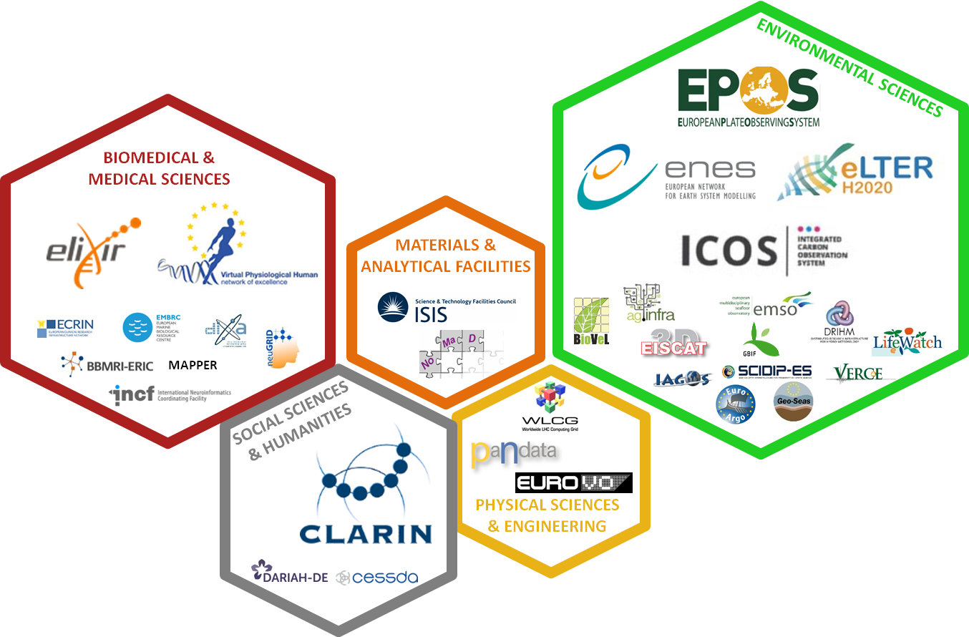
Community-Driven Solutions
EUDAT services are designed, built and implemented based on user community requirements.
Notes:
Community-Driven Solutions: EUDAT works with a wide range of communities to deliver the B2 Suite of research data services as part of its Collaborative Data Infrastructure (CDI).Experience shows that actively involving user communities in all steps is a must for infrastructure projects, and increases the likelihood of broader uptake of developed services. To be successful in this ambitious initiative, EUDAT is using novel methods to involve all the stakeholders, both in the discussions to determine the required services, and in the process of designing, developing and implementing those services. Some of the core communities are:
Social Sciences and Humanities
CLARIN: Common Language Resources and Technology Infrastructure
Biomedical and medical Sciences:
ELIXIR: A distributed infrastructure for life-science information
Environmental Sciences
VPH: Virtual Physiological Human
EPOS: European Plate Observing System
ENES: European Network for Earth System Modelling
ICOS: Integrated Carbon Observation System LTER Europe: European Long Term Ecological Research Network

Slide 6
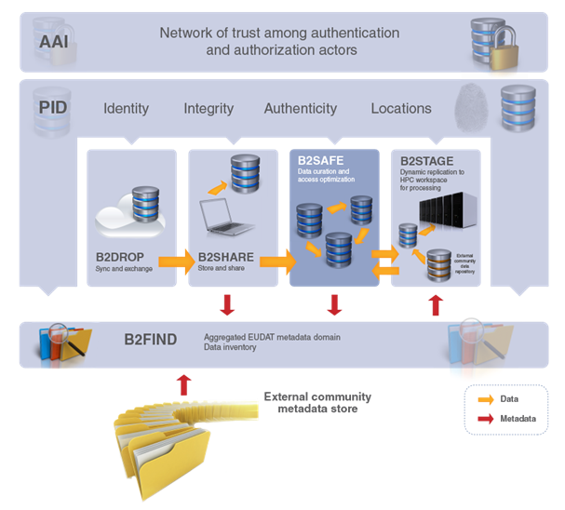

Where is B2SAFE in the EUDAT suite?
B2SAFE
Replicate Research Data Safely
Notes:
Where is B2SAFE in the EUDAT suite?: B2SAFE = Replicate Research Data Safely . B2SAFE is the cornerstone of EUDAT's service for safe replication. B2SAFE and other B2 Services:
B2SHARE: B2SHARE is a user-friendly, reliable and trustworthy way for researchers, scientific communities and citizen scientists to store and share small-scale research data from diverse contexts. The service is professionally managed and data is safely preserved via B2SAFE replication service.
B2STAGE: In conjunction with B2SAFE, replicate community data sets, ingesting them onto EUDAT storage resources for long-term preservation. B2STAGE is a reliable, efficient, light-weight and easy-to-use service to transfer research data sets between EUDAT storage resources and high-performance computing (HPC) workspaces.
B2FIND: B2FIND is a discovery service based on metadata steadily harvested from research data collections from EUDAT data centres and other repositories. The service offers faceted browsing and it allows in particular to discover data that is stored through the B2SAFE and B2SHARE services.

Slide 7

Better safe than sorry….
“I want to replicate my collection X to two data centres and store the collection safely for 10 years”.
In today’s rich data-storage ecosystems, large data centres must offer a robust, safe and highly available replication service to allow community and departmental repositories to replicate their research data:
to guard against data loss in long-term archiving and preservation,
to optimize access for users from different regions, and
to bring data closer to powerful computers for compute-intensive analysis.
Notes:
Better safe than sorry….: “I want to replicate my collection X to two data centres and store the collection safely for 10 years”. There’s been a data explosion. The number of data output is increasing. Scientists, projects, communities use and produce data sets for research purposes. These data are managed and stored at repositories. So the biggest challenge is being able to guard them and keep them safe. B2SAFE is a solution to this problem. In today’s rich data-storage ecosystems, large data centres must offer a robust, safe and highly available replication service….

Slide 8
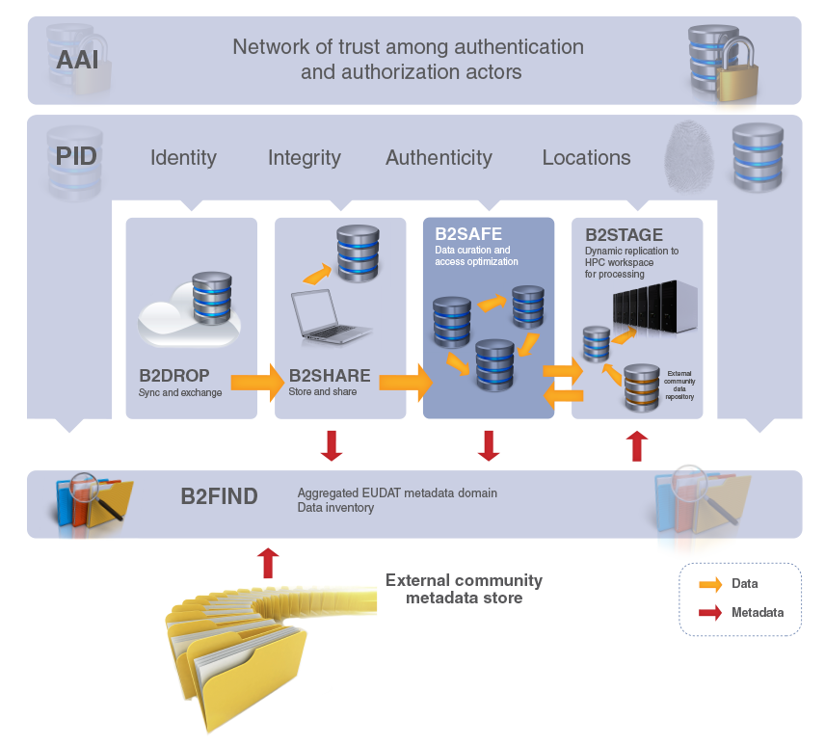
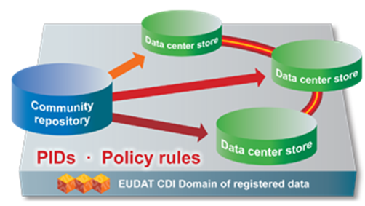
The ideal solution for communities with no facility for archival to:
replicate research data into secure data stores
archive and preserve research data in the long-term
bring data close to powerful compute resources
co-locate data with different communities
benefit from economies of scale
Features:
large-scale storage
robust and highly available
permanent PIDs
Notes:
B2SAFE is … (see slide

Slide 9
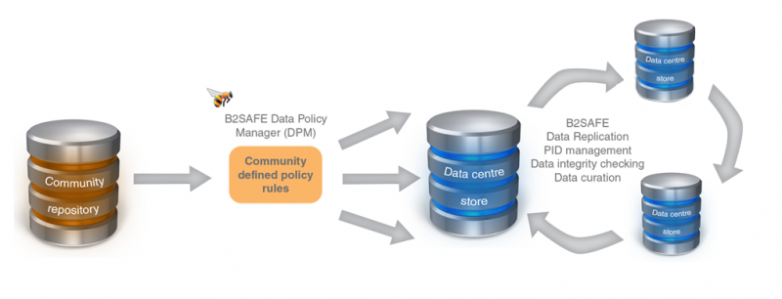
B2SAFE Features (1/2)
Based on the execution of auditable data policy rules and the use of persistent identifiers (PIDs).
Respects the rights of the data owners to define the access rights for their data and to decide how and when they are made publicly referenceable.
Employs Data Policy Manager to allow centrally managed, community-defined data policies.
Notes:
B2SAFE Features (1/2):
The Data Policy Manager aims to provide a policy management via a central interface. Data policies are centrally managed via a Data Policy Manager, and the policy rules are implemented and enforced by site-local rule engines (irods rules). This allows data managers to manage their policies on their data (ex. Set replication policies to community data) even for B2SAFE.
Based on the execution of auditable data policy rules and the use of persistent identifiers (PIDs).:
Respects the rights of the data owners to define the access rights for their data and to decide how and when they are made publicly referenceable.
Employs Data Policy Manager to allow centrally managed, community-defined data policies.:

Slide 10
B2SAFE Features (2/2)
Uses site rule-engines to implement and enforce policy rules.
Aggregates data from different disciplines into a storage system of trustworthy and capable data service providers.
Supports repository packages (e.g. DSPACE, FEDORA) and a lightweight HTTP-based solution.
Notes:
B2SAFE Features (2/2)
Uses site rule-engines to implement and enforce policy rules.
Aggregates data from different disciplines into a storage system of trustworthy and capable data service providers.
Supports repository packages (e.g. DSPACE, FEDORA) and a lightweight HTTP-based solution.

Slide 11
Who can benefit?
Small and medium-sized repositories
Data producers and data consumers
lacking the capacity to store data over longer periods of time
without long-term funding for the preservation of their data
without adequate compute capacity for data-intensive computational services
who need to be sure that trusted centres are taking care of their data
who want to access added-value services on data sources of interest to them
who wish to perform interdisciplinary research on top of data from the heterogeneous EUDAT communities
Notes:
Who can benefit? :
Repositories.
Data producers and consumers.

Slide 12
What makes B2SAFE unique
Data are stored in the EUDAT Collaborative Data Infrastructure (CDI) with known policies. Therefore, data are stored in transparent infrastructures across Europe.
Communities can benefit from the professionally managed EUDAT infrastructure and concentrate their effort and budget on their core research.
EUDAT is building a suite of additional services relevant for the “engine under the hood” of e-science infrastructures (e.g. EPOS, EMSO, CLARIN).
Data are stored next to HTC & HPC servers ideal for compute - intensive data processing.
Notes:
What makes B2SAFE unique: Slide data.

Slide 13
How can you use B2SAFE?
Any community and departmental data repositories can use B2SAFE. EUDAT experts can help setup the followed requered technologies
  Persistent Identifiers (PIDs).
  Metadata describing the properties and context of the data being replicated.
  iRODS (recommended) or similar data management technology for federation.
To help these groups use the B2SAFE service, EUDAT offers documentation, training material and a service helpdesk.
For more information please email: eudat-safereplication@postit.csc.fi
Notes:
How can you use B2SAFE?: You want to use B2SAFE? There are some prerequisites, the followed required technologies:
Persistent Identifiers (PIDs).
Metadata describing the properties and context of the data being replicated.
iRODS (recommended) or similar data management technology for federation.
If you have questions or you need help installing or even using these technologies, EUDAT offers documentation, training material and a service helpdesk. Any community and departmental data repositories can use B2SAFE. EUDAT experts can help setup the B2SAFE module and its prerequisites.

Slide 14






Safe Replication with B2SAFE
EPIC
service
PID
PID
Data Centre Store
EUDAT CDI Domain of registered data
Data Centre Store
Data Centre Store
Notes:
Safe Replication with B2SAFE: Lets take a look at a simple example. We are within the EUDAT infrastructure and a Community Center wants to replicate a DO at 3 EUDAT Data Centers.

Slide 15
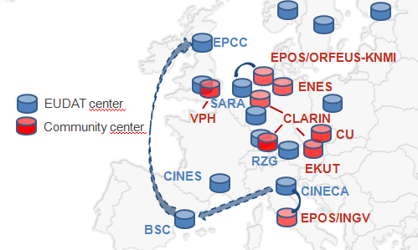
What happens?
Data from the Community repository is replicated in other data centres…..
…distributed across Europe.
Notes:
What happens?: This is actually so simple that Data from the Community repository is replicated in other data centres…..across Europe. BUT lets see the process step by step.

Slide 16



What happens step by step?
own PID system
OR
Data ingestion
Community repository Digital Object (DO)
PID
Community Centre
unique identifier (PID) to the DO
iRods
iRODS rules
Data replication
Based on community policy
PID assignment
PID
PID
Data Center Store 1
Data Center Store 2
iRods
iRods
Notes:
What happens step by step?:
The B2SAFE module is a set of iRODS rules which can be put together in workflows enabling data replication and PID management.
Prerequisites for a Community center
Persistent Identifiers (PIDs): The community center is responsible for assigning a unique identifier (PID) to the Digital Object.
iRODS (recommended) or similar data management technology for federation
B2SAFE module enabled
Steps
Community center assigns a PID to DO
Based on Community Policy and with iRods Rules the replication starts
We want to replicate the DO to EUDAT Data Center 1. A predefined B2SAFE rule is called which sends a PID creation request to the PID service in use. The replication process is triggered by invoking the B2SAFE replication rule at the client-side. The B2SAFE module ensure that the replica from EUDAT DC1 is assigned a unique PID (handle) . The EUDAT DC1 replica is ready.
We want to replicate the DO to EUDAT Data Center 2. We follow the same process. The B2SAFE module ensure that the replica from EUDAT DC1 is assigned a unique PID (handle) . The EUDAT DC2 replica is ready.
But let’s discuss about the actual DO and its replica.

Slide 17
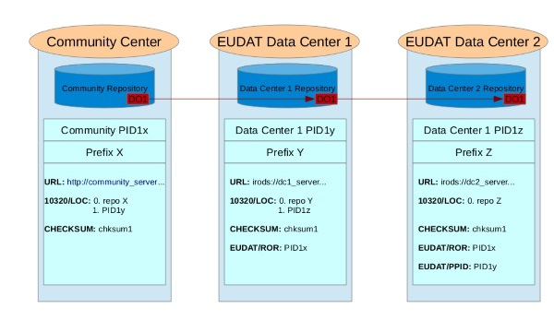
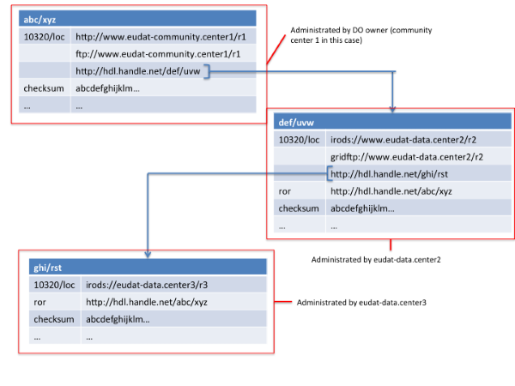
Original DO and replicas
ROR: Repository of Records, the repository where data was stored first.
PPID: Parent PID, the persistent identifier associated to the source object in a replication chain. If the chain has only two elements, the master copy and the first replica, then the PPID = ROR.
Notes:
Original DO and replicas (PID, ROR,PPID):
Main Acronyms:
ROR: Repository of Records, the repository where data was stored first.( controls replication process)
PID: Persistent identifier associated to a digital object or to a whole collection.
PPID: Parent PID, the persistent identifier associated to the source object in a replication chain. If the chain has only two elements, the master copy and the first replica, then the PPID = ROR.
Procedure (First Picture with CC and DC1 and DC2):
The Community Center owns a DO that wants to replicate across different data centres. (EUDAT Data Center 1 , EUDAT Data Center 2 as shown in the picture)
Before performing the 'safe replication' procedure the Community Center will be responsible for assigning a unique identifier (PID) to the Digital Object. This PID of the original digital object will be used as value for the ROR (Repository Of Record) for the handle record of the first replica and as a parent PID for the handle records of all other replica. So the community center assigns the PID1x to the DO.
Now we want to replicate the DO to EUDAT Data Center 1. The B2SAFE module ensure that the replica from EUDAT DC1 is assigned a unique PID (handle) . The PID is PID1y and the handle record contains
RoR: a reference to the original source of the replica (typically the community centre) RoR = PID1x
Now we want to replicate the DO to EUDAT Data Center 2. The B2SAFE module ensure that the replica from EUDAT DC2 is assigned a unique PID (handle) . The PID is PID1z the handle record contains
RoR: a reference to the original source of the replica (typically the community centre). RoR = PID1x
PPID: and a reference to the replica created by B2SAFE from this Community Center to another Data Center (in our example EUDAT Data Center 1). PPID = PID1y.
This results in a tree structure of PID records identifying all replicas and the "flow" of replication.
PID handle records: For each replica, links are stored in the instance at a data centre via one or more protocols, e.g. a URL to access the object via the iRODS protocol and via HTTP. In addition to the link, the B2SAFE service stores a checksum for that specific replica. This information is intended to be used to perform integrity checks.
abc/xyz: The PID of the DO a) loc: various links, locations .(one location is the PID of the EUDAT DATA CENTER 1 ) b) checksum for integrity
def/uvw: The PID of the Data Center 1 a) loc: various links, locations (one location is the PID of the EUDAT Data Center 2 ). b) checksum for integrity, c) RoR: reference to the original source of the replica
ghi/rst: The PID of the Data Center 1 a) loc: various links, locations . b) checksum for integrity, c) RoR: reference to the original source of the replica, d) PPID: reference to the replica created by B2SAFE from this Community Center to another Data Center (in our example EUDAT Data Center 1.

Slide 18












EUDAT partners are already using B2SAFE
Notes:
EUDAT partners are already using B2SAFE: A number of communities are already using the EUDAT B2 Suite.

Slide 19
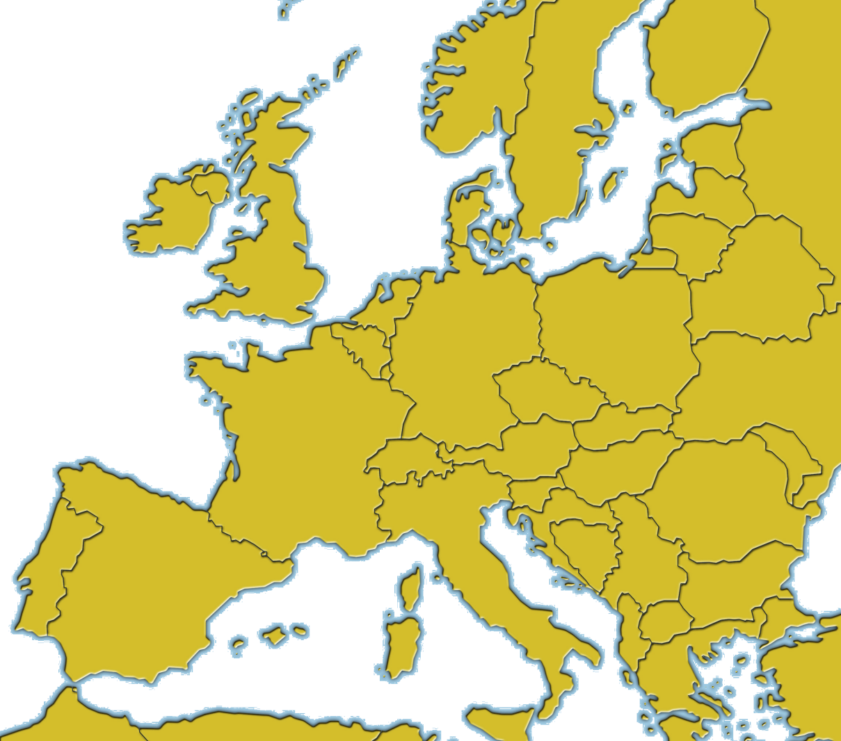
Replicate my collection X to three data centres
EPCC
ENES
EUDAT centre
VPH
CLARIN
Community centre
Lifewatch
CINECA
EPOS
BSC
Notes:
Replicate my collection X to three data centres: Clarin, EPOS, LifeWatch are using B2SAFE and are replicating data on behalf of their community to EUDAT Data Centers. Let’s have a look at the EPOS Community.

Slide 20

EPOS
EUDAT and EPOS community set up a collaboration to provide safe back-up and service redundancy to the Italian seismologist community. The set up of the automated data transfer between EPOS community and EUDAT is:
EPOS joined the EUDAT CDI
EUDAT defined a specific policy with EPOS
The iRODS irsync protocol was chosen to achieve the best performance.
In order to achieve an hourly synchronization, checksum sync and file-age limit options are used.
Notes:
EPOS: Community example: European Plate Observing System (EPOS) is the integrated solid-Earth sciences research infrastructure. The EPOS community currently utilise (or are planning to use) services like B2SAFE, B2DROP, B2STAGE, B2ACCESS, and B2HANDLE. About B2SAFE. This service is currently being used to facilitate long-term preservation of seismological datasets that are enriched with persistent identifiers (PIDs) and replicated onto external data facilities. In order to achieve that the basic setup is:
EPOS joined the EUDAT CDI
EUDAT defined a specific policy with EPOS (of when, how and what to do with data)
The iRODS irsync protocol was chosen to achieve the best performance.
But lets discuss about the actual process.

Slide 21

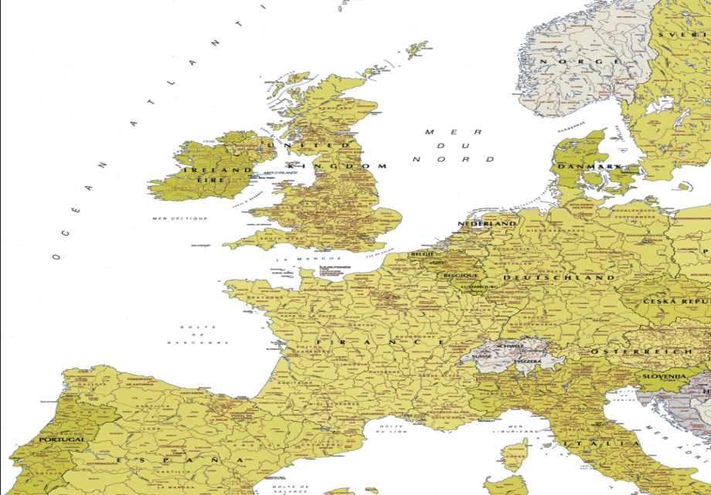


How to replicate the INGV data to B2SAFE - The process
PID Registry
EUDAT
Each digital object ingested by CINECA has been registered, assigning to it a Persistent Identifier (PID)
The PIDs are registered into the PID registry, which is hosted at SURFsara and based on the EPIC service
iRODS irsync tool, running multiple irsync processes
The data archive, so far, amount to
28,6 TB
7500000 files
EUDAT CDI – CINECA node
Notes:
EPOS: How to replicate the INGV data to B2SAFE - The process
All this stations transmits data via satellite links, internet, wire lines, radio modems, optical fibers.
Facts
The chosen door for the EUDAT CDI is the CINECA node, placed in Bologna, Italy
INGV receives around 15 GB/day - 5 TB/year
The connection between INGV and CINECA is via internet and has a theoretical bandwidth of 100 Mbits
INGV receives the data at its data center in Rome
Process
iRODS irsync tool is used, running multiple irsync processes to aggregate bandwidth, since each process reaches an average of 16 Mbits
Each digital object ingested by CINECA has been registered, assigning to it a Persistent Identifier (PID). The PIDs are registered into the PID registry, which is hosted at SURFsara and based on the EPIC service.
CINECA node acts as the main archive for the data (master archive)
Numbers
The replication of the whole archive has taken 3 months
INGV data archive, so far, amount to 28,6 TB 7500000 files
During the periodic synchronization process, about 3000 PIDs/day are create created
So far 7100000 PID are registered in the PID registry

Slide 22
Experimental features
The current B2SAFE implementation is able to support only a simple messaging model: the synchronous one. Messaging is an experimental feature that provides the results in case of asynchronous (server side triggered) replication process. The messages are posted to a queue which can be accessed via an HTTP interface.
The users who ingest data into B2SAFE via GridFTP are not able to retrieve the pid of the object. Metadata management is an experimental feature, that supports this functionality. When enabled it provides a set of metadata properties for each data object, storing them into a file (json), placed in (nearly) the same path of the related data object.
Notes:
Experimental Features:
Messaging: The current B2SAFE implementation is able to support only a simple messaging model: the synchronous one. Apart from the synchronous messaging model, there are scenarios where other models are required, like for example the asynchronous one via message queue or the publish/subscription. Messaging is an experimental feature that provides the results in case of asynchronous (server side triggered) replication process. The messaging feature supports a message queue for the asynchronous model. The users who ingest data into B2SAFE via GridFTP are not able to get back the PID of the object unless it is written in a file object, that is the rationale of the metadata feature. The messages are posted to a queue which can be accessed via an HTTP interface.
Metadata Management: The current B2SAFE implementation doesn’t support the retrieval of the PID of an object. For example, the users who ingest data into B2SAFE via GridFTP are not able to retrieve the PID of the object. The PID is minted but the user cannot retrieve it. Metadata management is an experimental feature, that supports this functionality. When enabled it provides a set of metadata properties for each data object, storing them into a file (json), placed in (nearly) the same path of the related data object.

Slide 23
B2SAFE Summary
B2SAFE offers:
  functionality to replicate datasets across different data centres in a safe and efficient way
  long-term solution for archiving and preserving research data
  an entry point to bring data closer to powerful computers for compute-intensive analysis
Notes:
Let’s close by looking briefly at actually B2SAFE is. B2SAFE Summary.

Slide 24
Future features
Easy setup. B2SAFE provides a script to build rpm and deb packages. Plan to provide downloadable, easy to install packages (i.e. click-install-run).
New extensions - connectors. For now, it is possible to ingest data into B2SAFE stored on a file system or in the DSPACE repository . New connectors for FEDORA and ePRINTS are planned to be implemented.
Improve the service with “dynamic data” (streaming data) capabilities.
Further integration with B2ACCESS.
Support authorization on basis of community access rules.
Notes:
And for the future some of our main concerns are.
A) Easy setup: B2SAFE provides a script to build rpm and deb packages. The idea is to provide a click-install-run easy to install package.
B) New extensions – connectors: Communities use different types of repositories to store their data. The most common repositories are DSPACE, Fedora, ePrints. At the moment, a DSPACE connector to ingest data to B2SAFE is implemented. New connectors for FEDORA and ePRINTS are planned to be implemented.
Improve the service with “dynamic data” (streaming data) capabilities.: Dynamic data may produce data streams that may be temporarily incomplete (and that may consequently fill up over time - automatically or after manual intervention). Dynamic data has been a challenging subject for B2SAFE. It is difficult to keep consistency between data objects, which are eligible to change and are replicated in a distributed environment. B2ASFE wants to support dynamic data within communities who have to deal with.
D) Further integration with B2ACCESS. B2ACCESS is an easy-to-use and secure Authentication and Authorization platform developed by EUDAT. It is a federated cross-infrastructure authentication and authorization framework for user identification and community-defined access control enforcement. It will be available for B2SAFE.
E) Support authorization on basis of community access rules. e.g. based on user memberships in EUDAT groups/communities

Slide 25

For more info: https://eudat.eu/services/b2safe
B2DROP User Documentation: https://eudat.eu/services/userdoc/b2safe
Notes:
Thank you all. For more information about B2SAFE you may visit https://www.eudat.eu/services/b2safe

