Slide 1
EOSC Governance Development Forum
6 April 2017
Per Öster
per.oster@csc.fi

Slide 2
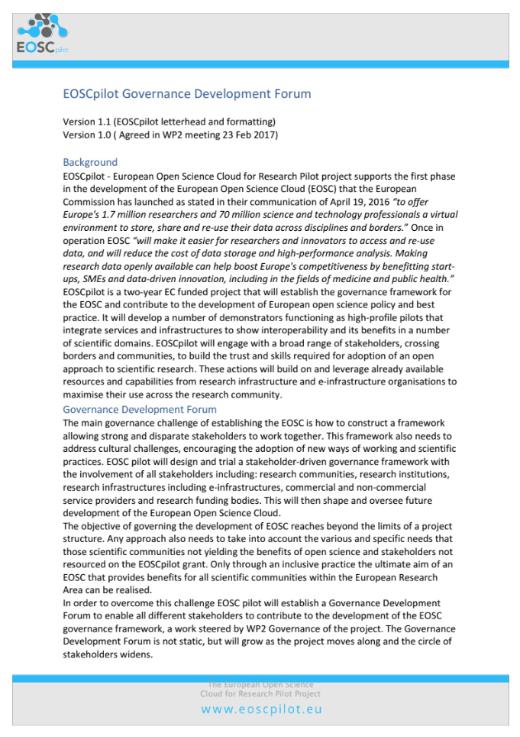
Governance Development Forum
Enable stakeholders to contribute to the governance development
A platform for information, dialogue, and development
https://b2drop.eudat.eu/s/h9FMylYznHpAU7S

Slide 3
EOSC Governance
EC communication on EOSC governance structure (COM(2016) 178 final):
Create a fit-for-purpose pan-European governance structure to federate scientific data infrastructures and overcome fragmentation. The institutional set-up will oversee long-term funding, sustainability, data preservation and stewardship. It will build on existing structures to involve scientific users, research funders and implementers*
* Such as ESFRI, INSPIRE, eIRG, GEANT, PRACE, ELIXIR, the Belmont Forum and similar federating initiatives

Slide 4
EOSC Governance
Example of basic notion of stakeholder engagement
”Those groups who can affect or are affected by the achievements of an organization's purpose should be given the opportunity to comment and input into the development of decisions that affect them”
  (Stakeholder Engagement: A Road Map to Meaningful Engagement, Doughty Centre, Cranfield School of Management)

Slide 5
EOSCpilot project will
establish the governance framework for the EOSC and contribute to the development of European open science policy and best practice;
develop a number of pilots that integrate services and infrastructures to demonstrate interoperability in a number of scientific domains; and
engage with a broad range of stakeholders, crossing borders and communities, to build the trust and skills required for adoption of an open approach to scientific research

Slide 6
WP Governance Objectives
WP Outputs:
D2.4 EOSC as a sustainable ecosystem
D2.5 EOSC Rules of Engagement
D2.6 Governance framework
D2.7 Stakeholder map
D2.8 Governance piloting
D2.9 Governance Development Board
D2.10 Alignment of national investments
To design and trial a stakeholder driven governance framework with the involvement of research communities, research institutions, research infrastructures including e-infrastructures, and research funding bodies, to shape and oversee future development of the European Open Science Cloud.
To identify appropriate federated governance model(s) and decision making structure for the EOSC.

Slide 7
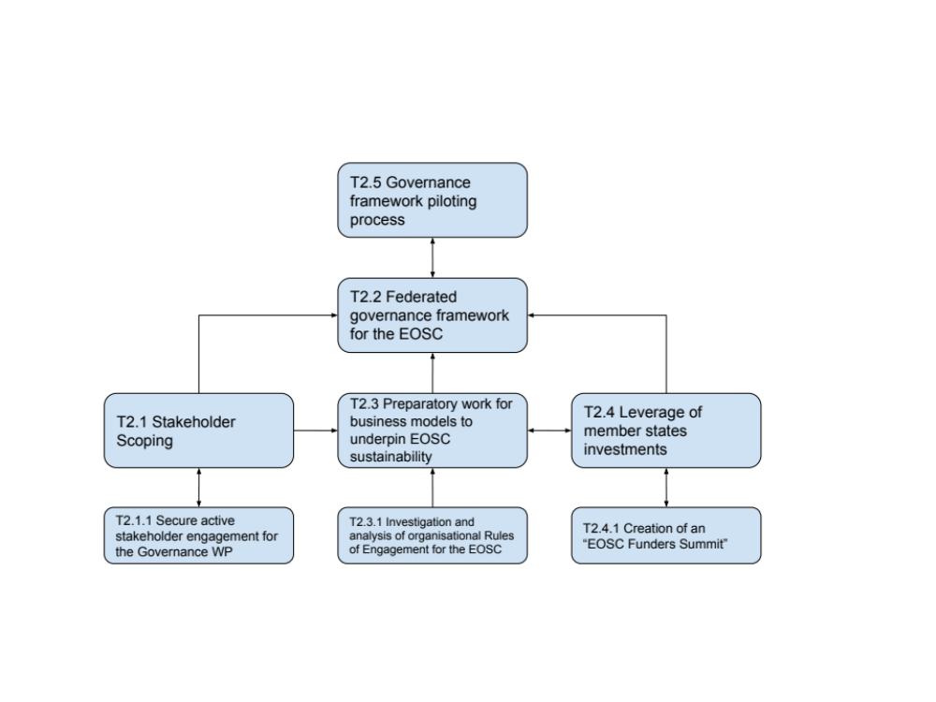
0
24

Slide 8
How to work with the EOSC Governance Development Forum

Slide 9
EOSC Engagement
EOSCpilot Engagement
EOSCpilot Pilots\Exemplars
Need to distinguish between:
Stakeholder engagement in the EOSCpilot
Stakeholder engagement as a driver of the overall governance framework of the EOSC
EOSCpilot
“Facilitators”
EOSC Implementations
a
b
EOSCpilot EOSC

Slide 10
EOSC Governance Development Forum
Direct input from stakeholders/members
  Dialogue, meetings, statements, whitepapers
Surveys
…

Slide 11
EOSC impact: How do you foresee EOSC being related to your work?
Most respondents foresee big impact for EOSC. Answers mainly highlight a) opportunities, b) gaps/warnings and c) EOSC influence on other initiatives.
Some examples:
-EOSC will most likely be a strong policy body through its governance framework. Data is central in all research infrastructures but it is not yet clear how EOSC and RDA will collaborate.
-EOSC will provide the larger (but hopefully light-weight) governance context for (GO)FAIR initiative. (GO)FAIR implementations intend to follow EOSC recommendations
-Bringing the existing European e-infrastructures at the centre of the evolution of the ecosystem and of the future governance of EOSC will not correspond to the expectations by the largest scientific communities for the future.

Slide 12
EOSCpilot WP2 & EC plans
European Commission
Roadmap to MS discussion, council & parliament review
EOSC summit
June 9 /12 2017
EOSC roadmap
Oct / Dec 2017
statements for summit
Outcomes
M1
M6
M8
M10
M13
M15
M22
M24
1st Gov Dev Forum
(WP2 – July 2017
2nd Gov Dev Forum
(WP2 – Nov 2017
3rd Gov Dev Forum
(WP2 – May 2018
EOSCpilot
First EOSCpilot Funders Summit (WP2 – Feb 2018)
Second EOSCpilot Funders Summit (WP2 – Oct 2018)
First Funder Institutions & Intermediaries Workshop (WP8 – Aug 2017)
Second Funder Institutions & Intermediaries Workshop (WP8 – Apr 2018)
EOSCpilot First Stakeholder Engagement Event (WP8 – Nov 2017)
EOSCpilot Second Stakeholder Engagement Event (WP8 - Oct 2018)
2 EOSCpilot Service Provider
Workshops (WP5 - ???)
4 Skills Workshops (training & requirements) (WP7 -???)
4 Industry Stakeholder Workshops (WP8 - ???)
2 Scientific Community Workshops (WP8 - ???)
Notes:
• Two EOSC Pilot Funders Summit (WP2): One organised per year (M13, M22), which serves as a platform for research funders to meet & work towards alignment of funding policies made up of the stakeholders.
• Two EOSC Pilot Service Provider workshops (WP5): of up to 50 people and used as requirements gathering meeting;
• Two Funders Institutions & Intermediaries workshops (WP8) aimed at raising awareness under intermediaries, libraries and institutions to be held at M8 & M15 (TBC)
• Two scientific community (WP8) workshops/events to target specific disciplines (to be co-located with large discipline-specific conferences).
• Four skills (WP7) workshops for training & requirements gathering focusing on understanding the training needs from different stakeholders.
• Four Industry stakeholder workshops (WP8) with major European companies interested in becoming a user of the infrastructure. These workshops will help to identify the stakeholders of an integration of the European Open Science Cloud and the Industrial Data Space and set the basis for an alliance. In addition they will gather business requirements from fields like legislation and regulation, accounting & valuation, data protection, taxation, data governance.

Slide 13
Results of the questionnaire
- Ways to engage stakeholders in the development of the EOSC governance framework

Slide 14
Target group of the questionnaire
Participants from three EOSC stakeholder workshops in 2015 and 2016:
  - 30 November 2015, Brussels: organised by HLEG EOSC to discuss the challenges and possible solutions for EOSC.
  - 5 Feb 2016, Rome: organised by EUDAT, EGI, OpenAIRE, GÉANT, and LIBER to understand the roles of e-Infrastructures and RIs in EOSC.
  - 29 June 2016, Brussels: organised by EC for Member State representatives to discuss preparation of a roadmap outlining the governance and funding of EOSC.
Questionnaire sent to 68 respondents - 21 responses.
Respondents mainly represented RIs followed by e-Infrastructures. Funding Bodies the least represented.

Slide 15
Main objective of the questionnaire
Get a head start of the Governance Development Forum by building on thoughts and views from people already involved in the planning and development of EOSC
Find out efficient ways to involve stakeholders in the EOSC governance framework development
Learn about the participants thoughts on the workshop topics

Slide 16
Participants thoughts on workshop topics:
- most useful topic for the development of EOSC
Answers indicate quite different drivers and motivations for different stakeholders.
Some examples of most useful workshop topics:
-The importance and the role of the RIs was more clearly understood and stated
-Sensitive data management and sharing, stakeholder engagement when dealing with sensitive data
-Issues related to the procurement. Synergies between RIs and e-Infrastructures
-The workshop highlighted quite a diversity in perception on the actual scope of EOSC, in particular between e-Infrastructures and other research infrastructures
-In order to turn the EOSC vision into a working implementation, we need to embed the practical advice of repository managers, IT service operators and researchers in the governance and operation

Slide 17
Ways to involve stakeholders in EOSC governance development
Answers indicate similar main steps for stakeholder involvement:
  identify key stakeholder groups
  engage in targeted dialogue
  give clear and specific roles to each stakeholder on issues that concern them
Example of answers:
-The different stakeholder groups need to be clearly identified and engaged with agreed commitments and incentives for participation. Regular EOSC focused meetings between the stakeholders and DGs RTD, CNECT and GROW should be organised.
-It will never be possible to get all different kind of stakeholder under the same "umbrella". Enable a working relation and communication channel between the different stakeholder layers, as it will never be possible to have one governance body consisting of researchers and funders!

Slide 18
EOSC impact: How do you foresee EOSC being related to your work?
Most respondents foresee big impact for EOSC and highlight:
  a) opportunities
  b) gaps/warnings
  c) EOSC influence on other initiatives.
Examples of answers:
-EOSC will most likely be a strong policy body through its governance framework. Data is central in all RIs but it is not yet clear how EOSC and RDA will collaborate.
-Bringing the existing European e-infrastructures at the centre of the evolution of the ecosystem and of the future governance of EOSC will not correspond to the expectations by the largest scientific communities for the future.
- EOSC will provide the larger (but hopefully light-weight) governance context for (GO)FAIR initiative. (GO)FAIR implementations intend to follow EOSC recommendations

Slide 19
Open questions
Is there (still) a big diversity in perception on the actual scope of EOSC?
Can a common understanding of EOSC still embrace different and even conflicting expectations about EOSC among stakeholders?
What level of engagement from different stakeholders should be considered ”good enough” for EOSC governance development? Is it enough to be given the opportunity to influence?

Slide 20
Next steps
Surveys
Monthly web meetings
Website
Collect statements and whitepapapers
EGDF Meetings

Slide 21
Thanks!
Next EGDF webinar
4 May 14:00 CEST

