Slide 1
EOSC Governance Development Forum 4th Webinar
17 August2017
Per Öster (per.oster@csc.fi)

Slide 2
Governance Development Forum
Enable stakeholders to contribute to the governance development
A platform for information, dialogue, and development
http://eoscpilot.eu/about/governance

Slide 3
EOSC Summit
Brussels
12 June 2017

Slide 4
EOSC Summit
Organized by DG RTD and DG CNECT
Commissioner Moedas
RTD Director-General Robert-Jan Smits
Five panels covering a number of EOSC topics including governance

Slide 5
EOSC Declaration of 10 July
A Declaration and more than 30 statements about EOSC to be endorsed by the member states
  Data Culture and FAIR Data
  Research Data Services and Architecture
  Governance and Funding

Slide 6
The Declaration
RECOGNISING the challenges of data driven research in pursuing excellent science
GRANTING that the vision of European Open Science is that of a research data commons, widely inclusive of all disciplines and Member States, sustainable in the long-term
CONFIRMING that the implementation of the EOSC is a process, not a project, by its nature iterative and based on constant learning and mutual alignment
UPHOLDING that the EOSC Summit marked the beginning and not the end of this process, one based on continuous engagement with scientific stakeholders, the European Commission
PROPOSES that all EOSC stakeholders consider sharing the following intents and will actively support their implementation in the respective capacities

Slide 7
The Declaration on Governance and Funding
[Governance model] A long-term, sustainable research infrastructure in Europe requires a strong and flexible governance model based on trust and increasing mutuality. As interdisciplinarity is one of the main objectives of the EOSC, the governance model should be based on representativity, proportionality, accountability, inclusiveness and transparency
[Governance framework] The EOSC governance framework will be co-designed, stakeholder driven and composed of three main layers: 1) institutional, including EU Member States and European Commission 2) operational, including a governance board and relevant working committees (e.g. thematic and functional) and 3) advisory, including a stakeholder forum.
[Governance board] A governance board will coordinate the efforts of stakeholders endorsing the EOSC Declaration, with the broad mandate to reach practical agreements for the implementation of an EOSC Roadmap by 2020. The board will have an advisory role and an implementing role of the decisions by Member States and European Commission concerning the programming, financing and towards the setting up of a long-term governance and business model for the EOSC. It will make best use of the outcomes of past and current projects (e.g. EOSCpilot, eInfraCentral and EOSChub) and independent expert advice and studies.

Slide 8
The Declaration on Governance and Funding
[Coordination structure] A coordination structure, funded by Horizon 2020, will help the governance board to manage the implementation, according to agreed rules and methods of stakeholder participation. The structure and its participating entities should be accountable for the responsibilities assumed, based on an objective assessment of their level of readiness in delivering the EOSC main functionalities.
[Long-term sustainability] The European Commission, Member States and Research Funders will use existing and future resources strategically, to ensure long-term sustainability of open research data and research infrastructures, facilitating inter-disciplinarity.
[Funding] Over time, a co-funding mechanism mixing different revenue streams for the EOSC will be set up, to increase the accountability of the governance, building trust, sharing resources and building long-term capacity for European research data. Early implementation of the EOSC will pilot innovative business models and support an integrated data and service platform for European research.
[Global aspects] The EOSC will be European and open to the world, reaching out over time to relevant global research partners. It will increase the global value of open research data and support stakeholder engagement, including researchers and citizens. It will gradually widen the initiative to federated network of infrastructures and nodes from global research partners. The EOSC Stakeholder Forum will have an important role in this sense.

Slide 9
Governance Framework
Straw-man

Slide 10
Governance: Approach
The Governance framework will:
enable and encourage engagement from the key stakeholder communities:
  European e-Infrastructures, Data and Research Initiatives, Service and cloud providers, Research funders, Research Communities and Institutions, Research Infrastructures, Policy makers.
enable interoperability and co-ordination within a number of different domains:
  legal interoperability, interoperability of organisational processes, technical interoperability, operational interoperability, data and information interoperability

Slide 11
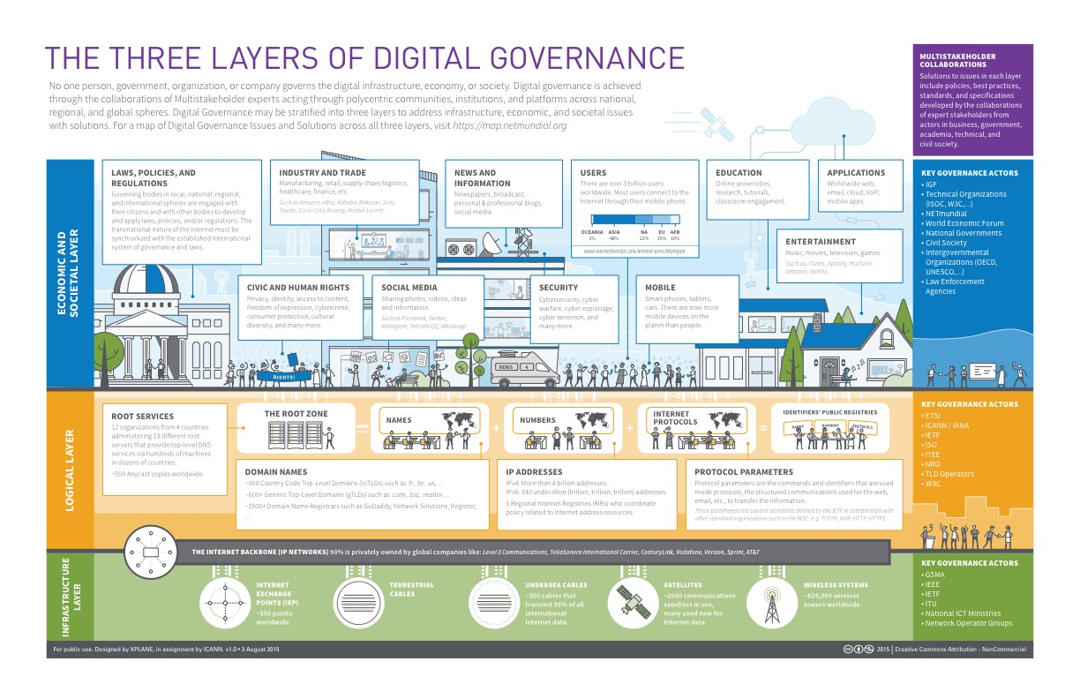
Digital Governance Ecosystem

Slide 12
Digital Governance Ecosystem

Slide 13
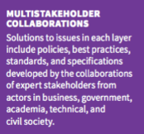
Digital Governance Ecosystem

Slide 14
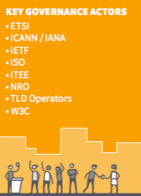
Digital Governance Ecosystem

Slide 15
EOSC Governance Ecosystem?
Research Community Layer
Key Governance Agency
Thematic Service Layer
Key Governance Agency
The relevant EOSC Layers?
Identify actors and activities
Data and Content Layer
Key Governance Agency
e-Infrastructure Layer
Key Governance Agency

Slide 16
The Governance Framework
Governance Framework Grammar
outlines Engagement Mechanisms
needed to enable EOSC Actors
to co-ordinate the Engagement Aspects
required to ensure interoperability within the Engagement Contexts,
according to the Actors’ Roles within the Supply Chain.
EOSC Actors
European e-Infrastructures
Data/Research Initiatives
Cloud providers
Research funders
Cloud community
Research Communities and Institutions
Research Infrastructures (RIs)
Policy makers
Supply Chain Roles
Consumer
Intermediary\Aggregator
Provider
Funder
Policy/Regulatory
Engagement Contexts
Legal\Policy
Organisational
Operational
Technical
Data\Information
Skills
Research challenges\agenda
Financial
Political
Engagement Aspects
Responsibility
Strategy
Acquisition
Performance
Conformance
Human behaviour
Engagement Mechanisms
Expert Group
Forum
Council
Board
Legal Structure
Governance Intent
Triplet defines who and their objective
Governance Structure
“Duplet” defines what needs to be achieved and how
A Governance Actor
is an implementation of a Governance Structure
in order to meet an Governance Intent

Slide 17
Governance: Status and Next Steps
Undertaken:
Stakeholder mapping exercise
Progressing with a framework which will help conceptualise the range of stakeholders and interoperability objectives
Assessing different governance approaches across these, and how these may fit together.
Next Steps:
Planning to have a draft framework for discussion late summer
  To gather feedback from a broader community
  Feedback initially via online tools and forum
  Then via workshops, including EOSCpilot stakeholder event at end Nov.

Slide 18
Follow
Follow the Governance Development at:
  http://eoscpilot.eu/about/governance

Slide 19
Upcoming events
2 October in Tallinn
  Governance development forum in conjunction with e-IRG meeting and Estonian presidency
Monthly webinars, next 14 September
EOSCpilot at Open Science Fair, Athens 6-8 September
EOSCpilot Stakeholder Engagement Event
  28-29 November in Brussels

Slide 20
Q&A
Alt. write to egdf-secretariat@eoscpilot.eu

Slide 21
Thanks!
Next EGDF webinar
14 September 14:00 CEST

