Slide 1
B2SHARE
Peter Wittenburg
The Language Archive, Max Planck Institute, Netherlands

Slide 2
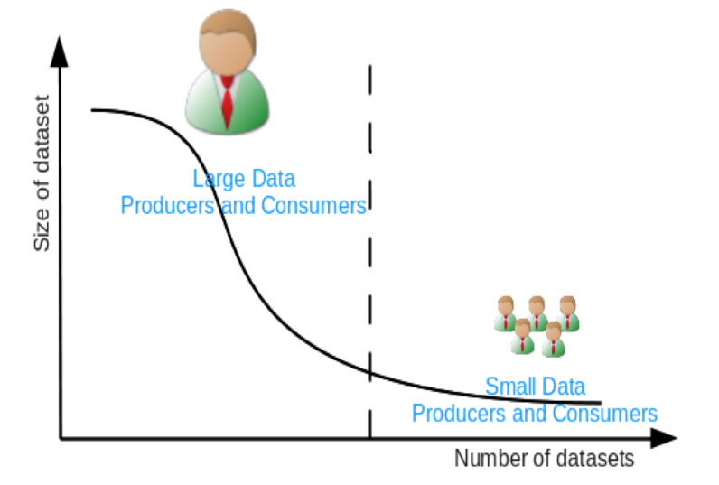
What is B2SHARE’s goal?
offer store + share options for long tail of data
- to all European researchers
- encouraging sharing and Open Access
- in an easy way (low barriers)
- allow community branding

Slide 3
B2SHARE User Requirements
Easy deposit, search, sharing, access
community branding – EUDAT simply proper data steward
  CLARIN, DRIHM, EUON (now restricted on purpose)
Standard/generic metadata set (DataCite)
  Metadata extensions per ”community”
Integrate deposited data to EUDAT’s domain of registered data
  metadata, PIDs, replication, finding
data independence from technology
several service providers to meet trust issue
Persistence of data, low costs
Check format (JHOVE) and curate metadata
Support social tagging

Slide 4
B2SHARE – done – not done
Easy deposit, search, sharing, access
community branding – EUDAT simply proper data steward
  CLARIN, DRIHM, EUON (now restricted on purpose)
Standard/generic metadata set (DataCite)
  Metadata extensions per ”community”
Integrate deposited data to EUDAT’s domain of registered data
  metadata, PIDs, replication, finding
data independence from technology
several service providers to meet trust issue
Persistence of data, low costs
Check format (JHOVE) and curate metadata
Support social tagging

Slide 5
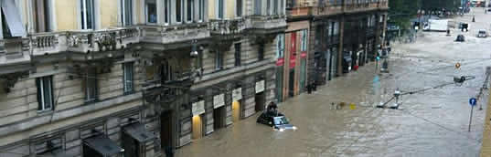
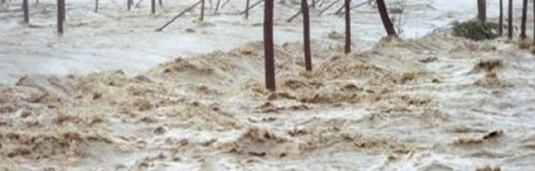
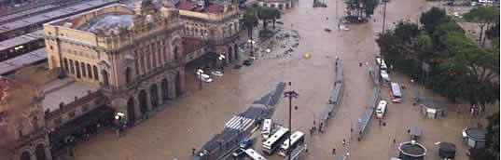
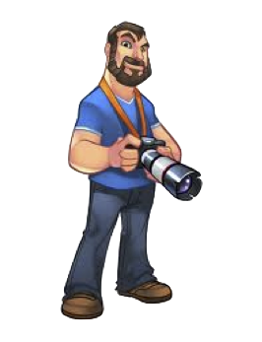
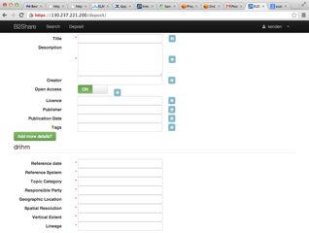

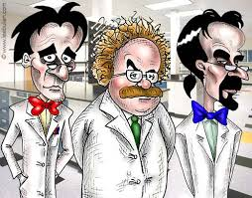

DRIHM
Bridge between citizen and community scientists about Hydrology Observations
Specific Community Metadata Extensions
(provided by DRIHM)
Describe
Scientists
Citizens

Slide 6
B2SHARE Timeline
Task Force
1st MD Selection
turning to
service
Technology Selection
Prototype
ready
EUDATStart
Disseminating and engaging communities
Update
Specs
1st UI
Mockup
1st Note
2011
2012
2013
2014
discussion
convincing
evaluating
requirements
specification
designing
prototyping
recruitment
branding
getting service ready
getting out to communities
adding functions
adding nodes

Slide 7
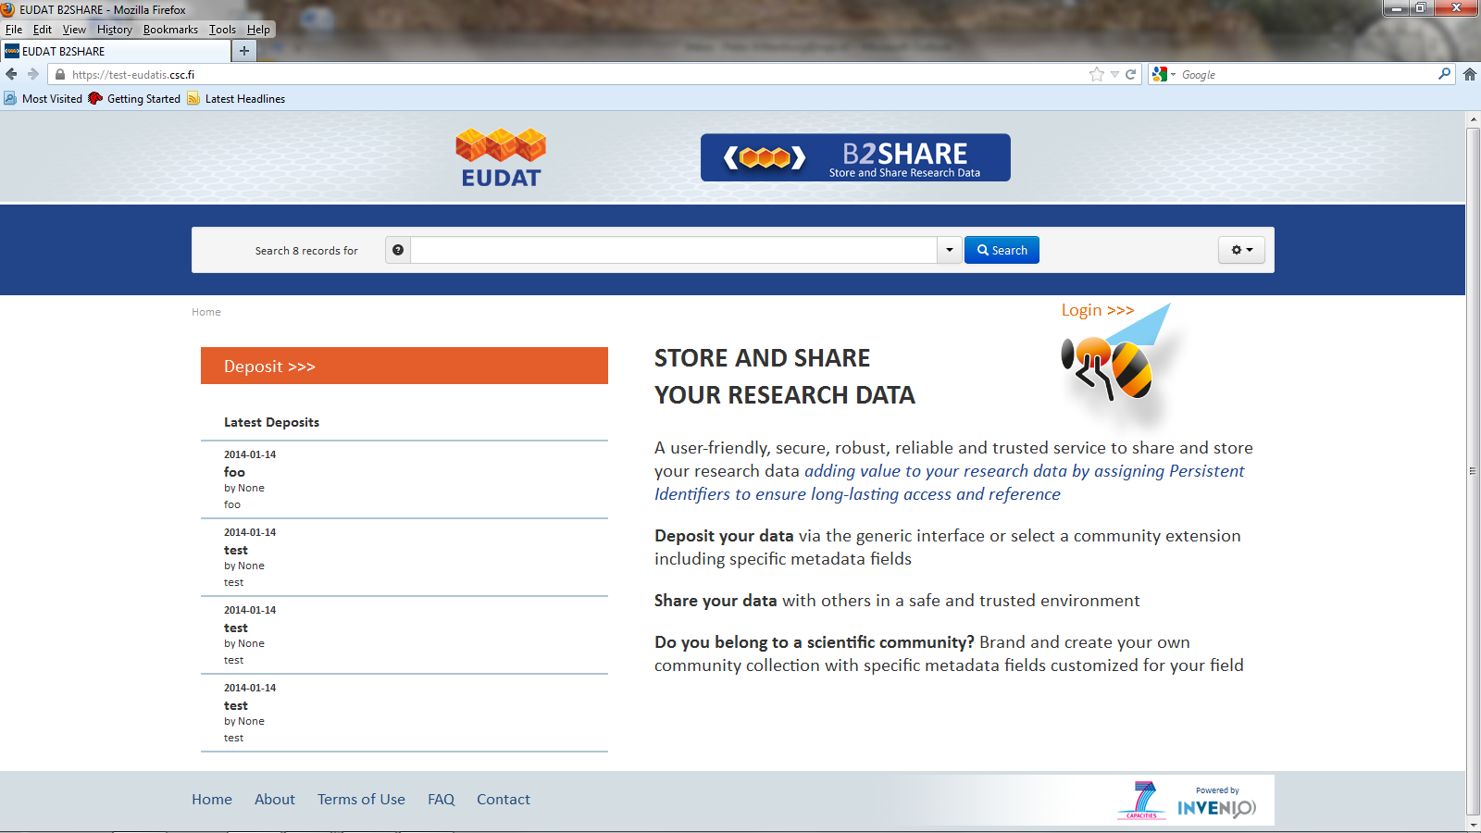
B2SHARE in 4 steps: home

Slide 8
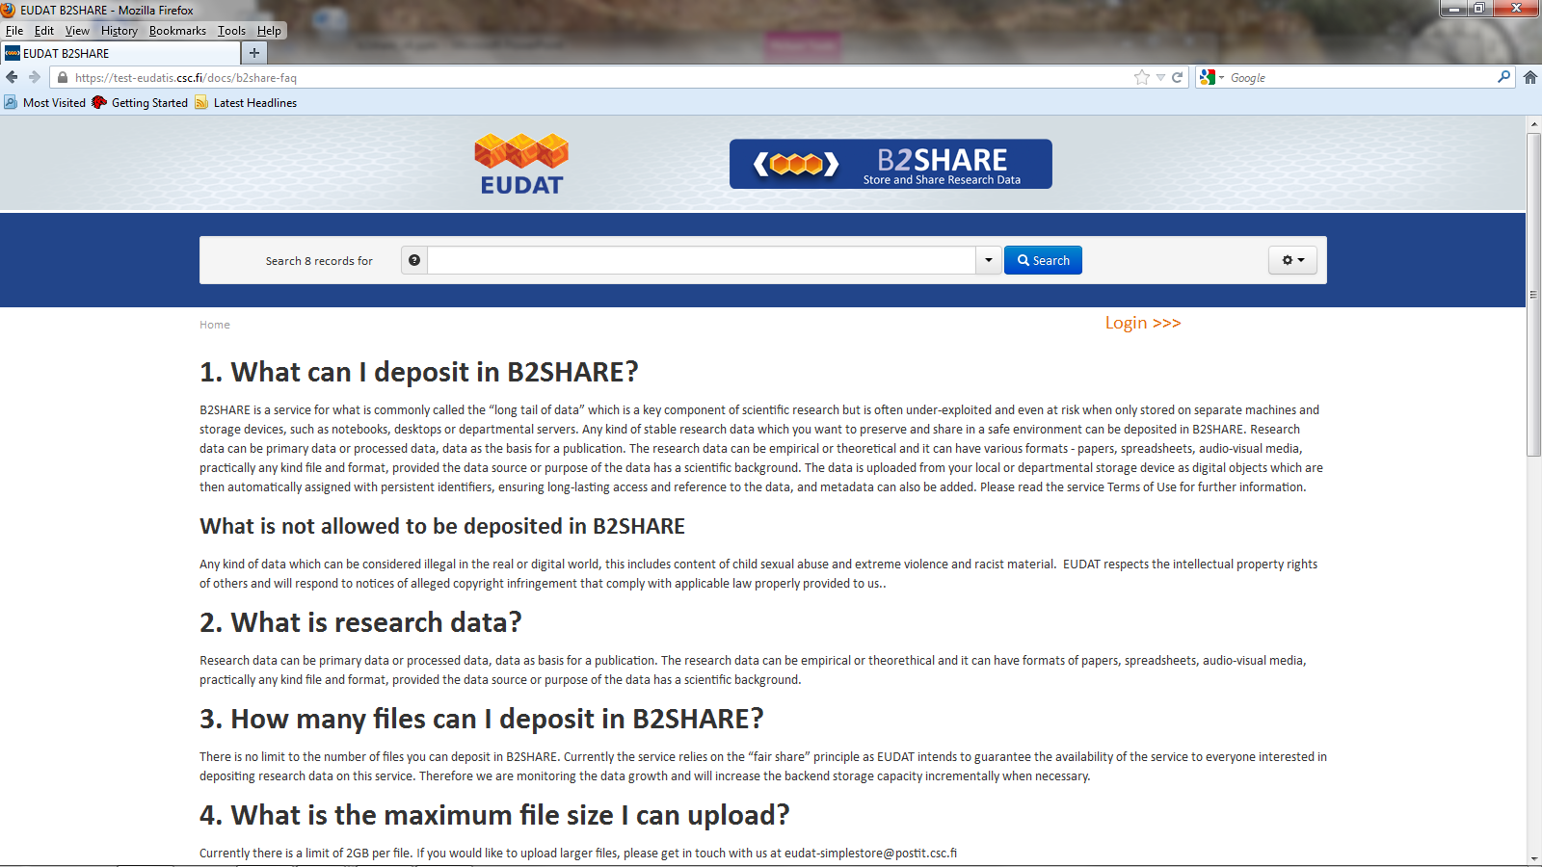
B2SHARE in 4 steps: FAQ

Slide 9
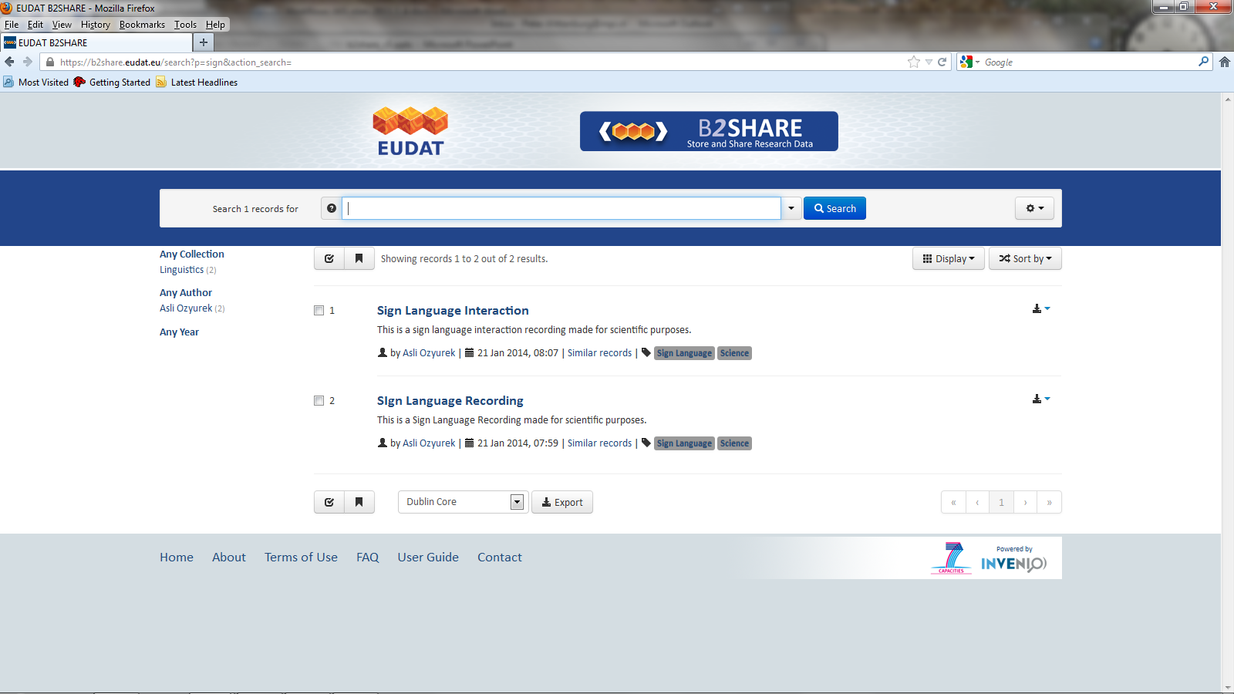
B2SHARE in 4 steps: search

Slide 10
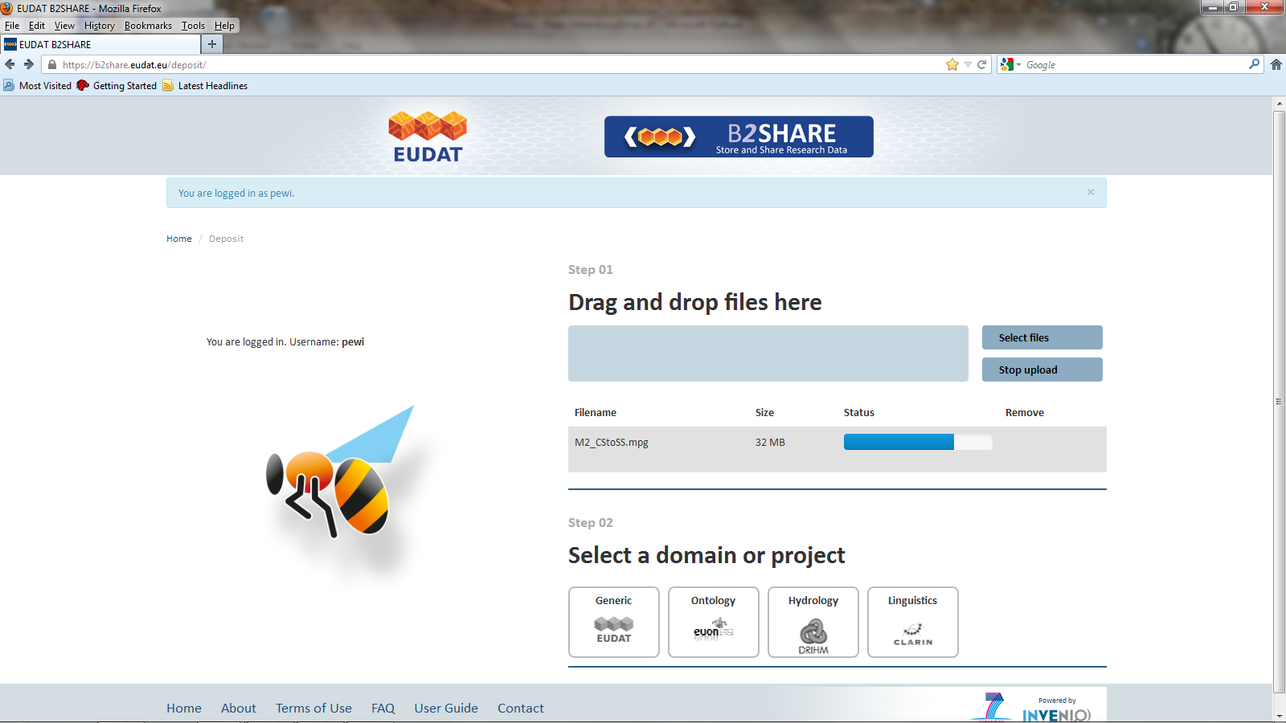

B2SHARE in 4 steps: Deposit I

Slide 11
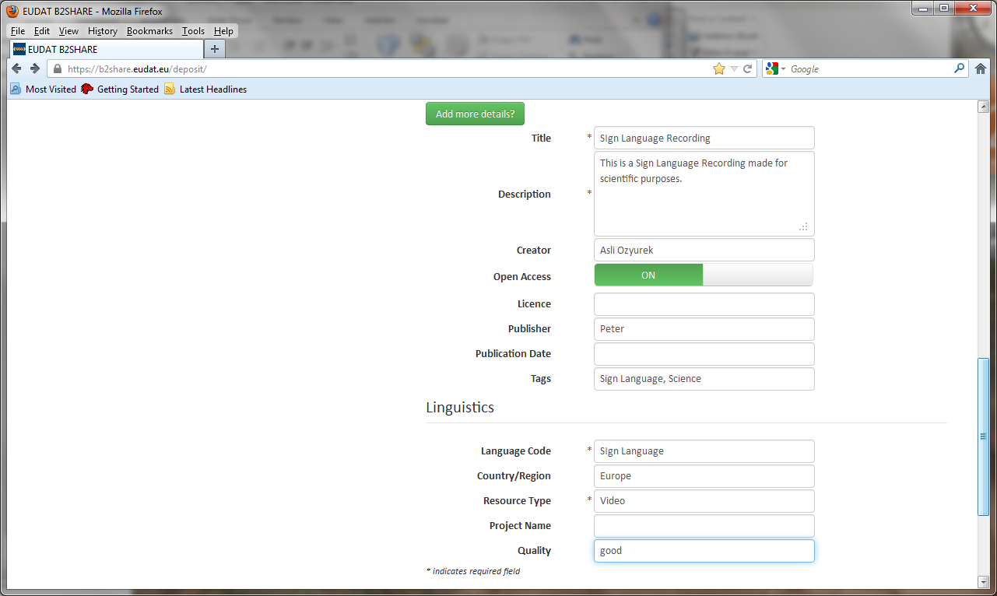
B2SHARE in 4 steps: Deposit II

Slide 12
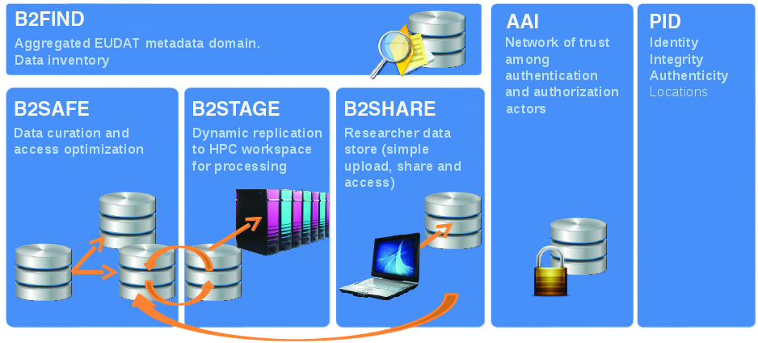


Embedding

Slide 13
B2SHARE Resources
PROTOTYPE PHASE
  2 chairs (Erwin Laure, Peter Wittenburg)
  2 developers (Ilja Livenstein, Adrian Mouat - partly)
  community and center experts
SERVICE PHASE
  Product Manager (Pavel Stranak, CU)
  5 developers (CU, KTH, 2 EKUT, PSNC, STFC)
  3 deployers (2 CSC, PSNC, more to come)
  involvement of WP2 (legal issues etc), WP3 (branding, community outreach & engagement, training, etc), WP4 (requirements, UI, involvement), WP5 (generic technology issues, etc), WP6 (deployment, service stability, etc)

Slide 14
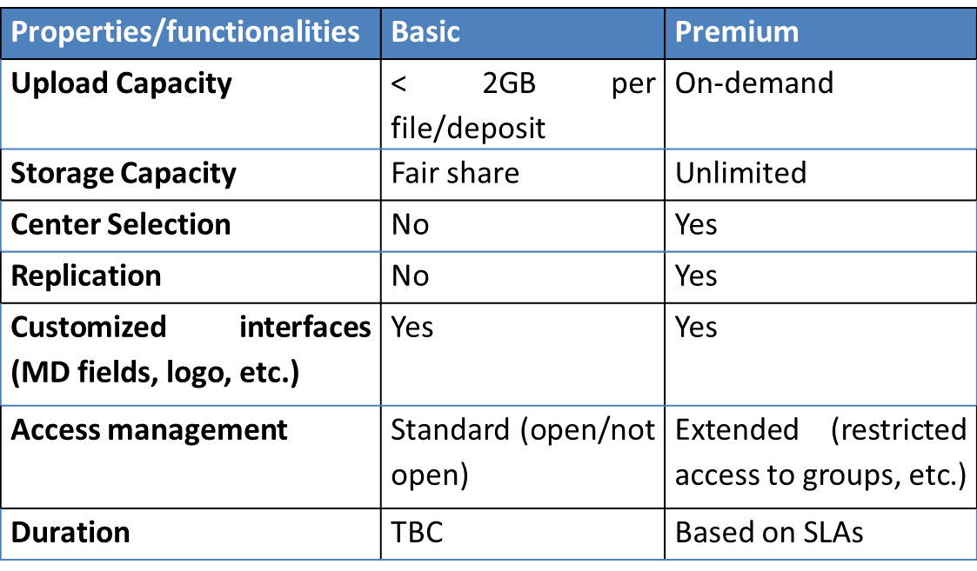
B2Share Basic/Premium

Slide 15
What are the next steps?
Next steps include
  allow group sharing
  implement replication
  increase number of centres offering B2SHARE service
  integrate more communities with their own branding
  optimize community branding
  integrate type check library (JHOVE)
  check new technologies (WP5)
  Shibboleth integration

Slide 16

Thanks for your attention

