Slide 1
EUDAT Services
New Service Plans
Peter Wittenburg
EUDAT WP4 Leader
The Language Archive, Max Planck Institute, Netherlands
2nd EUDAT Review, Brussels, 23rd Jan 2014

Slide 2
Interaction Processes (of course overlapping phases)
workshop
for WGs
offer first
4 services
implement
basic 4 services
brainstorm
on additional
services
run survey
on new
services
decide about future
directions
EUDATStart
offer additional
services
UF
Conf
2011
2012
2013
2014
basically 5 core
communities
+ forum/conf interactions
involve new communities,
intensify
interaction
open calls for
collaborations
Working Groups

Slide 3
Service Survey Results (141 answers)
ready to go
in preparation
in discussion
in fact much confirmation of earlier interactions
new hot topics: Data Lifecycle Support, Dynamic Data, Registries

Slide 4
Working Group Survey Results
sufficient interest in WGs we established
new topic for WG: Data Lifecycle Management
(related with Workflows, Policies, Dynamic Data Treatment)
need to brainstorm
PS: working group plan inspired by DataONE

Slide 5
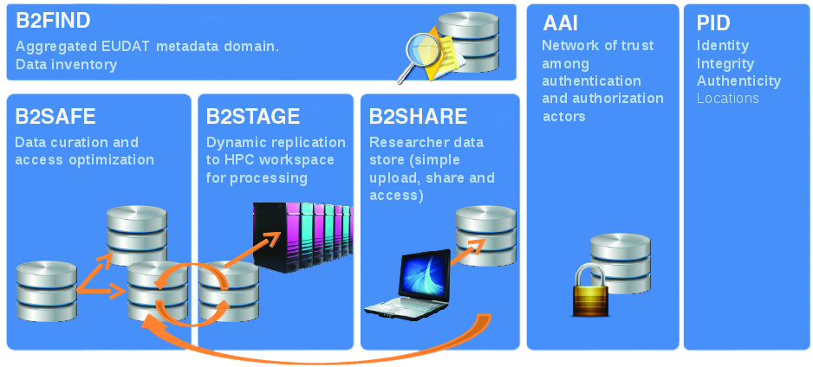




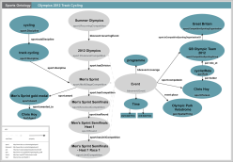
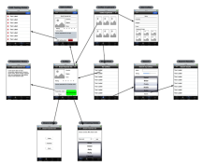


Service Overview
ready to go
in preparation
in discussion
add down-loadable
repl. packages:
HTTP
Fedora
D-SPACE
EUDAT Box
Semantic Anno
Generic Workflow
Dynamic Data
dropbox-like service
easy sharing
local synching
checking , referencing and
annotating
automating data processing
immediate handling
B2DROP
B2NOTE

Slide 6
Relation Working Groups - Services
Working Group Ideas
Semantic Issues
Workflows
Dynamic Data
Dynamic Data Ext.
Service Plan
Semantic Annotation
Workflows (GEF)
Dynamic Data
B2DROP (EUDAT Box)
Data Life Cycle Support
Registries
??
WGs since a number of aspects need
to be sorted out first
exact meaning of term
exact shaping of the service and understand implications
focus of interest of communitie

Slide 7
B2DROP service
Purpose: offer a low-barrier data synchronization and sharing tool & service respecting ownership rights
State: Powerfolder and OwnCloud were tested by Jülich, CSC, RZG, PSNC. OwnCloud is more robust, is Open Source and has advanced clients. Yet no final decisions.
Timeline: close prototype phase, create service now
first service to be ready in June
Involved: several centres will provide the service, users can choose (trust and sustainability aspects)

Slide 8
Semantic Annotation Service
Purpose: allow to annotate (human), mark-up (refer to ontology, correct if necessary, etc.)
State: design has been made, basic machinery is ready as prototype, first simple UI ready, output in OAF in progress, looking for usable components, BSC is hosting site (XML DB, API)
Timeline: full prototype ready in June
Involved: Biodiversity group Vienna, BSC

Slide 9

Semantic Annotation WG
Purpose: include expert knowledge to ensure being generic and to design new services
Chairs: Johannes Peterseil (Biodiversity, Vienna)
Yann Le Franc (Bioinformatics, Paris)
Peter Wittenburg (EUDAT liaison)
first concrete action lines:
  advice to Semantic Annotation (concept, available tools, shaping, etc.)
  building/support of EUON (European Ontology Network)
    using B2SHARE as a simple entry point
    Chairs: James Malone (EBI), Yann Le Franc, Herbert Schentz (Vienna)
future question: which other semantic services are required

Slide 10
Workflow Service
State: WP7 work focusing now on “Generic Execution Framework” as a showcase
Timeline: showcases of GEF ready in June
Involved: U Tübingen, DKRZ, CERFACS
ESGF
Execution Engine
ENES
WebLicht
Execution Engine
CLARIN
XXX
Execution Engine
YYY
transformations
Generic Execution Framework
Implications, Requirements
Notes:
service implementation and the API functions supported by the GEF framework and how much training is needed to make use of the infrastructure. The service has been implemented in JAVA and provides an HTTP/Rest API interface. The basic functions are: send/get data and send/get workflows, which can only be executed by a community manager. On the subject of training an example was given about the uptake of the WebLicht workflow engine within the CLARIN community. This has been good and unexpected; currently the WebLicht workflow engine is used for teaching purposes at a number of universities to explain linguistics.
During the discussions comments on the results from the Workflow working group were given:
EUDAT should try to minimise the number of workflows, but adopt a bottom up approach;
EUDAT should look at cross community aspects and information about workflows should be discoverable. For this EUDAT could provision a workflow repository and registry service in which communities can provide content about workflow execution engines.

Slide 11
Workflow WG
Purpose: understand fully the requirements for a common service, start with two applications from CLARIN and ENES
Chairs: Christian Page (CERFACS, ENES)
Erhard Hinrichs (U Tübingen, CLARIN)
Morris Riedel (EUDAT Liaison)
Action lines:
  guide and study the concrete GEF work
  look at other work and solutions (PNNL, DataONE, EarthCube, etc)
  study requirements for GEF (AAI, hot deployment, rights, etc)

Slide 12
Dynamic Data WG
Purpose: understand deeply how to deal with data streams that are gappy and change content at unpredictable times
State: broad discussions in the Working Group on terms, mechanisms and challenges (EPOS, COOPEUS, DataOne, CLARIN, EuroArgo, etc.)
Reshaping of WG: combination with Data LifeCycle Support where Dynamic Data is the most challenging area
Chairs: Daan Broeder (CLARIN)
Andreas Rauber (Comp Science, Vienna)
Alberto Michelini (EPOS)
Peter Wittenburg (EUDAT Liaison)

Slide 13
Relation to RDA I
Working Groups
Data Foundation and Terminology Data Domain Terminology
PID Information Types Harmonized API
Data Type Registries Flexible Registries
Practical Policy Recommended Policies
Metadata Standards Directory Overview about Metadata
Data Description Registry Interoperability finding data across multiple
registry systems
Standardisation of Data Categories ISO 639-6
and Codes
Data Citation Citation Recommendation
Wheat Data Interoperability defining community standards

Slide 14
Relation to RDA II
Cross-Domain IGs
Research Data Provenance
Big Data Analytics
Brokering
Data in Context
Long tail of research data
Metadata
Preservation e-Infrastructure
Semantic Interoperability
PIDs
Federated Identity Management
Publishing Data
Certification of Digital Repositories
Community Capability Model
Development of cloud computing capacity and education for developing world
Engagement Group
Legal Interoperability
Domain Specific IGs
Toxic genomics Interoperability
Structural Biology
Agricultural Data Interoperability
Biodiversity Data Integration
Defining Urban Data Exchange for Science
Digital Practices in History and Ethnography
Marine Data Harmonization

Slide 15
Next Steps: WGs and Services
January 2014: getting the WGs running/continuing
March 2014: deciding about relevant topics to be taken up
March 2014: evaluating results of collaboration call
March 2014: deciding about future JRAs
March 2014: deciding about what to take up in EUDAT1
April/May 2014: WG meetings (to be determined)
Sept 2014: WG meetings at RDA Plenary in Amsterdam (almost fixed)
....

Slide 16
Thanks for the attention.

