Slide 1

B2DROP User Training
How to use EUDAT’s B2DROP?
This work is licensed under the Creative Commons CC-BY 4.0 licence
Notes:
B2DROP is a secure and trusted data exchange service for researchers and scientists to keep their research data synchronized and up-to-date. You can store and share up to 20 GB of data for free. The basic functionality of B2DROP is explained in this presentation.

Slide 2


EUDAT: A truly pan-European Infrastructure
EUDAT offers common data services to both research communities and individuals through a network of 35 European organisations.
EUDAT enables European researchers from any discipline and any geographical location to preserve, find, access, and process data in a trusted environment.
European infrastructures
Technology Providers
Research Communities
Notes:
B2DROP is one of the services offered by EUDAT, the pan-European Infrastructure. EUDAT offers common data services, supporting multiple research communities as well as individuals, through a geographically distributed resilient network connecting general purpose data centres and community-specific data repositories. EUDAT enables European researchers from any discipline and any geographical location to preserve, find, access, and process data in a trusted environment.

Slide 3

















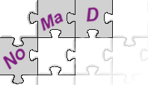












Community-Driven Solutions
EUDAT services (B2 Service Suite) are designed, built and implemented based on user community requirements.
ENVIRONMENTAL SCIENCES
BIOMEDICAL & MEDICAL SCIENCES
MATERIALS & ANALYTICAL FACILITIES
MAPPER
SOCIAL SCIENCES & HUMANITIES
PHYSICAL SCIENCES
& ENGINEERING
Notes:
The services offered by EUDAT, the B2 service suite, are community driven as they are designed, built and implemented based on user community requirements. Meaning that the communities have direct influence on these services and contribute to the development of them. Services are defined not just by core communities in the EUDAT collaboration which are CLARIN, ENES, ELIXIR, EPOS, ICOS, LTER Europe & VPH, but additional communities are elicited to ensure EUDAT services are as generic and applicable to as wide an audience as possible.

Slide 4
Introduction
B2DROP - For whom?
Researchers (including citizen scientists) who want to share their research with a small set of collaborators prior to making it available to a wider audience.
B2DROP - What can you do with it?
  a service to store and exchange data
  synchronization of multiple versions of your data
  automated desktop synchronization on many platforms
B2DROP - Why should you use it?
  free storage up to 20 GB
  simple to use interface
  trusted storage: data stays in Europe (currently hosted at Juelich, Germany)
  share data across national boundaries
Notes:
There’s a more general presentation available on B2DROP within the B2 service suite. On this slide you find the highlights from that presentation. B2Drop is built for researchers who would like to share their research outcomes with a few co-workers within or outside their own organization prior to making it available to a wider audience. You can exchange files, upload new versions and integrate it into your folder structure on several devices, like pc, laptop and/or tablet.
The offer you can’t refuse: 20 GB free storage while stored within Europe in a simple to use interface.

Slide 5
What will be covered?
Terms and Conditions
Accessing the Service
Using the web interface
Installing the client
Using the client
Impact of Versioning
Linking with Other B2 Services
Security
Support requests
Notes:
The B2DROP user training will cover the following points:
The terms and conditions for using the B2DROP service
Accessing the service
How to use the web interface
How to install the client
How to use the client
Impact of Versioning
Linking with Other B2 Services
Security
Support requests

Slide 6
Terms and Conditions
  Not for personal, recreational, political or commercial use
  Availability defined by SLA – no guaranteed availability at any specific instant
  No unlawful or inappropriate content
  Potential sanctions: account suspension, termination, deletion of content or criminal proceedings
Complete text: https://b2drop.eudat.eu/themes/b2drop/terms-of-use.html
Notes:
There are few terms and conditions fo which you should be aware before using B2DROP:
Not for personal, recreational, political or commercial use
Availability defined by SLA – no guaranteed availability at any specific instant
No unlawful or inappropriate content
Potential sanctions: account suspension, termination, deletion of content or criminal proceedings

Slide 7
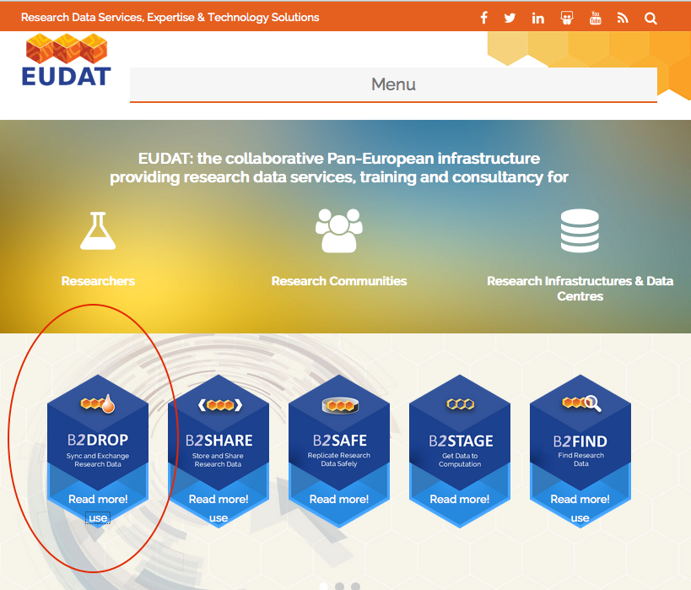
Getting started via EUDAT website: https://eudat.eu/
Notes:
You can access B2DROP via the general EUDAT website https://eudat.eu/ . Click the small button ‘use’ in the blue B2DROP box in the left bottom corner of the webpage.

Slide 8
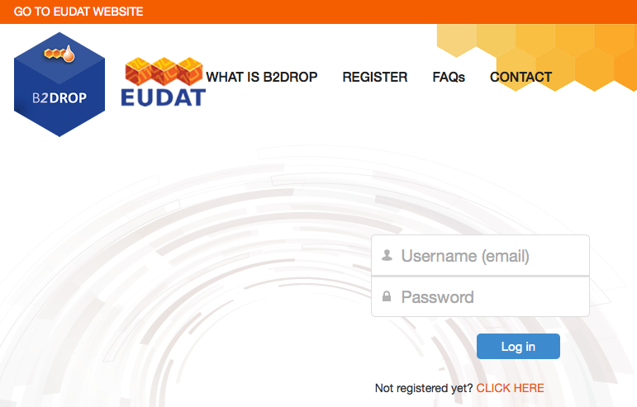
…or directly: https://b2drop.eudat.eu/
Notes:
The easiest way however is to go to B2DROP directly via https://b2drop.eudat.eu/.

Slide 9
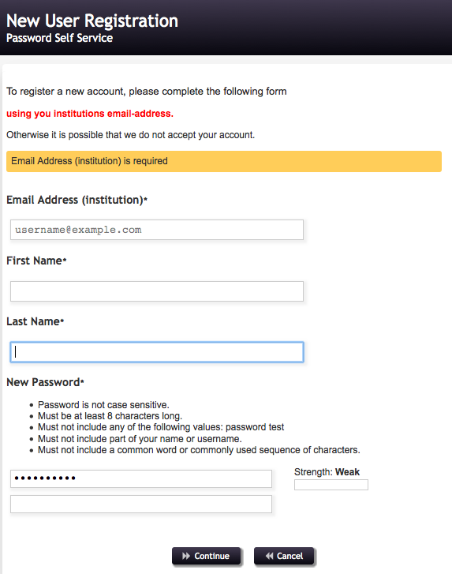
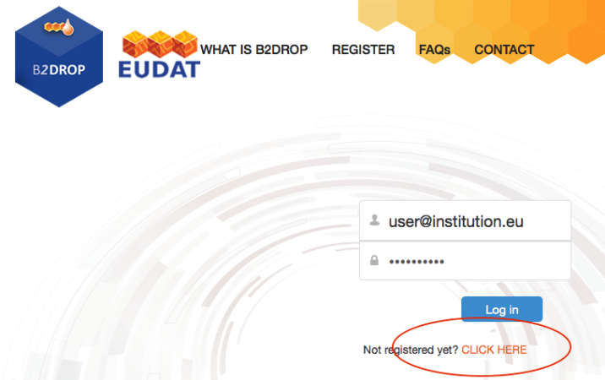
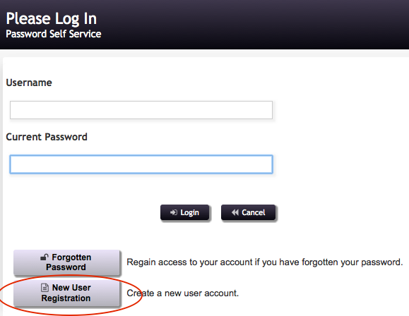
Accessing B2DROP 1/2
Registration
  Limited to institutional e-mail addresses
  Time limited process
Notes:
To use B2DROP you need to register yourself first. This is quite easy. Please fill in your details and use your institutional e-mail address. After confirmation you can use B2DROP immediately!

Slide 10

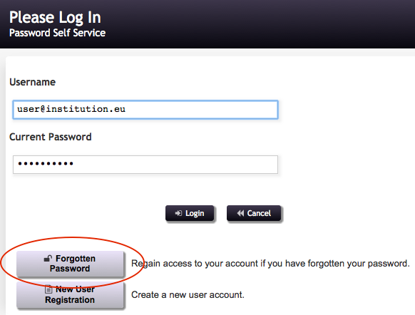
Accessing B2DROP 2/2
Forgotten password: CLICK HERE
You’ll be forwarded to the Password Self Service.
Click ‘Forgotten Password’
Fill in your details and you’ll receive a security code by e-mail
Fill in the code at the Password Self Service website and you can change your password
Notes:
In case you would have forgotten your password, you could retrieve it via the Password Self Service. This service is available under the button CLICK HERE, which you use for creating a new account too. Simply follow the steps and you’ll use B2DROP very soon again indeed.

Slide 11

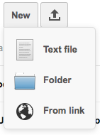
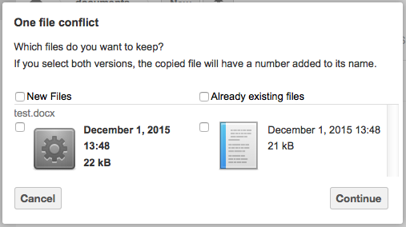
Using the web interface 1/2
Upload and download of a file (max. 10 GB)
  Click the upload button
  Browse your computer, select a file and click ‘Open’.
  The file will be uploaded into your B2DROP space.
Create a folder
  Click ‘New’, then ‘Folder’
  Name folder + enter
Keeping versions
  Files with similar names will be noticed by B2DROP: ‘One file conflict’. You can choose what version(s) you’d like to keep.
Renaming files and folders
  Select the folder
  Click the ‘pencil’ button
  Change the name + enter
Notes:
On this slide you’ll find a step-by-step guide:
to upload or download a file
create a new folder
creating, selecting and storing versions of files
renaming files and folders

Slide 12
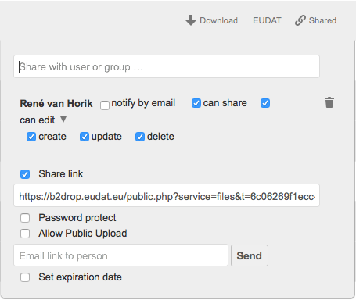
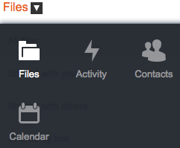
Using the web interface 2/2
Creating new contacts and groups
  Click dropdown menu next to ‘Files’:
  Click ‘Contacts’
  Create new contact + enter
  Select contacts
  Import contacts
  Create a group
Default sharing files and folders
  Via contact or e-mail
  Adding password protection, allowing upload access, set an expiration time on the sharing
Unsharing: by clicking the ticked box ‘Share link’.
Notes:
Some information on:
Creating new contacts and groups
Select contacts by starting their first name. B2DROP will suggest some profiles, please click on the right one.
Sharing files and folders via the ‘Share’ button
Unsharing

Slide 13
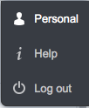
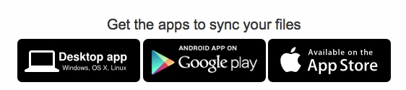
Installing B2DROP client
To install a desktop app:
  Click on your username
  Select ‘Personal’
  Click on the appropriate app. You will be directed to an external website.
  Click ‘desktop client’, then Windows, Mac or Linux
  After installing you need to configure the program by entering the address b2drop.eudat.eu
  Please log in
Your will find a folder ownCloud in your Finder now.
User documentation:
http://eudat.eu/services/userdoc/b2drop
Video Tutorial:
https://youtu.be/YyjPv4s7DxY
Notes:
A step-by-step guide for embedding B2DROP in your personal file directory.
There’s a (concept) video available to assist you with this. https://youtu.be/YyjPv4s7DxY

Slide 14

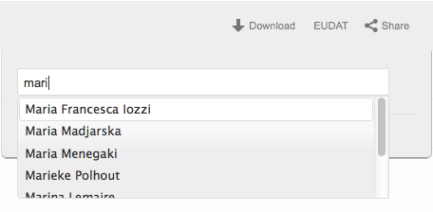
Using the client: sharing
Ways of using B2DROP:
  copying + pasting files into the ownCloud folder
  selecting + dragging files into the folder. NOTE: the files will be removed from the original location if you drag + drop them.
Sharing files:
  Click ‘Share’ behind the file name
  Enter the first name of a B2DROP user.
  Select the right person
  The item has been shared. You can define settings, such as allowing to share,
  create, edit etc.
Notes:
You can now share files via B2DROP by copying + pasting them into the ownCloud folder, or moving them to the folder by selecting + dragging them. Please note that the files will be removed from the original location if you drag + drop them.
To share a file or folder, please click the button ‘Share’ after the file name or folder name. Specify with whom you would like to share the item by name (if someone has a B2DROP account) or by e-mail.

Slide 15
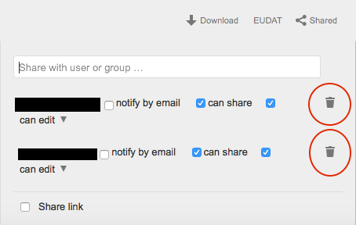
Using the client: unshare
Unshare items:
  Click ‘Shared’ behind file name
  Click on the trashcan behind user you would like to unshare files with
  The name will disappear, item will be unshared.
Protecting link by password
You can treat the ownCloud
as any other file system.
Notes:
A short guide on unsharing items. Quite easy and simple. To undo unsharing, simply invite people to your folder or file again.

Slide 16
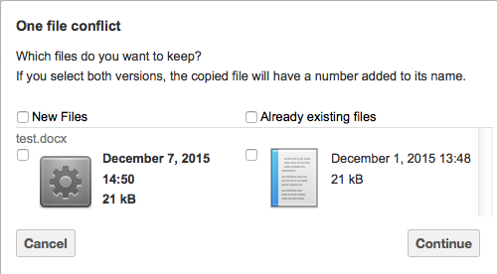
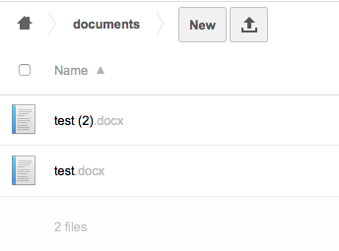
Versioning
If you upload a file with exact the same file name as an existing file, B2DROP will detect this and ask you what you’d like to do: keep one or keep both files:
  Keep one, and only that file will be kept
  Keep both, a number will be added to the file name of the newest file.
  If you want a different way of
  versioning, add the version
  number to the file name manually.
Notes:
B2DROP will notice when you try to upload a file with an already existing name in the same folder / space. B2DROP will ask you which version(s) you’d like to keep: one, or both. If you choose to keep both, the new file will be known in B2DROP as ‘filename (2)’.
It’s a safety measurement: if you would like to keep several versions of files, it’s probably best to add an elaborate versioning in the filename yourself with a version number or date, such as ‘filename v1.0’ or ‘filename 01-02-2016’.

Slide 17
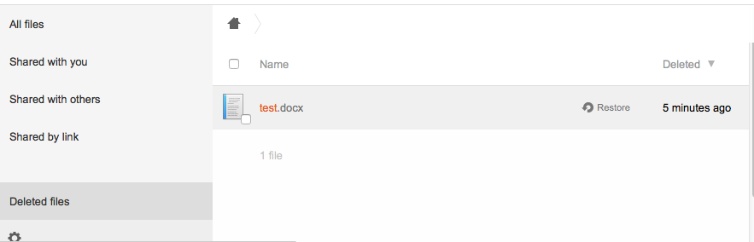
Deleting files
To delete a file, you can click on the trashcan which appears when browsing over the file name.
Please note that the file will be deleted immediately.
You can retrieve deleted files via the folder ‘Deleted files’ at the left side, and choose ‘Restore’.
Notes:
Simply remove files by clicking on the trashcan behind the file name. If you will have made a mistake, you can retrieve your deleted files via the folder with the same name in the left bottom corner.

Slide 18
SECURITY
Your privacy is important to us. Only you and those you share your files with can see your data. In urgent matters an administrator could access your files
Daily backups of all files in B2DROP are taken and kept on tape in a different location in Juelich
User Information security
  Also stored at Juelich
  User info is not encrypted
  Transfer to 3rd party (e.g. in case of moving the service to another partner): b2drop.eudat.eu would be moved to a different location
Notes:
Your privacy is important to us. You decide with whom to share files and folders. In urgent matters an administrator could access your data, but we hope it will never be necessary.

Slide 19
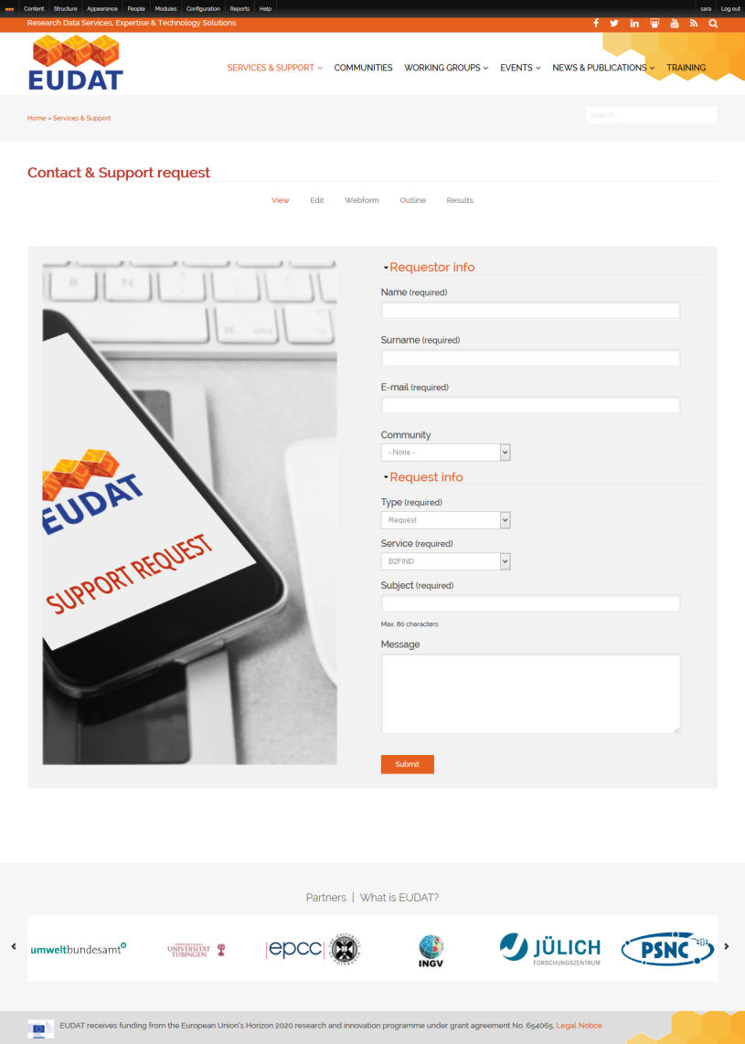
Support requests
https://eudat.eu/support-request?Service=B2DROP
Notes:
EUDAT runs a specific help desk system to support B2DROP users and it can be accessed via http://www.eudat.eu/support-request

Slide 20
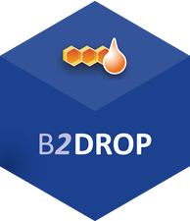
b2drop.eudat.eu
For more info: https://eudat.eu/services/b2drop
User documentation:
http://eudat.eu/services/userdoc/b2drop
Notes:
Additional information on B2DROP can be found at https://eudat.eu/services/b2drop.
Detailed user documentation is also available at http://eudat.eu/services/userdoc/b2drop

