Slide 1

B2ACCESS
The simple and secure authorisation and authentication platform of EUDAT
This work is licensed under the Creative Commons CC-BY 4.0 licence
Version 1
January 2016
Notes:
B2ACCESS is the simple and secure authorisation and authentication platform of EUDAT.

Slide 2
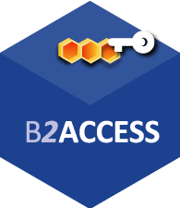


A truly pan-European Infrastructure
EUDAT offers common data services to both research communities and individuals through a network of 35 European organisations.
b2access.eudat.eu
Our vision is to enable European researchers from any discipline to preserve, find, access, and process data in a trusted environment, as part of a Collaborative Data Infrastructure.
European infrastructures
Technology Providers
Research Communities
Notes:
B2ACCESS is one of the services offered by EUDAT, the pan-European Infrastructure. EUDAT offers common data services, supporting multiple research communities as well as individuals, through a geographically distributed resilient network connecting general purpose data centres and community-specific data repositories. EUDAT wants to enable European researchers from any discipline to preserve, find, access, and process data in a trusted environment, as part of a Collaborative Data Infrastructure.

Slide 3




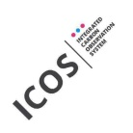



















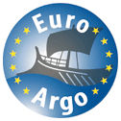

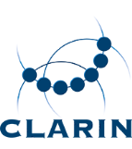



Community-Driven Solutions
EUDAT services are designed, built and implemented based on user community requirements.
b2access.eudat.eu
ENVIRONMENTAL SCIENCES
BIOMEDICAL & MEDICAL SCIENCES
MATERIALS & ANALYTICAL FACILITIES
MAPPER
SOCIAL SCIENCES & HUMANITIES
PHYSICAL SCIENCES
& ENGINEERING
Notes:
The services offered by EUDAT are community driven as they are designed, built and implemented based on user community requirements. This means that the communities have direct influence on these services and contribute to the development of them. Services are defined not just by researchers in the EUDAT collaboration, but we also elicit requirements from other communities to ensure our services are as generic and applicable to as wide an audience as possible.

Slide 4
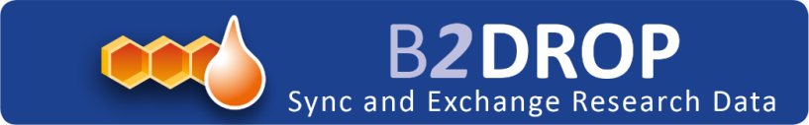
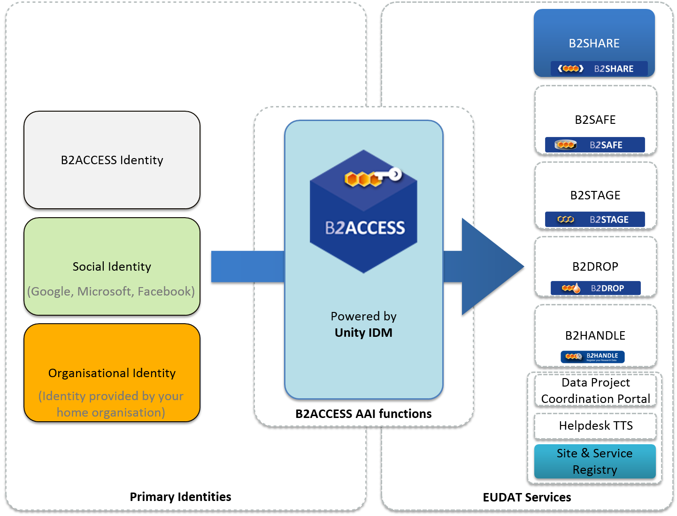
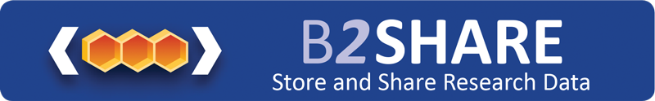
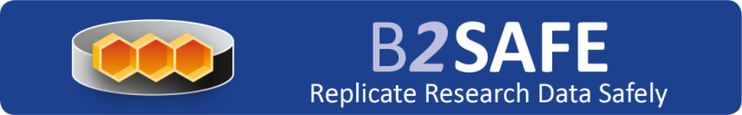
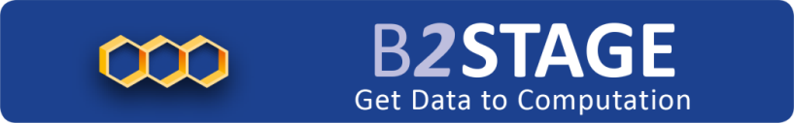

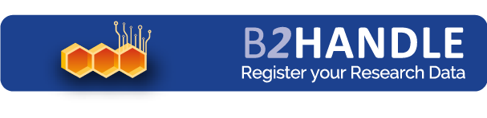

The EUDAT Service Suite
b2access.eudat.eu
Notes:
The EUDAT service suite represents an integrated set of services to support researchers manage their data through the data lifecycle. As your data moves through the data lifecycle, EUDAT services will help you manage your data using best practices followed by some of the world’s largest communities. The services available cover a wide range of functionalities. B2SAFE enables communities to replicate and safely store their large-scale data on robust, reliable datacentres operated by the EUDAT partners. B2HANDLE registers all data on EUDAT with a unique identifier which can be globally resolved on the standard handle system. B2STAGE allows users to efficiently move their data between EUDAT sites; one example of using B2STAGE is so as to move data to a compute cluster, then deposit the results of the computation back into EUDAT. B2DROP allows EUDAT users to easily exchange working data, while B2SHARE allows to deposit and disseminate final research data at a smaller scale, but easier than with B2SAFE. B2FIND allows searches on the EUDAT metadata and is one of the key enablers of multi-disciplinary research on EUDAT. B2ACCESS, the topic of this talk, is the simple and secure authorisation and authentication platform of EUDAT, which allows single sign-on on EUDAT’s public and internal service. At the moment B2SHARE and the Site and Service Registry have adopted B2ACCESS, with more services integrating it rapidly.

Slide 5
What is B2ACCESS?
b2access.eudat.eu
The federated cross-infrastructure Authorisation and Authentication Framework
Enables single sign-on access to the EUDAT services
Easy to use and secure
Developed on top of the Unity Open Source security framework
Notes:
B2ACCESS is the easy to–use and secure EUDAT federated cross-infrastructure authorisation and authentication framework. It allows users to authenticate themselves using a variety of credentials and then presents the EUDAT services with a single identity for the user. B2ACCESS makes end-user access to the EUDAT services easier, as users only need to sign on once, then use various EUDAT services without needing to input their username and password in the same session. B2ACCESS is a recent development, but it is being adopted by the EUDAT services at a high pace, because it allows users to easily authenticate themselves and use the services. At the same time, it eases user management for the service administrators, which explains why all EUDAT services, user-facing and internal, will eventually use B2ACCESS for authentication and authorisation. B2ACCESS is based on the Open Source Unity framework for federated ID management.

Slide 6
B2ACCESS Features
b2access.eudat.eu
Supports several methods of authentication via the users' primary identity providers, also including Google, Microsoft and Facebook
Integrated with EduGain and therefore supports identities from hundreds of Universities and Research institutions around the world.
Can be used as primary identity provider, if necessary
Can be integrated with any EUDAT service and beyond (SAML, OAuth2 and X.509)
Provides unique and persistent EUDAT IDs
Allows service managers to specify authorisation decisions.
Notes:
B2ACCESS supports several methods of authentication via the users' primary identity providers, including OpenID, SAML and x.509. B2ACCESS is integrated with EduGain and therefore support identities from theoretically hundreds of Universities and Research institutions around the world. B2ACCESS can also be used as a primary identity provider, if necessary, but the EUDAT services place higher trust on institutional IDs, then Google, Microsoft and Facebook (and in future other OpenID providers), then B2ACCESS’ own credentials. B2ACCESS can be integrated with any EUDAT that supports SAML, OAuth2 or X.509 certificates, so it is pretty simple to adopt. Once authenticated through their preferred means, users present the EUDAT services with a unique ID, which is persistent across the EUDAT infrastructure. One of the key reasons for EUDAT developing B2ACCESS is that it allows service managers to specify authorisation decisions in a scalable fashion, by adding the users’ unique IDs to groups. This simplifies management of the service without compromising on security. In future, B2ACCESS will also allow communities to define policies for access control, but this is a service currently available for access to EUDAT services.

Slide 7
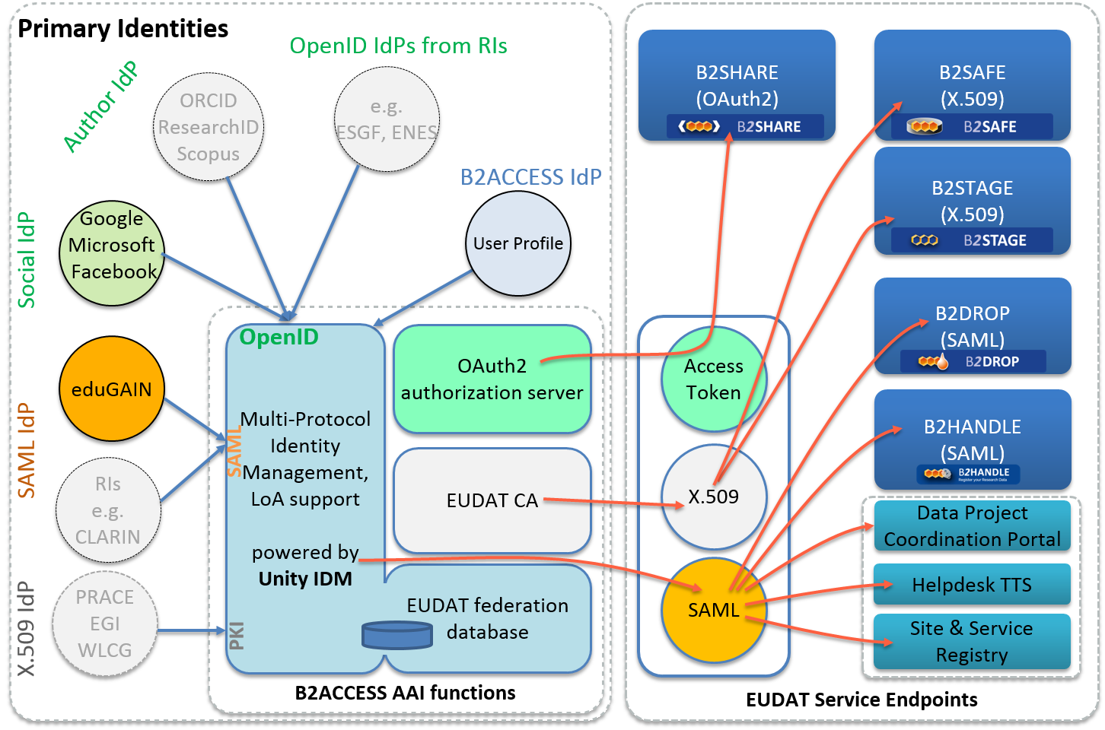
How it works
b2access.eudat.eu
Different methods are used for authentication and for integration with the EUDAT services
Notes:
This slide shows the workflow of B2ACCESS. Users authenticate with B2ACCESS using their preferred OpenID, SAML or X.509 identity. At the moment eduGAIN, Google, Microsoft, Facebook and the B2ACCESS native ID are available, with more on the pipeline. In future, the institutional IDs will contain tokens which will allow the communities to signal to B2ACCESS that users belong to this community. Irrespective of the authentication mechanism that the user elects, B2ACCESS uses the Unity framework to present a single, EUDAT-specific ID to the EUDAT service end-points. These services natively support OAuth2, SAML or X.509 schemes for authentication and authorisation and benefit from B2ACCESS’ ability to integrate with these schemes. B2ACCESS administrators handle user registration, while EUDAT Service Managers allocate users to groups that can access their services.

Slide 8
Who benefits from B2ACCESS?
b2access.eudat.eu
End Users of the EUDAT services integrated with B2ACCESS
Managers and administrators of the EUDAT services integrated with B2ACCESS
Investigating ways so community applications can be integrated with B2ACCESS to get user identities and attributes for Authorization and Authentication decisions
Notes:
B2ACCESS makes access to EUDAT services simple for the user. Support for social and institutional IDs is welcome news to the EUDAT communities. Additionally, B2ACCESS simplifies the day-to-day running of EUDAT services and increases their uptake and use. We are working towards solutions so that community applications that support one of SAML, OAuth2 or X.509 certificates can benefit from B2ACCESS support to integrate with B2ACCESS and also simplify the Authentication and Authorisation aspects of running their services.

Slide 9
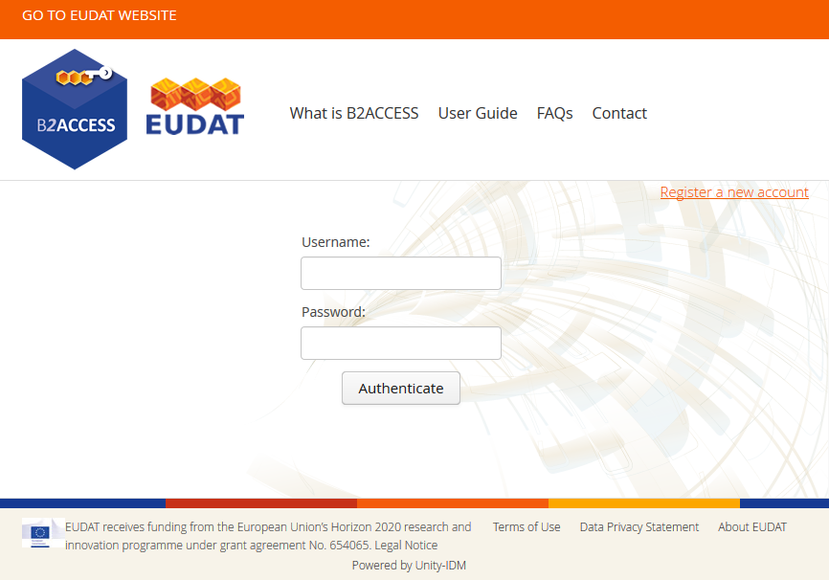
Simple & Easy to Access
Access via https://b2access.eudat.eu
Register and log in using your Social account, Home organisation ID Provider or B2ACCESS ID
b2access.eudat.eu
Notes:
B2ACCESS can be accessed via the link shown and via the EUDAT homepage. Users can log in using their social account, home organisation ID (if the organisation is registered) or a B2ACCESS ID. Registering with the service is simple and support and help is offered at each stage.

Slide 10

Thank you
b2access.eudat.eu
For more info: http://eudat.eu/services/b2access
User documentation: http://eudat.eu/services/userdoc/b2access-usage
Notes:
For more info please visit: http://eudat.eu/services/b2access . The User documentation can be found at : http://eudat.eu/services/userdoc/b2access-usage

