Slide 1
EOSC Governance Development Forum
5th Webinar
14 September 2017
Per Öster (per.oster@csc.fi)

Slide 2
Governance Development Forum
Enable stakeholders to contribute to the governance development
A platform for information, dialogue, and development
http://eoscpilot.eu/about/governance

Slide 3
EC EOSC Declaration
Endorsements asked for
15 September 2017
(tomorrow)

Slide 4
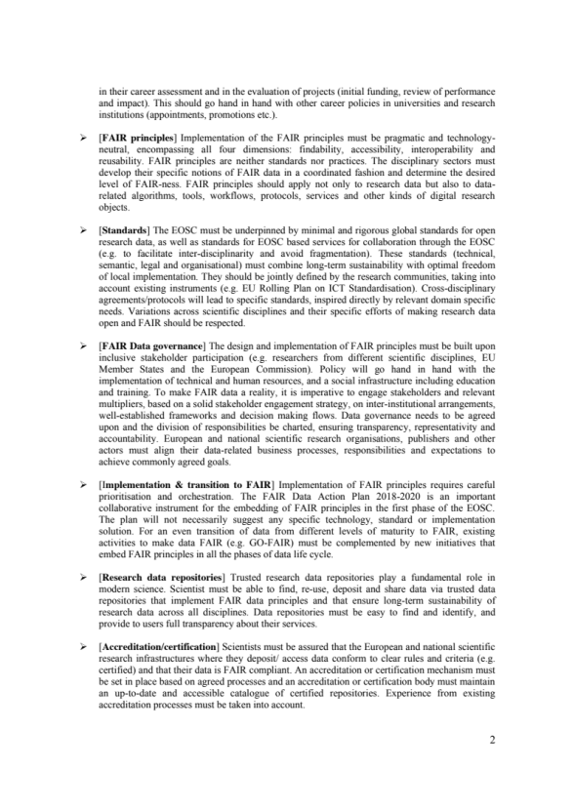
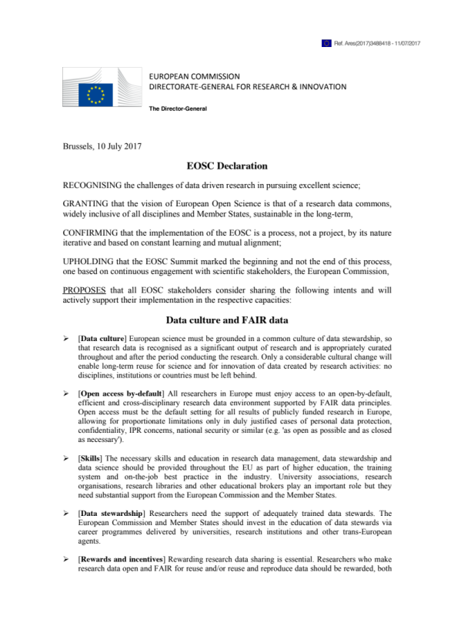
EOSC Declaration
Conclusion of EOSC Summit 12 June
  A Declaration and more than 30 statements about EOSC to be endorsed by the member states and other stakeholders
    Data Culture and FAIR Data
    Research Data Services and Architecture
    Governance and Funding

Slide 5
Governance
by EOSCpilot

Slide 6

EOSC Declaration on Governance
[Governance framework]
The EOSC governance framework will be co-designed, stakeholder driven and composed of three main layers:
  institutional, including EU Member States and European Commission
  operational, including a governance board and relevant working committees (e.g. thematic and functional) and
  advisory, including a stakeholder forum.
Strategic
Executive/
Advisory

Slide 7
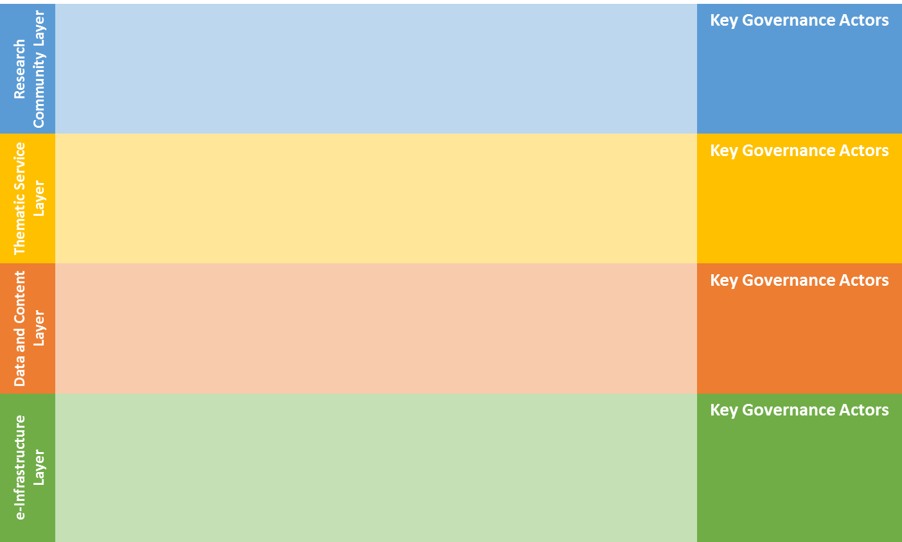
Member states and EC on research strategies and funding
Strategic
Executive/
Advisory
EOSC Stakeholders
European e-Infrastructures
Data/Research Initiatives
Cloud providers
Research funders
Cloud community
Research Communities and Institutions
Research Infrastructures (RIs)
Policy makers
Engagement Contexts
Legal\Policy
Organisational
Operational
Technical
Data\Information
Skills
Research challenges\agenda
Financial
Political
e.g. Top down EOSC implementation board
e.g. Bottom up forum research on standards and tools

Slide 8
Funding

Slide 9
EOSC Declaration on Funding (1)
[Funding] Over time, a co-funding mechanism mixing different revenue streams for the EOSC will be set up, to increase the accountability of the governance, building trust, sharing resources and building long-term capacity for European research data. Early implementation of the EOSC will pilot innovative business models and support an integrated data and service platform for European research.

Slide 10
EOSC Declaration on Funding (2)
[Long-term sustainability] The European Commission, Member States and Research Funders will use existing and future resources strategically, to ensure long-term sustainability of open research data and research infrastructures, facilitating inter-disciplinarity.

Slide 11
EOSC Declaration on Funding (3)
[Rewards and incentives] Rewarding research data sharing is essential. Researchers who make research data open and FAIR for reuse and/or reuse and reproduce data should be rewarded, both in their career assessment and in the evaluation of projects (initial funding, review of performance and impact). This should go hand in hand with other career policies in universities and research institutions (appointments, promotions etc.).

Slide 12
Tasks on funding within EOSCpilot Project
Leverage of Member States investment
  “exploring mechanisms for better alignment of national infrastructure priorities and investment strategies, and placing it in a European context”
Creation of a “EOSC Funders Summit”
  “alignment of funding and policy for the build-up and operation of the EOSC”
Preparatory work for business models to underpin EOSC sustainability
  “identify the principles and mechanisms through which the value within EOSC can be delivered and cost be recovered”

Slide 13
The building blocks
(MS’, EC’s and Other’s investments)
National, regional, and local research infrastructures and e-infrastructures
  Credible?
  Compatible?
International research infrastructures and e-infrastructures (e.g. ESFRI, EIROforum, GÉANT, EGI, PRACE, EUDAT,…)
  Compatible?
Commercial cloud and service providers
  Credible?
  Compatible?
Research Communities
Thematic Services
Data and Content
E-infrastructures

Slide 14
Some open questions
What kind of revenue streams are foreseen to be base of a co-funding model, and how plausible are they?
  National research budgets, EU H2020 and FP9, Foundations, PPP,…
What are the mechanisms MS can agree on, to use the resources strategically to achieve sustainability of EOSC?
How to arrange cost recovery for trans-national access?
  Bartering? Cloud-credits? Market? EC trans-national , and virtual access funding instruments? Open access policy? …?
Are open access policies (cf. research infrastructures and PRACE) possible to be applied to national e-infrastructures?

Slide 15
Governance: Status and Next Steps
Undertaken:
Stakeholder mapping exercise
Progressing with a framework which will help conceptualise the range of stakeholders and interoperability objectives
Assessing different governance approaches across these, and how these may fit together.
Next Steps:
Planning to have a draft framework for discussion very late summer
  To gather feedback from a broader community
  Feedback initially via online tools and forum
  Then via workshops, including EOSCpilot stakeholder event at end Nov.

Slide 16
Follow
Follow the Governance Development at:
  http://eoscpilot.eu/about/governance

Slide 17
Upcoming events
2 October in Tallinn
  Governance development forum in conjunction with e-IRG meeting and Estonian presidency
Monthly webinars, next 12 October
EOSCpilot Stakeholder Engagement Event
  28-29 November in Brussels

Slide 18
Q&A
Alt. write to egdf-secretariat@eoscpilot.eu

Slide 19
Some open questions
What kind of revenue streams are foreseen to be base of a co-funding model, and how plausible are they?
  National research budgets, EU H2020 and FP9, Foundations, PPP,…
What are the mechanisms MS can agree on, to use the resources strategically to achieve sustainability of EOSC?
How to arrange cost recovery for trans-national access?
  Bartering? Cloud-credits? Market? EC trans-national , and virtual access funding instruments? Open access policy? …?
Are open access policies (cf. research infrastructures and PRACE) possible to be applied to national e-infrastructures?

Slide 20
Thanks!
Next EGDF webinar
12 October 14:00 CEST

