Slide 1
Staheholder driven governance framework for EOSC
Matthew Dovey, Saara Kontro, Per Öster
EOSC Governance Development Forum, 9th November 2017

Slide 2
EOSCpilot project will
establish the governance framework for the EOSC and contribute to the development of European open science policy and best practice;
develop a number of pilots that integrate services and infrastructures to demonstrate interoperability in a number of scientific domains; and
engage with a broad range of stakeholders, crossing borders and communities, to build the trust and skills required for adoption of an open approach to scientific research

Slide 3
EOSCPilot’s vision on EOSC governance
capable of supporting the definition, management and coordination of EOSC components and service providers without imposing a strict hierarchical model or supply chain
define organisational, operational and managerial interoperability, whilst recognising the System-of-Systems will evolve and adapt over time.
a rich ecosystem consisting of many different stakeholders and a heterogeneity of services and technologies which will need to operate across a wide range of organisational, community and national borders.
same principles of openness, transparency and inclusion that EOSC seeks to encourage amongst the research community
Governance Board
(Executive)
Institutional funders
(MemberStates, EC)
Stakehol-ders Forum
Three level governance model introduced in the EOSC declaration

Slide 4
WP2 Governance
Stakeholder scoping
Engage stakeholder through Governance development forum
Federated governance framework for the EOSC
Governance framework piloting process
Preparatory work for business models to underpin EOSC sustainability
Investigation and analysis of organisational principles of engagement
Leverage of member states investments
Creation of "EOSC Funders Summit"
Partners
ARC
CSC
PRACE
MPG
Elixir
STFC
BSC
CNR
Jisc
Jisc
SURF
CNRS
GÉANT
ICOS RI
EGI.eu
Notes:
The stakeholder scoping is an iterative process giving a base for the Governance development forum which gather feedback from stakeholders that can be fed into the development of a governance framework. A draft governance framework is produced and piloted (peer review and independent validation). The iterative process should result in a Governance framework for EOSC with support among a large group of stakeholders. Work on underpinning business models and formulation of principles of engagement support the governance framework and is used to engage and build trust with funders.

Slide 5
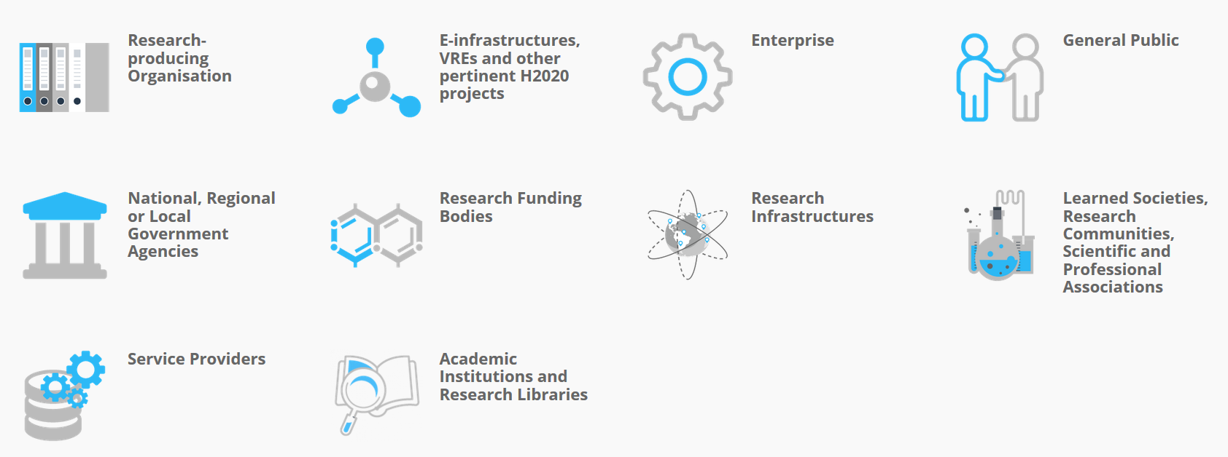
EOSC stakeholders
”Those groups who can affect or are affected by the achievements of an organization's purpose should be given the opportunity to comment and input into the development of decisions that affect them”
Stakeholder Engagement: A Road Map to Meaningful Engagement – Cranfield School of Management

Slide 6
Consultation feedback applied to governance
framework drafting
Governance as simple and flexible as possible, no need to create new legal structure, leverage on what is already existing
Involve all stakeholders in the governance, including researchers and citizens
Items for the framework draft
European Interoperability Framework one of the founding elements of the governance framework
3 options as the EOSC Core Resources Delivery Model one of which does not foresee any new legal structure or organization
Governance model described in the EOSC declaration included in the governance framework draft, the relation between the 2 explained
Community governance model applied in the framework ensuring stakeholder drivenness
Layered governance framework, importance of interoperability between layers
Stakeholders have different roles and their participation may serve different purposes in EOSC
Federated governance framework for the EOSC
Apply European Interoperability Framework and Digital Governance Ecosystem of Internet
Importance of MS and Associated Countries in the governance and decision making
Unclear relation between the governance model described in the EOSC declaration and governance framework draft by EOSCpilot

Slide 7
Stakeholder roles
CONSUMER
Will make use of services, data, or other resources from EOSC
Learned Societies, Research Communities, Scientific and Professional Associations
Research Infrastructures
Research Producing Organisation
e-Infrastructures, VRE, and Other H2020 Projects
Academic Institutions and Research Libraries
General Public
PROVIDER
Provides services, data or other resources (e.g. training) into EOSC
e-Infrastructures, VRE, and Other H2020 Projects
Service Providers
Enterprise
Academic Institutions and Research Libraries
Research Infrastructures
STRATEGIC
Will be involved in the strategic direction, compliance and funding of EOSC
National, Regional or Local Government Agencies
Research Funding Bodies

Slide 8
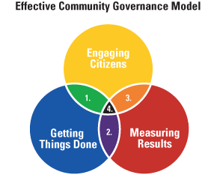
Community Governance Models
Governance Board
(Executive)
1 Community Problems Solving: Aligns “Engaging Citizens” and “Getting Things Done.”
2 Organizations Managing for Results: Aligns “Measuring Results” and “Getting Things Done.”
3 Citizens Reaching for Results: Aligns “Engaging Citizens” and “Measuring Results.”
4 Communities Governing for Results: Aligns all three core skills.
Institutional funders
(MS, EC)
Stakeholders Forum
http://www.rtmteam.net/page.php?pageID=25&section=overview_of_ecg

Slide 9
EOSC Governance Layers
Strategic
Measuring results
Institutional, including EU Member States and European Commission
Executive/Operational, including a governance board at the executive level and relevant working committees (e.g. thematic and functional)
Advisory, including a stakeholder forum
Executive
Getting things done
Engaging community
Steering

Slide 10
Community Governance Model for EOSC
Steering
EOSC Stakeholders
(Providers, Consumers, Strategy)
Executive
Strategic
Performance Against Needs
Requirements
Best Practices
EOSC Resources
Objectives
Metrics

Slide 11
EOSC Resource Model:
Principles of Engagement
EOSC
EOSC resources = technical, middleware, knowledge, access and facilitation services
Compliant
EOSC Supported
Resources
Externally Supported Resources
External
Compatible
EOSC Core
Resources
Compliant
Most of the resources within EOSC fully compliant with the Principles of Engagement
Compatible
Not fully compliant (yet), technically compatible with the EOSC, of value to EOSC Consumers
External
Resources outside of EOSC, of value to EOSC consumers, may or not be technically compatible with EOSC resources, “non-EOSC approved players are free to explore any role in the Open Science ecosystem they wish, even if they do not adhere to the RoE”

Slide 12
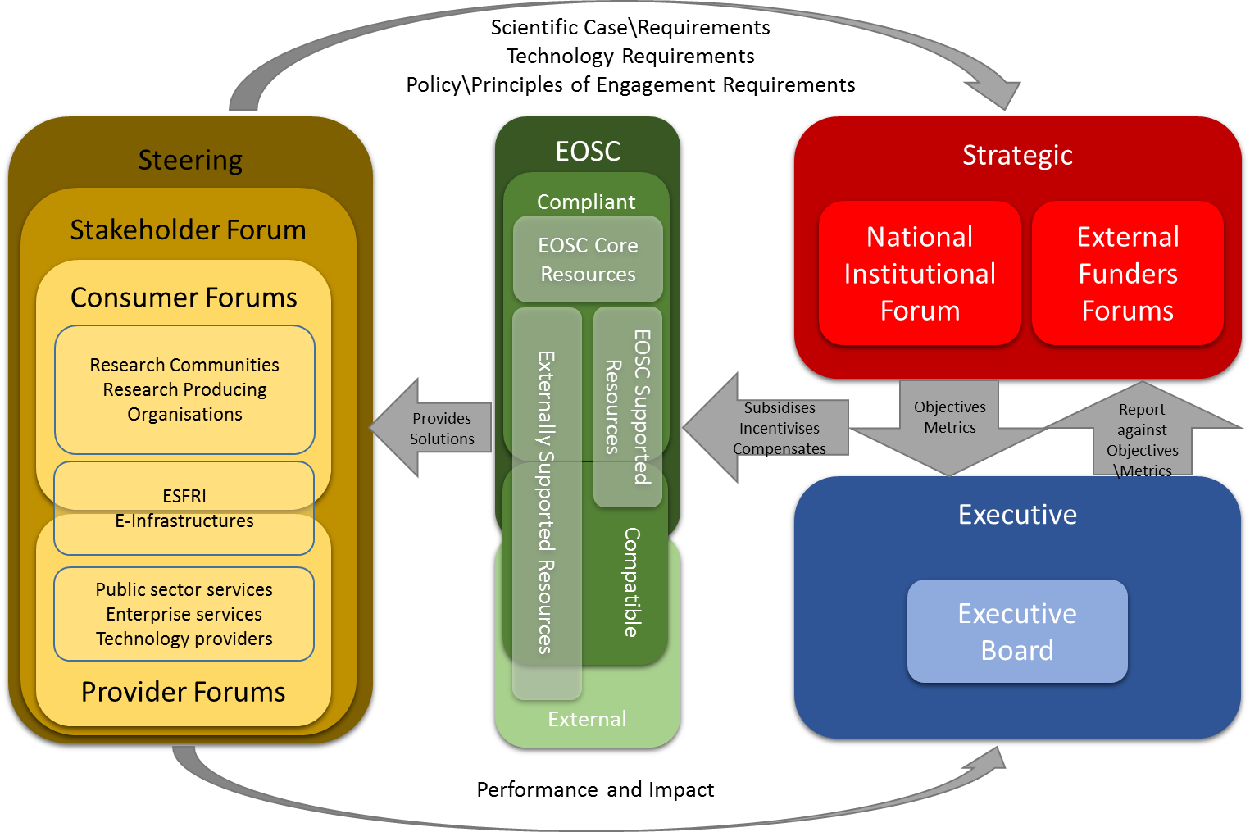
EOSC Governance Decision Flow Model

Slide 13
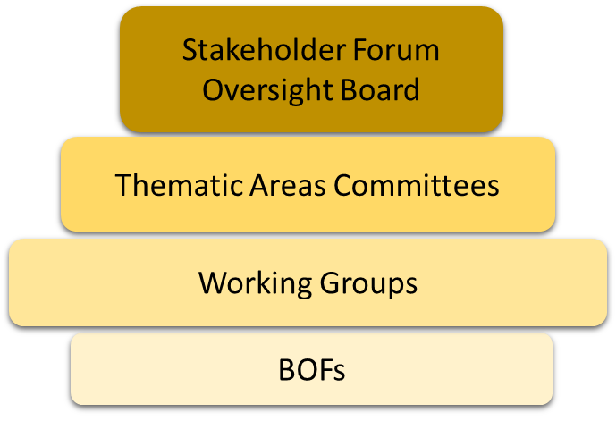
Stakeholder Forums Strawman
Steering
Stakeholder Forum
Consumer Forums
Research Communities
Research Producing Organisations
ESFRI
E-Infrastructures
Provider Forums
Public sector services
Enterprise services
Technology providers
Shape the Advisory Stakeholder Forum Session @ EOSCPilot Stakeholder Forum 28-29 November, Brussels
https://eoscpilot.eu/content/shape-advisory-stakeholder-forum

Slide 14
Next Steps
Co-design Stakeholder Forums with stakeholders
Develop Business Models for Executive to deliver EOSC
Incorporate Principles of Engagement and Policy Framework into the Governance Framework
Discuss, pilot and develop the Governance Framework with stakeholders

Slide 15
Get involved
EOSC governance development forum monthly webinars
  Business models, Dec 7, 14 CET
1st EOSC stakeholder forum organized by EOSCPilot, Nov 28 – 29
Thematic workshops targeting different stakeholders, next Jan 25, in Porto in conjunction with EUDAT conference
More info at https://eoscpilot.eu/about/governance-framework
Register for project updates at
https://eoscpilot.eu/user/register

