Slide 1
EUDAT B2ACCESS
Jens Jensen, STFC
CORBEL workshop, Paris
31-32 May (or 0-1 June) 2016

Slide 2
EUDAT in nuce
Multidisciplinary data e-Infrastructure supporting a wide range of research communities & projects
B2SAFE – data storage and replication
B2DROP – user file storage
B2FIND – metadata/search
B2SHARE – upload and share data
B2STAGE – move data into and out of other einfra
B2GETHER – collaborators
B2ACCESS – account mgmt and SSO
Data pilots ~ 25 activities

Slide 3
Data pilots overview
Applicant Community
Scientific domain
Example projects
WestLife
Preservation of herbarium species
Clinical trials
Cervical cancer & type 2 diabetes

Slide 4
Data pilots overview
Total storage request 1220-4300 TB
Requested EUDAT services

Slide 5
B2ACCESS Overview
Multiple Levels of Assurance (LoA)
IdP1
IdP2
IdP3
B2ACCESS
Community
portal
B2THIS
B2THAT
EUDAT

Slide 6
B2ACCESS Workflow
AttrAuth
IdP
B2ACCESS
Authorisation
Browser
B2Service
User
Portal
API B2Service

Slide 7
User Slide
Log in with any of these:
  Community identities
    CLARIN, climate,
    Recently added Instruct (structural biology)
  Social media and related
    Google, Facebook, Microsoft Live, GitHub
    ORCID
  National Identity Federations
    = Universities, Academic Research Orgs
    … via eduGAIN

Slide 8
Technology Slide
Internally translates to, er, internal credential
Supporting diverse services
  OAuth2 / OIDC
  X.509 (EUDAT’s user CA)
  SAML (WebSSO profile)
Each carries attributes
  Attributes are harmonised
  Compensating for external IdPs publishing differently
  Communicate the LoA to the service

Slide 9
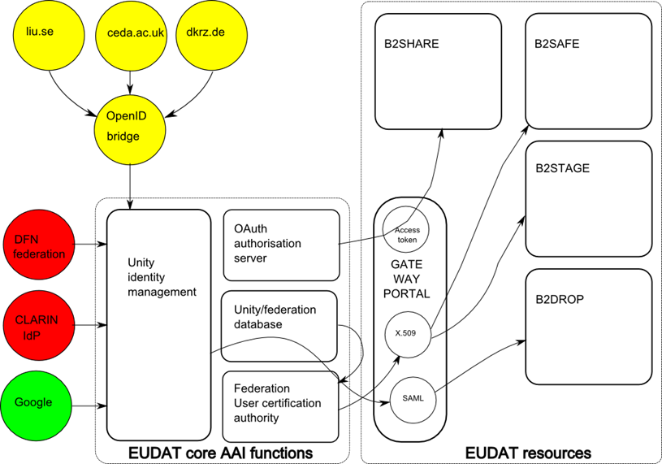
B2ACCESS Architecture Slide

Slide 10
Strategy Slide
Can B2ACCESS ids be consumed by services not in EUDAT?
  Yes… (maybe)
  Policy: eduGAIN compliance (release of attrs.)
  Or of course you could be an EUDAT community
  … easy! ☺
Different models for community portal integration
  If you have one…
Future work on multi-LoA sources of information
  E.g. attribute providers

Slide 11
The (Honest) Evaluation
If someone offers you username/password
  Kick them out!
  Obsolete, insecure, unmanageable
Future authentication
  Support federated identity management
  Multi-LoA authentication
  Include support for community and social ids
Future authorisation
B2ACCESS is not perfect (yet)
  But every project/einfra is working on similar technology
  Because it is the future
  And all einfrastructures should interoperate

Slide 12
Demo
If there is time…
  If not, try it yourself
  You can self register with any (accepted) id
Preproduction / staging
  https://eudat-aai.fz-juelich.de:8443/
Production
  https://b2access.eudat.eu/
Support
  helpdesk@eudat.eu
Contact
  jens.jensen@stfc.ac.uk

