Slide 1

B2ACCESS User Training
How to register with B2ACCESS
This work is licensed under the Creative Commons CC-BY 4.0 licence.
Attribution: EUDAT – www.eudat.eu
Version 1
February 2016
Notes:
The main purpose of this presentation is to discuss how to use B2ACCESS, in particular focusing on the Registration and Login features.

Slide 2
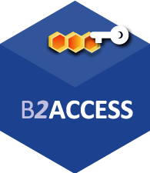
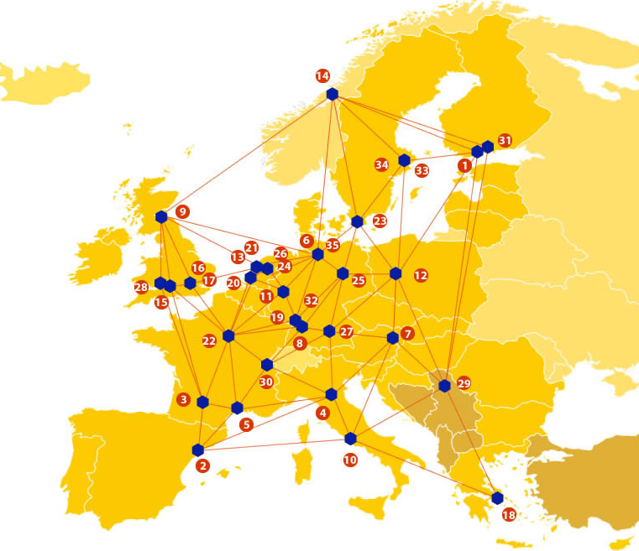

A truly pan-European Infrastructure
EUDAT offers common data services to both research communities and individuals through a network of 35 European organisations.
b2access.eudat.eu
Our vision is to enable European researchers from any discipline to preserve, find, access, and process data in a trusted environment, as part of a Collaborative Data Infrastructure.
European infrastructures
Technology Providers
Research Communities
Notes:
B2ACCESS is one of the services offered by EUDAT, the pan-European Infrastructure. EUDAT offers common data services, supporting multiple research communities as well as individuals, through a geographically distributed resilient network connecting general purpose data centres and community-specific data repositories. EUDAT wants to enable European researchers from any discipline to preserve, find, access, and process data in a trusted environment, as part of a Collaborative Data Infrastructure.

Slide 3

















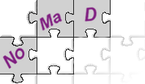












Community-Driven Solutions
EUDAT services are designed, built and implemented based on user community requirements.
b2access.eudat.eu
ENVIRONMENTAL SCIENCES
BIOMEDICAL & MEDICAL SCIENCES
MATERIALS & ANALYTICAL FACILITIES
MAPPER
SOCIAL SCIENCES & HUMANITIES
PHYSICAL SCIENCES
& ENGINEERING
Notes:
The services offered by EUDAT are community driven as they are designed, built and implemented on user community requirements. This means that the communities have direct influence on these services and contribute to the development of them. Services are defined not just by researchers in the EUDAT collaboration, but we also elicit requirements from other communities to ensure our services are as generic and applicable to as wide an audience as possible.

Slide 4

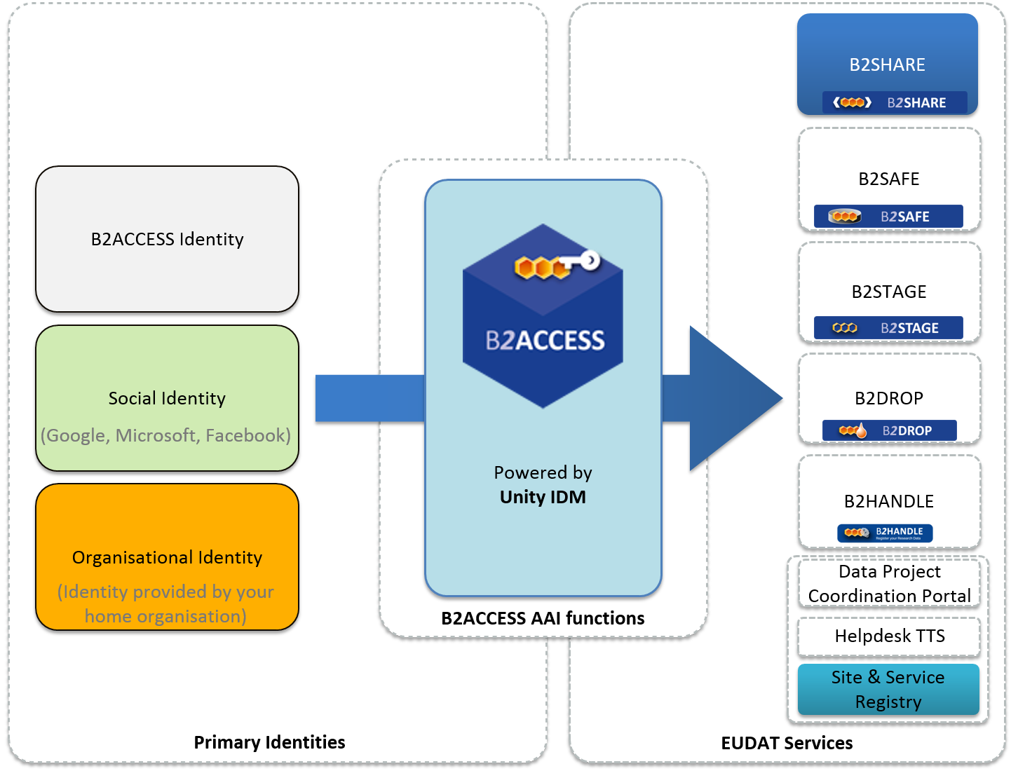






The EUDAT Service Suite
b2access.eudat.eu
Notes:
The EUDAT service suite represents an integrated set of services to support researchers manage their data through the data lifecycle. As your data moves through the data lifecycle, EUDAT services will help you manage your data using best practices followed by some of the world’s largest communities. The services available cover a wide range of functionalities. B2SAFE enables communities to replicate and safely store their large-scale data on robust, reliable datacentres operated by the EUDAT partners. B2HANDLE registers all data on EUDAT with a unique identifier which can be globally resolved on the standard handle system. B2STAGE allows users to efficiently move their data between EUDAT sites; one example of using B2STAGE is so as to move data to a compute cluster, then deposit the results of the computation back into EUDAT. B2DROP allows EUDAT users to easily exchange working data, while B2SHARE allows to deposit and disseminate final research data at a smaller scale, but easier than with B2SAFE. B2FIND allows searches on the EUDAT metadata and is one of the key enablers of multi-disciplinary research on EUDAT. B2ACCESS, the topic of this talk, is the simple and secure authorisation and authentication platform of EUDAT, which allows single sign-on on EUDAT’s public and internal service.

Slide 5
What is B2ACCESS?
b2access.eudat.eu
The federated cross-infrastructure Authorisation and Authentication Framework
Enables single sign-on access to the EUDAT services
Easy to use and secure
Developed on top of the Unity Open Source security framework
Notes:
B2ACCESS is the easy to–use and secure EUDAT federated cross-infrastructure authorisation and authentication framework. It allows users to authenticate themselves using a variety of credentials and then presents the EUDAT services with a single identity for the user. B2ACCESS makes end-user access to the EUDAT services easier, as users only need to sign on once, then use various EUDAT services without needing to input their username and password in the same session. B2ACCESS is a recent development, but it is being adopted by the EUDAT services at a high pace, because it allows users to easily authenticate themselves and use the services. At the same time, it eases user management for the service administrators, which explains why all EUDAT services, user-facing and internal, will eventually use B2ACCESS for authentication and authorisation. B2ACCESS is based on the Open Source Unity framework for federated ID management.

Slide 6
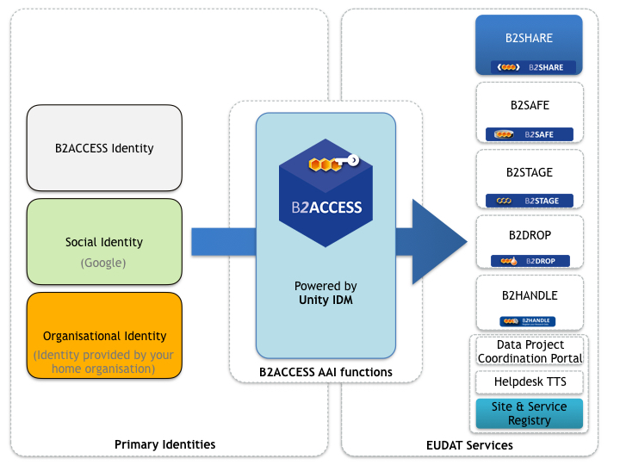
Using B2ACCESS
b2access.eudat.eu
EUDAT users to authenticate themselves using a variety of credentials. The following log-in options are supported:
User's Home Organisation Identity Provider
Social account
B2ACCESS ID
In order to support a wide range of IdPs we have joined the EduGain federation!
Notes:
The EUDAT users can use B2ACCESS to authenticate themselves using a variety of methods of authentication:
Home organisation identity provider
Social account, e.g. Google, Microsoft and Facebook
EUDAT ID
It’s simple and easy to register using the 3 different options. EUDAT has joined the EduGain federation in order to supports a wide range of Identity Providers. Although not all services are currently integrated, B2SHARE and the service registry are fully integrated, with the remaining EUDAT Services to follow in the coming months.

Slide 7
What will be covered
Account Registration
Registering
Logging In
Possible Issues
Profile Management
Account Deactivation and Removal
b2access.eudat.eu
Notes:
(As per slides)

Slide 8
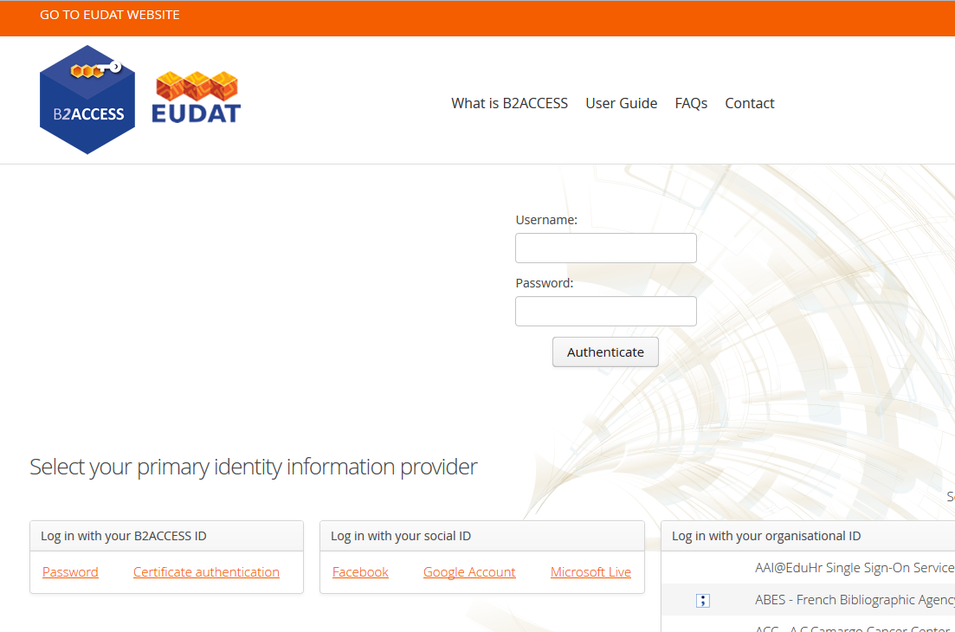
Account Registration
End users can access the portal via this link https://b2access.eudat.eu/
This portal allows the user to log in using one of three different methods
b2access.eudat.eu
Notes:
Here we can see the login portal of B2ACCESS and from here users can register through the three different options highlighted at the bottom. The user can access the portal via the link shown.

Slide 9
Registration is a two-stage process
b2access.eudat.eu
In order to register with B2ACCESS, you need to first log in
After log in, you can register with the B2ACCESS system, to create your unique B2ACCESS account
If you log in with a credential not associated with your B2ACCESS account, you can choose to associate it with your B2ACCESS account, or create another one
Notes:
(As per slides)

Slide 10
Registering-Home Organisation Identity Provider
b2access.eudat.eu
Use the search bar to seek, then click the name of your home organisation in the Log in with your Organisation ID tab and click Authenticate
You are then redirected to the login page of your home organisation.
Provide your credentials and log in.
After successful log-in, if you are not registered yet with these credentials, you will be offered two possibilities:
Register an account: a new local account will be created
Associate an account: an existing local account will be associated with your external identity
Fill in the registration form presented
Agree to the Terms of Use and Data Privacy Statement and submit
B2ACCESS will send you an email confirming that your registration request was accepted
Notes:
Your home organisation identity provider is the most trusted log in option for B2ACCESS. EUDAT has joined the EduGain federation. This means that EUDAT supports a wide range of IdPs and end-users can use their home organisation ID to register. To register – Follow the instructions on the slide.

Slide 11
Registering – Social Account
b2access.eudat.eu
Click the Google Account link in the Google Authentication tab and click Authenticate
You are then redirected to the login page of Google.
Provide your credentials and log in.
Give Google permission to publish your attributes to B2ACCESS
If you are not registered yet, you will be offered two possibilities:
Register an account: a new local account will be created
Associate an account: an existing local account will be associated with your Google identity
Fill in the name of your home organisation and (optionally) apply for membership in one of the presented groups
Agree to the Terms of Use and Data Privacy Statement and submit
B2ACCESS will send you an email confirming that your registration request was accepted
Notes:
You will also be able to log in using an already active social account. For this example we discuss Google, though the other social accounts should be very similar. To begin click the Google account link and then authenticate. Follow the instructions on the slide.

Slide 12
Registering – B2ACCESS ID
Click on the Register a new account link
You will be offered three registration forms to choose from:
OAuth Client Registration Form (not covered in this tutorial)
Create B2ACCESS Account (username only)
Create B2ACCESS Account (certificate + optional username)
Choose Create B2ACCESS Account (username only) - here you have to fill in the required data
Or choose Create B2ACCESS Account (certificate + optional username) – for this a valid X.509 certificate installed in your browser can reduce the amount of typing required
Example DN: CN=joe user, O=Example University, OU=students, C=TV
Agree to the Terms of Use and Data Privacy Statement and submit
b2access.eudat.eu
Notes:
To register with a B2ACCESS ID click on the “Registering a new account” link at the top right of the web-page. You will then be offered three registration forms. OAuth Client Registration Form is for registration of computer services and is not covered in this presentation.
If you choose Create B2ACCESS Account (username only) you need to fill in the following data:
Your preferred User name
Your secure password (twice). Note that the B2ACCESS site instructs your browser to not remember your username and password.
Email address
Organisation name (optional)
Common Name (CN, optional)
Comments (optional)
If you choose Create B2ACCESS Account (certificate + optional username) then you need to fill in fewer fields:
Your Distinguished Name, where you can use the optional facility to extract it from an uploaded X.509 certificate. The format B2ACCESS follows is LDAP and an example distinguished name is shown on the screen: CN is Common Name, your full name; O is the name of your organisation; OU is Organisational Unit, a group where you belong in your organisation; and C is the Country where your organisations is based.
An optional preferred User name
Your email address
And optionally your organisation name
In both cases, you need to agree to the Terms of Use and Data Privacy Statement and submit.

Slide 13
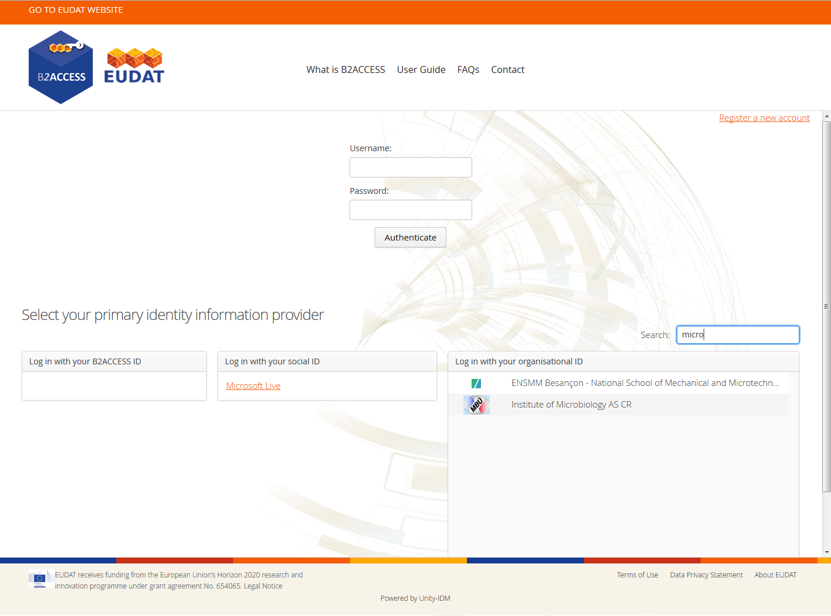
Logging In
After registering you can log in with your B2ACCESS ID at https://b2access.eudat.eu/
You can log in using either your organisational ID, social ID or B2ACCESS ID.
b2access.eudat.eu
Notes:
You generally do not need to log in to B2ACCESS. The EUDAT services integrated with B2ACCESS present their own B2ACCESS interfaces, and once logged in with one such service, your session is valid for other integrated services. You may need to log in so as to manage your B2ACCESS account, which we discuss later. After registering, logging in is very simple. Username-password is shown here, because when we took the screenshot that’s what the user had last used to log in. You can use any ID you have used to register before. Note also how the filter “micro” on the search applies to all possible authentication options, leaving only “Microsoft Live” under Social, and the two organisations that include “micro” in their name. This also applies when trying to select an ID for registration.

Slide 14
Log In - Home Organisation Identity Provider
b2access.eudat.eu
Click the name of your Home Organisation in the Log in with your Organisation ID tab:
Scroll through the list to find your Home Organisation
Or type the name of your Home Organisation in the search box
After selecting your Home Organisation, click the Authenticate button
You are redirected to the log-in page provided by your home organisation. Provide your credentials and log in.
Notes:
Logging in using Home Organisation ID – Follow instructions on the slide

Slide 15
Log in – Social Account
b2access.eudat.eu
Click the Google Account link in the Google Authentication tab and click Authenticate
Provided that you have previously registered, you will automatically login
Notes:
Again we cover Google here, although the workflow is similar for the other Social account ID Providers. Follow instructions on the slide

Slide 16
Log in – B2ACCESS ID
b2access.eudat.eu
Click the Login with native B2ACCESS ID
Fill in your username and password in the two input fields and click Authenticate
Provided that you have previously registered, you will automatically login
Notes:
B2ACCESS ID log in- follow instructions on the slide

Slide 17
Possible Issues
b2access.eudat.eu
You may not get a “Registration successful” message.
This is a known issue; registrations are successful irrespective of that.
Sometimes the captcha appears only partially on the screen.
Cancelling and retrying seems to work.
B2ACCESS requires certain attributes provided by your Home Organisation Identity Provider. If these attributes are not provided, login / registration will fail.
You can inform the EUDAT support team via this link http://eudat.eu/support-request?service=B2ACCESS
Notes:
You may go through the registration process but not get a “Registration successful” message. It’s a known problem that the B2ACCESS team is dealing with, but registrations are successful; just go back to the B2ACCESS page and log in as required.
Sometimes the captcha appears only partially on the screen, which prevents you from completing the registration. Cancelling and retrying seems to work.
If you face any issues either with logging in or registering with your home institution credentials, it may be due to B2ACCESS not having the correct attributes provided by your home organisation ID provider. If this happens you should contact the EUDAT support team via the link on the slide. This can also be accessed via the B2ACCESS pages on the EUDAT website.

Slide 18
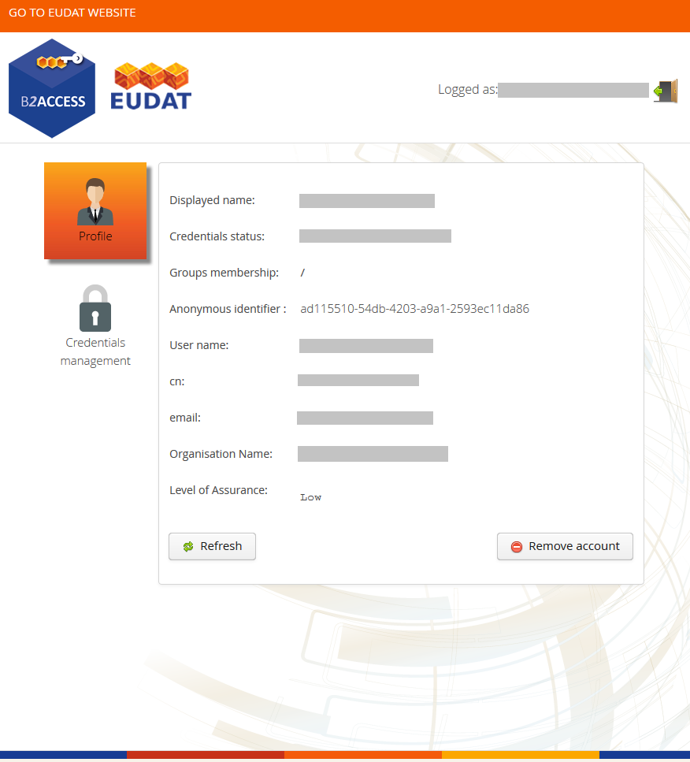
Profile Management
To access your user profile page, please log in https://b2access.eudat.eu/
You can see details about your account
You can schedule to immediately remove, or disable and in the future deactivate your account.
b2access.eudat.eu
Notes:
This is the profile management page which you can access after you log in. You can see your email at the top and the logout button. The page shows your Displayed name and your credential status (which is whether you have set a B2ACCESS password), the Groups that you belong to, your unique, anonymous B2ACCESS ID, your username, canonical name, email and organisation name and also the Level of assurance for the credentials you have used to log in. The B2ACCESS team is working on making the Level of Assurance consistent, for example, the user who took the screenshot had logged in using a Google ID, which should display a “Medium” level of assurance, but the screen reads “Low”.
Remove account at the bottom right allows you schedule, or immediately delete your account; this is discussed next.

Slide 19
Account Deactivation and Removal
b2access.eudat.eu
Temporary Account Deactivation
If necessary, accounts can be temporarily deactivated for a chosen number of days.
To do so-
Log in to B2ACCESS- Profile management page - Click Remove account button.
Select the option Disable immediately and remove after a grace period. Choose the number of days you want the account to be suspended.
Confirm your choice.
The account will be automatically removed if the user does not log in during this deactivation period.
Notes:
You can temporarily deactivate your account for a certain number of days. To do this click on the Remove account button at the bottom right of the Profile management page. Select the option Disable immediately and remove after a grace period and choose the number of days you want the account to be suspended, then Confirm your choice. Please note that if you log in during the grace period, the scheduled deletion will be cancelled and the account will not be removed.

Slide 20
Account Deactivation and Removal
Permanent Account Removal
To remove an account:
Log in to B2ACCESS. - Profile management page. Click Remove account button.
Select the option Remove immediately.
Confirm your choice.
Removing or deactivating an account with one of your identities does not affect accounts registered with other identities. E.g. if you remove your account registered with your Google identity you are still able to use your native B2ACCESS account.
You can register a new account with the same identity and same data (e.g. membership in the groups) after removing the old one.
b2access.eudat.eu
Notes:
You can also permanently remove your account. To do so follow the same instructions as before, but select Remove immediately. The deletion will only apply to the identity with which you are logged in, not other identities, so if you have cancelled your Google account you can remove it from B2ACCESS, but you can use other identities you have registered, including your institutional ID and your B2ACCESS native ID. If you delete your account immediately or after a grace period, you cannot undo the action. However, you can register a new account with the same ID you have previously deleted.

Slide 21
Profile Management
To access your user profile page, please log in https://b2access.eudat.eu/
You can see details about your account
You can schedule to immediately remove, or disable and in the future deactivate your account.
You can also manage your credentials
b2access.eudat.eu
Notes:
[Note animation; this is coming back to the page discussed before, to discuss Credentials Management.]
Credentials Management allows you to manage your B2ACCESS password.

Slide 22
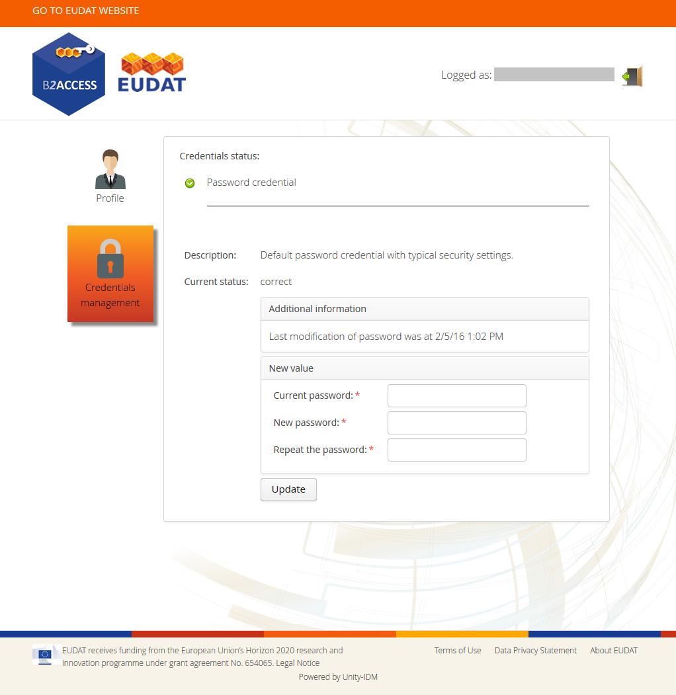
Credentials Management
Add or change your B2ACCESS password
b2access.eudat.eu
Notes:
Click on Credentials management. On the screenshot the user has not set a password; one does not need to do so, and remember that the B2ACCESS ID has a low Level of Assurance. Setting a password here effectively registers your B2ACCESS ID.

Slide 23

Credentials Management
Add or change your B2ACCESS password
b2access.eudat.eu
Notes:
But assuming you have set one, changing your password is straightforward. As expected, you need to know your previous password before you can change it.

Slide 24
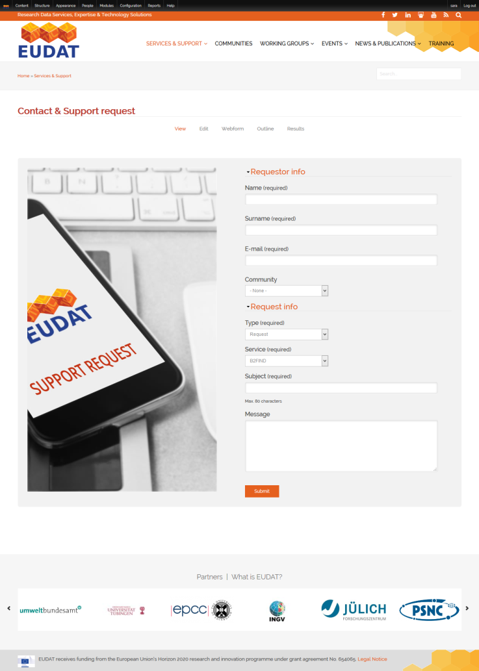
Support Requests
b2access.eudat.eu
Support for B2ACCESS is available via the EUDAT ticketing system through the web-form http://eudat.eu/support-request?service=B2ACCESS
Notes:
Support for B2ACCESS is available via the EUDAT ticketing system through the web-form http://eudat.eu/support-request?service=B2ACCESS .

Slide 25

Thank you
b2access.eudat.eu
For more info: http://eudat.eu/services/b2access
User documentation: http://eudat.eu/services/userdoc/b2access-usage
Notes:
For more info: http://eudat.eu/services/b2access
User documentation: https://eudat.eu/services/userdoc/b2access-usage

