Slide 1

WDS Certification
Objective: building trust in the usage of data & data services
Michael Diepenbroek
Rorie Edmunds
Mustapha Mokrane
Lesley Rickards
Notes:
Why certification

Slide 2
Outline
Objective
  Proxy for quality of service
Basic concepts
  OAIS etc.
Basis principles
  Abstraction etc.
Development of standards
Examples of implementations
  NESTOR, OCLC -> ISO etc.
  DINI
  WMO, DSA, ICSU-WDS

Slide 3
Quality indicators
Used workflows for data curation
Used standards and interoperability
Used policies
Re-usage of data
Increase in data holdings
Availability & development of services
Feedback from users
Certifications & accreditations

Slide 4
Trustworthiness
Threats to the preservation of information are:
impaired integrity, authenticity and confidentiality
Hidden bonds between the information and the data carriers, physical ageing of the data carriers
Rapid changes in the technical infrastructure required to interpret the digital objects
Loss of knowledge about the data
Etc.
Notes:
Might lead to total loss of accessibility and usability

Slide 5
Basic concepts
  Digitale Object
    Discrete units of information
    Multiple representations – e.g. Same content as text or audio
    Interpretation: processed by machines or understood by humans
  Metadata
    Usage and discovery metadata
    Needed for findablity, identification, and re-usage of data
    Might be created at different stages of the data life cycle
    Together with digital objects they comprise a conceptual unit (data entity, data set)
  Digital repository
    Information system consisting of people and technical systems
    Responsibility for long-term preservation, accessibility, and usability of digital objects
    Reference model for an „Open Archival Information System – OAIS“
  Usage by designated community
    Usage is based on the needs of communities
    Legal, organisational, and technical changes might affect the community‘s ability to interpret digital objects
    Repositories need to monitor such changes
  Trustworthiness
    Capacity of an information system to operate in accordance with its objectives and specifications (i.e. it does exactly what it claims to do).
    Basic values are integrity, authenticity, confidentiality and availability.

Slide 6
Information, representation, interpretation

Slide 7
Metadata

Slide 8
Trustworthiness – basic objectives
System operation according to its objectives and specifications
Integrity: completeness and exclusion of unintended modifications to data sets
Authenticity: data sets actually contain what they claim to contain (metadata)
Availability: (1) guaranteed access to data & services, (2) data sets & services are usable
Notes:
1. it does exactly what it claims to do, this can be different according to the roles a facility has - individual criteria are related to the objectives of a facility

Slide 9
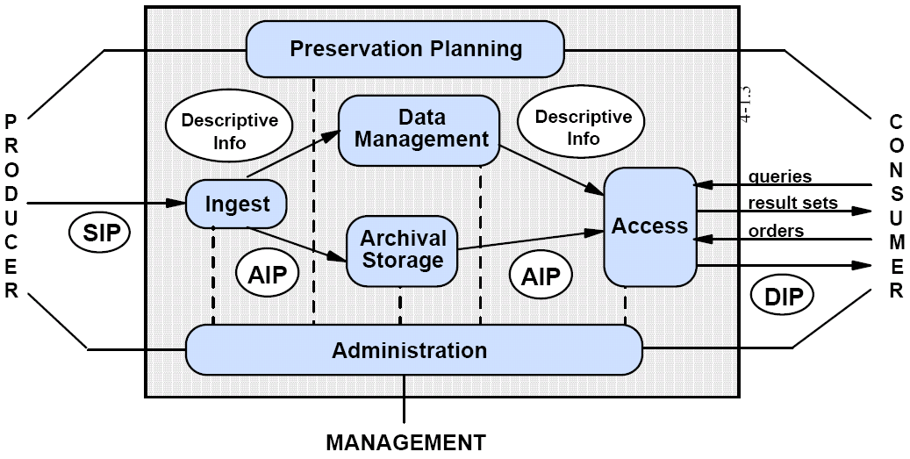
What are the building blocks?
  ISO16363 (OCLC, Nestor, TRAC)
    standard criteria for repositories
  Open Archival Information System (OAIS)
    used as the basis for terminology and structure of the criteria catalogue
  Data Seal of Approval (DSA)
    for the metric
  WMO Information System
    for some aspects of technical organisation
  WDS specific criteria
    should support the ICSU strategy
Notes:
OCLC: Online Computer Library Center
Metric: distinguishment between minimum requirements and recommendations
Each of the basic and specific requirements can be rated

Slide 10
Some principles for the derivation of criteria
Criteria are formulated at a very abstract level
Still, not all relevant aspects can be formalized properly – comprehensible language needed
Expertise of reviewers is needed for deeper understanding of services supplied
Questionnaire with certification criteria should allow for revisions
Certification should be a feasible and a learning exercise for applicants as well as for reviewers
Should also be usable for periodic assessment of WDS members

Slide 11
Membership types
Regular
  Nodes that deal directly with data curation & data analysis services
Network
  groups of regular members and serve as coordinating agents
Partner
  Giving support to regular or network members
Associated
  interested in the endeavor, and participate in the discussion
SERVICES
multi-
disciplinary
global
regional
disciplinary
ARCHIVES

Slide 12
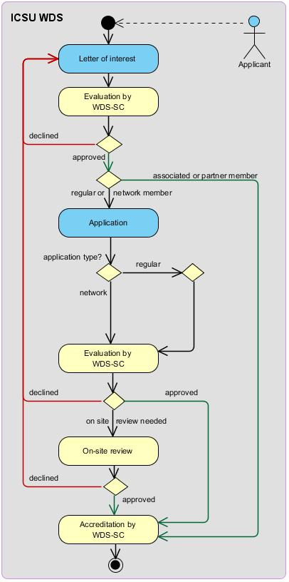
Certification procedure
Reviewers board - certification agency (CA)
Organization of the accreditation, certification, and monitoring process
Regular, partner & associate members

Slide 13
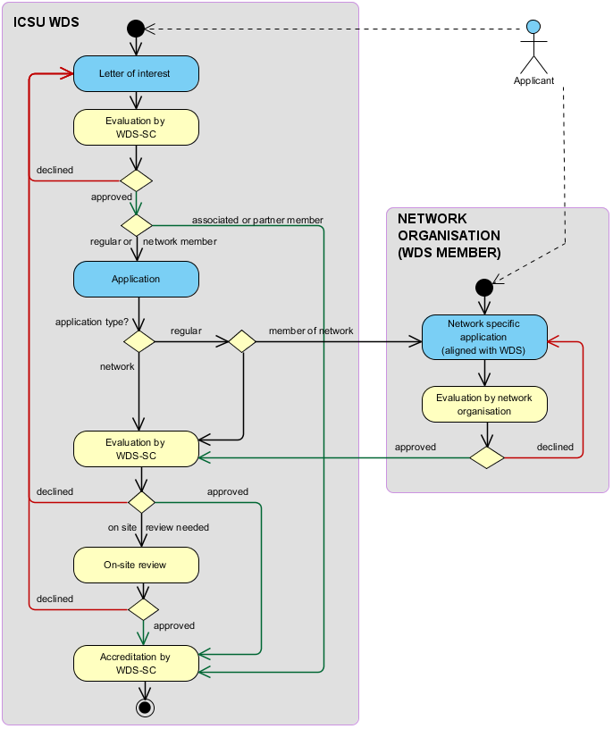
Certification procedure
Network
members

Slide 14
Current state
Started in 2011
164 expressions of interest (EoI)
86 members
  56 regular members
  10 network members,
  3 partner members
  17 associate members
About 60% successful applications

Slide 15
Current state
Times needed for the certification process
  on the applicants side: less than a week
  on the reviewers side: 1 day
Reviewers board needs to be extended
Applicants need staff with expertise on different levels (organisation, data management, technical)
Feedback left by applicants and outside groups initiated a revision of the catalogue of criteria
Overall perception: many facilities have not reached their potential

