Slide 1

EUDAT-B2FIND
This work is licensed under the Creative Commons CC-BY 4.0 licence.
Attribution: EUDAT – www.eudat.eu
Version 3
May 2016

Slide 2


EUDAT: A truly pan-European Infrastructure
EUDAT offers common data services to both research communities and individuals through a network of 35 European organisations.
EUDAT wants to enable European researchers from any discipline to preserve, find, access, and process data in a trusted environment, as part of a Collaborative Data Infrastructure.
European infrastructures
Technology Providers
Research Communities
Notes:
B2FIND is one of the services offered by EUDAT, the pan-European Infrastructure. EUDAT offers common data services, supporting multiple research communities as well as individuals, through a geographically distributed resilient network connecting general purpose data centres and community-specific data repositories. EUDAT wants to enable European researchers from any discipline to preserve, find, access, and process data in a trusted environment, as part of a Collaborative Data Infrastructure.

Slide 3






























Community-Driven Solutions
EUDAT services (the so called B2 Service Suite) are designed, built and implemented based on user community requirements.
ENVIRONMENTAL SCIENCES
BIOMEDICAL & MEDICAL SCIENCES
MATERIALS & ANALYTICAL FACILITIES
MAPPER
SOCIAL SCIENCES & HUMANITIES
PHYSICAL SCIENCES
& ENGINEERING
Notes:
The services offered by EUDAT, the so called B2 service suite, are community driven as they are designed, built and implemented on user community requirements. This means that the communities have direct influence on these services and contribute to the development of them. Services are defined not just by researchers in the EUDAT collaboration, but we also elicit requirements from other communities to ensure our services are as generic and applicable to as wide an audience as possible.

Slide 4

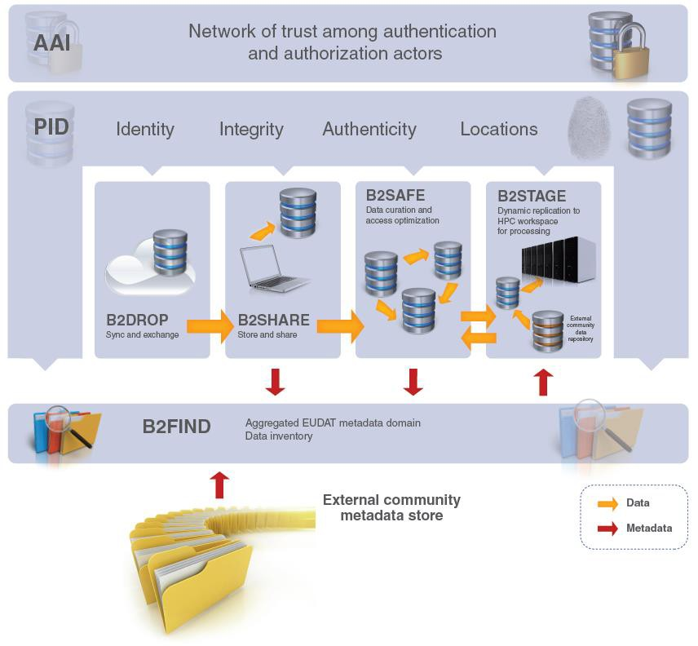






The EUDAT Service Suite
Notes:
The EUDAT service suite represents an integrated set of services to support researchers manage their data through the data lifecycle. As your data moves through the data lifecycle, EUDAT services will help you manage your data using best practices followed by some of the world’s largest communities. The services available cover a wide range of functionalities. B2SAFE enables communities to replicate and safely store their large-scale data on robust, reliable datacentres operated by the EUDAT partners. B2HANDLE registers all data on EUDAT with a unique identifier which can be globally resolved on the standard handle system. B2STAGE allows users to efficiently move their data between EUDAT sites and compute facilities ; one example of using B2STAGE is so as to move data to a compute cluster, then deposit the results of the computation back into EUDAT. B2DROP allows EUDAT users to easily exchange working data, while B2SHARE allows to deposit and disseminate final research data at a smaller scale, but easier than with B2SAFE. B2ACCESS is the simple and secure authorisation and authentication platform of EUDAT, which allows single sign-on on EUDAT’s public and internal service. At the moment B2SHARE and the Site and Service Registry have adopted B2ACCESS, with more services integrating it rapidly. B2FIND, the topic of this talk, allows searches on the EUDAT metadata and is one of the key enablers of multi-disciplinary research on EUDAT.

Slide 5

What is B2FIND?
B2FIND
is the metadata service of EUDAT
is based on a comprehensive joint metadata catalogue of research data collections stored in EUDAT data centres and other repositories
provides a powerful and user-friendly discovery service on metadata covering a wide range of research communities
b2find.eudat.eu

Slide 6
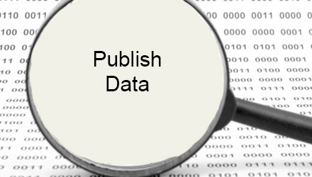
Why should you publish your metadata in EUDAT B2FIND ?
Make your research data
  search-, view-, and accessible to the public
  popular in a cross-disciplinary and international scope
Improve interoperability and re-use of data
Allow feedback and annotations on your research output
Benefit from validation, quality assurance and added value of your meta data

Slide 7

Data from a huge selection of subjects
B2FIND has a truly cross-community approach
Metadata are harvested from a wide range of research areas
  From Climate Research to Social Sciences
  From Biodiversity to Linguistics
  From Archaeology to Seismology
This necessitates the transformation and homogenisation of the diverse metadata to achieve the usage of a common vocabulary for the whole catalogue

Slide 8
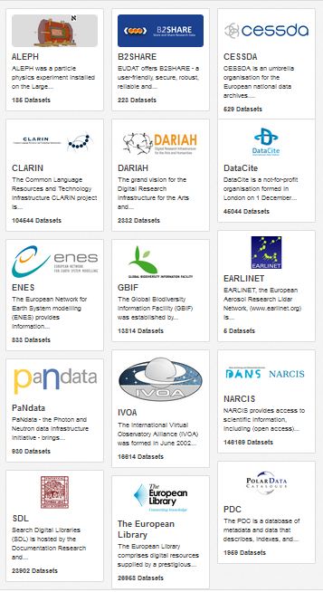
B2FIND communities
B2FIND initially indexed metada
  harvested from EUDAT core communities (as ENES and CLARIN) and
  stored through the EUDAT service as B2SHARE
EUDAT extended and is extending the service to other external and reliable data and metadata providers
The list of currently integrated communities is available at http://b2find.eudat.eu/group/

Slide 9
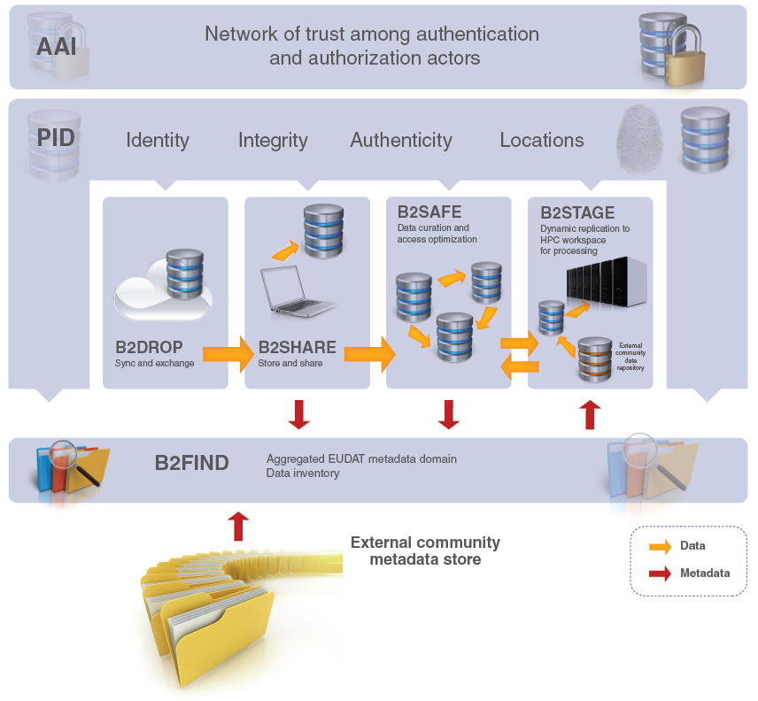
Where is B2FIND in the EUDAT suite?
B2FIND
stores metadata through other EUDAT services such as B2SHARE to provide access to data objects within the EUDAT CDI
is used in inter-service use cases, e.g. to identify links to data collections, which will be transferred to HPC platforms through B2STAGE

Slide 10
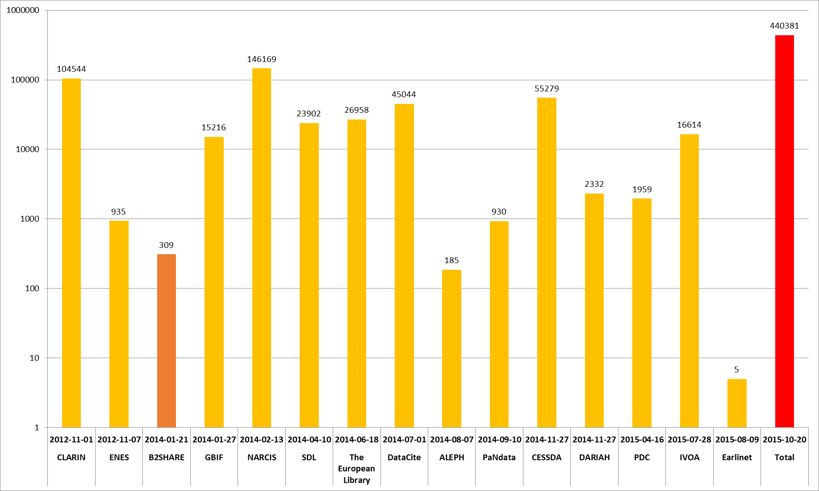
B2FIND MD Catalogue
Ingestion status
> 400000 records
15 communities
  (14 external + B2SHARE)

Slide 11

The Metadata (MD) Ingestion Roadmap
How get your metadata published in EUDAT B2FIND ?
MD Generation
Data
Provider
on
Community site
MD Repository and Provider
MD Harvesting
Service Provider
on
EUDAT site
MD Mapping and Validation
MD Uploading and Indexer

Slide 12

Metadata Generation
has to be done in close proximity to the data production
should be part of the data management plan
must be checked and possibly enhanced to aim in a comprehensive data description
benefits from quality control at an early stage
should be based on common ontologies and metadata formats

Slide 13
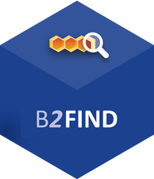

Metadata repository and provider
To be set up on community site to allow harvesting
The standard protocol OAI-PMH is to be used as a preference
But as well other data transfer techniques are supported, if necessary
EUDAT offers support for the installation

Slide 14
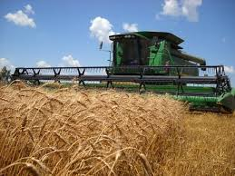
MD Harvesting
B2FIND harvests regular and incrementally from OAI endpoints
Initially the B2FIND team will do a first harvest try on a given and accessible OAI endpoint
The frequency and the harvested sets have to be negotiated with the community

Slide 15
MD Schemas (excerpt)
Name | Specification | Description | Used by B2FIND to harvest from Communities
Dublincore | Specification: See at http://dublincore.org/specifications/ and in the following standard documents: IETF RFC 5013 ISO Standard 15836-2009 NISO Standard Z39.85 | The Dublin Core Schema is a small set of vocabulary terms that can be used to describe web resources (video, images, web pages, etc.), as well as physical resources such as books or CDs, and objects like artworks. The full set of Dublin Core metadata terms can be found on the Dublin Core Metadata Initiative (DCMI) website, see left. | DataCite NARCIS PanData TheEuropeanLibrary SDL DARIAH IVOA PDC
ISO 19115 | http://www.iso.org/iso/home/store/catalogue_tc/catalogue_detail.htm?csnumber=53798 | ISO 19115-1:2014 defines the schema required for describing geographic information and services by means of metadata. It provides information about the identification, the extent, the quality, the spatial and temporal aspects, the content, the spatial reference, the portrayal, distribution, and other properties of digital geographic data and services. | ENES Earlinet
MarcXML | http://www.loc.gov/standards/marcxml/ | MARC (MAchine-Readable Cataloging) standards are a set of digital formats for the description of items catalogued by libraries, such as books. It was developed by Henriette Avram at the US Library of Congress during the 1960s to create records that can be used by computers, and to share those records among libraries. | B2SHARE ALEPH
CMDI | http://www.clarin.eu/content/component-metadata | CMDI (Component MetaData Infrastructure) was initiated by CLARIN to provide a framework to describe and reuse metadata blueprints. Description building blocks (“components”, which include field definitions) can be grouped into a ready-made description format (a “profile”). | CLARIN
DDI | http://www.ddialliance.org | DDI (Data Documentation Initiative) is an effort to create an international standard for describing data from the social, behavioural, and economic sciences. | CESSDA

Slide 16
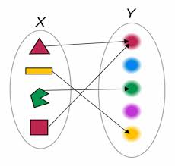
Metadata Mapping
The community specific ‘raw’ metadata are processed and homogenized to B2FIND schema in the following steps
Parse harvested XML records and select entries by MD format specific rules
Analyse and parse values and map onto key-value pairs (JSON) vs. given controlled vocabularies
Use (community specific) ontologies and thesauri
This results in JSON records satisfying the specification of the B2FIND schema

Slide 17
B2FIND MD Schema (excerpt)
Metadata Type | B2FIND Field name | Semantic definition | Allowed values / CV | Level of Obligation | Occurrence
General information | Title | A name or title a resource is known | Free text | Mandatory | 1
 | Description | All additional textual information | CKAN2.0 only supports plain text | Recommended | 1
Data Access | Source | URI of the related resource | Valid URL | Mandatory | 1
 | PID |  | Persistent Identifier | Recommended | 1
 | DOI |  | Digital Object Identifier | Recommended | 1
Provenance data | Creator | List of the main researchers involved in producing the data | Text field (‘;’ list of citied names, separately indexed) | Recommended | 0-n
 | Discipline | Field of research | Text field (mapped and validated against CV) | Recommended | 0-n
 | Publisher | The person or institution publishes the data
 | PublicationYear | The year when the data was or will be made public | YYYY | Recommended | 1
Data coverage | TemporalCoverage | Relation to or Coverage of a specific interval in time. | Interval between two UTC Date Timestamps : [ BeginDateTime , EndDateTime ] | Optional | 1
 | SpatialCoverage | The spatial limits of a place. | A spatial point or box specification, CKAN representation : spatial={"type":"Polygon","coordinates":[[[minlat,minlon…]]} | Optional | 1

Slide 18
B2FIND closed vocab
for ‚Discipline‘
Mapping of the Facet ‘Discipline’
Humanities
1.1 History
1.2 Linguistics
1.3 Literature
1.4 Arts
1.4.1 Performing arts
…
1.5 Philosophy
1.6 Religion
Social sciences
2.1 Anthropology
2.2 Archaeology
….
2.7 Geography
Natural sciences
3.1 Biology
3.2 Chemistry
3.3 Earth sciences
3.4 Physics
…
Formal sciences
4.1 Mathematics
4.2 Computer sciences
5. Professions
5.1 Agriculture
….
5.6 Engineering
5.6.1 Chemical Eng.
5.12 Library studies
5.13 Medicine
Community
Filter by Subsets
Map by specific rules
Assigned Discipline
CLARIN
Linguistics
e.g. OAI set= ‚Artworks of …‘
Arts
TheEuropean Library
dc:subject=??
=“*World War*”
History
GBIF
Biology
ENES
Earth Sciences
Elementary Particle Physics
ALEPH
Chemistry
PanData
Natural Sciences
Physics

Slide 19

Metadata Validation
Examine each field for coverage, consistency and validity
Semantic validation by using
  controlled vocabularies
  standard libraries, e.g. iso639 library for ‘Language’
‘Technical’ checks, e.g.:
  Conformance of date-time fields with UTC format
  Test spatial coverage by geonames.org and consistency of lat/lon coordinates
  online checks of URL’s to the data objects (‘Source’, ‘PID’ and ‘DOI’)

Slide 20
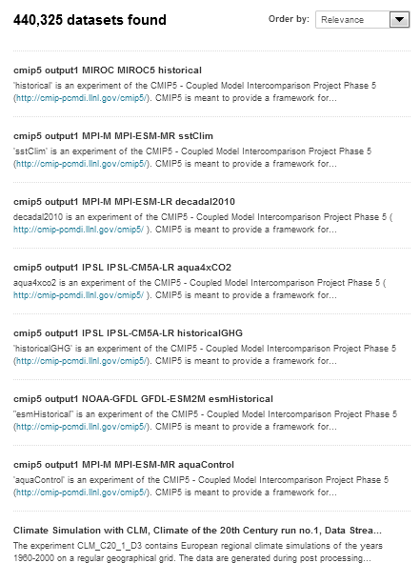
Metadata Uploading
Finally the checked and mapped JSON records are uploaded as datasets to the MD catalogue, which is based on the open source code CKAN.
CKAN
provides a rich RESTful JSON API and
uses SOLR for dataset indexing
That enables users to query and search in the catalogue

Slide 21
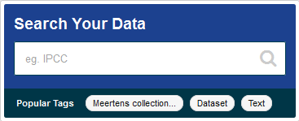
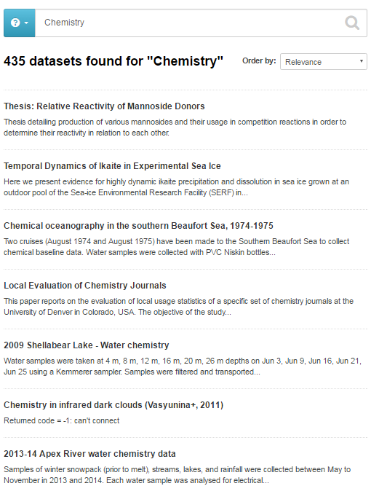
B2FIND Discovery Portal
Search and browse datasets
Search and browse all data sets via Keyword searches
Results displayed in easy to read format and listed in order of relevance to your search

Slide 22
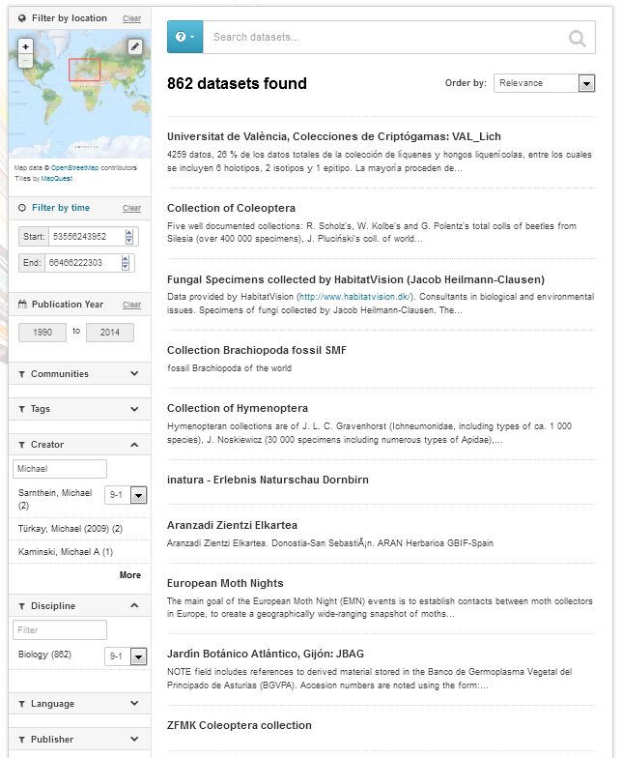
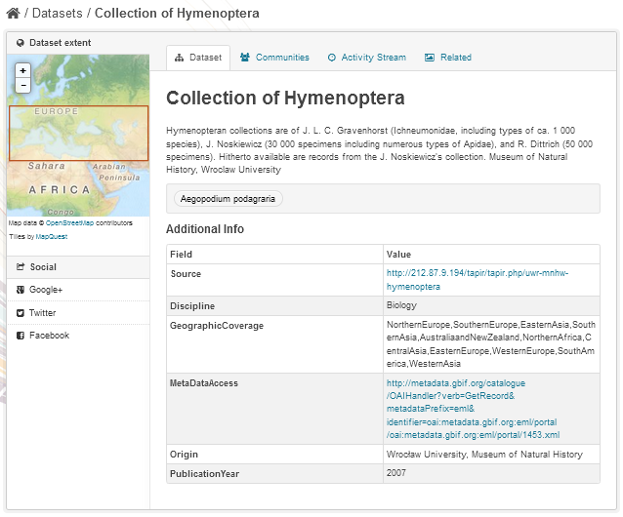
B2FIND Discovery Portal
Facetted Search
B2FIND provides ‘faceted’ search for
Free text
Location
Temporal coverage
Publication year
Textual facets:
  Communities
  Tags
  Creator
  Discipline
  Publisher etc.
Dataset view provides
Display of metadata
Geo spatial extent
Title and abstract
Associated tags
Table of field-value pairs
Links to data resources

Slide 23

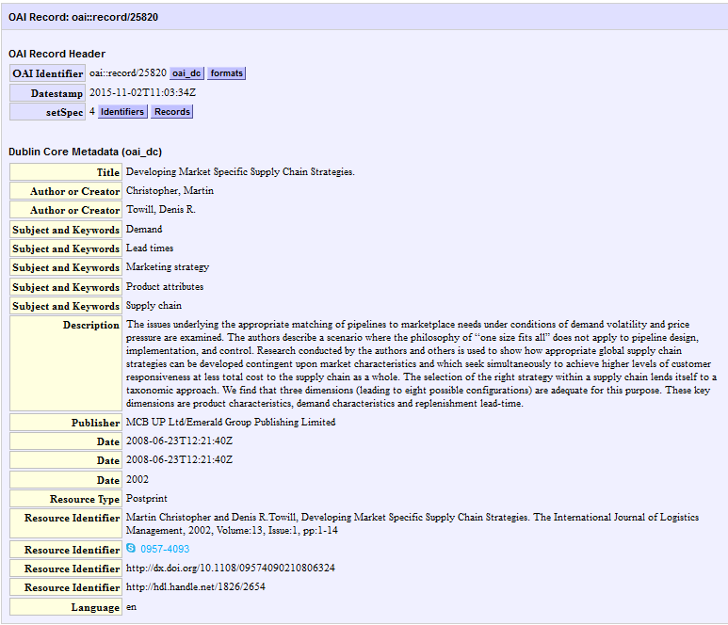
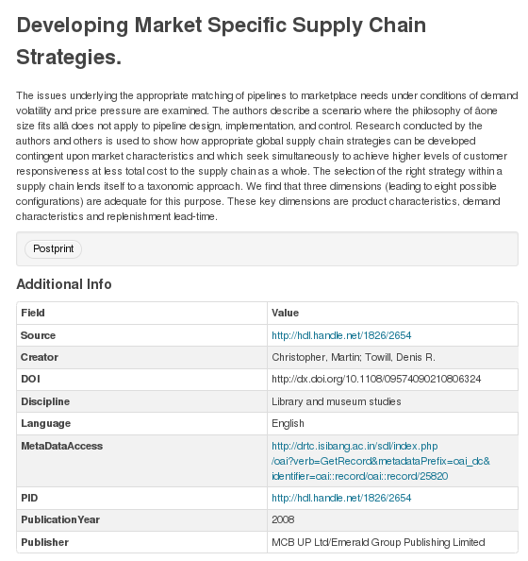
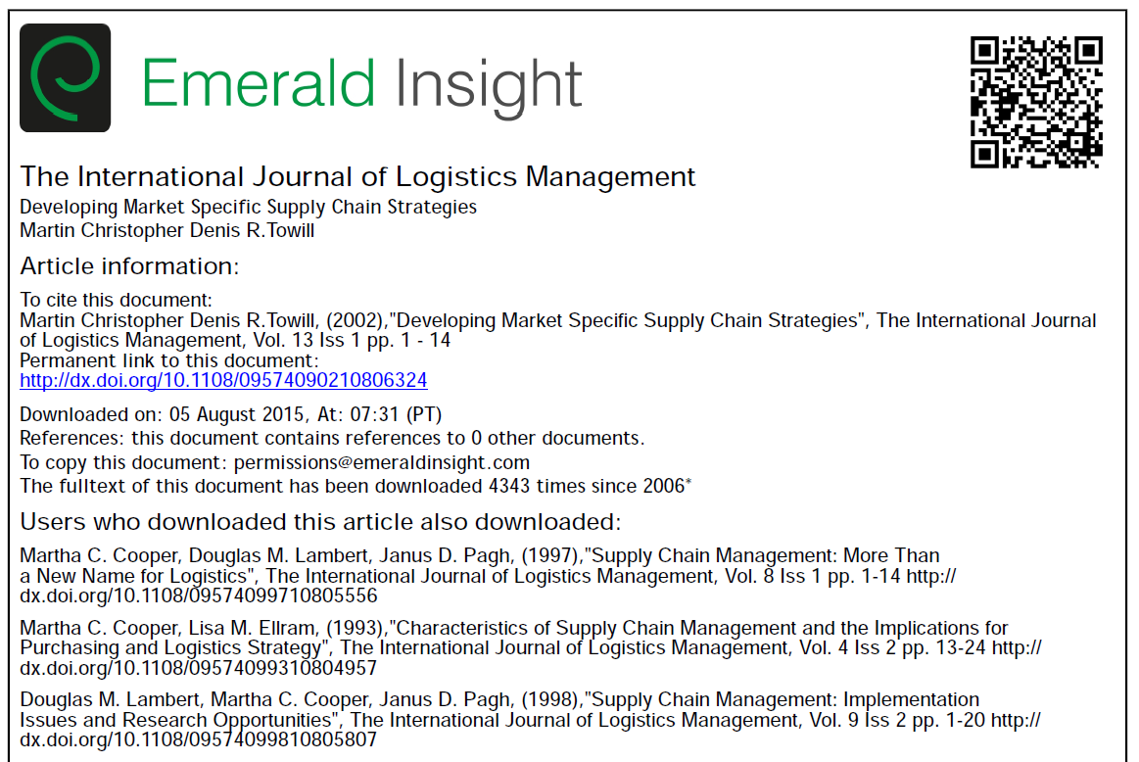
Data Access
Resolved link to
data object
View of originally
harvested metadata record
Link to (another landing page of)
the data object

Slide 24
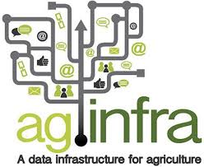
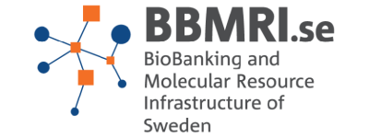







Upcoming Improvements
Address more communities and aggregators
Improve functionality of portal
  Include annotating function
  Taxonomies
Customisation
  Templates and extendable facets for specific community needs
  Usage of vocabularies and ontologies
  Individually adapted user interfaces
Improve Quality of the metadata by
  enhancement of the mapping and validation
  Continued exchange and feedback between the communities and the B2FIND team

Slide 25
Thank you !
For more info: http://eudat.eu/services/b2find
User documentation: https://eudat.eu/services/userdoc/b2find-integration
Notes:
For more info please visit: http://eudat.eu/services/b2find . The User documentation can be found at : https://eudat.eu/services/userdoc/b2find-integration

