Slide 1
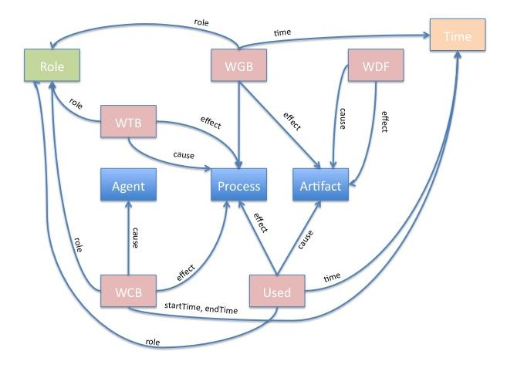

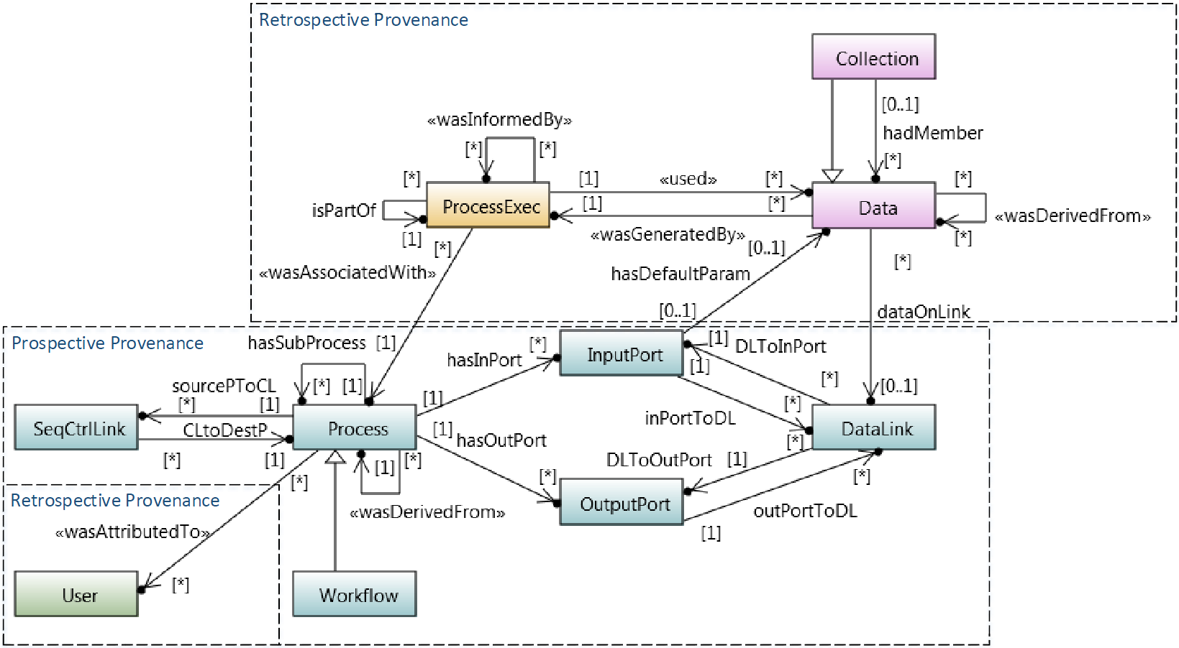
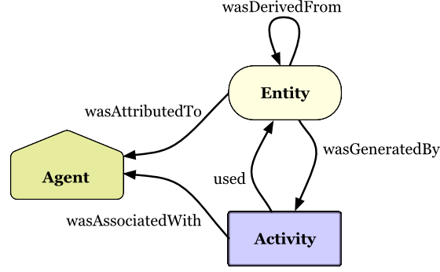
Enabling scientific data reproducibility with automated provenance management in scientific data repository
Ajinkya Prabhune

Slide 2
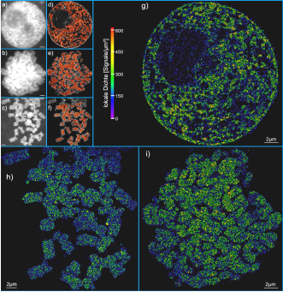
Introduction: Nanoscopy
Scientific perspective
Investigation on “aggressive B-cell lymphomas”
Novel imaging method capable of capturing images at nanometer resolution
Microscopy technique – Spectral Precision Distance Microscopy (SPDM)
Custom developed high-resolution microscopes located at Uni. Heidelberg and Uni. Mainz
Notes:
Currently new algorithms are being developed (new workflows)

Slide 3




Challenges
  Managing the lifecycle of large raw-dataset in the range of 150-200 TB
  Community developed data-processing algorithms that are constantly updated
  Scientific workflows that are continuously modified for improving the scientific results
  Allow repeatability and reproducibility of scientific results
  Sharing the scientific workflows and its associated provenance
Raw
Intermediate
Result
Result
Images
Analysed
Images
Fig.1 Basic representation of a nanoscopy workflow

Slide 4
Introduction: Scientific workflow
What is a scientific workflow ?
  A set of systematically organized processing steps used to accomplish a scientific task.
What is a workflow language ?
  A language that allows to describe the processing tasks and the execution order. Example BPEL4WS (Apache ODE), SCUFL(Taverna), MoML(Kepler).
What is a workflow management system (WFMS) or workflow engine ?
  A software that coordinates the processing steps defined in the workflow.
Why are workflows and workflow management system important ?
  Automate the complex tasks for a scientific experiment.
  Easy repetition of the experiments.

Slide 5
Goals
Goal 1: Identify a W3C standard provenance model, capable of modeling both the workflow and its associated provenance.
Goal 2: Automatically generate the provenance trace for each execution of a scientific workflow.
Goal 3: Develop the provenance management framework for NORDR and integrate into KIT Data Manager.

Slide 6
Goal 1 : Identify a comprehensive and a standard provenance model.
Why ProvONE? → ProvONE provenance model is a W3C standard ^{[2]}
Easy to integrate existing metadata vocabulary for modeling the provenance contextual information (for example Dublin Core terms)

Slide 7
ProvONE control classes and associations
Workflow – A Workflow is a distinguished Process that represents a complete scientific workflow.
Process – The Process represents the computational task. Attributes such as process-name, process-id, process-description can be associated with a Process.
ProcessExec
Retrospective
Prospective
wasAssociatedWith
hasInPort
sourcePToCL
Process
ClToDestP
hasOutPort

Slide 8
ProvONE control classes and associations
SeqCtrlLink – A SeqCtrlLink specifies the control link between two Processes. A destination Process that is linked to a source Process can only begin its execution once the source Process is finished.
InputPort – One or more InputPort(s) can be associated with a Process. An InputPort allows to pass input data to a process. For example, the input parameter(s) for a process.
Process-A
sourcePToCL
SeqCtrlLink
ClToDestP
Process-B
hasInPort
Process-A
InputPort

Slide 9
ProvONE control classes and associations
OutputPort – One or more OutputPort(s) can be associated with a Process. An OutputPort allows to identify the outcome of a process. For example, output data type, output parameters, output description.
hasOutPort
Process-A
OutputPort

Slide 10
ProvONE control classes and associations
DataLink – A DataLink enables data to be sent between two Processes. For example, Process B can consume the output of Process A via the DataLink
Data
Retrospective
Prospective
Process-A
dataOnLink
Process-B
hasOutPort
hasOutPort
outPortToDL
DLToInPort
OutputPort
DataLink
InputPort

Slide 11
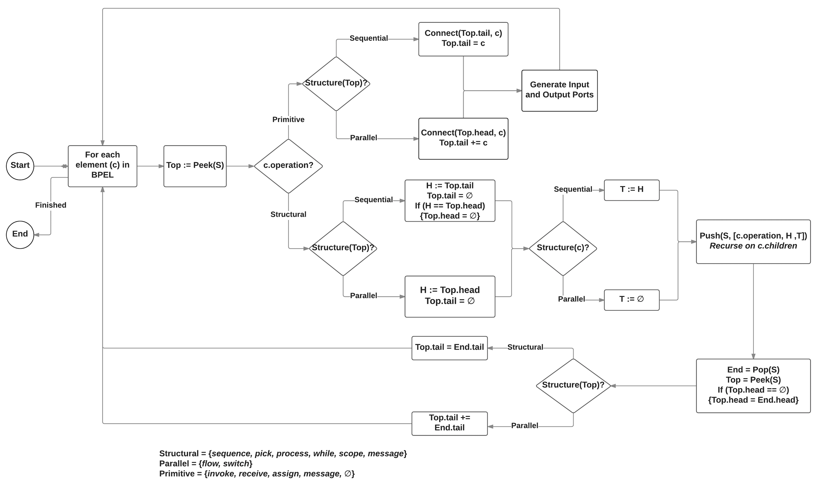
Goal 2 : Automatically generate the ProvONE provenance trace.
Prov2ONE graph drawing algorithm for automatically generating the ProvONE provenance graph from specification (BPEL4WS) → USENIX TaPP/IPAW

Slide 12
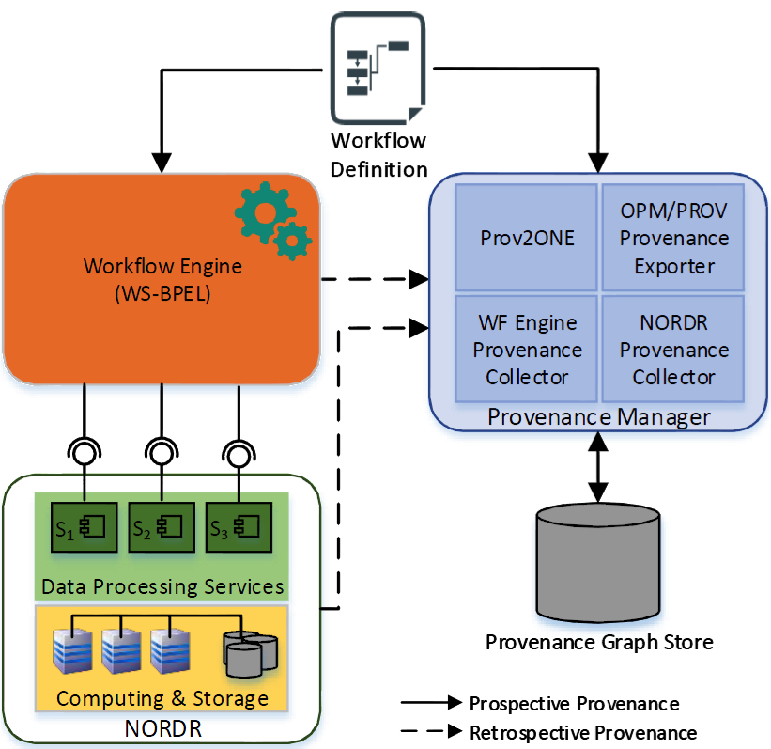
Goal 3 : Provenance management framework for scientific data repository.
Prov2ONE graph drawing algorithm implementation for automatically generating the ProvONE prospective provenance graph
Services for collecting retrospective provenance from NORDR and workflow engine
Semantic mapping for enabling interoperability between OPM/PROV and ProvONE
Dedicated graph database for storing the ProvONE provenance graphs (ArangoDB)
Provenance challenge recommended queries implemented for querying the provenance store

Slide 13
Semantic mapping between ProvONE and
Prov-DM
wasInformedBy
wasDerivedFrom
used
ProcessExec
Data
wasGeneratedBy
wasAssociatedWith
wasDerivedFrom
Entity
wasAttributedTo
Process
used
wasGeneratedBy
wasAttributedTo
Agent
wasAssociatedWith
Activity
User
{software,person,organization}
wasInformedBy

Slide 14
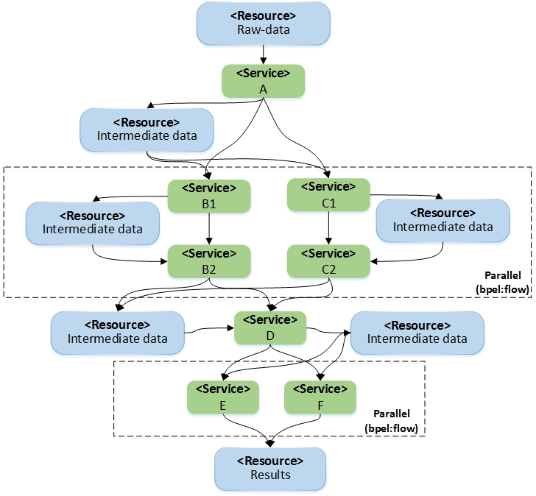
Example nanoscopy scientific workflow
Defined in BPEL4WS workflow specification
Apache ODE workflow execution engine
Data processing services ( community specific algorithms) implemented in NORDR
Complex workflow composition comprising
  sequential processes
  parallel processes
  resource sharing

Slide 15

Example nanoscopy scientific workflow
Defined in BPEL4WS workflow specification
Apache ODE workflow execution engine
Data processing algorithm services implemented in NORDR
Complex workflow composition comprising
  sequential processes
  parallel processes
  resource sharing

Slide 16
Conclusion
Single W3C standard provenance model for handling both prospective as well as retrospective provenance
Automated provenance modelling of any workflow defined in BPEL4WS using Prov2ONE algorithm.
Storing provenance in dedicated graph database for easy provenance querying
  IPAW provenance challenge queries implemented for ProvONE
  Enabling scientific data reproducibility
  Capture scientific workflow evolution
Provenance management framework for scientific data repositories (NORDR)
On going work
Prov2ONE extension for exporting OPM/PROV retrospective provenance from ProvONE
Enabling ProvONE provenance graphs visualization by integration D3.js
Notes:
repeatability
The closeness of agreement between independent results obtained with the same method on identical test material, under the same conditions (same operator, same apparatus, same laboratory and after short intervals of time).
reproducibility
The closeness of agreement between independent results obtained with the same method on identical test material but under different conditions (different operators, different apparatus, different laboratories and/or after different intervals of time).

Slide 17
Bibliography
[1] Prabhune, Ajinkya, et al. "An Optimized Generic Client Service API for Managing Large Datasets within a Data Repository." Big Data Computing Service and Applications (BigDataService), 2015 IEEE First International Conference on. IEEE, 2015.
[2] Online :http://vcvcomputing.com/provone/provone.html

