Slide 1

Organisation von Daten in VR
Peter Wittenburg
Max Planck Compute & Data Facility
Dir. RDA Europe / TAB RDA Global
Co-Chair of Data Foundation & Terminology Group
Co-Chair of Data Fabric Group

Slide 2

Overview
some trends
data and heterogeneity
some modeling
Global Digital Object Cloud
remaining aspects

Slide 3
Dynamic data world
Sciences/Societies are Changing & Data is the Oil.
Are in an Exploratory Phase & Let 1000 Flowers Blossom.
Consolidation Phase is needed & Reduction of solution Space.
Can Harmonization of Data Organization Help?
What do we mean with Data Organisation?

Slide 4


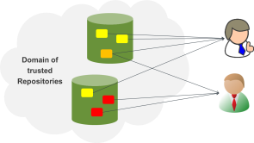
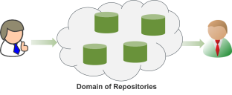
Basic aspects when talking about data
Volume, Variety, Velocity, etc.
From simple to complex structures
(it‘s the multiple relations)
Re-use/re-combination of data in
different contexts by unknown
experts
Trust and Acknowledgement
Problem
Need to estimate usage and requirements
in 10 years! Building infrastructures takes time! Imagine agents
(humans/machines) using profiles to find and correlate useful data!

Slide 5
Why is it so hard to use data?
easy to locate ONE instance of a file in a directory path or a cloud object
but ...
  where are the copies?
  how to interpret content?
  where is the metadata? Is it machine readable? etc.
  where to find its PID for referencing if it has one?
  where to find its access permissions?
  where to find its relations (DO and content level)?
  how to extract information from scripts?
  etc.
Nothing has been agreed upon, everyone does it differently!
All this we could call Dynamic Knowledge Layer.

Slide 6
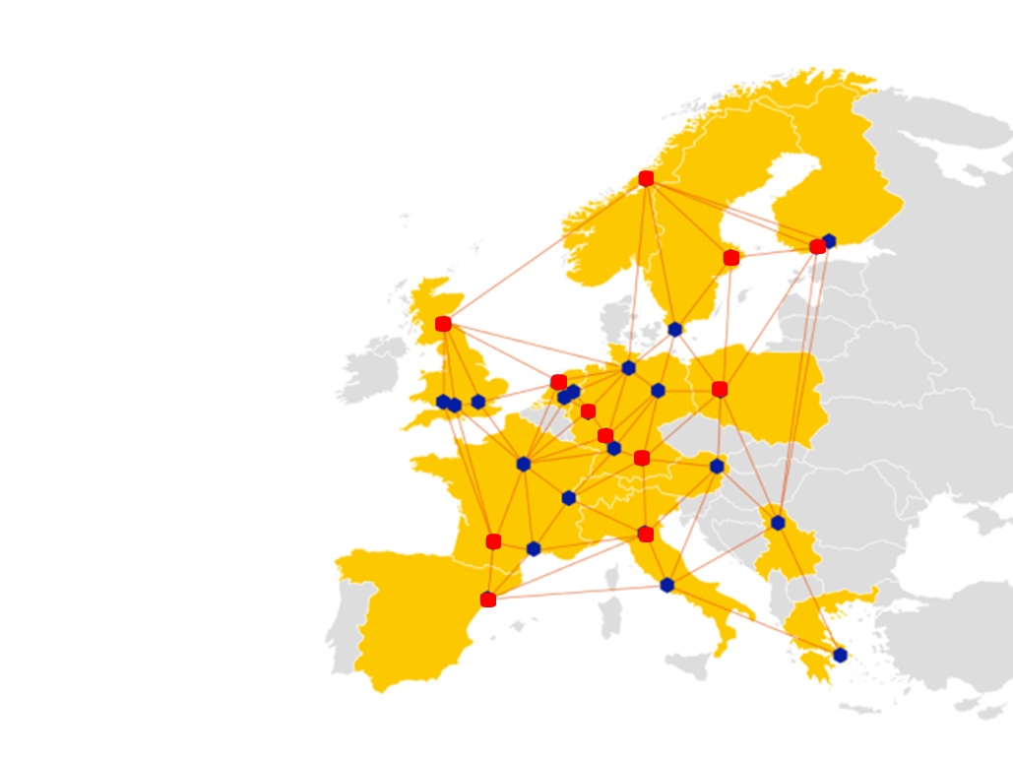
Even worse in federations
Replicating data on physical level (files, clouds, databases) is doable
But what about all sorts of metadata (keywords, annotations, relations, rights, etc.)
Too complicated due to a lack of agreements

Slide 7
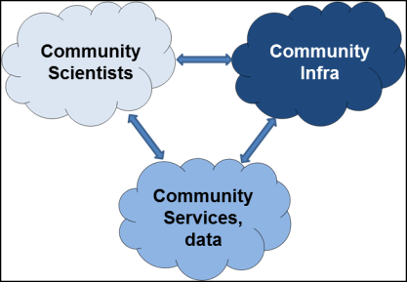
There are so many good ideas
Organizations
Countries Disciplines
eInfrastructures
(starting offering services)
Industry
(starting proprietary
services)
ESFRI: much awareness raising in Europe, lots of young people trained, much testing of variety of approaches, identifying gaps in service landscape, etc.
eInfra: starting to change towards service orientation, need more stable services, need clarification of costs
Solution Space is huge – costs are huge!
Hampering investments!

Slide 8
Pressure from scientists
~120 Interviews/Interactions
3 Workshops with Leading Scientists (RDA EU, US)
there are positive project examples etc. but ...
  DM and DP not efficient and too expensive due to bad data organisations
  (Biologist for 75% of his time data manager)
  federating data incl. virtual information is much too expensive
pressure towards DI research is high, but only some departments are fit for the challenges
Senior Researchers: can’t continue like this!
  need to move towards proper data organisation and automated workflows is evident
  but changes now are risky:
    lack of trained experts
    lack of guidelines and support towards recommended solutions
    huge solutions space makes investments risky

Slide 9
Also pressure from funders
G8/FAIR/FORCE11/etc. – data should be
  searchable/findable -> create useful/rich metadata
  accessible -> deposit in trusted repository and use PIDs
  interpretable -> create metadata, register schema and semantics
  re-usable -> provide contextual metadata
  persistent -> provide persistent repositories
Need urgent actions to improve – but how?

Slide 10
What can we do????
Data Generators
Data Users
Researcher
defined
Project-Infrastructures
(NoMaD, DOBES, etc.)
GLUE?
Domain-Infrastructures
(DARIAH, CLARIN, ELIXIR, etc.)
e-Infrastructures
(EUDAT, OpenAIRE, EGI, etc.)
IT
defined
Agreed Data Organisation Principles are one key for interoperability.

Slide 11
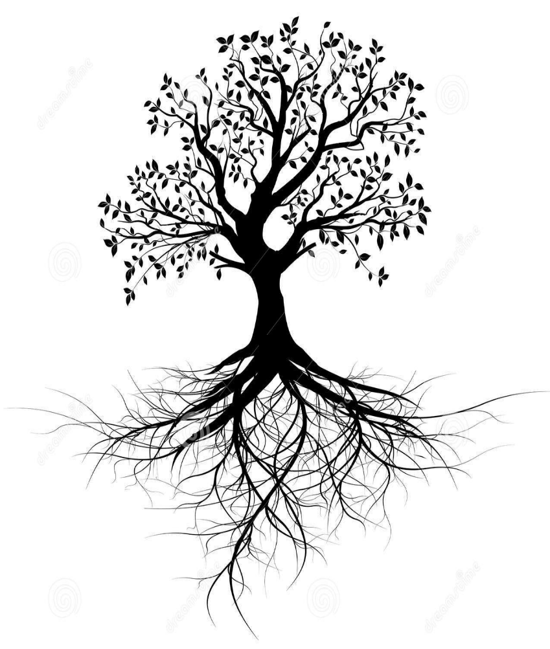

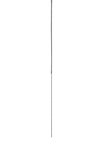

Task: Identifying COre COmponents
Scientific
Analytics
Leave flexibility
Even more opportunities
Reduce heterogeneity & costs Make solutions stronger Achieve sustainability
Management Curation Access
Leave flexibility
Even more opportunities
PID, AAI, MD, WF, Registries, Repositories, meta-semantics, etc.
Scientific
Creation
Consolidation Phase is needed to Reduce the solution space

Slide 12
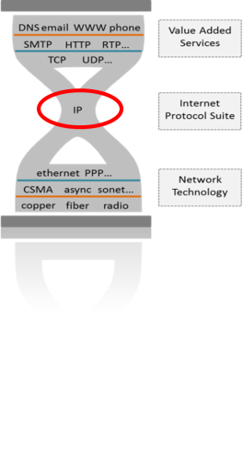
Learn from Internet?
Finding the right level
Agreeing on one standard as a community process
ISO-OSI
IBMnet
Usenet
DECnet
TCP/IP
X25
Ethernet
MPSNet
many
others
TCP/IP
Opened new area
New industries
New businesses
New jobs
let‘s call it a
Core Component
X*10 suggestions
Hampering openness,
innovation, investments,
collaboration
Little job creation

Slide 13
Questions
Do you agree with challenges and trends?
Do you agree with data principles?
Is it the right question to look at all the different initiatives or can we focus just on our own?

Slide 14
Overview
some trends
data and heterogeneity
some modeling
Global Digital Object Cloud
remaining aspects

Slide 15
Does heterogeneity matter?
So many different file-types of DO (no proper classification)
  time series data
  layers of derived data
  text data (whatever structure)
  assertions (triples)
  graphs (whatever structure)
  „metadata“
  programs (some could see them as data)
  databases (as containers)
  spreadsheets
  etc.
some containers use proprietary formats, i.e. reading them is technology dependent

Slide 16
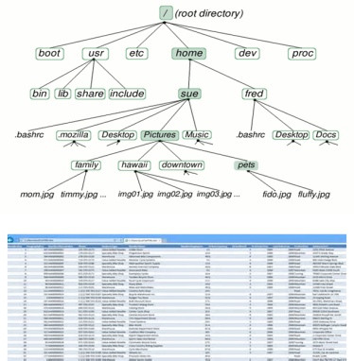
Old methods don‘t work any longer
too many files
context can‘t be stored in names
relations can‘t be stored in directory paths
spreadsheets will be forgotton after x months
spreadsheet content adhoc
take care: databases encapsulate and many don‘t have an XML export
etc.

Slide 17
Questions
Who is using spreadsheets and defining structure?
Who is using databases as primary store and has an external schema?
Who is using file systems and has difficulties?

Slide 18
Overview
some trends
data and heterogeneity
some modeling
Global Digital Object Cloud
remaining aspects

Slide 19
What is data modelling in CS sense
Widely influenced by the database community for many years
Conceptual Schema
Entities, Attributes,
Relationships, Integrity Rules
Logical Schema
Tables, Colums,
OO classes, XLS, etc.
Physical Schema
Storage, Channels,
parallelisation, etc.
Nicely harmonized for rDBMS and can express a lot etc.
But db formats often proprietary.
Often databases are just used as containers for fast operation.

Slide 20
Files are our usual means
External Properties:
PID
size
owner
location
checksum
type
rights
relations
etc.
Internal Properties:
syntax/format
semantics
encoding
interpretation
processing
curation
management
finding
accessing
curation
nothing principally wrong with files
but where to store all property information?
some do within the files (headers) but ...

Slide 21
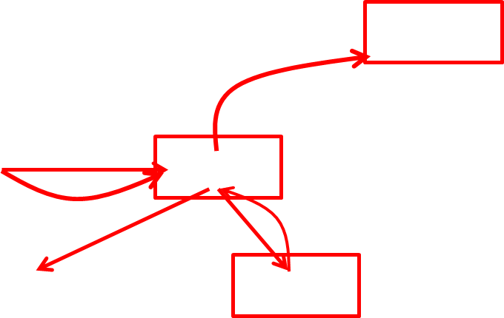
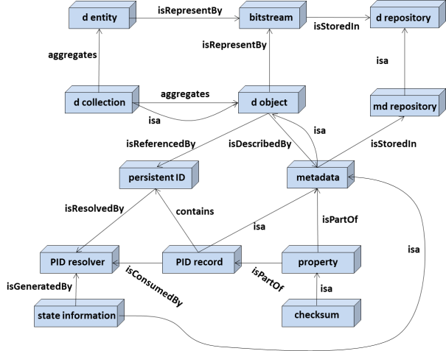
Data Organisation following DFT Model
need a method to identify digital content independent of its type (realization?), etc.
otherwise no reference possible which would be fatal
granularity is a domain decision
Robert Kahn
Janis Kallinikos
Fedora Commons
DOI Documents
etc.
basic messages are congruent with FAIR principles

Slide 22
Nature of (virtual) collections
collections
collection X
PID
Metadata
PIDs
collection has
a PID
some metadata
a huge amount of PIDs pointing to collections and metadata descriptions (and/or data PIDs)
PIDs
metadata
descriptions

Slide 23
Fair Principles
To be Findable:
F1. (meta)data are assigned a globally unique and eternally persistent identifier.
F2. data are described with rich metadata.
F3. (meta)data are registered or indexed in a searchable resource.
F4. metadata specify the data identifier.
To be Accessible:
A1 (meta)data are retrievable by their identifier using a standardized communications
protocol.
A1.1 the protocol is open, free, and universally implementable.
A1.2 the protocol allows for an authentication and authorization procedure, where necessary.
A2 metadata are accessible, even when the data are no longer available.
To be Interoperable:
I1. (meta)data use a formal, accessible, shared, and broadly applicable language for
knowledge representation.
I2. (meta)data use vocabularies that follow FAIR principles.
I3. (meta)data include qualified references to other (meta)data.
To be Re-usable:
R1. meta(data) have a plurality of accurate and relevant attributes.
R1.1. (meta)data are released with a clear and accessible data usage license.
R1.2. (meta)data are associated with their provenance.
R1.3. (meta)data meet domain-relevant community standards.

Slide 24
Kahn&Wilensky Organisation
handle generator
requests
receives
disseminations
via RAP
requests
originator
depositor
repository A
user
hands-over
deposits
via RAP
stores
maintains
replicates
work
ownership
data
metadata
(Key-MD)
PID
access rights
registered DO
- data
- metadata
(Key-MD)
PID
property record
rights
type (from central
registry)
ROR flag
mutable flag
transaction record
repository B
some external
properties
Definitions/Entities
originator = creates digital works and is owner;
depositor = forms work into DO (incl. metadata),
digital object (DO) = instance of an abstract data type;
registered DOs are such DOs with a Handle;
repository (Rep) = network accessible storage to store DOs;
RAP (Rep access protocol) = simple access protocol
Dissemination = is the data stream a user receives
ROR (repository of record) = the repository where data was stored first;
Meta-Objects (MO) = are objects with properties
mutable DOs = some DOs can be modified
property record = contains various info about DO
type = data of DOs have a type
transaction record = all disseminations of a DO
from Kahn & Wilensky paper
on Digital Objects from 2006
as basis for interactions
(first version in 1995!)
worked extremely well in talking
to each other
Notes:
EPTID: no SSO, no authorization

Slide 25
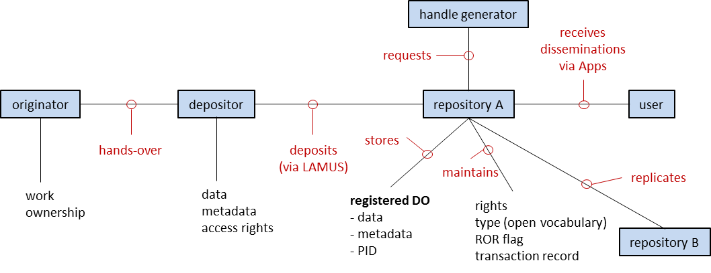
Typical organisation in CLARIN

Slide 26
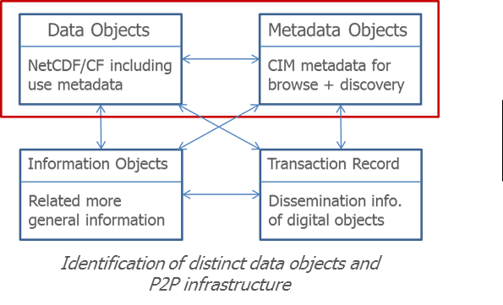
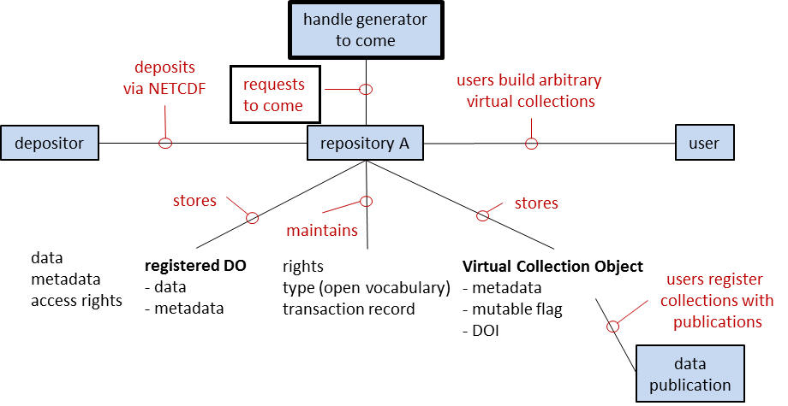
Typical organisation in ENES

Slide 27
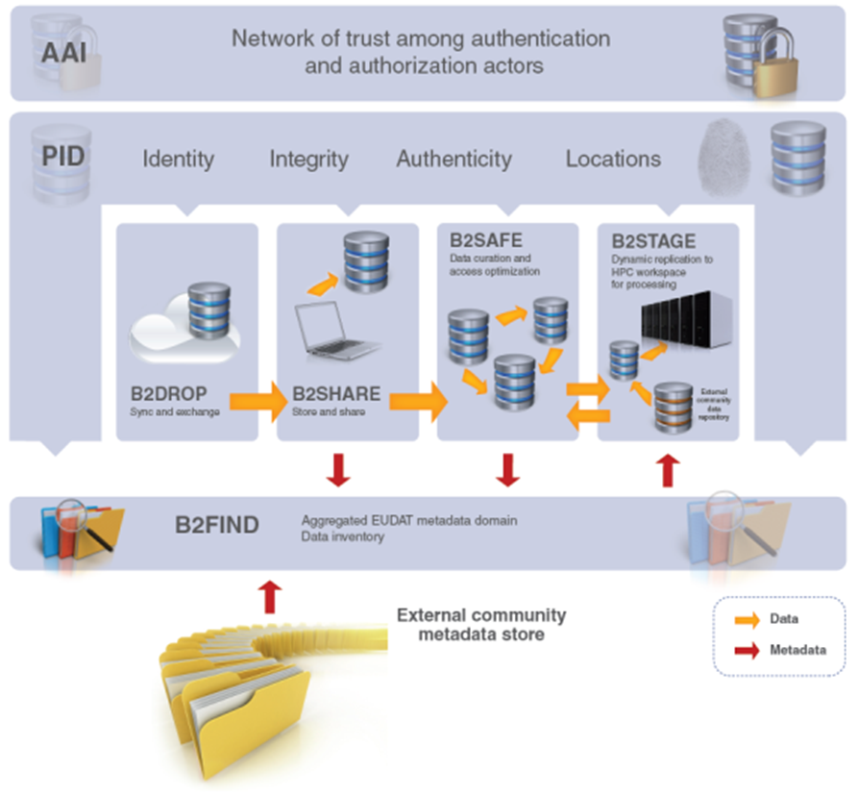
Data organisation in EUDAT

Slide 28
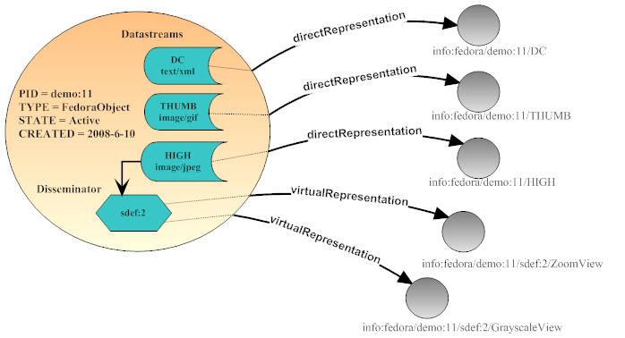
FEDORA Object Model
DO has a PID, streams don‘t have a PID
binding is done within the object
some information is lacking such as existence of copies, rights record, etc.
could be inserted but ...

Slide 29
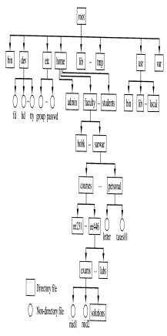
Cloud approach
Application
Software
(rights, md, relations, social tags, etc.)
dispatcher
pointer
(hash code)
includes a local
virtualisation layer
DFT model = global & open
Cloud model = local & prop

Slide 30
Does a DO always stand for a file?
no - DO can be one of the many different types of digital entitites
  DO could be a file or a collection of files/collections
  DO could be a query for a database
  DO could include a set of assertions
  etc.
What is the basic deal?
repository needs to ensure that the user always gets the same referenced content!
how can you check – use PIDs with checksums

Slide 31
Questions
Do you accept the limitation of the file system model?
Do you understand the DFT model?
Do you understand & accept the virtualisation concept?
Do you see the difference between DFT and Clouds?

Slide 32
Overview
some trends
some trends
data and heterogeneity
some modeling
Global Digital Object Cloud
remaining aspects

Slide 33
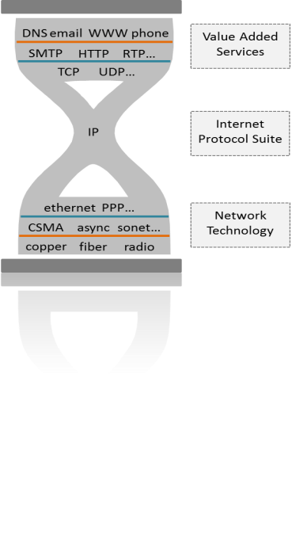
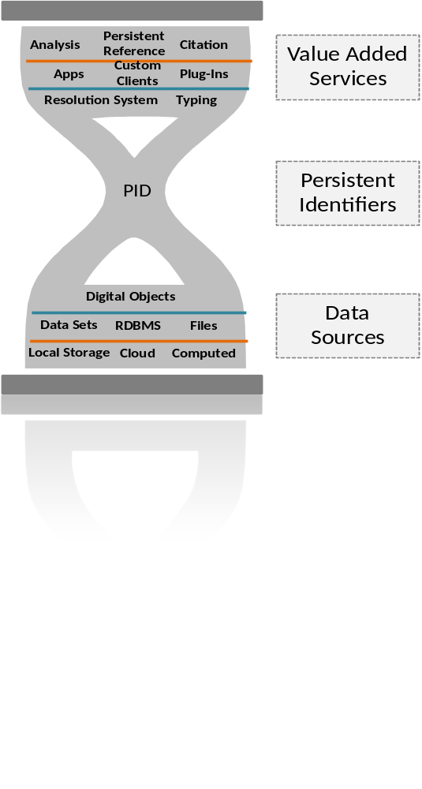
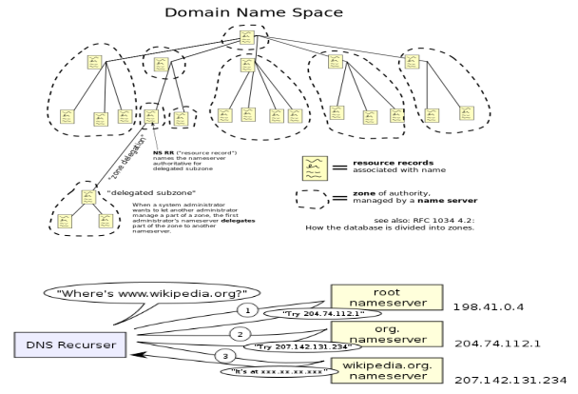
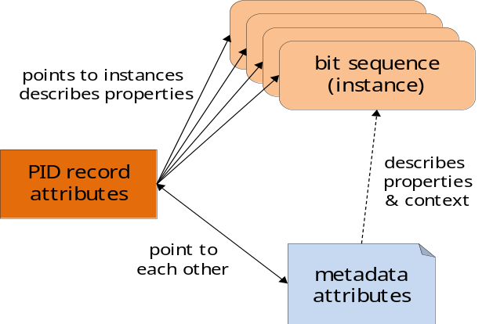
Role of Persistent Identifier
what

Slide 34
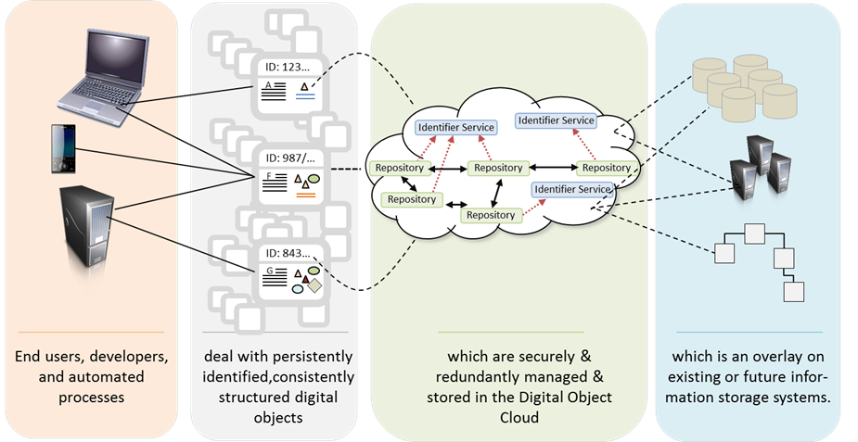
Global Cloud of DOs
Diagram thanks to Larry Lannom.

Slide 35
How to bind all this – PID centered model
PID
PID
PID
paths
PID
PID
Metadata
Rights
data copies
Relations
Provenance
We need to rely on persistence and availability of PID Records!
This needs to be performant enough!

Slide 36
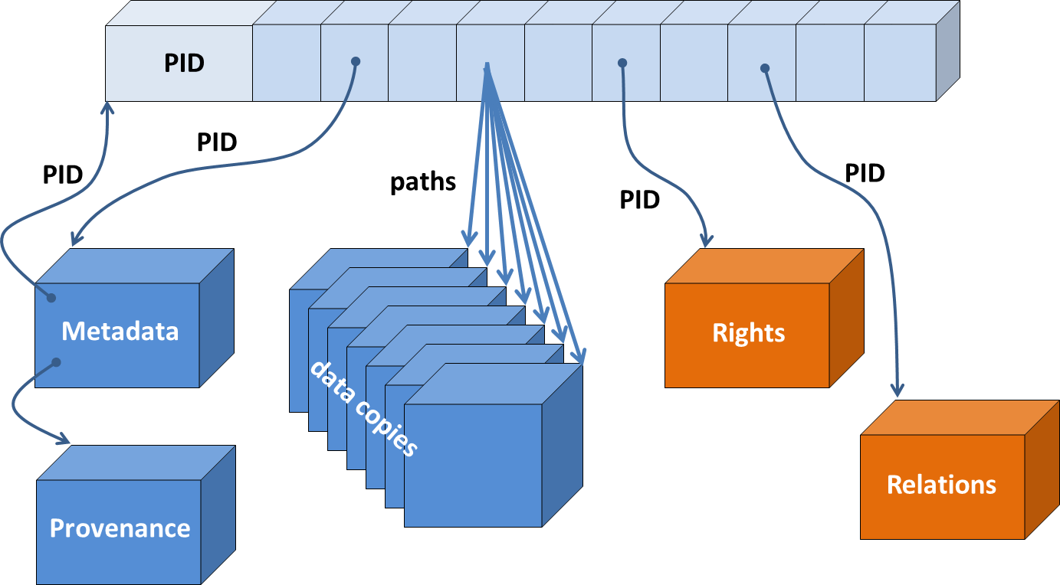
Advantages of such a data organisation
PID system is global
just need the DO‘s PID to find all related information
all is not embedded in ONE repository and thus independent of instances etc.
two access ways are supported since metadata includes PID
could be extended to versions and presentations
in general a simple system
but?
other points of interest:
pointers to schemas
checksum
RoR flag
etc.

Slide 37
PID Registration & Resolving Systems
it‘s all about trust
  do we trust that PID (records) will survive?
    finally it‘s about trust in a bunch of people and organisations
    trust on stability of specs
  do we trust that data will survive?
    not per se – dependent on repository and policies applied
    a policy could state that data can be deleted after 10 years
    in ideal case a flag would be inserted into PID record
  do we trust in reliability, availability and performance (resolution & registration) of a world-wide service?
  do we trust that there will be services on top?

Slide 38
Types of Identifiers
much out there – just a few to be mentioned
  domain IDs in specific registries, databases, etc.
  BAR codes for all sorts of things
  ORCID for authors to correct for spelling variations etc.
  cool URIs finally remain places, no attributes
  IP addresses to be meant for routing & finding nodes in network
  ARK interesting ideas for DOs, but no wide support
  Handles interesting ideas for DOs and wide support
  DOIs are special Handles (prefix = 10, charter, business model)
some identifiers are just numbers
some identifiers are designed to respond with relevant properties
such as multiple locations, checksum for checks, etc. which can be
administered by the record owner

Slide 39
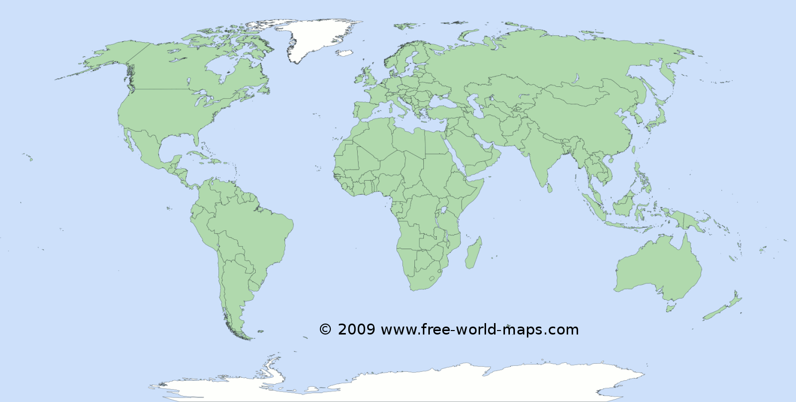
Worldwide Handle Services
HS now governed by International DONA Board with close relation to the International Telecom Union (ITU)
currently a redundant system of MPAs in operation (one at GWDG)
more such MPAs will come – probably in all major countries
they act as registration authorities for centres offering services such as
DOI (Crossref, DataCite, EIDR, etc.), EPIC, etc.
HS is ready to serve everyone

Slide 40
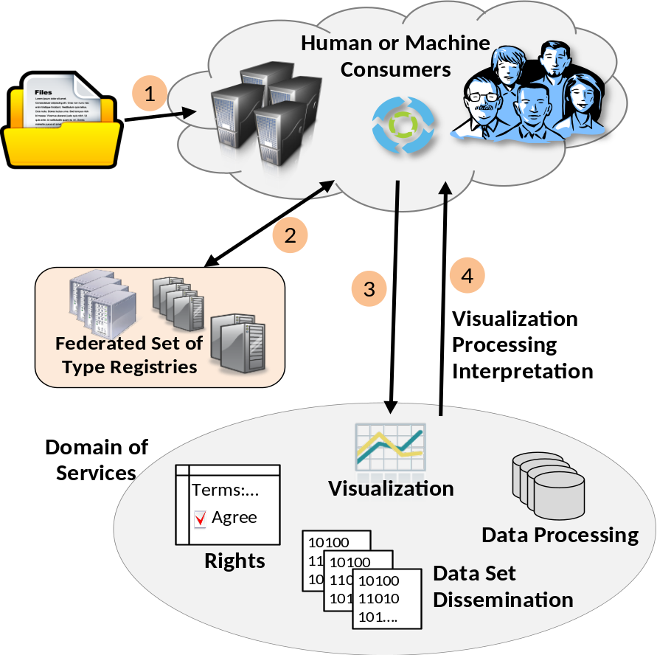
Requires information typing (RDA DTR)
a machine readable registry for data types
Linking structure/semantics with functions
you get an unknown file,
pull it on DTR and content is being
visualized
You find a tag and know how to
interpret
no free lunch: someone needs to
register and define type
PIT Demo already working with
DTR
Various sciences make use of it

Slide 41
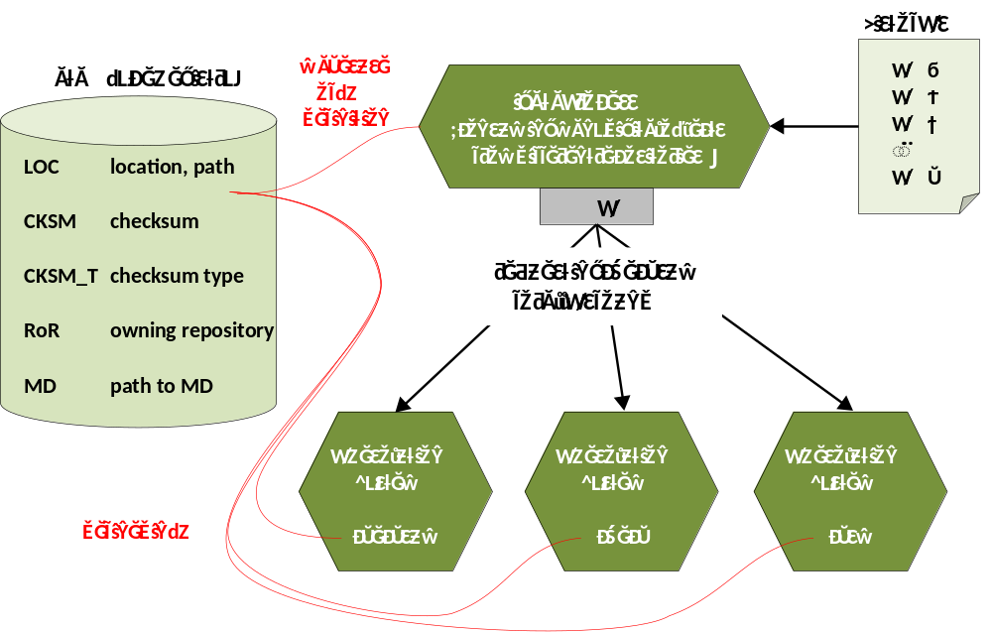
Typing enables generic API (RDA PIT)
a generic API and a set of basic attributes
a PID Record is like a Passport (Number, Photo, Exp-Date, etc.)
if all PID Service-Provider agree on one API and talk the same language (registered terms) SW development will become easy
Climate community
using it together
with DTR
EPIC will
adapt its API

Slide 42
Questions
Do you agree with the core role of PIDs?
Do you see the advantage of storing some properties in the PID record?
Do you think that the Global Handle System (DONA) is set up to maximise trust?
Could you go with a Global DO Cloud?

Slide 43
Overview
some trends
some trends
data and heterogeneity
some modeling
Global Digital Object Cloud
remaining aspects

Slide 44
Semantic Web /OLD
metadata
descriptions
knowledge
extraction
RDF
triples
textual
data
knowledge
extraction
RDF
triples
triple
store
database
data
knowledge
extraction
RDF
triples
other
data
knowledge
extraction
RDF
triples
domain of reasoning
etc.
What is a DO in the domain of assertions – obviously any assertion needs to be
identified. What is persistent and what is citable?

Slide 45
Will NoSQL DB change world?
this is all new technology to support big volumes, aggregates, clusters & distribution
  key-value db
  document db
  column family db
  graph db
  array db (for multivariable time series data)
many of the dbs are opensource, so we can access content independent of technology
many open questions to me yet
what about noSQL born data?

Slide 46
Some conclusions
adhere to the basic DFT data organisation
participate in a domain of registered data and metadata to which we can refer to and which we can cite
use Handles/DOIs where applicable
participate in a simple binding strategy so that our machines can find all information related to a DO
make sure that metadata is accessible
store your data in trustworthy repositories and take care that these are audited according to DSA/WDS
make use of generic APIs in your software where possible
register your syntax and semantics
don‘t rely on encapsulated formats
in case of DBs make sure that queries get a PID

Slide 47
References
RDA DFT: https://rd-alliance.org/groups/data-foundation-and-terminology-wg.html
RDA DTR: https://rd-alliance.org/groups/data-type-registries-wg.html
RDA PIT: https://rd-alliance.org/groups/pid-information-types-wg.html
RDA DDCit: https://rd-alliance.org/groups/data-citation-wg.html
RDA DSA/WDS: https://rd-alliance.org/groups/repository-audit-and-certification-dsa%E2%80%93wds-partnership-wg.html
RDA DF: https://rd-alliance.org/group/data-fabric-ig.html
FAIR: https://www.force11.org/group/fairgroup/fairprinciples
G8: https://epubs.stfc.ac.uk/work/12236702
Survey: http://hdl.handle.net/11304/6e1424cc-8927-11e4-ac7e-860aa0063d1f
Handle System: http://www.handle.net/
DOI: https://www.doi.org/
DONA: https://www.dona.net/
Kahn/Wilensky: https://www.doi.org/topics/2006_05_02_Kahn_Framework.pdf
Stehouwer, Wittenburg, Principles for Data Sharing and Re-use: are they all the same?, http://hdl.handle.net/11304/1aab3df4-f3ce-11e4-ac7e-860aa0063d1f

Slide 48
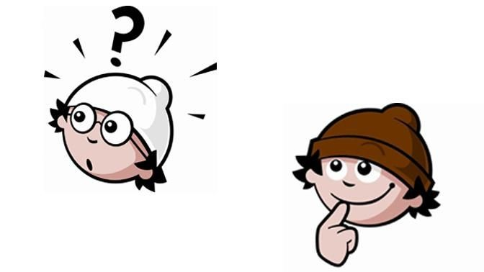
Vielen Dank für Ihre Aufmerksamkeit.

Slide 49
Results from interviews
~120 Interviews/Interactions
3 Workshops with Leading Scientists (RDA EU, US)
still many obstacles to Open Data
lack mechanisms of trust and acknowledgements
trend towards trustful centres – still lacking offers for all
there are positive project examples etc. but ...
  too much manual work or via ad hoc scripts
  hardly usage of automated workflows and lack of reproducibility
  DM and DP not efficient and too expensive
  (Biologist for 75% of his time data manager)
  federating data incl. virtual information much too expensive

Slide 50

Typical Management Pattern
Enabling
Technologies
Collections +
Properties
ID
ID
ID
ID
ID
0100
0101..
ID
0100
0101..
0100
0101..
ID
ID
ID
ID
0100
0101..
PID
Access
(ref. resolution, protocols, AAI)
ID
ID
ID
ID
ID
0100
0101..
Data Managers
Data Scientists
ID
formalized policies
workflow engine
ID
ID
can all be done based
on properties stored in
PID/Metadata attributes
(in general external prop.)
Datasets
Assessment
Accessed via Repositories

Slide 51
CoCos at separable Layers
Enabling
Technologies
metadata domain
ID
Discovery
ID
ID
0100
0101..
ID
ID
ID
0100
0101..
0100
0101..
ID
ID
ID
ID
0100
0101..
Access
(ref. resolution, protocols, AAI)
PID
ID
ID
ID
ID
ID
0100
0101..
Scientists, Data Curators,
End Users, Applications
ID
Interpretation
ID
ID
requires to look into
the object and thus use
content and contextual
information
Datasets
Reuse
Accessed via Repositories
Notes:
EPTID: no SSO, no authorization

