Slide 1
RDA for Data Practitioners
Peter Wittenburg / Rainer Stotzka

Slide 2
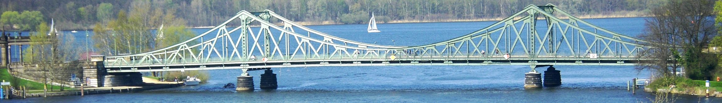
Research Data Alliance
Vision:
Researchers openly sharing data across technologies, disciplines, and countries
Mission:
Building the social and technical bridges
Guiding Principles
Openness
Consensus
Balance
Harmonization
Community-driven
Non-profit
> 700 active members
Working Groups
Interest
Groups
Plenaries

Slide 3
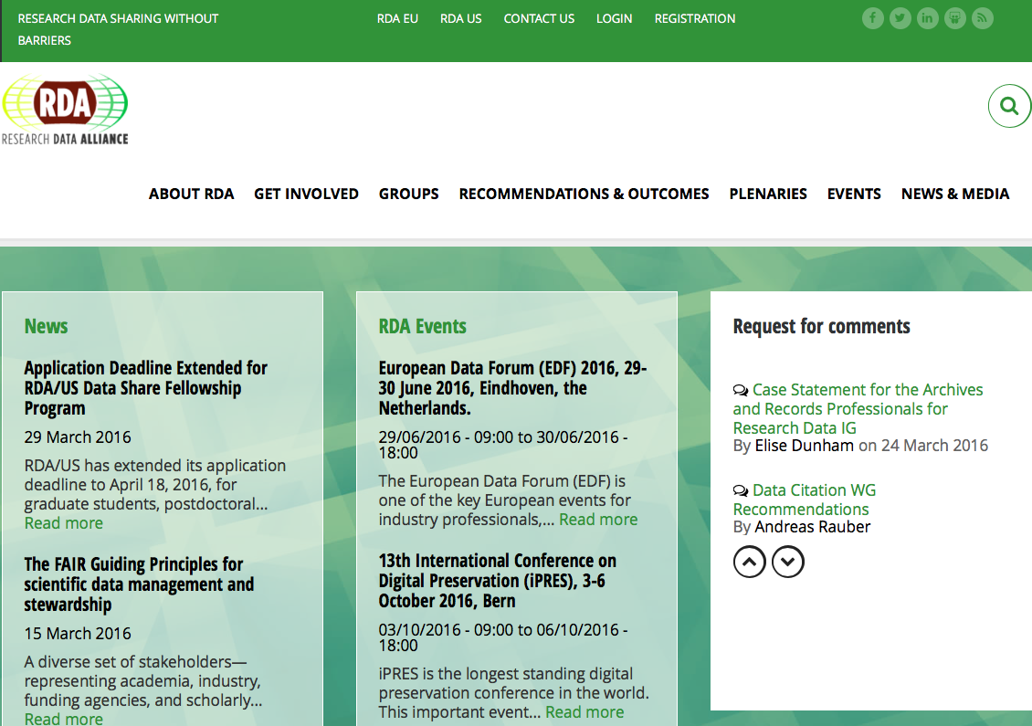
http://rd-alliance.org

Slide 4
http://rd-alliance.org

Slide 5
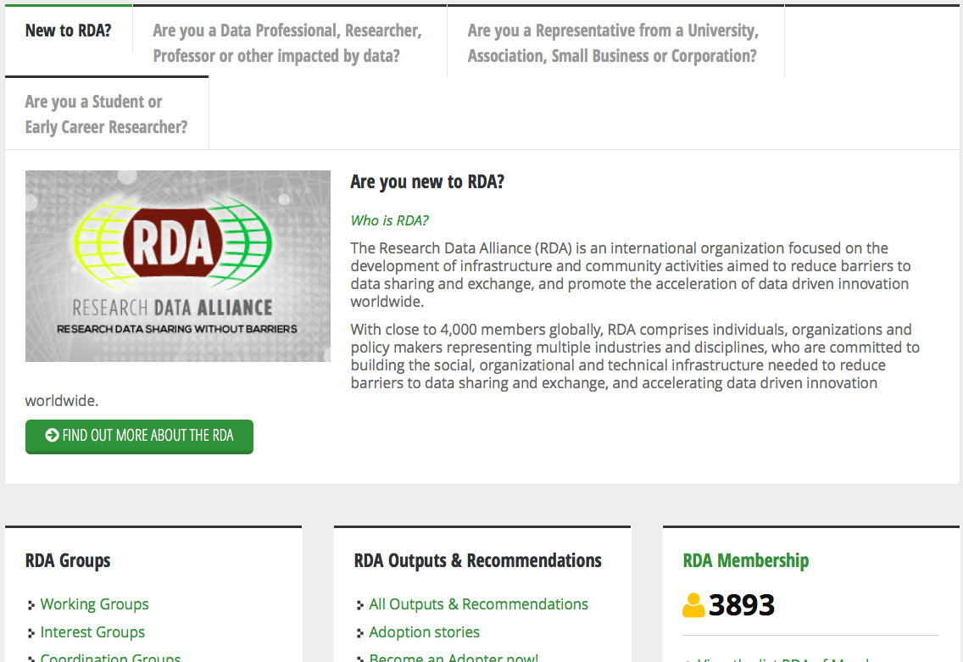
http://rd-alliance.org

Slide 6
http://rd-alliance.org

Slide 7
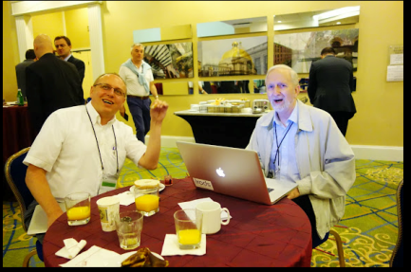
27 RDA Working Groups
Experts that are engaged in creating deliverables that will directly enable data sharing, exchange, or interoperability.
Concrete problem
Short time frame (~18 months)
Consensus-driven
Concrete output improving data exchange, deliverables
  Technical specifications and implementation practices,
  Conceptual models or frameworks,
  Policies, and
  Other documents and practices
Clear adoption by one or more specific communities
Working groups and their deliverables undergo a community review process.
Notes:
Example: PID Information Types

Slide 8
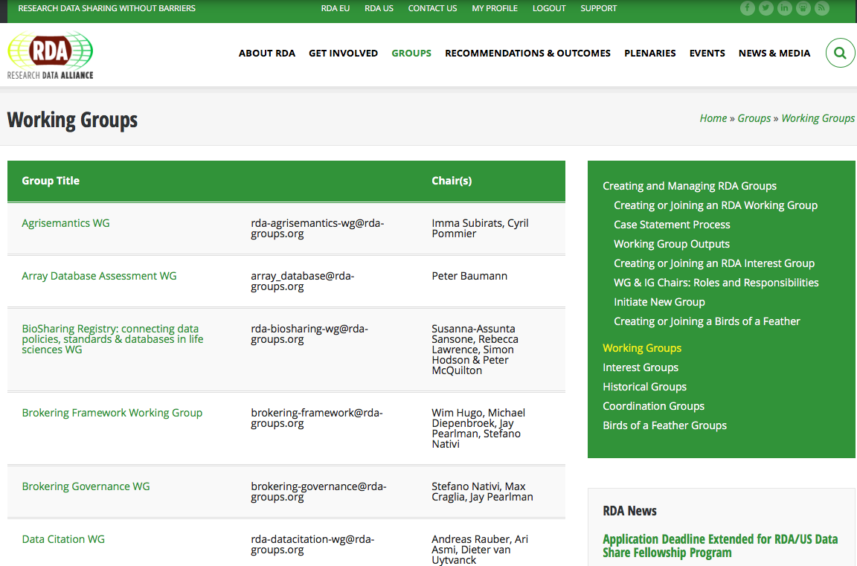
https://rd-alliance.org/groups/working-groups

Slide 9
https://rd-alliance.org/groups/working-groups

Slide 10
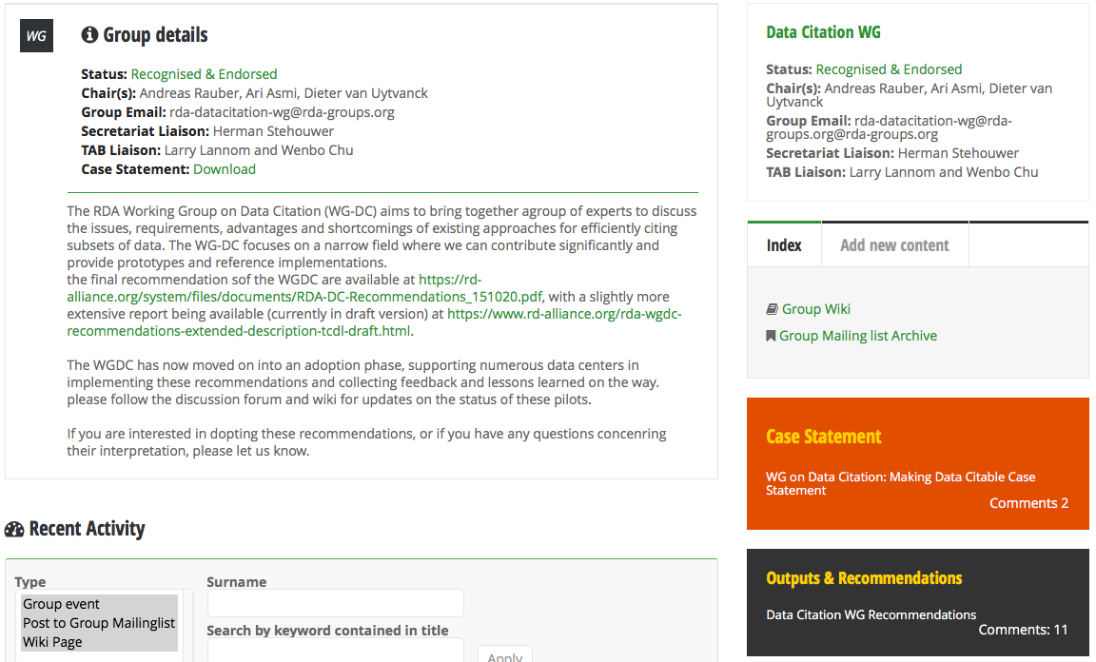
https://rd-alliance.org/groups/data-citation-wg.html

Slide 11
https://rd-alliance.org/groups/data-citation-wg.html

Slide 12
https://rd-alliance.org/groups/data-citation-wg.html

Slide 13
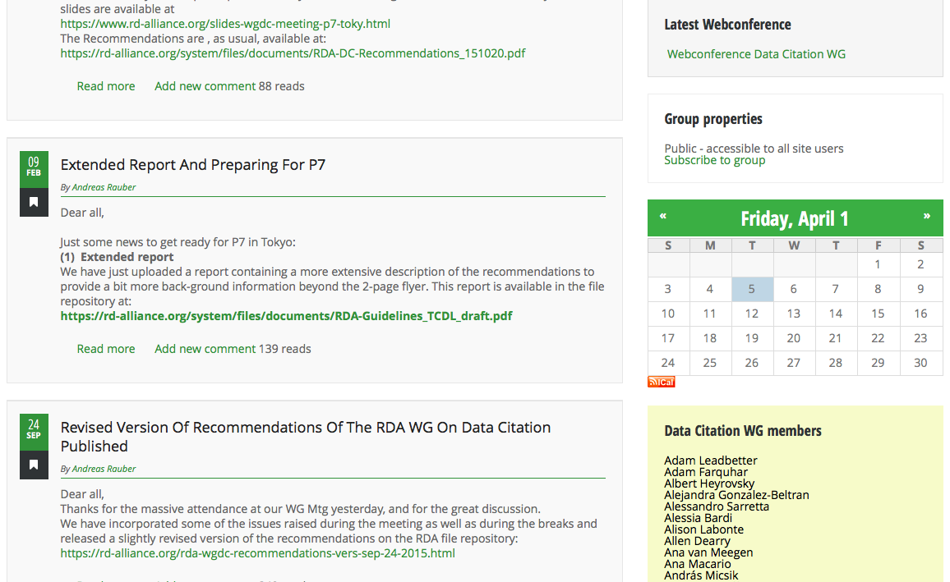
https://rd-alliance.org/groups/data-citation-wg.html

Slide 14
https://rd-alliance.org/groups/data-citation-wg.html

Slide 15
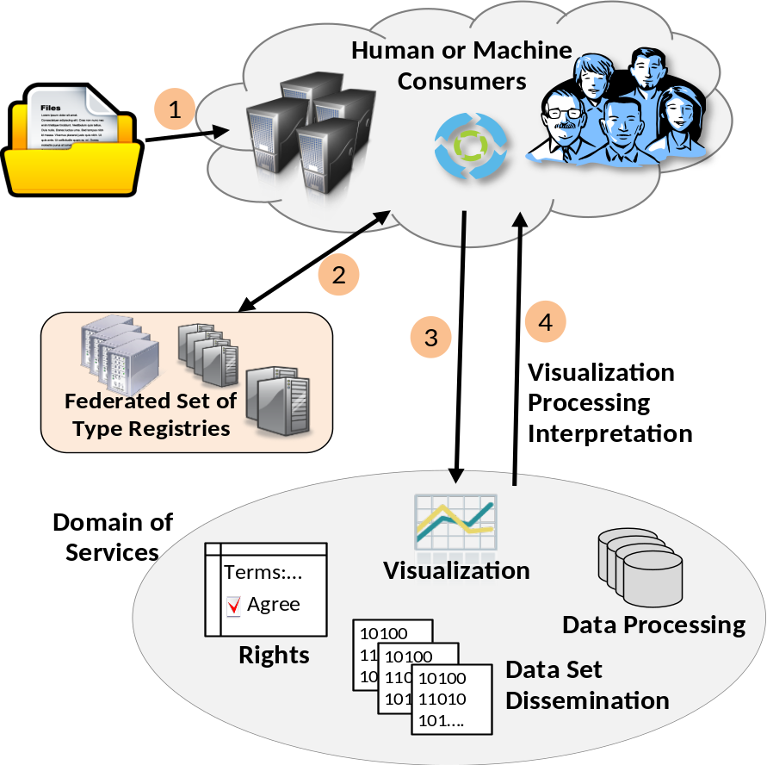
Data Type Registries
result: a registry for data types
Linking structure/semantics with functions
you get an unknown file,
pull it on DTR and content is being
visualized
You find a tag and know how to
interpret
no free lunch: someone needs to
register and define type
PIT Demo already working with
DTR
Various sciences make use of it

Slide 16
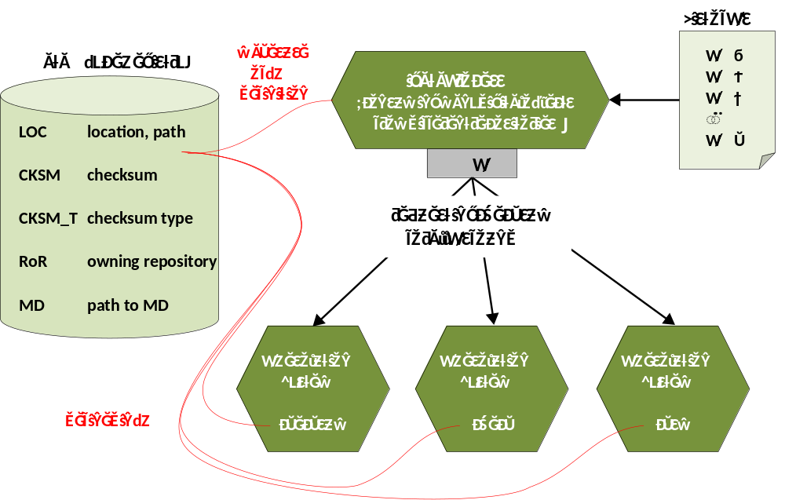
PID Information Types
result: a generic API and a set of basic attributes
a PID Record is like a Passport (Number, Photo, Exp-Date, etc.)
if all PID Service-Provider agree on one API and talk the same language (registered terms) SW development will become easy
Climate community
using it together
with DTR
EPIC will
adapt its API

Slide 17
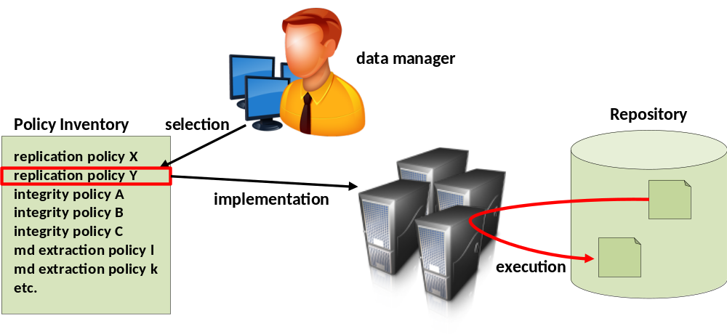
Practical Policies
Practical Policies = executable Workflow Statements
result: a set of Best Practice PPs for a number of typical DM/DP tasks (Integrity Check, Replication, etc.)
currently a large collection of PPs, currently being evaluated

Slide 18
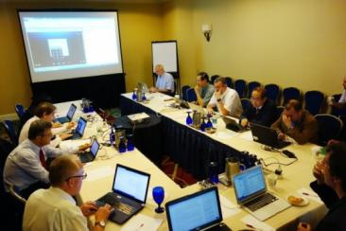
44 RDA Interest Groups https://rd-alliance.org/groups/interest-groups
Experts that are engaged in creating deliverables that will directly or indirectly enable data sharing, exchange, or interoperability.
Group around a common interest
Exist as long as they are active
Coordination and communication
Outputs:
  Platform that leads to the formation of one or more Working Groups
  Communication and coordination across Working Groups/Interest Groups
  Communication and coordination with communities outside RDA
  Important deliverables such as surveys, recommendations, reports
Notes:
They should not be for promoting specific projects or technologies.
Examples: Data Analytics interest Group, Photon & Neutron Science

Slide 19
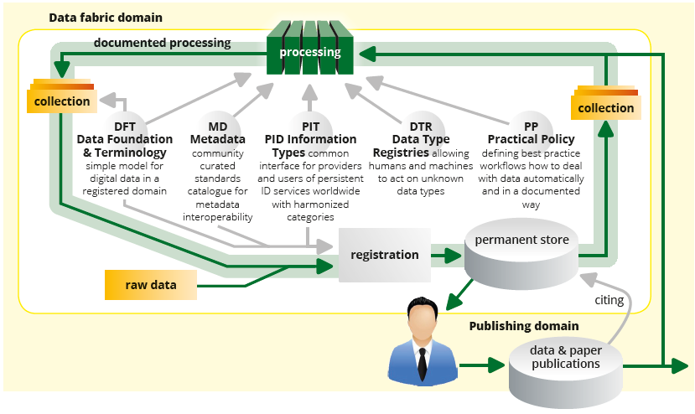
Data Fabric Interest Group
Data Fabric IG looking at the data production and consumption cycle in the labs
Other WG/IGs looking at data publication workflows and citation

Slide 20
Group Clustering
Solutions
Social
Technical
Beneficiary
Data providers
Data consumers

Slide 21
Focus of RDA Groups
Solutions
Social/organizational solution aimed at data provider
Social/organizational solution aimed at data consumer
Social
Q1
Governance, Certification, Cost Recovery, Legal, …
Q2
Technical solution aimed at data provider
Technical solution aimed at data consumer
Technical
Beneficiary
Data providers
Data consumers

Slide 22
Outputs & Benefits
Social
Data Citation
Cite data that is subjected to change
All changes are reflected in the citation information that includes a time-stamp & version history
Technical
Data providers
Data consumers
Data Foundation & Terminology (DFT)
Increased cross disciplinary data exchange and interoperability
Common data model
Foundational vocabulary and query tool
DSA-WDS Repository Audit and Certification
Convergent DSA-WDS certification standard
RDA/WDS Publishing Data Services
Universal linking service between data and the scientific literature

Slide 23
Group Clustering
Solutions
Repository, Fabric, Analytics, Identity, Management, ...
Social/organizational solution aimed at data provider
Social/organizational solution aimed at data consumer
Social
Q1
Q2
Technical solution aimed at data provider
Technical solution aimed at data consumer
Technical
Beneficiary
Data providers
Data consumers

Slide 24
Outputs & Benefits
Social
Data Type Registry
“MIME-types” for data
Information for tools to interpret, process, and display data
Technical
Data providers
Data consumers
PID Information Types (PIT)
Generic API
Set of basic attributes
RDA/WDS Publishing Data Workflows
Workflows for Research Data Publishing: Models and Key Components: http://dx.doi.org/10.5281/zenodo.20308
Dataset: http://dx.doi.org/10.5281/zenodo.19107
Practical Policies
Template of policy descriptions for automation
Basic set of 11 policy areas

Slide 25
Group Clustering
Interoperability, Harmonization, Integration, Metadata, ...
Solutions
Social/organizational solution aimed at data provider
Social/organizational solution aimed at data consumer
Social
Q4
Q3
Technical solution aimed at data provider
Technical solution aimed at data consumer
Technical
Beneficiary
Data providers
Data consumers

Slide 26
Outputs & Benefits
Social
Technical
Data Description Registry Interoperability (DDRI)
Find connections across research data registries and create global views of research data
Data providers
Data consumers
Wheat Data Interoperability
Framework to support the establishment of a global wheat information system
Interoperability by:
  Creating an interoperability framework
  Providing guidelines on wheat data (cookbook)
  Repository of linked vocabularies

Slide 27
Group Clustering
Solutions
Social/organizational solution aimed at data provider
Social/organizational solution aimed at data consumer
Social
Education, Engagement, Bridging, Ethics, ...
Q4
Q3
Technical solution aimed at data provider
Technical solution aimed at data consumer
Technical
Beneficiary
Data providers
Data consumers

Slide 28
Outputs & Benefits
Social
Technical
RDA/CODATA Summer Schools in Data Science and Cloud Computing in the Developing World
First summer school course in the data science approaches and skills that are essential for 21st century research
Data providers
Data consumers
Metadata Standards Directory
Community curated standards catalogue for metadata interoperability

Slide 29
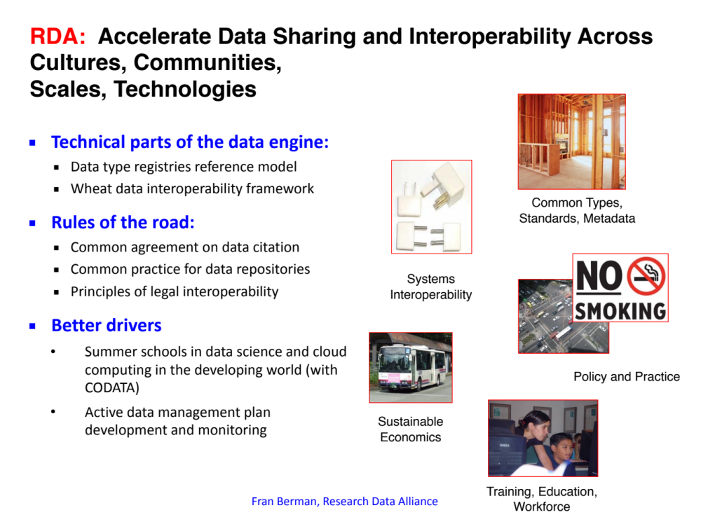
Fran Berman, Research Data Alliance

Slide 30
RDA Governance
Working Groups
implementable, impactful outcomes
Interest Groups
domain coordination, idea generation, maintenance, …
RDA Membership
Technical Advisory Board
socio-technical vision and strategy
Secretariat
administration and operations
Organisational
Advisory Board
needs, adoption, business advice
Council
organisational vision and strategy
RDA Foundation
Funders Forum

Slide 31
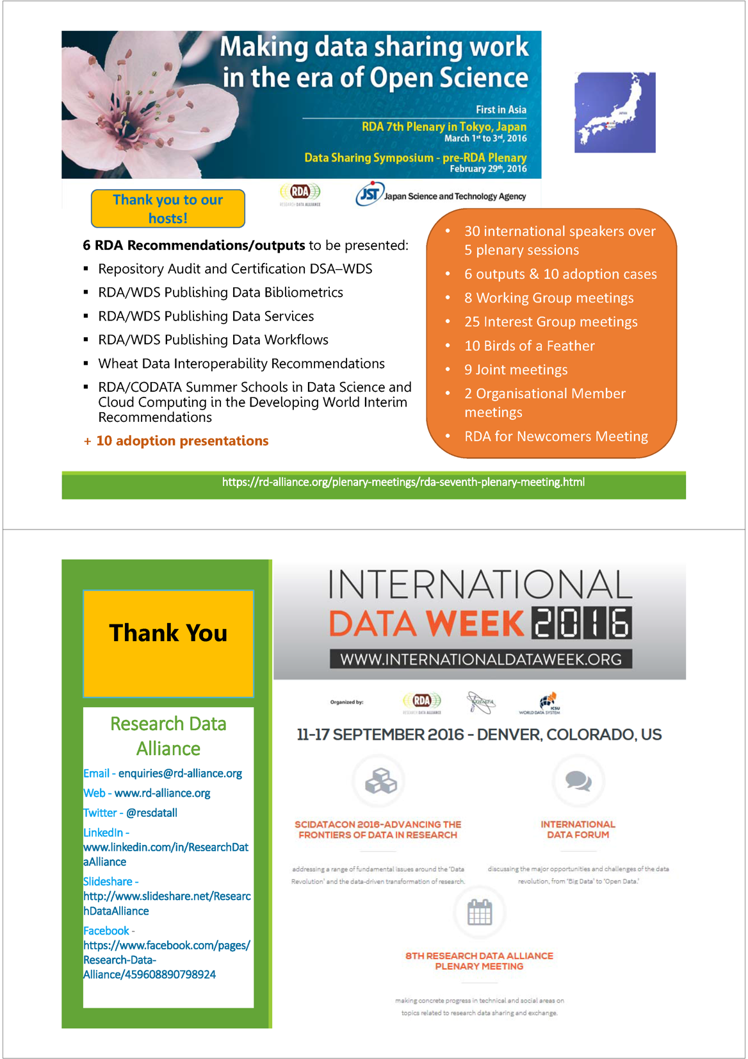
RDA Plenary Meetings
Fran Berman, Research Data Alliance

Slide 32
RDA Plenary Meetings
Fran Berman, Research Data Alliance

Slide 33
Getting active – RDA Global/Europe
 | RDA global | RDA Europe/Country
Become member | Be part of the global interaction
Participate in meetings/plenaries | Meet the experts
Participate in groups | Bring in your thoughts about barriers
Become chair | Take initiative to overcome barriers
Participate in training events |  | Get the knowledge from international experts
Initiate uptake projects |  | Integrate RDA outputs into your software environment
Ask for travel support |  | Participate in plenaries etc.
Participate in meetings |  | Participate in European or national meetings
Co-organise meetings |  | Co-organise European or national meetings

Slide 34
RDA Europe

Slide 35
General Support
Giving advice and support (incl. sending an expert to location)
Early Career Programme (travel support to plenaries)
Chairs Programme (supporting travel of chairs)
Co-Organising community-based meetings
Co-Organising regional/national meetings

Slide 36
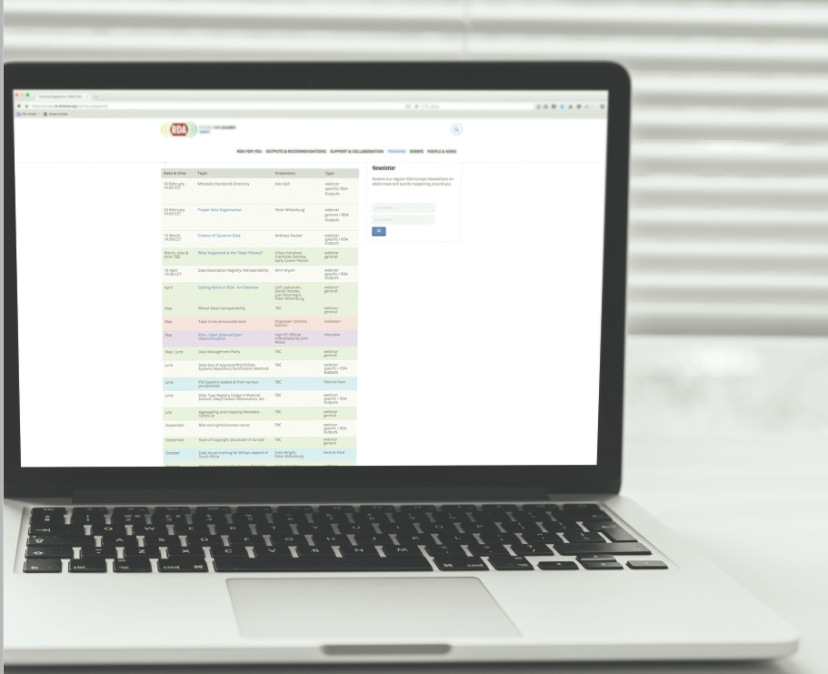
Training & Webinars
training webinars, face-to-face workshops, hackathons/datathons partly organized as “summer schools” and special meetings on request.
Delivered in different formats by International Experts:
RDA recommendations and outputs – e.g. Data Description Registry Interoperability
General topics – e.g Data Management Plans, State of EU Copyright discussion
Interviews – e.g. Open Science/Open Data/Innovation
information sessions – e.g. What happened at the Tokyo Plenary?
Scheduled (Feb-Dec 2016) so far …
Face-to-Face | 3
Hackathon | 2
General | 9
specific / RDA Outputs | 9
interviews | 2
webinar | 18
http://europe.rd-alliance.org/training-programme
Hilary Hanahoe, RDA Europe

Slide 37
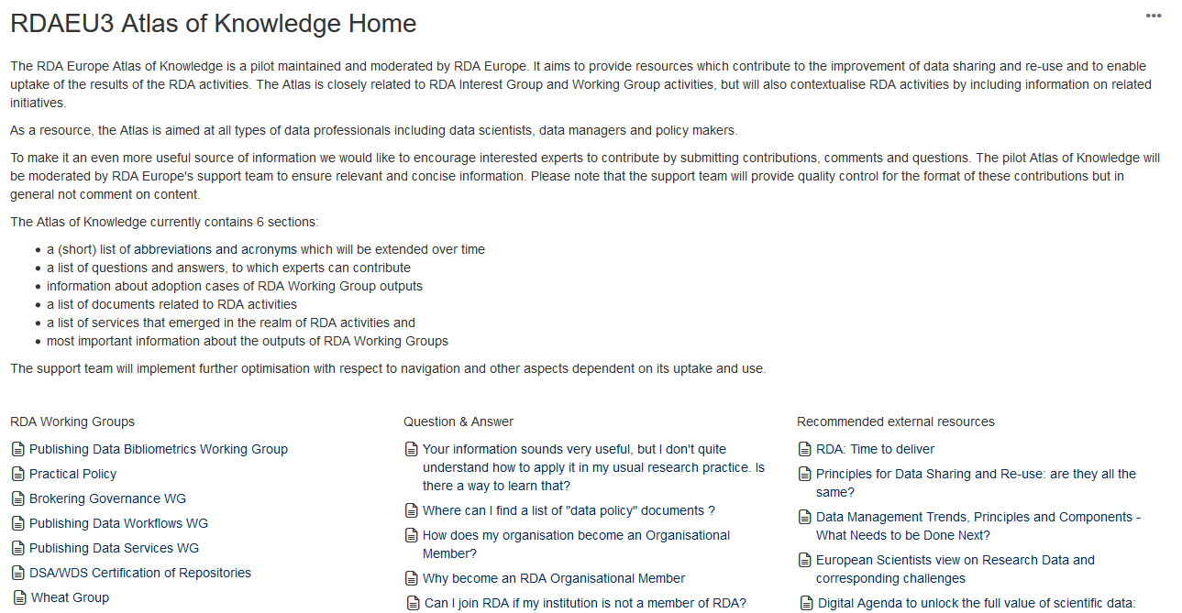
RDA Europe Atlas of Knowledge Pilot
moderated wiki focusing on issues raised by RDA Working Groups and Interest Groups
will also incorporate topics with a much broader focus
advice about research data issues and to also carry out analysis work to clarify open questions.
executed in collaboration with research communities & experts from different fields & initiatives with deep experience & knowledge to give the most comprehensive answers
https://confluence.csc.fi/display/RDAEUKB/RDAEU3+Atlas+of+Knowledge+Home

Slide 38
RDA Europe Adoption Projects
Dynamic Data Citation & the Argo data set
Adopting: Dynamic Data Citation
Creation of a Query interface for phenotyping data
Adopting: Wheat Data Interoperability (WDI)
Integration of the RDA Metadata Standards Directory into DMPonline
Adopting: Metadata Standards Directory
Analysis of the OpenPhilology/Perseus and the CLARIN data repositories
Adopting: Data Foundation and Terminology
Implementation of a Query Store for the VAMDC infrastructure
Adopting: Data Citation
Integration of the DLI Service into the OpenAire infrastructure
Adopting: Publishing Data services
Introduction of PIDs to the Armenian Life Sciences
Adopting: PID Information Types
Objective: to support communities that want to test/adopt RDA outputs.
1st call: Sept – Dec 2015
Outcome: 25 submitted & 7 selected.
Start: Mid 2016
2nd Call: April 2016
https://rd-alliance.org/rda-magazine-online.html

