Slide 1
The B2 SERVICE SUITE
www.eudat.eu/services
This work is licensed under the Creative Commons CC-BY 4.0 licence.
Attribution: EUDAT – www.eudat.eu

Slide 2
B2 SERVICE SUITE
EUDAT offers a complete set of research data services, expertise and technology solutions to all European scientists and researchers.
These shared services and storage resources are distributed across 15 European countries.
Data are safely stored alongside some of Europe’s most powerful supercomputers.

Slide 4
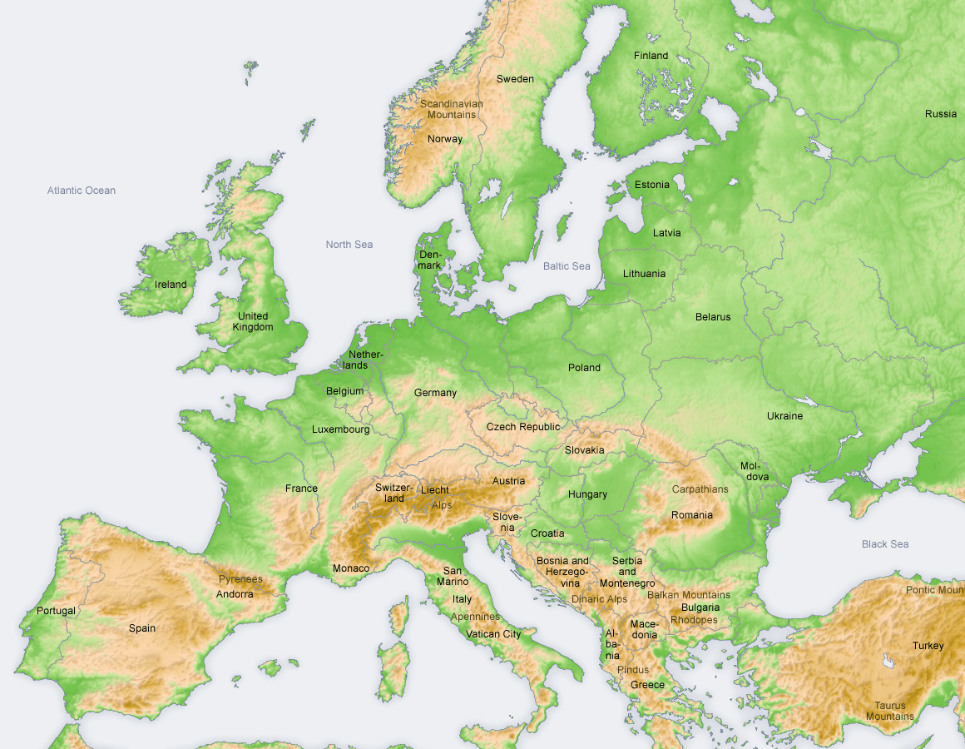


B2 SERVICE SUITE is part of EUDAT...
a pan-European initiative building a sustainable cross-disciplinary and cross-national data infrastructure providing a set of shared services for accessing and preserving research data
supporting multiple research communities by working closely with them to deliver these technical services as part of the EUDAT Collaborative Data Infrastructure (CDI)

Slide 5
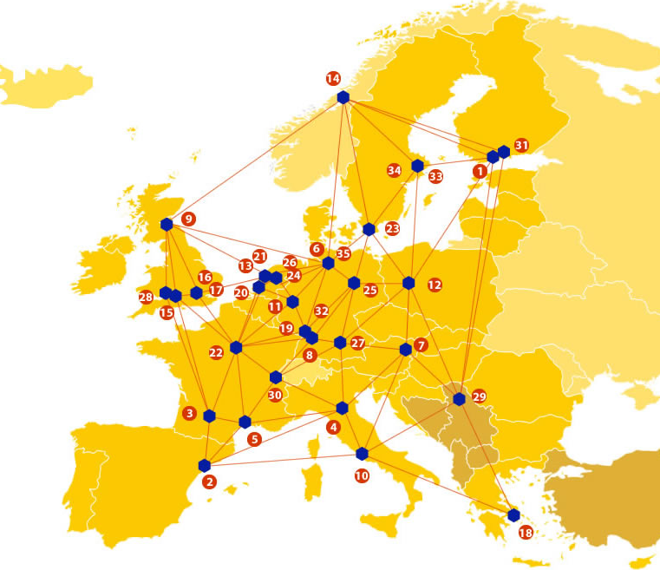
A truly pan-European Infrastructure
EUDAT offers common data services, supporting multiple research communities as well as individuals, through a geographically distributed, resilient network of 35 European organisations
Our vision is to enable European researchers and practitioners from any research discipline to preserve, find, access, and process data in a trusted environment, as part of a Collaborative Data Infrastructure

Slide 6

















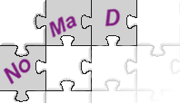







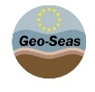




Community-Driven Solutions
EUDAT services are designed, built and implemented based on user community requirements.
ENVIRONMENTAL SCIENCES
BIOMEDICAL & MEDICAL SCIENCES
MATERIALS & ANALYTICAL FACILITIES
MAPPER
SOCIAL SCIENCES & HUMANITIES
PHYSICAL SCIENCES
& ENGINEERING

Slide 7
B2DROP
EUDAT’s Personal Cloud Storage Service
B2DROP is a secure and trusted data exchange service for researchers and scientists to keep their research data synchronized and up-to-date and to exchange with others.

Slide 8
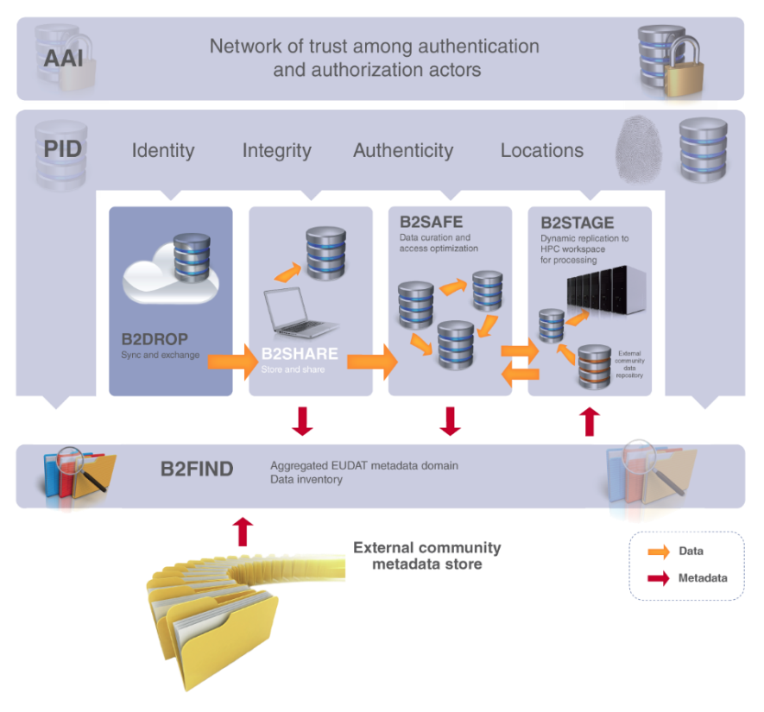
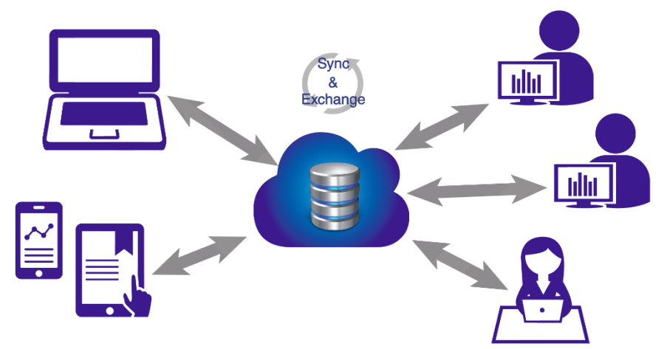
An ideal solution for researchers and scientists to:
Store and exchange data with colleagues and team members, including research data not finalized for publishing
share data with fine-grained access controls
synchronize multiple versions of data across different devices
Features:
20GB storage per user
Living objects, so no PIDs
Versioning and offline use
Desktop synchronisation

Slide 9
B2SHARE
B2SHARE is a user-friendly, reliable and trustworthy way for researchers, scientific communities and scientists to store and share small-scale research data from diverse contexts.

Slide 10
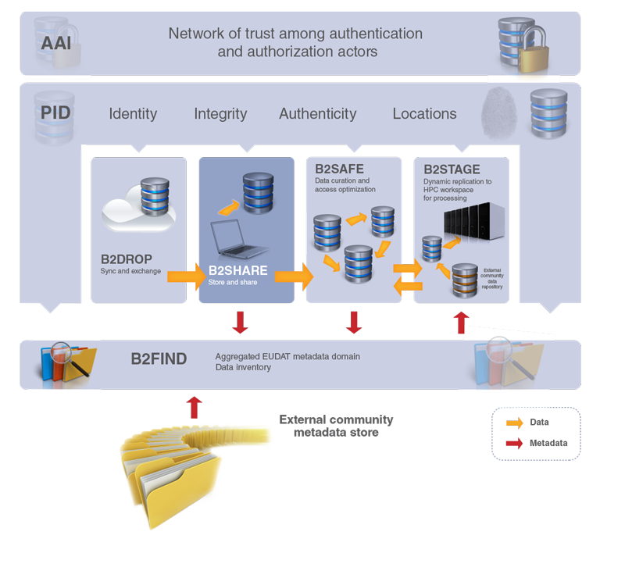
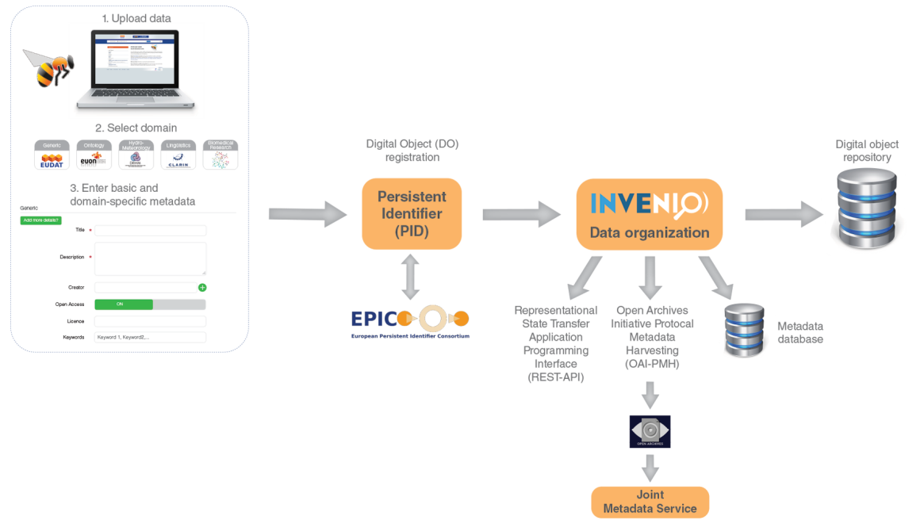
A winning solution for researchers, scientists and communities to:
store data safely at a trusted and certified data centre
preserve data to guarantee long-term persistence
control access and share data with colleagues and the world
Features:
metadata management
permanent PIDs
Open Access support

Slide 11
B2SAFE
B2SAFE is a robust, safe and highly available service which allows community and departmental repositories to implement data management policies on research data across multiple administrative domains in a trustworthy manner.

Slide 12
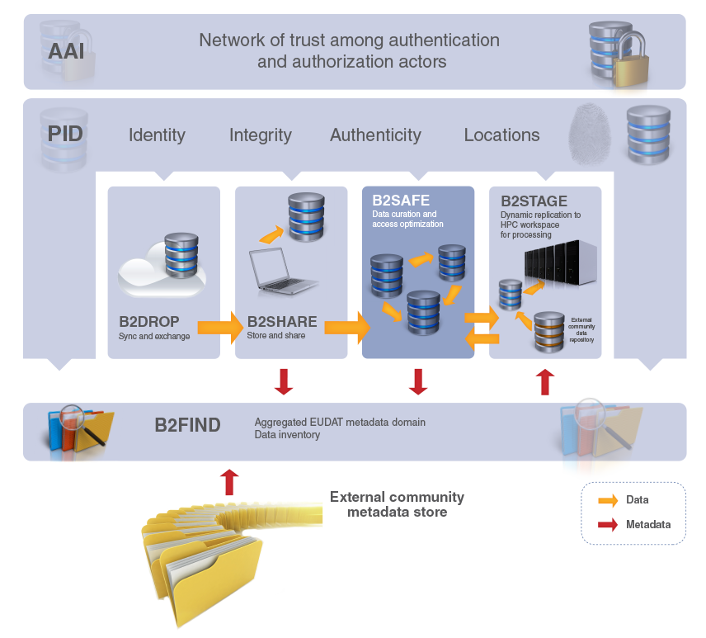
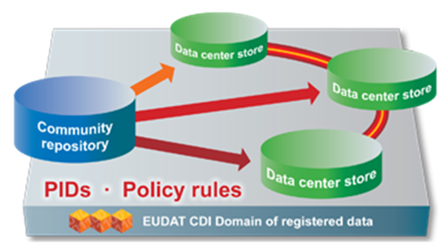
The ideal solution for communities with no facility for archival to:
replicate research data into secure data stores
archive and preserve research data in the long-term
bring data close to powerful compute resources
co-locate data with different communities
benefit from economies of scale
Features:
large-scale storage
robust and highly available
permanent PIDs

Slide 13
B2STAGE
B2STAGE is a reliable, efficient, light-weight and easy-to-use service to transfer research data sets between EUDAT storage resources and high-performance computing (HPC) workspaces

Slide 14
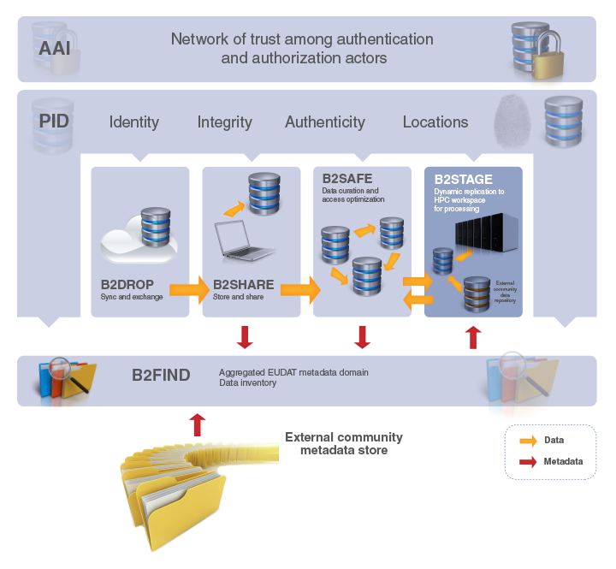
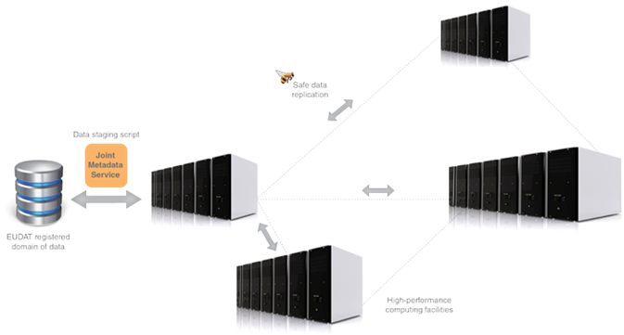
Facilitating communities to:
move large amounts of data between data stores and high-performance compute resources
re-ingest computational results back into EUDAT
deposit large data sets onto EUDAT resources for long-term preservation
Features:
high-speed transfer
reliable and light-weight
manages permanent PIDs

Slide 15
B2FIND
B2FIND is a simple, user-friendly metadata catalogue of research data collections stored in EUDAT data centres and other repositories.

Slide 16
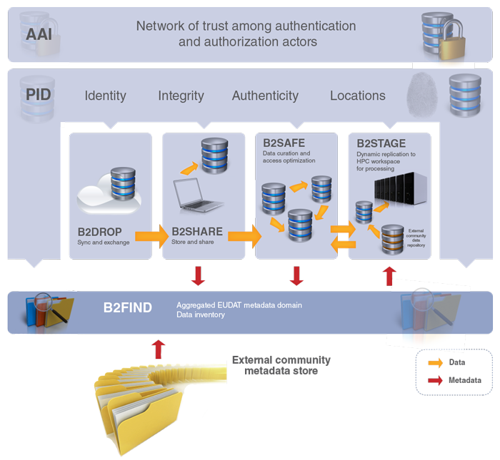
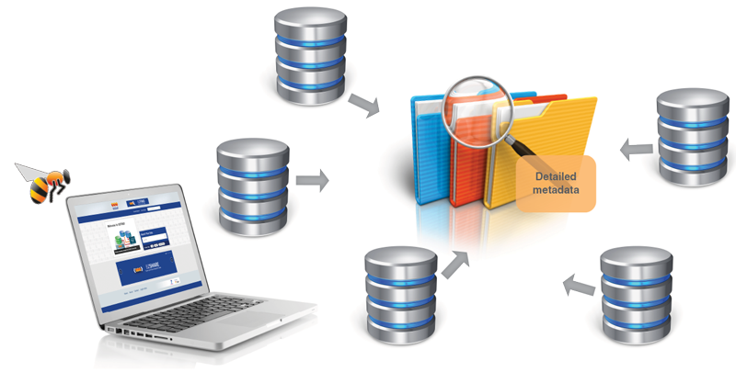
A metadata catalogue service to:
seek data objects and collections using powerful metadata searches
catalogue community data by means of selected metadata
browse through multi-disciplinary data collections filtered by content, provenance and temporal keywords
Features:
simple to use
standards-based
comprehensive catalogue

Slide 17
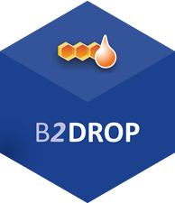

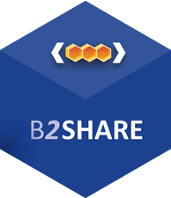

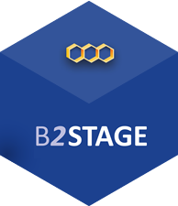
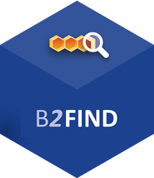
For more info:
https://b2drop.eudat.eu
https://eudat.eu/services/userdoc/b2drop
https://b2share.eudat.eu
https://eudat.eu/services/userdoc/b2share
https://eudat.eu/services/userdoc/b2safe
https://eudat.eu/services/userdoc/b2stage
http://b2find.eudat.eu
https://eudat.eu/services/userdoc/b2find

