Slide 1

EPOS and EUDAT Collaboration
https://www.epos-ip.org/

Slide 2


EUDAT: A truly pan-European Infrastructure
EUDAT offers common data services to both research communities and individuals through a network of 35 European organisations.
EUDAT wants to enable European researchers from any discipline to preserve, find, access, and process data in a trusted environment, as part of a Collaborative Data Infrastructure.
European infrastructures
Technology Providers
Research Communities

Slide 3
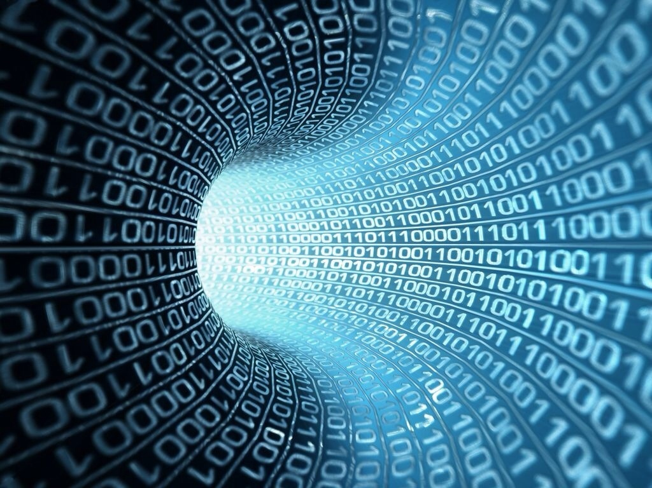
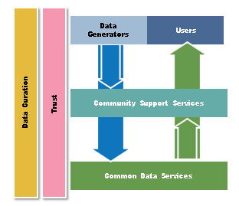
EUDAT Vision & Mission
The vision: Data is shared and preserved across borders and disciplines thereby enhancing the value and quality of research at large.
The mission: To enable data stewardship within and between European Research Communities through a Collaborative Data Infrastructure, a common model and service infrastructure for managing data spanning all European research data centres and community data repositories.

Slide 4
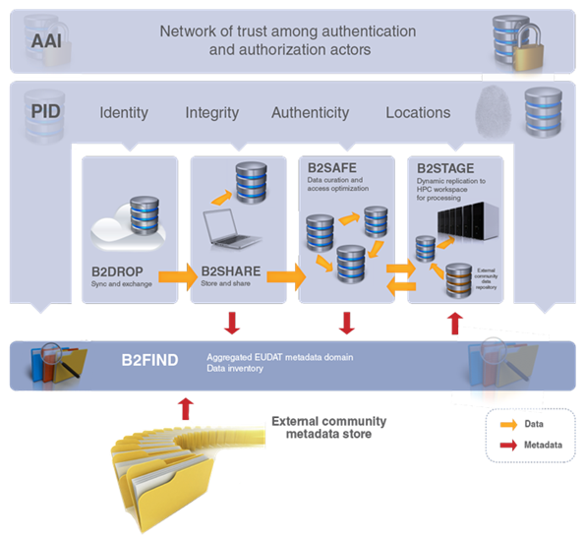







B2 Service Suite
Covering both access and deposit, from informal data sharing to long-term archiving, and addressing identification, discoverability and computability of both long-tail and big data, EUDAT services seek to address the full lifecycle of research data
https://www.eudat.eu/services
Notes:
B2FIND
stores metadata as well through other EUDAT services such as B2SHARE to provide access to data object within the EUDAT CDI
is used in inter-service use cases, e.g. to select links to data to be transferred to HPC platforms through B2STAGE

Slide 5
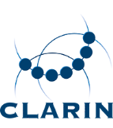
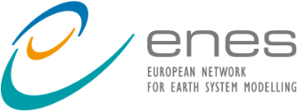




Building solutions with the communities
EUDAT services (B2 Service Suite) are designed, built and implemented together with user communites.
Common Language Resources and Technology Infrastructure (CLARIN)
European Network for Earth System Modelling (ENES)
Distributed infrastructure for life-science information (ELIXIR)
European Plate Observing System (EPOS) - Solid Earth sciences Research Infrastructure
Integrated Carbon Observation System (ICOS) to quantify & understand greenhouse gas balance
Long-Term Ecosystem Research (LTER) in Europe

Slide 7
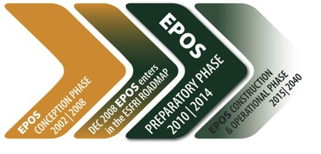
EPOS: ambition
The European Plate Observing System (EPOS) is the ESFRI initiative of the Solid Earth sciences:
A long-term plan to facilitate integrated use of data, models and facilities from pre-existing and newly established research infrastructures for solid Earth science.
It represents a scientific vision and approach to enable innovative multidisciplinary research towards a better understanding of the physical processes controlling earthquakes, volcanic eruptions and unrest episodes, tsunamis, as well as those driving tectonics and Earth surface dynamics.

Slide 8
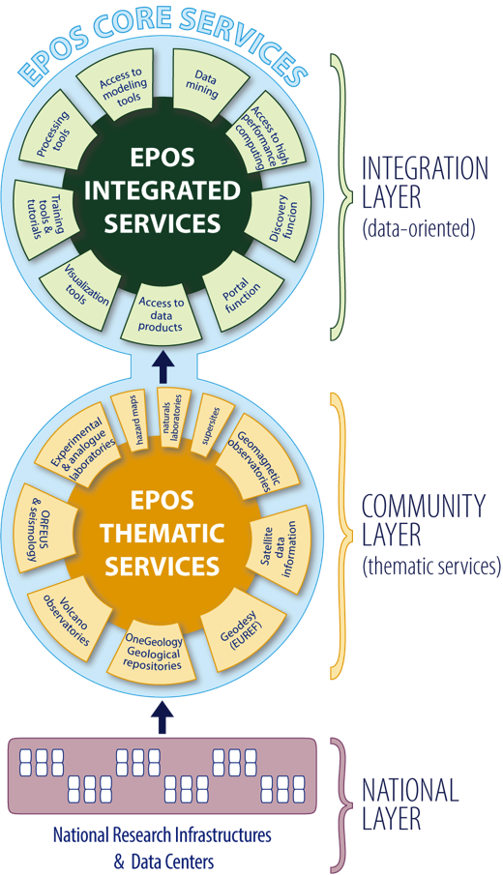
EPOS: organization
EPOS Integrated Core Services
provide simplified access to multidisciplinary data and data-derived products, combine data with modeling results (simulations), processing and visualization tools
Thematic Core Services
community-driven infrastructures provide discipline-specific data services, these will build on pre-existing international collaboration/organizations (e.g. ORFEUS).
The various communities organize their services. Seismology (EPOS-S) will provide and extend waveform data offerings through ORFEUS/EIDA.
National Research Infrastructures and facilities
provide services at national level and send data to the European thematic data infrastructures.

Slide 9
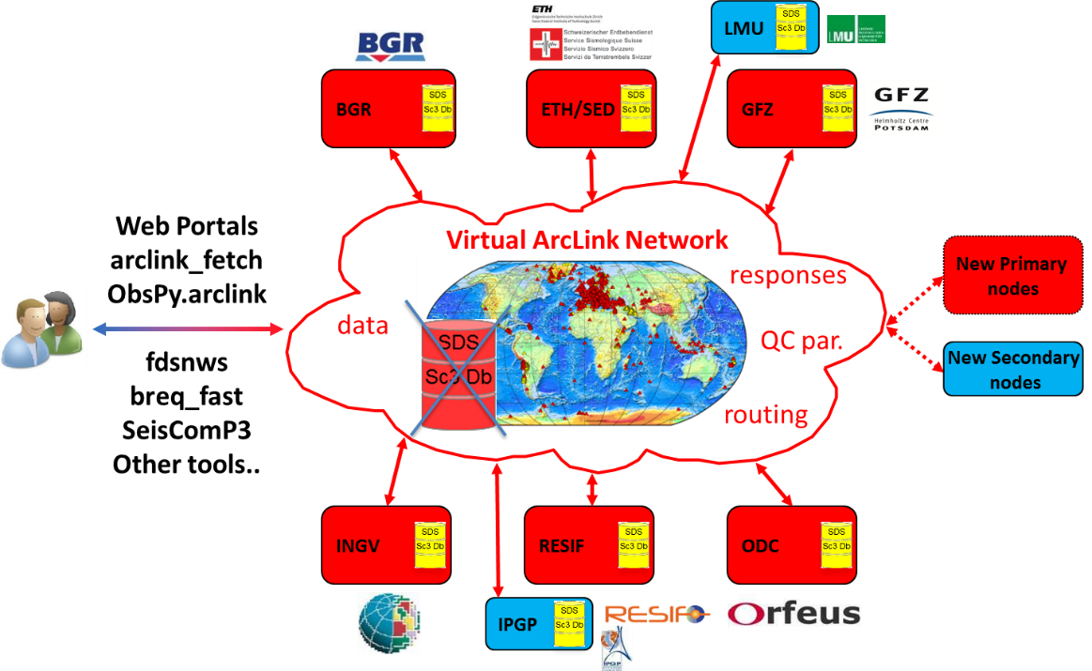
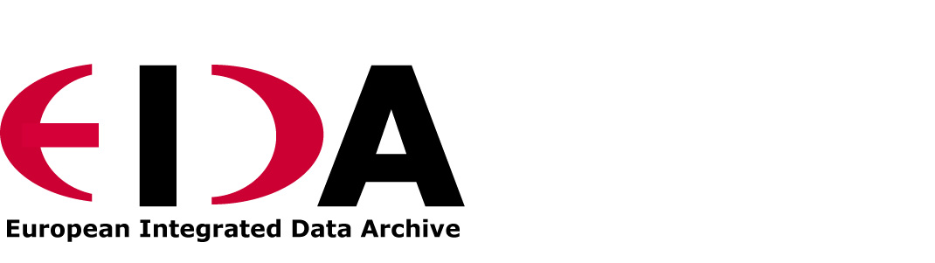

The EIDA uptake pilot
The European Integrated Data Archive is a federated seismological data centre within Orfeus
Romania
Turkey
Greece
http://www.orfeus-eu.org/eida/eida.html
Why EPOS-S / EIDA is the obvious choice for the pilot?
Seismology has a very long tradition and widely recognised culture in data sharing
Existing and widely accepted standards for data formats and exchange protocol
Well-established governance
Very large community within Earth sciences
Shares products and methods with other disciplines
Well-defined development plan

Slide 10
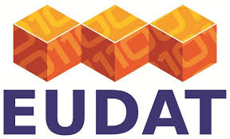
EUDAT – EPOS – EIDA relation
EUDAT:
Community independent
Generic data management services
Generic data discovery
EPOS:
Solid Earth sciences
Community services integration
Organise and foster data standards and sharing and facility access
Cross-discipline data access (brokerage)
Multidisciplinary data-products, data modelling analysis and visualisation tools
EIDA:
Seismology
Key element of the EPOS system
Fundamental service for higher level products
Seismic waveform data and metadata services
Subset selection from DOs
Any other specific community beyond EIDA within EPOS
B2SAFE
B2STAGE
DYNAMIC DATA
TCS
TCS
TCS
B2FIND
ICS
BIG DATA
ICS
ICS

Slide 11
EUDAT Service Uptake by EPOS: objectives
Improve data preservation
Improve data discoverability, reuse and accessibility
Guarantee failsafe and transparent access
Achieve full identification, citation, tractability of data and reproducibility of (scientific) products
Facilitate data movement and analysis of large volumes of data
Evolve EIDA services
Subsequently extend the effort to other EPOS domains and services

Slide 12


EPOS & EUDAT Service Uptake Plan
Data replication and long term preservation (B2SAFE)
        Data replication & long term preservation of archived data to serve as basis of further developments & activities
        Know location of all replica’s for access optimization
Data Staging (B2STAGE)
        Facilitate data movement and analysis of large volumes of data

Slide 13


EPOS & EUDAT Service Uptake Plan
Multi-disciplinary joint metadata catalogue (B2FIND)
Authentication & Authorisation (B2ACCESS)
        Find all EPOS data deposited in B2SAFE
        Federated and multi protocol: Development of an AAI service to be used also outside of EUDAT data centers, to manage user authentication, authorization and identification needs

Slide 14
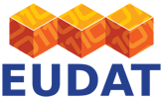
For more information
http://www.eudat.eu/
http://www.epos-ip.org/

