Slide 1

EUDAT, OpenAIRE & DMPs
Sarah Jones
Digital Curation Centre, Glasgow
sarah.jones@glasgow.ac.uk
Twitter: @sjDCC
Data Management Services in the Cloud, Indigo Data Cloud workshop, Barcelona, 4 April 2017

Slide 2

H2020 Open Research Data Pilot
Image CC-BY-NC-SA by Tom Magllery www.flickr.com/photos/lwr/13442910354

Slide 3

H2020 open research data pilot
Already expanded from a select pilot to all work areas
All need to consider which data can be made open
Mantra = “As open as possible as closed as necessary”
Underlying driver is good (FAIR) data management
Image CC-BY-SA by SangyaPundir

Slide 4
Key requirements of the open data pilot
Beneficiaries participating in the Pilot will:
  Deposit data in a research data repository of their choice
  Take measures to make it possible for others to access, mine, exploit, reproduce and disseminate the data free of charge
  Provide information about tools and instruments necessary for validating the results (where possible, provide the tools and instruments themselves)
  http://ec.europa.eu/research/participants/data/ref/h2020/grants_manual/hi/oa_pilot/h2020-hi-oa-data-mgt_en.pdf
Notes:
4

Slide 5
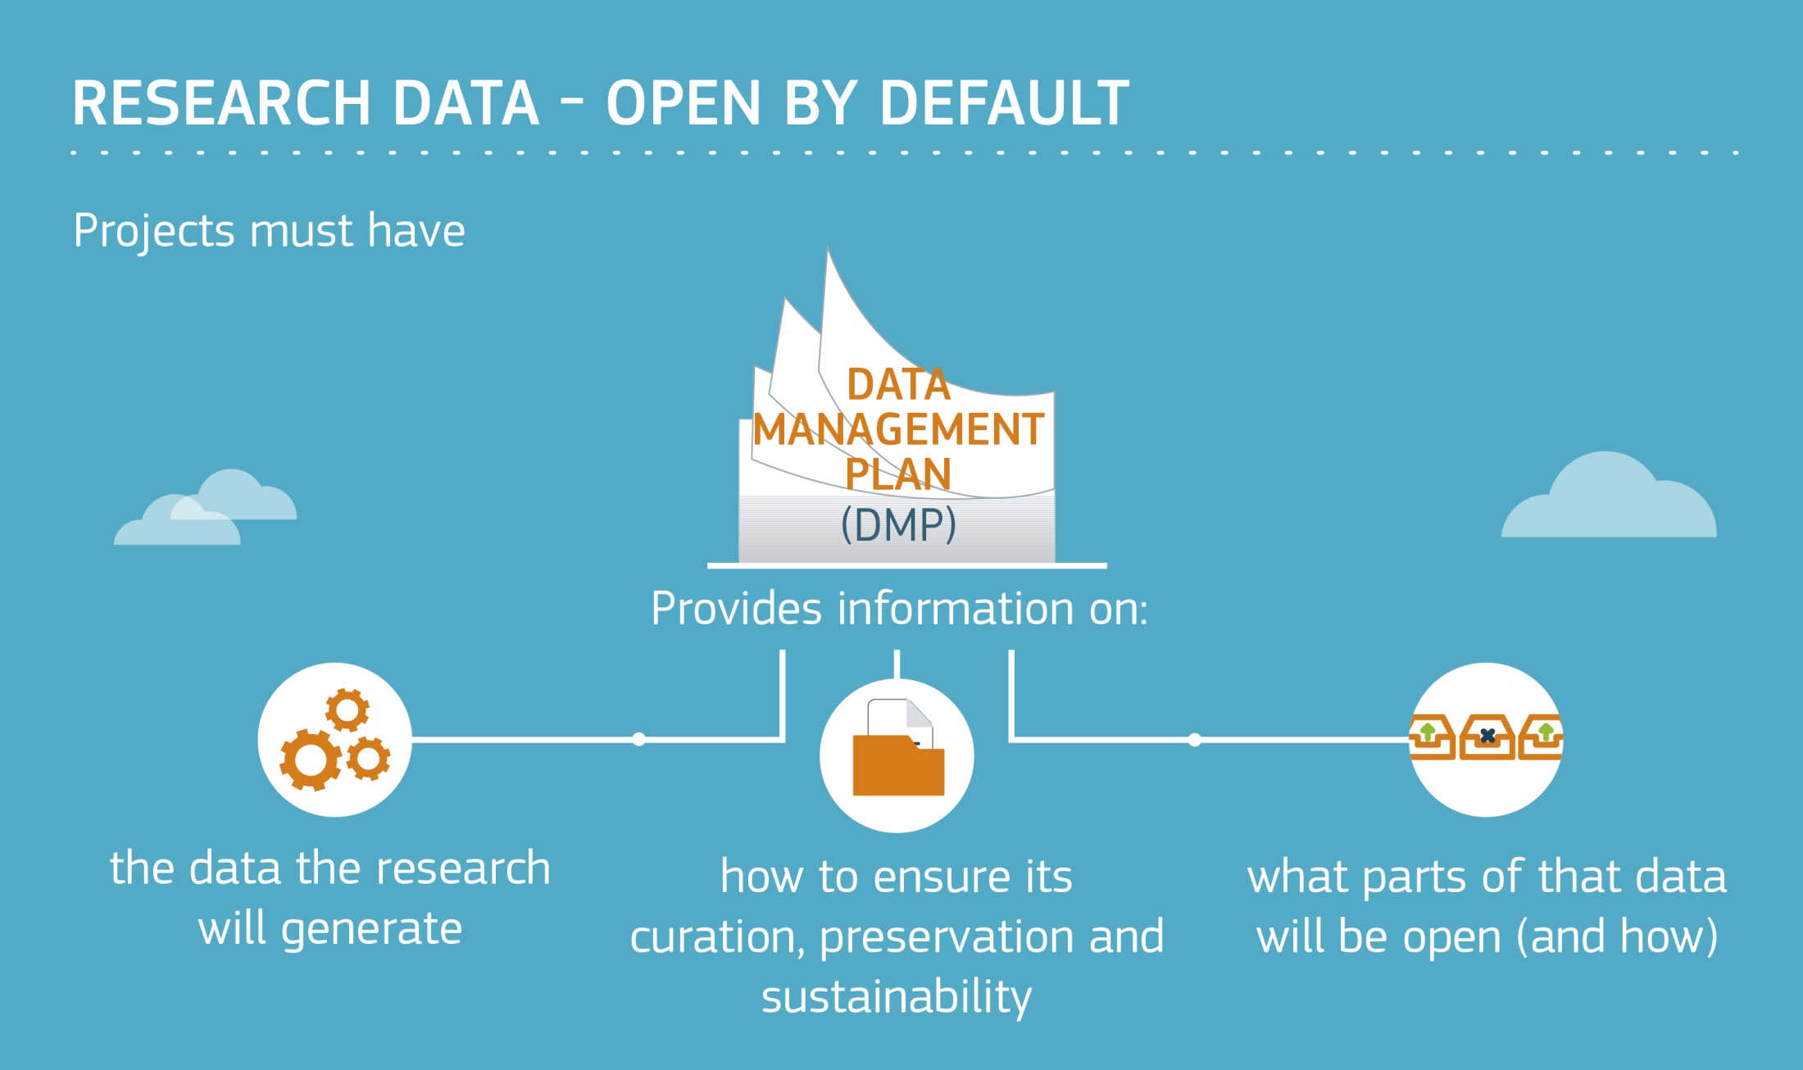

Slide 6
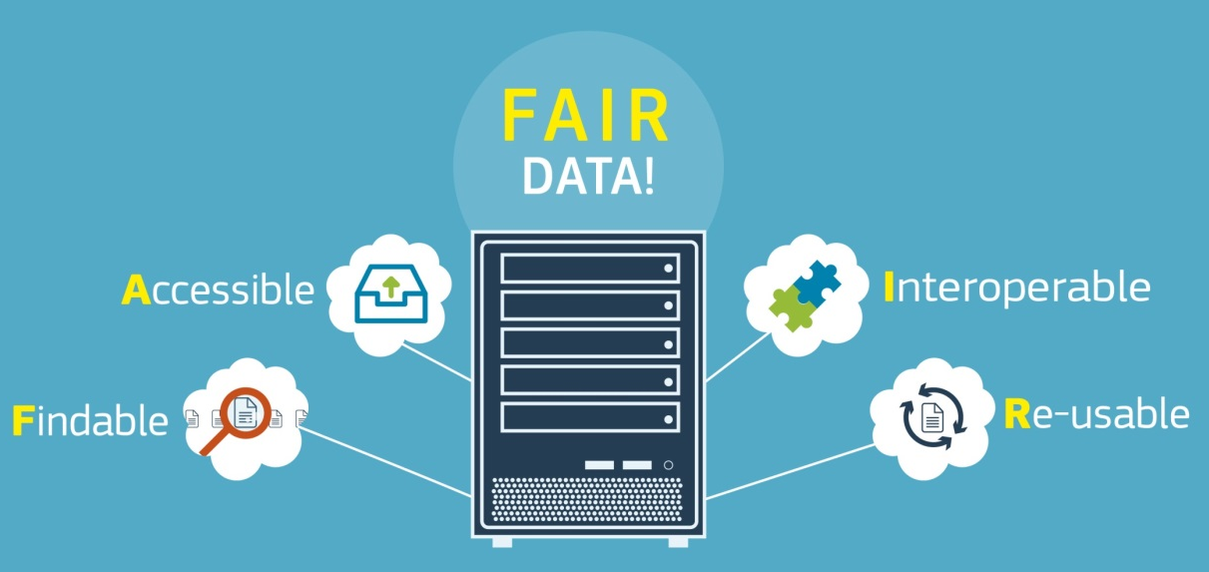
A FAIR approach to DMPs
Findable
  Assign persistent IDs, provide metadata, register in a searchable resource...
Accessible
  Retrievable by their ID using a standard protocol, metadata remain accessible even if data aren’t...
Interoperable
  Use formal, broadly applicable languages, standard vocabularies...
Reusable
  Rich metadata, clear licences,
  community standards
  provenance...
www.force11.org/group/fairgroup/
fairprinciples
Notes:
6

Slide 7
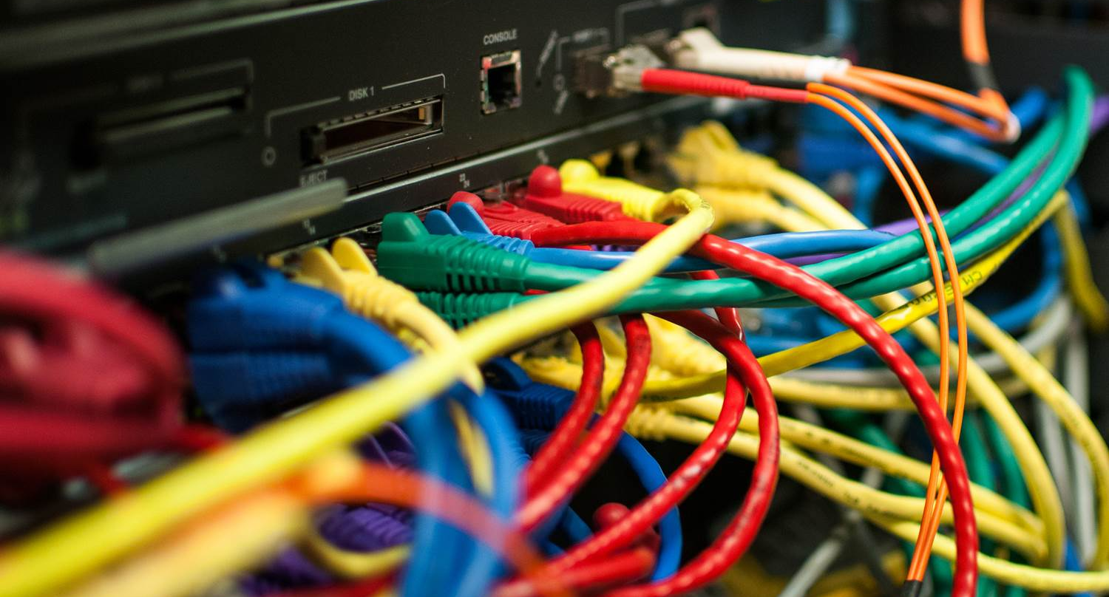
EUDAT service suite
Image CC-BY-NC ‘Data centre’ by Bob Mical www.flickr.com/photos/small_realm/15995555571

Slide 8



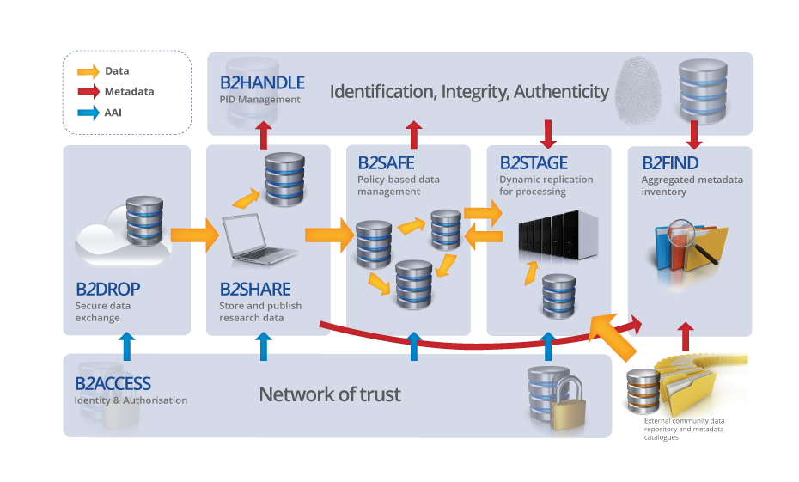




EUDAT Services Suite
EUDAT offers a complete set of research data services, expertise and technology solutions to all European scientists and researchers.
http://www.eudat.eu/services

Slide 9
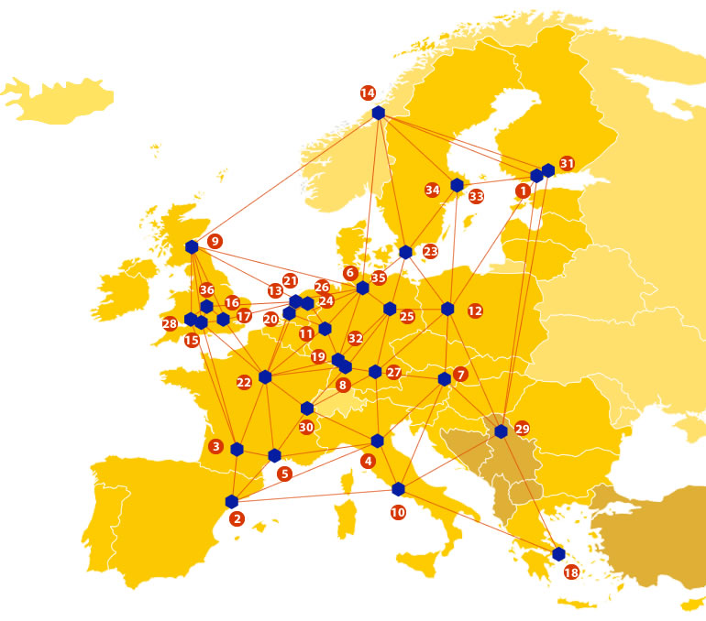
A truly pan-European Infrastructure
EUDAT offers common data services, supporting multiple research communities as well as individuals, through a geographically distributed, resilient network of 36 European organisations
Our vision is to enable European researchers and practitioners from any research discipline to preserve, find, access, and process data in a trusted environment, as part of a Collaborative Data Infrastructure
Solutions are community-driven and built with pilots in different disciplines

Slide 10
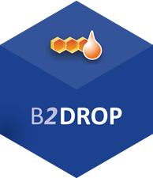
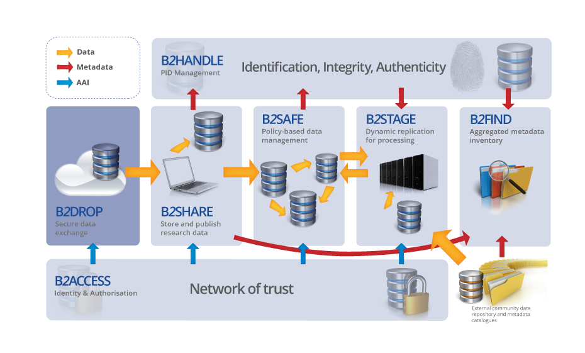
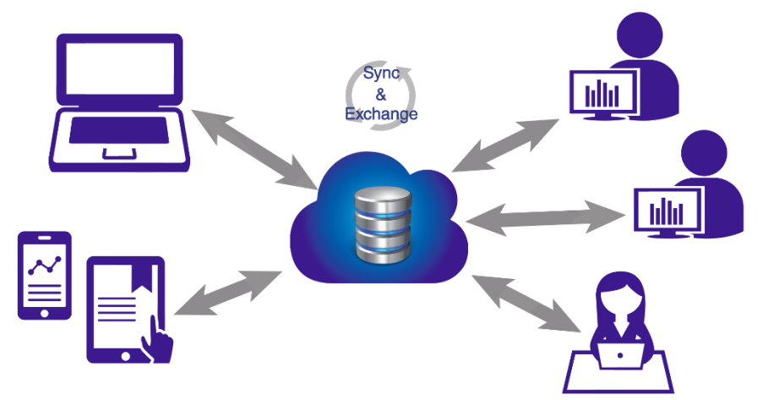
B2DROP – personal cloud
An ideal solution for researchers and scientists to:
Sync and Share Research Data
Store and exchange data with colleagues and team members, including research data not finalized for publishing
share data with fine-grained access controls
synchronize multiple versions of data across different devices
Features:
20 GB storage per user
Living objects, so no PIDs
Versioning and offline use
Desktop synchronisation
b2drop.eudat.eu

Slide 11
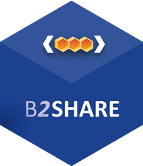
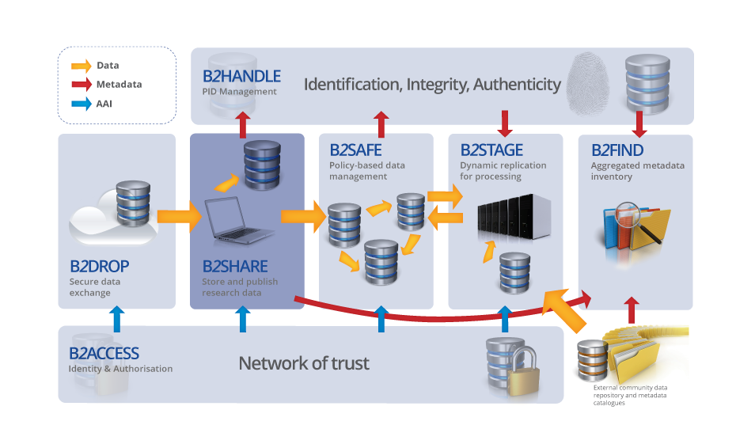
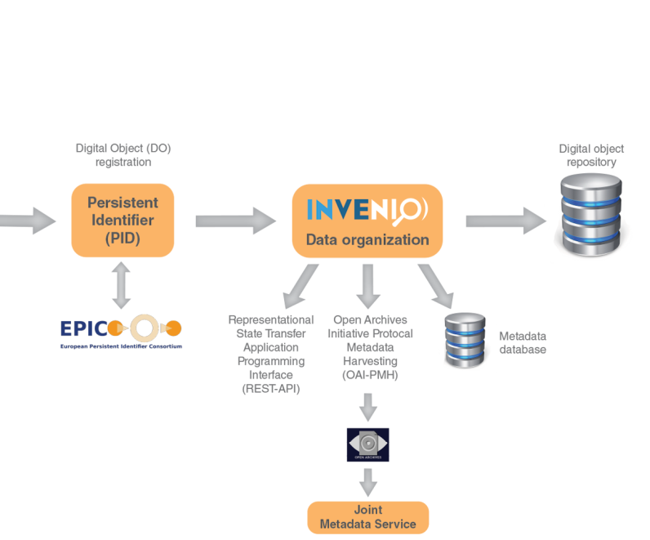
B2SHARE - repository
A winning solution for researchers, scientists and communities to:
Store and Publish Research Data
store data safely at a trusted and certified data centre
preserve data to guarantee long-term persistence
control access and share data with colleagues and the world
Features:
Metadata management
Permanent PIDs
Open Access support
b2share.eudat.eu

Slide 12

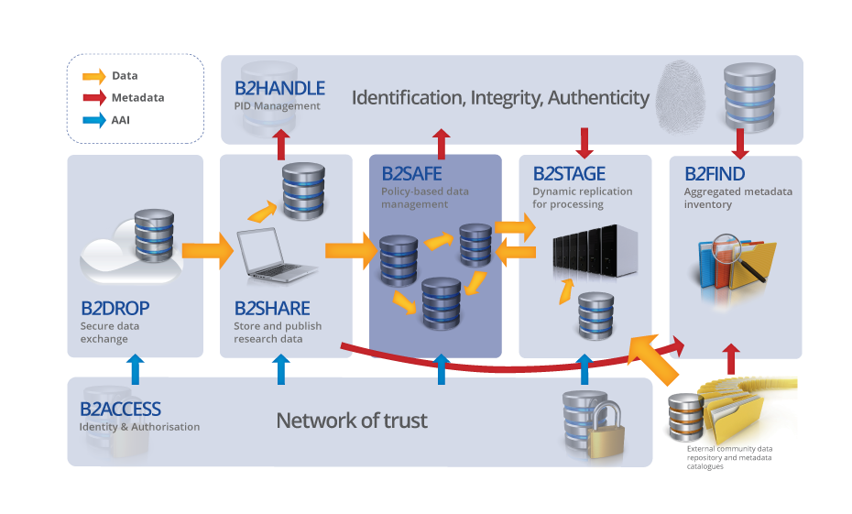
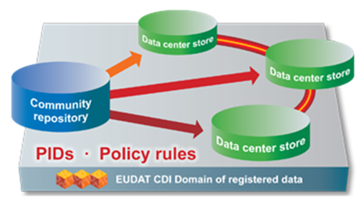
B2SAFE - preservation
The ideal solution for communities with no facility for archival to:
Replicate Research Data Safely
replicate research data into secure data stores
archive and preserve research data in the long-term
bring data close to powerful compute resources
co-locate data with different communities
benefit from economies of scale
Features:
Large-scale storage
Robust and highly available
Permanent PIDs
eudat.eu/b2safe

Slide 13
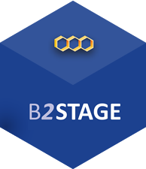
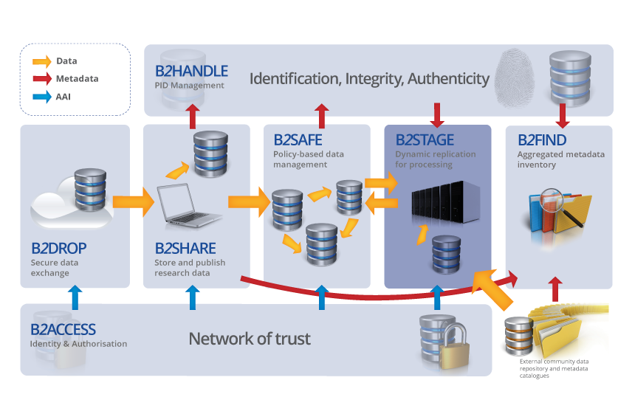
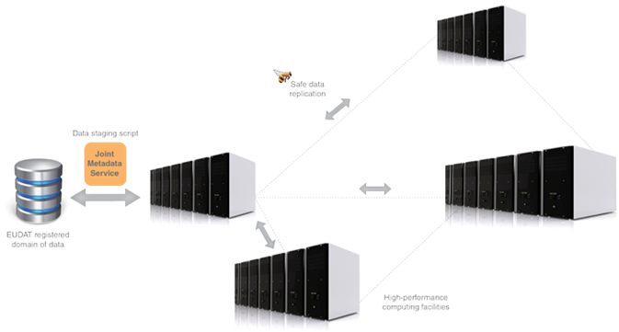
B2STAGE - transfer
Facilitating communities to:
move large amounts of data between data stores and high-performance compute resources
re-ingest computational results back into EUDAT
deposit large data sets onto EUDAT resources for long-term preservation
Get Data to Computation
Features:
High-speed transfer
Reliable and light-weight
Manages permanent PIDs
eudat.eu/b2stage

Slide 14
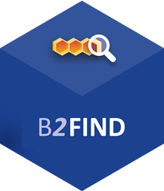
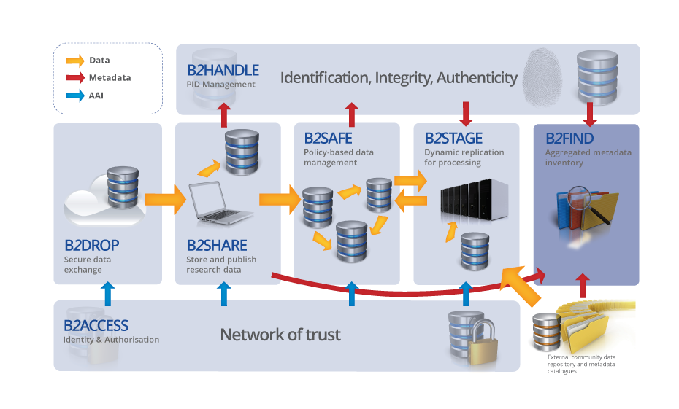
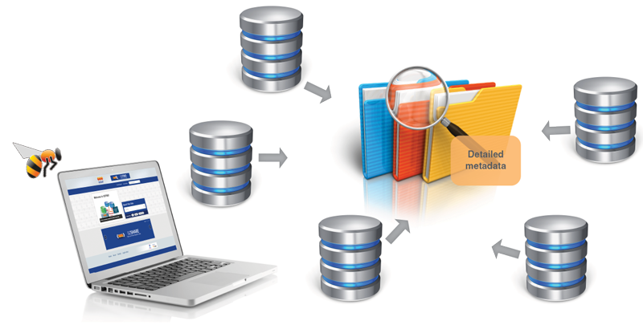
B2FIND - catalogue
A metadata catalogue service to:
Find Research Data
seek data objects and collections using powerful metadata searches
catalogue community data by means of selected metadata
browse through multi-disciplinary data collections filtered by content, provenance and temporal keywords
Features:
Simple to use
Standards-based
Comprehensive catalogue
b2find.eudat.eu

Slide 15
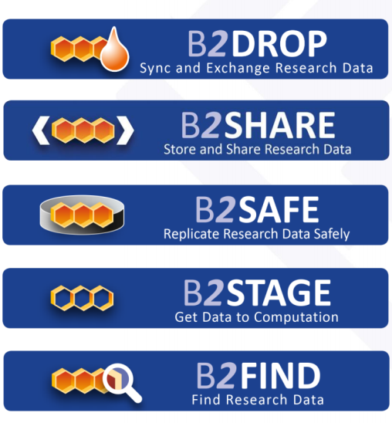

EUDAT support for DMPs
Provide custom guidance in DMPonline flagging EUDAT data services to help implement data management
Potential for example / suggested answers
Plan to connect DMPonline with its internal Data Project Management Tool to generate service requests
EUDAT
DPMT
Researcher answers questions in DMPs
Service request information is automatically transferred to DPMT
Resources are allocated

Slide 16
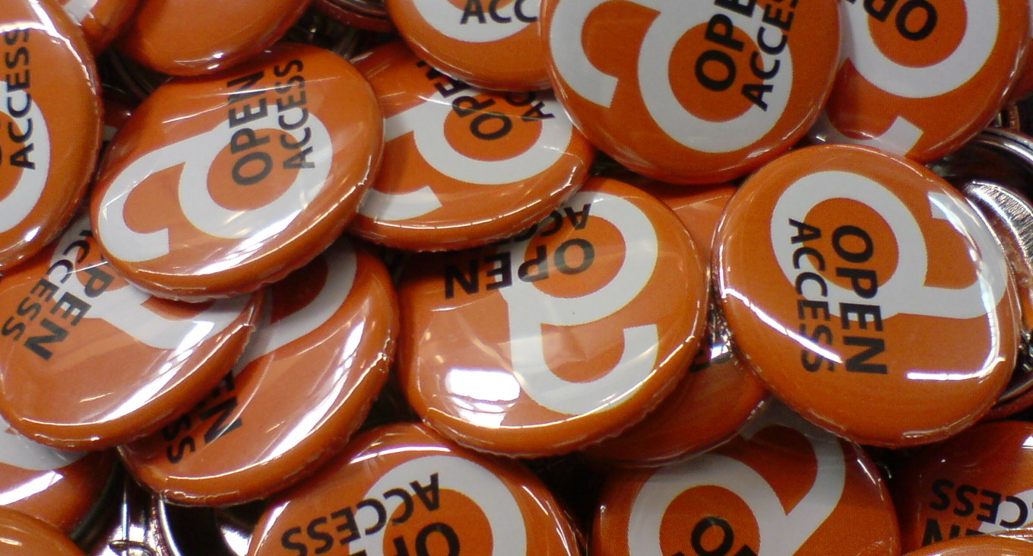
OpenAIRE services
Image CC-BY-SA ‘Open Access Buttons’ by h_pampel www.flickr.com/photos/34070876@N08/3602393341

Slide 17

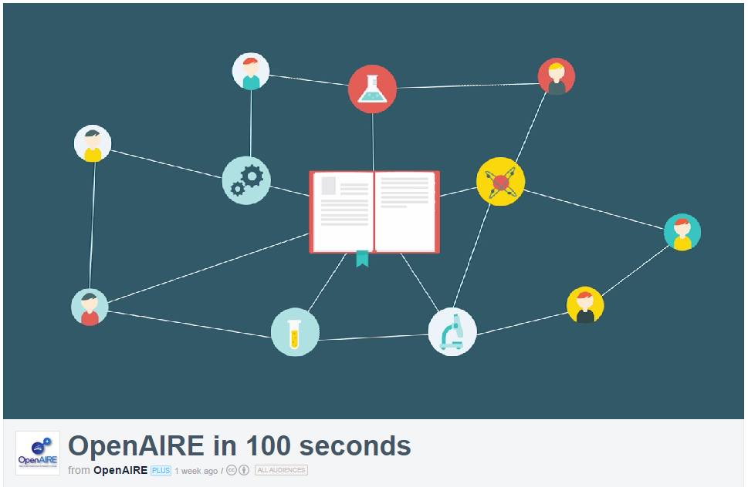
OpenAIRE
Open Access Infrastructure for research in Europe
aggregates data on OA outputs
mines & enriches it content by linking thing together
provides services & APIs e.g.
to generate publication lists
or support EC reporting
lots of guidelines on H2020
Open Data pilot and DMPs
  www.openaire.eu
http://vimeo.com/108790101
Notes:
OpenAIRE is also worth checking out. This is an EC-funded project to provide infrastructure for open access. They’ve recently released a short video that tells you how they can help.
Essentially OpenAIRE aggregates metadata from different repositories to compile a complete list of publications and related outputs. They mine and enrich the content, de-duplicating entries and linking together publications with data, details about the project, authors, funders etc. OpenAIRE also provides a number of useful services & APIs, for example you can embed a publication list for your project in your website that is automatically updated whenever someone adds a new paper to a repository (this is harvested into OpenAIRE and pushed out to your list).

Slide 18

Zenodo
Zenodo is a multi-disciplinary repository that can be used for the long-tail of research data
  An OpenAIRE-CERN joint effort
  Multidisciplinary repository accepting
      Multiple data types
      Publications
      Software
  Assigns a Digital Object Identifier (DOI)
  Links funding, publications, data & software
  www.zenodo.org
Notes:
18

Slide 19
Example H2020 DMPs in Zenodo
Helix Nebula – High Energy Physics example
https://zenodo.org/record/48171#.WATexnriF40
Tweether – engineering (micro-electronics) example
https://zenodo.org/record/55791#.WATei3riF40
AutoPost – ICT example https://zenodo.org/record/56107#.WATefXriF40
More listed at: www.dcc.ac.uk/resources/data-management-plans/guidance-examples

Slide 20
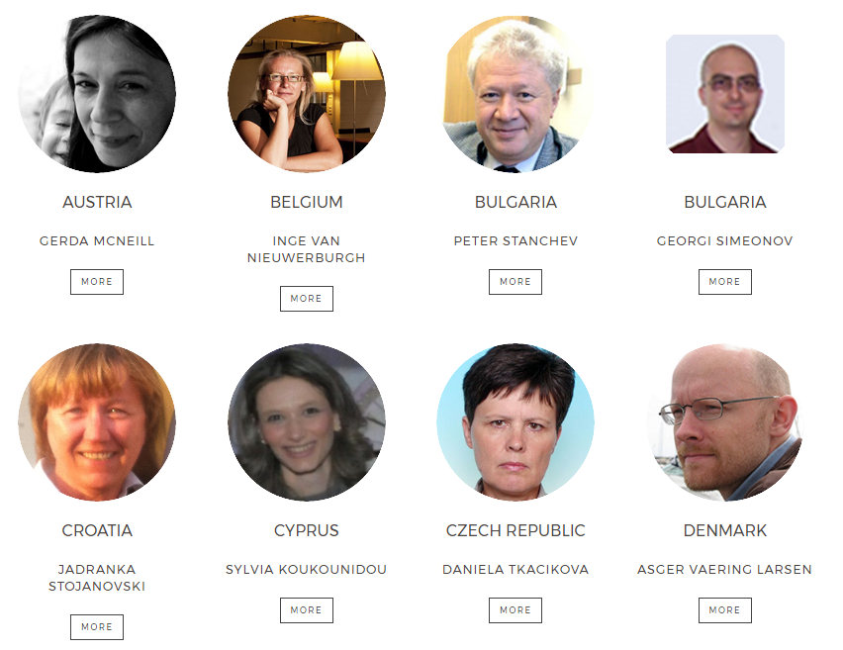
Network of Open Access Desks (NOADs)

Slide 21
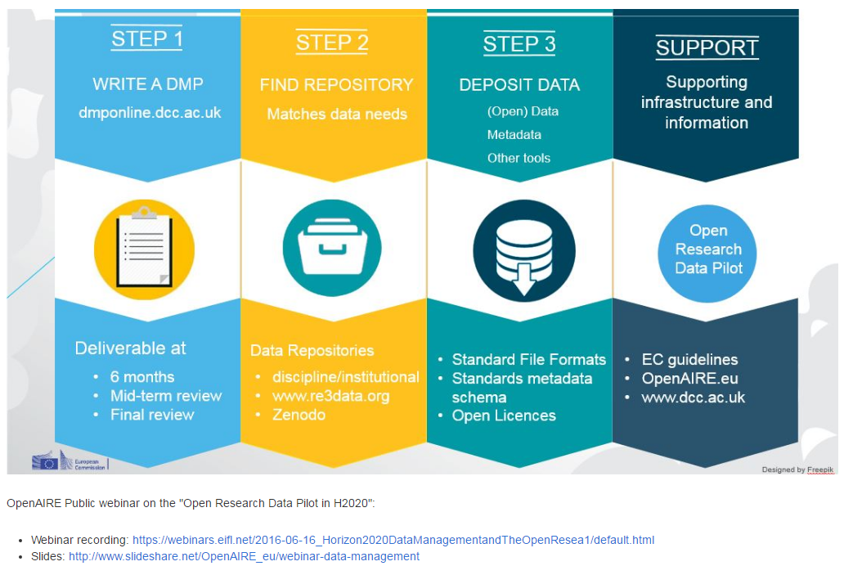
OpenAIRE webinars
www.openaire.eu/webinars

Slide 22
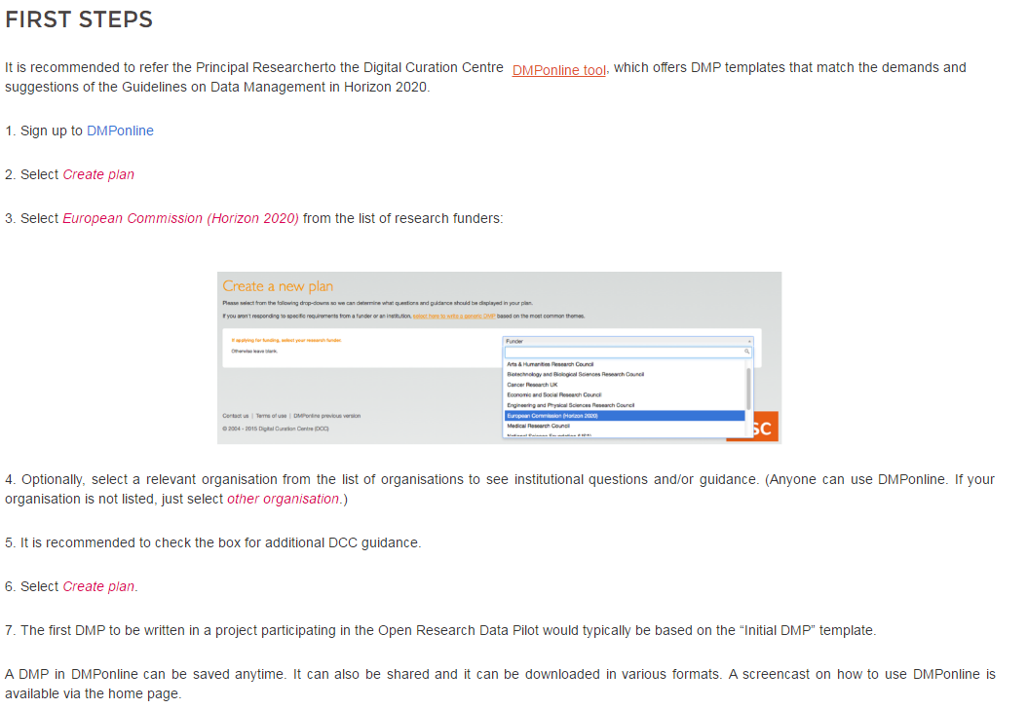
OpenAIRE guidelines on writing DMPs
https://www.openaire.eu/opendatapilot-dmp

Slide 23
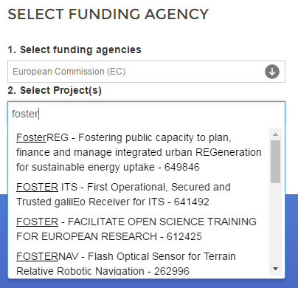

OpenAIRE plans with DMPonline
Adding option to allow projects to deposit DMP in Zenodo as way to publish plan and obtain a DOI
Considering using OpenAIRE API to let PIs select their H2020 project to automatically populate grant ID field and link the DMP with other outputs

Slide 24

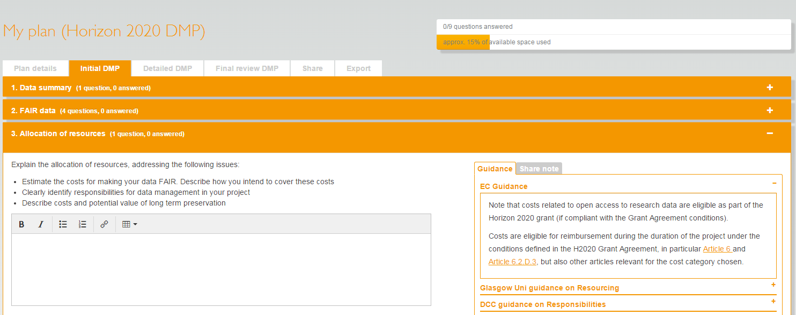
What is DMPonline?
A web-based tool to help researchers write DMPs
Includes a template for Horizon 2020
https://dmponline.dcc.ac.uk

Slide 25
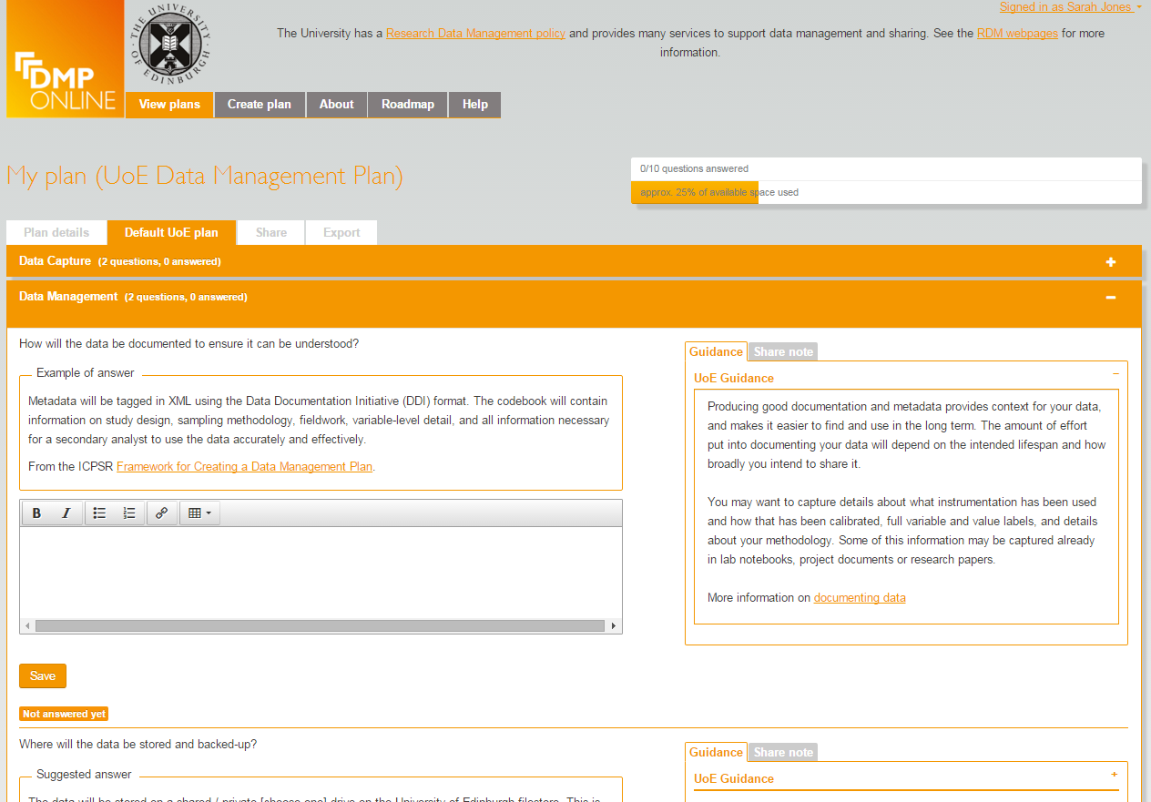
Options for unis to customise
Organisations can:
Add their own template(s)
Customise existing funder templates
Provide example and suggested answers
Local guidance with links to support and services
Include their own logo and text in a banner
Review basic statistics
…

Slide 26
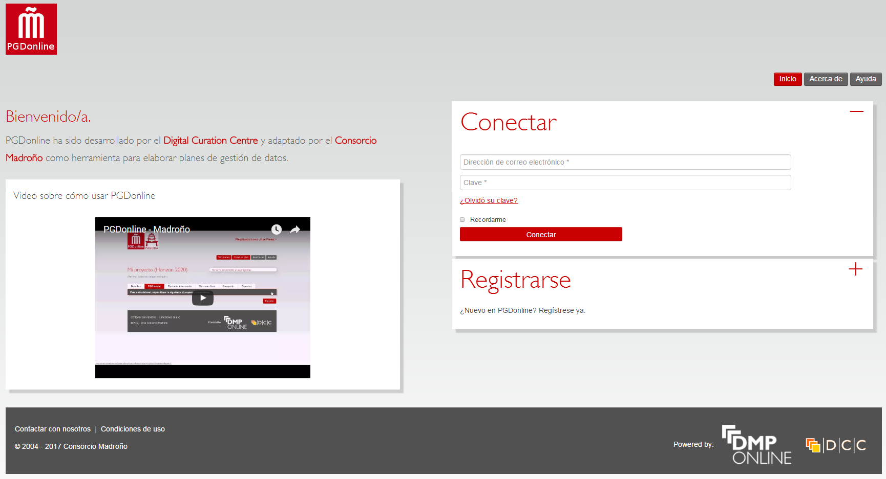
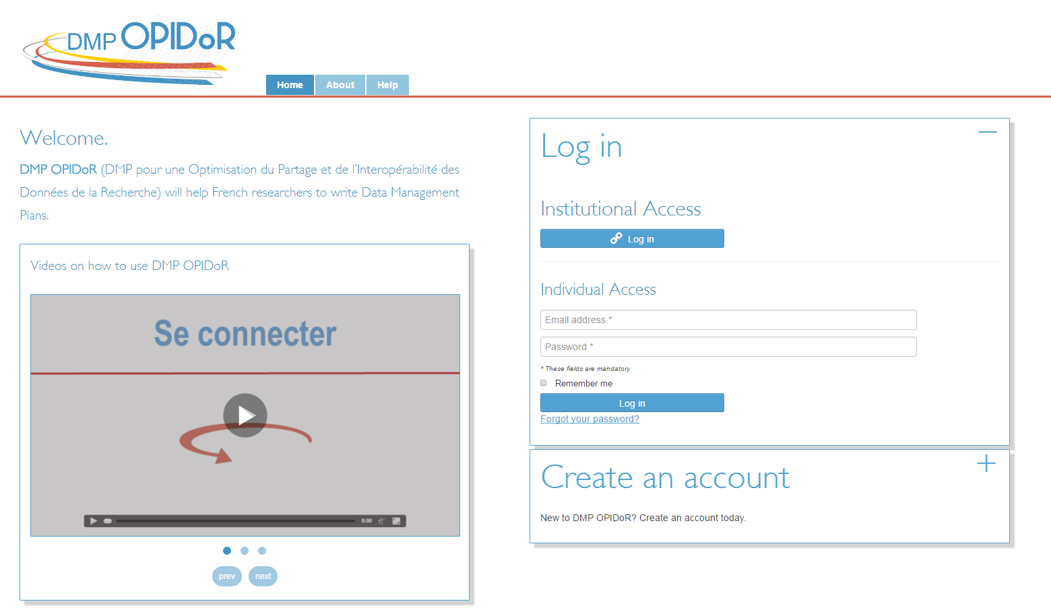
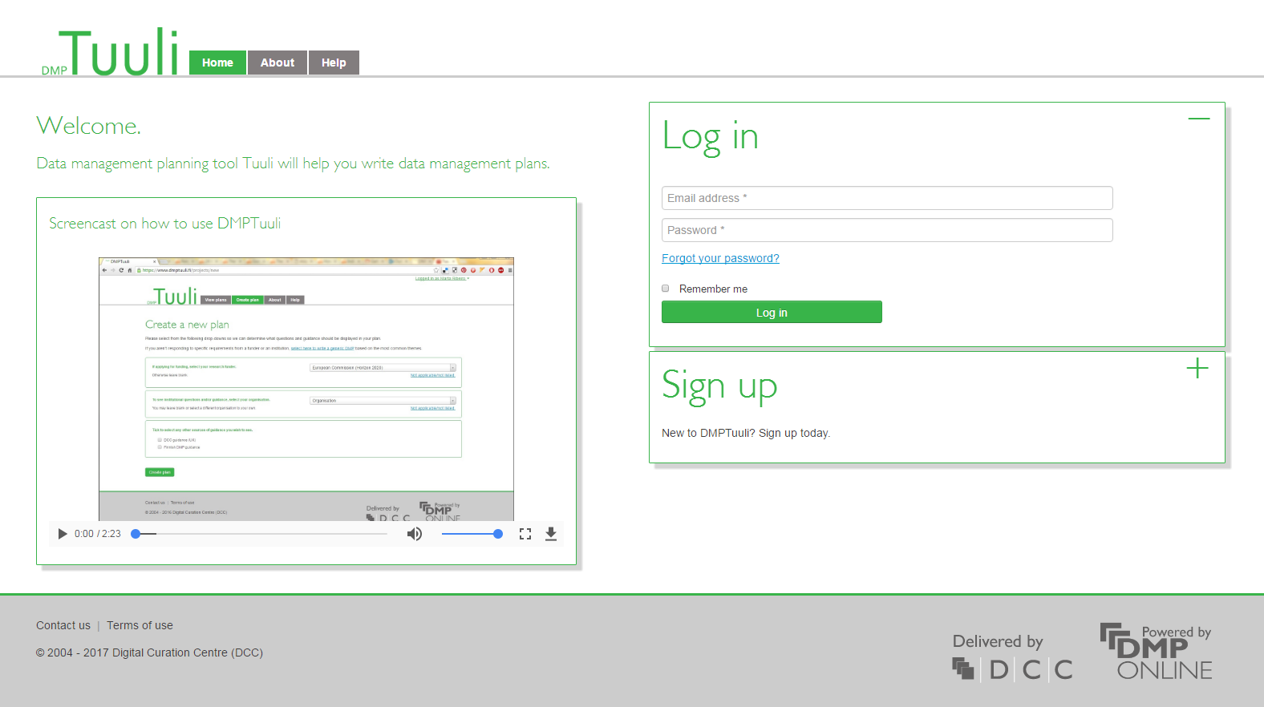
National / local DMP Tools
https://github.com/DMPRoadmap/roadmap/wiki/Local-installations-inventory

Slide 27
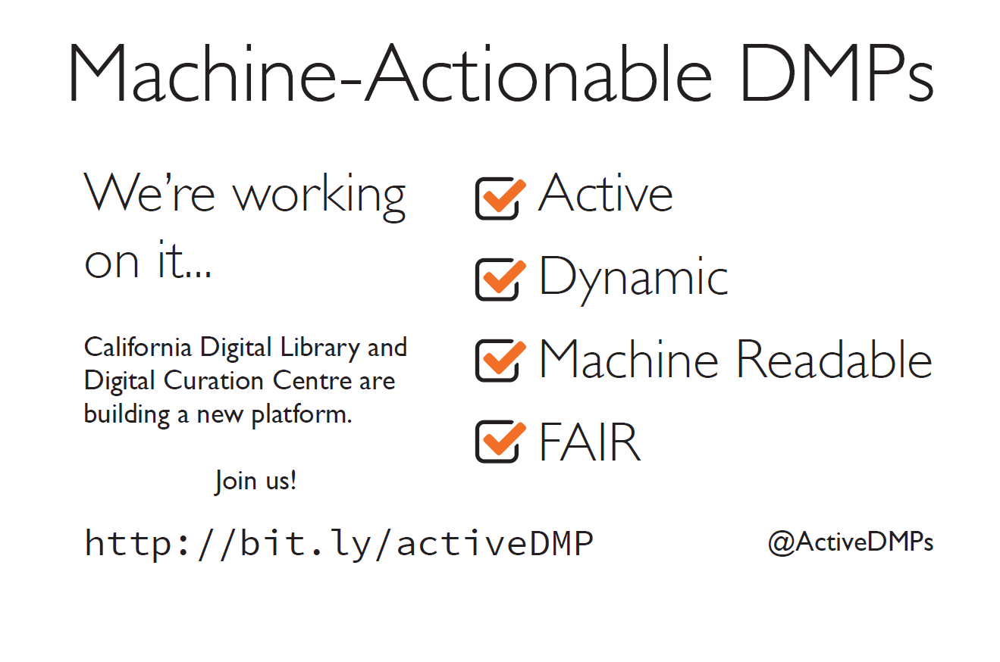

Machine-actionable DMP vision
Connecting services to make DMPs useful to all
Held workshops to define requirements
Released white paper for comments
Join IG Active DMPs on Thursday @ 9:30am
@ActiveDMPs
#ActiveDMPs

Slide 28

Thanks for listening
DCC resources on Data Management Planning
www.dcc.ac.uk/resources/data-management-plans
Follow us on twitter:
@digitalcuration and #ukdcc

