Slide 1


ILÖK - Institute of Landscape Ecology
Münster – 20th May, 2025
An Introduction to Open Data and Open Reproducible Research
Markus Konkol
52°North Spatial Information Research GmbH
m.konkol@52north.org

Slide 2
Learning Goals
Upon completion of this lecture, you will be able to
Articulate what is meant by
  Open Science
  FAIR and Open Data
  Open Reproducible Research
Apply open principles to your own work

Slide 3

Make research outputs transparently available
What does Open Science mean?
Increase diversity of research outputs
Public research = Public good
Level the field
Open hardware
Diverse knowledge producers
Scientific publications
Open source software and source code
Open dialogue with other knowledge systems
Open Scientific Knowledge
Computational infrastructures
Diverse knowledge holders
Open research data
Open Science infrastructure
Participatory science
Open educational resources
Open engagement of societal actors
Repositories
Citizen science
From: https://articles.unesco.org/sites/default/files/2022-09/logo-blue.svg
Further reading: UNESCO Recommendation on Open Science
Notes:
Umbrella term
NEXT
First, Open Scientific knowledge
OA to Sc. publications
Open hardware (specifications)
We will learn about Open research data and Open Source Software and Code later
OER is about providing free access to teaching materials
Focus not on articles only
NEXT
Second, Open Science infrastructures
Repositories
Comp. infrastructures
NEXT
Third, Open engagement of societal actors
Participatory and citizen science
NEXT
Finally, open dialogue with other knowledge systems and producers
For example, indigenous data
Developed by UNESCO
NEXT
Cover 4 principles
Make research outputs transparently available
Increase the diversity of research outputs
Make sure publicly funded research becomes a public good
Level the field and allow everyone to access and contribute to science

Slide 4
Open and FAIR Data
Open Scientific Knowledge
Open research data
Open Science infrastructure
Repositories

Slide 5


The research cycle
Has the number of snow days decreased over time in Germany?
Research question
Reuse
Design study
Publish
Collect data
Peer review
Analyse data
Submit report
Store data + results
Write report
Notes:
Research cycle in a nutshell, steps to achieve new scientific findings
Assume, a climatologist (Amy) observed…
Good researcher, find evidence for observation
decides to carry out study
First, define research question

Slide 6


The research cycle
Research question
Reuse
Design study
Publish
Collect data
Peer review
Analyse data
Submit report
Store data + results
Write report
Notes:
Next step: find a way to answer the research question.
design a study or an experiment.
E.g., search for databases that store data on the number of snow days for the last years at different locations in the Ger.

Slide 7




The research cycle
Research Data is data that was
Observed
Measured
Collected
Created
Generated
to create new research findings
Research question
Reuse
Design study
Publish
Collect data
Peer review
Analyse data
Submit report
Store data + results
Write report
Further reading: Research data management explained - What is research data?
Notes:
Collected data helps to answer her research question → „Research Data“.
Research Data can be very different
depending on the research question study design.
In our scenario we have the number of snow days
But Research data can be sth completely different:
Someone doing research in art – paintings are research data
NEXT
Generally speaking: Research Data can be any data that was observed, measured, collected, created, or generated to create new research findings.

Slide 8



The research cycle
Data analysis using
Analysis scripts
Workflows
In R or Python
Research question
Reuse
Design study
Publish
Collect data
Peer review
Analyse data
Submit report
Store data + results
Write report
Notes:
The next step: apply some statistical methods.
NEXT
could be done using analysis scripts or workflows in R or Python.

Slide 9







The research cycle
Research question
Reuse
Design study
Publish
Collect data
Peer review
Analyse data
Submit report
Store data + results
Write report
Notes:
Amy also needs to consider where to store the research data and the analysis.
She could do that on her laptop but is this a good idea?
What if she spills her drink over her computer.
What if her laptop gets lost on the train?
She might also leave her research institute and return her laptop to the administrator who has no idea about the research data and simply resets the laptop.
The same issues can happen when using external hard drives.
In all these cases, the research data, which is of so much value, is gone.
The issue of storing research data will be a key topic of this session.

Slide 10


The research cycle
Research question
Reuse
Design study
Publish
Collect data
Peer review
Analyse data
Submit report
Store data + results
Write report
Notes:
After she is done with the analysis, she has to write a report summarising all she did + interpretations and conclusions
Aka scientific article

Slide 11

The research cycle
Research question
Reuse
Design study
Publish
Collect data
Peer review
Analyse data
Submit report
Store data + results
Write report
Notes:
This scientific article is what she is going to submit for peer review to a scientific journal or conference.

Slide 12


The research cycle
Research question
Reuse
Design study
Publish
Collect data
Peer review
Analyse data
Submit report
Store data + results
Write report
Notes:
Other experts check the paper and evaluate if her results are sound and valid.

Slide 13

The research cycle
Research question
Reuse
Design study
Publish
Collect data
Peer review
Analyse data
Submit report
Store data + results
Write report
Notes:
paper gets published.
From this moment, other researchers can access the article and read what she investigated.

Slide 14



The research cycle
Where is Amy’s data?
How can I access her data?
Am I allowed to reuse it?
Who should get credit?
Research question
Reuse
Design study
Publish
Collect data
Peer review
Analyse data
Submit report
Store data + results
Write report
Notes:
Others can build upon the work
Answer similar research questions
Find correlations
He needs data she has collected already
Two options
Start from scratch: time consuming, duplication efforts
Reuse her data: save time
Answer several questions
Reusing someone else’s data not as easy as it sounds

Slide 15


The research cycle → RDM challenges → addressed by
Research question
Reuse
Design study
Publish/
archive
Research Data +
Code
Collect data
Peer review
Analyse data
Submit report
Store data + results
Write report
Notes:
That was the research cycle in a nutshell.
As you can see, research data plays an essential role and acts as a building block in every step of the research cycle.
It is not only important for the researcher carrying out a study but also for others aiming to build upon the published research.
And this is where Open Data comes into play.

Slide 16
What is Open Data?
“Data is open if it can be freely accessed, used, modified and shared by anyone for any purpose - subject only, at most, to requirements to provide attribution and/or share-alike. Specifically, open data is defined by the Open Definition and requires that the data be
A. Legally open: that is, available under an open (data) license that permits anyone freely to access, reuse and redistribute.
B. Technically open: that is, that the data be available for no more than the cost of reproduction and in machine-readable and bulk form.”
Further reading: Open Data Handbook
Notes:
According to the open data handbook, “Data is open if it can be freely accessed, used, modified and shared by anyone for any purpose - subject only, at most, to requirements to provide attribution and/or share-alike.
Data has to be open in a legal and a technical way.
Legally open means that data is available under an open (data) license that permits anyone freely to access, reuse and redistribute
Who is working with the data?
Humans, sure, but also software
Hence, data should be also technically open, which means…
that the data be available for no more than the cost of reproduction and in machine-readable and bulk form.”

Slide 17




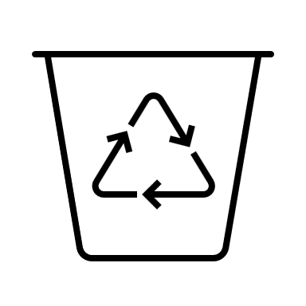

Guiding principles
How can we facilitate reuse? Where shall we store the data? How to clarify usage?
The FAIR Principles are a set of principles for good data management.
  Necessary to achieve high-quality Open Data.
FAIR stands for Findable, Accessible, Interoperable, and Re-usable.
  Can be also applied to algorithms, tools, and workflows.
Support humans and machines to find, access, mix, and re-use data.
Further reading: The FAIR Guiding Principles…, The State of Open Data
Notes:
There are several open questions left.
How can we facilitate the reuse of the research data?
Where shall we store the data?
How can we clarify what others can and can not do with the data?
The FAIR principles will help us to answer these questions.
The FAIR Principles are a set of guidelines for good data management.
essential requirement for publishing useful and high-quality open data.
Increasingly required by funders
acronym that stands for Findable, Accessible, Interoperable, and Re-usable.
not only data in the form of measurements or similar, but also algorithms and tools.
Mentioned earlier: But how do humans work with data?
They are using machines. So, their computers.
For this reason, it is important that the FAIR principles also support machines to find, access, mix, and re-use datasets.

Slide 18










Findable, Accessible, Interoperable, Reusable
Open Science Infrastructure should be not-for-profit!
Further reading: Research Data Repositories: Review…
Notes:
First FAIR practice: Findability of research data
For open data, Need to find a place on the web to store data
Online storage options are called repositories
Own website, dropbox, google drive?
Content not indexed by search engines
Not findable by typing search terms in search engine
Sharing only possible via link
Might not know you or project
Repos exist specifically designed to store research data
Examples of established data repositories, such as, Zenodo, DANS, Open Science Framework, and DRYAD.
There are many more repositories, such as Mendeley data.
Provides all the functions we need to make our data findable…
…for-profit and commercial and thus not in line with Open Science, which requires such infrastructure to be not-for-profit.

Slide 19
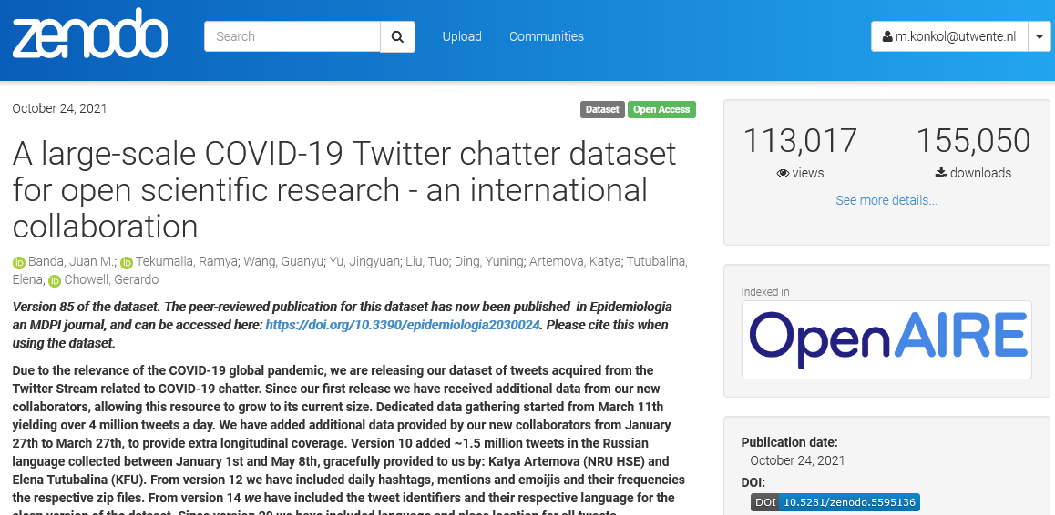
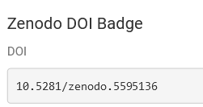

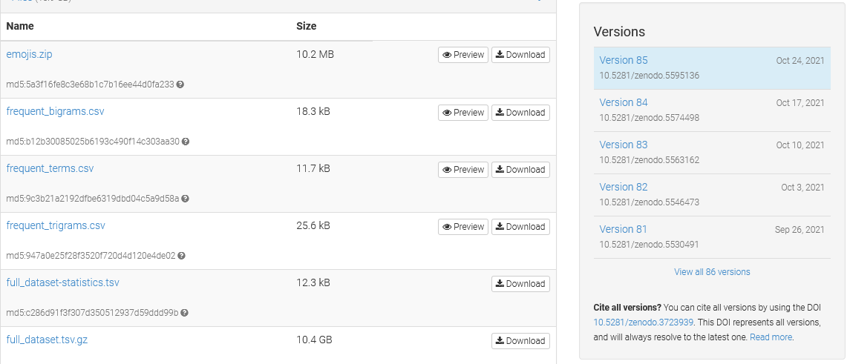
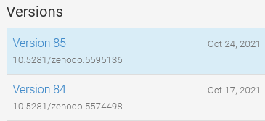
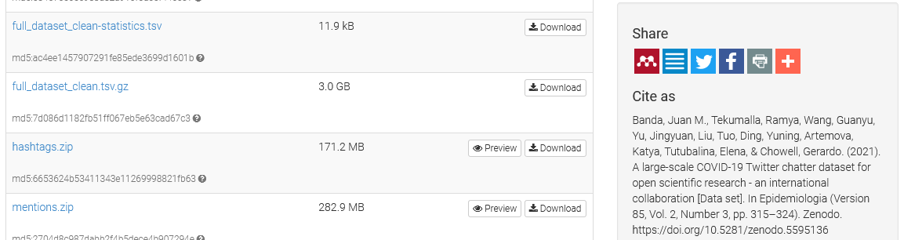
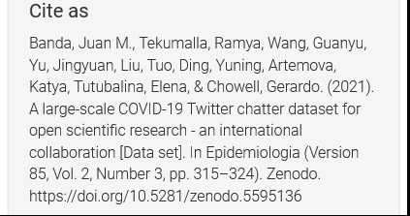





Findable, Accessible, Interoperable, Reusable
Use globally unique and persistent identifiers (e.g., DOI - digital object identifier).
Further reading: A large-scale COVID-19 Twitter chatter dataset for open…
Notes:
Another fair principle to make RD findable is to use globally unique and persistent identifiers.
Such identifiers are a special type of web address.
URLs to your website is also a web address and it’s also unique.
It is unique, yes, but it is not persistent.
This means that URLs can change but persistent identifiers cannot change.
If your research data is stored in a persistent way, you also cannot just delete or modify the data.
The most common persistent identifier for research materials is the Digital Object Identifier, in short DOI.
NEXT
What you see here is an example of a dataset stored on the research repository Zenodo.
NEXT
As you can see, the dataset also has a DOI.
NEXT
Versioning of datasets
NEXT
DOI also part of citation
If you are re-using someone else’s research data, you have to copy this snippet and cite the reused data in your work.

Slide 20
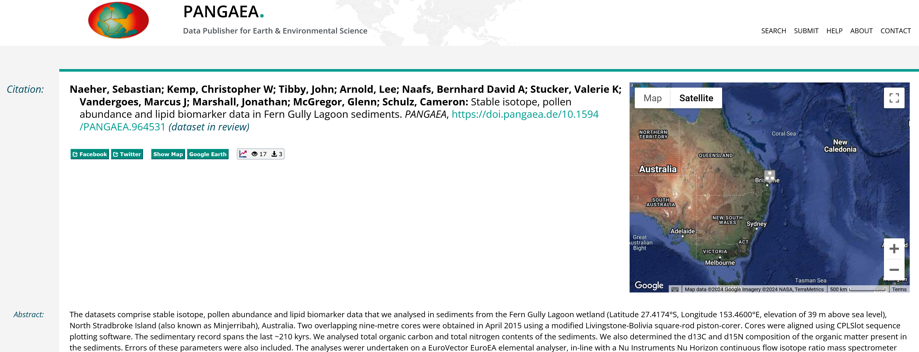
Findable, Accessible, Interoperable, Reusable

Slide 21
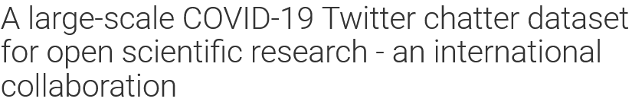
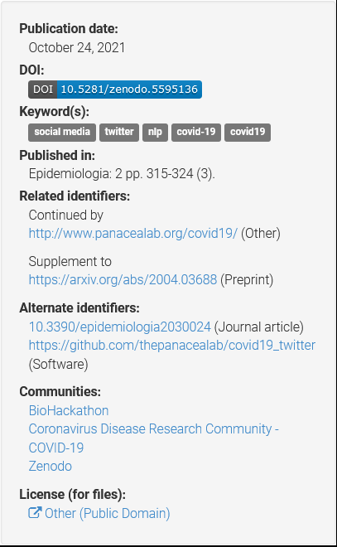
Findable, Accessible, Interoperable, Reusable
Describe data with rich metadata.
Title
Creator
Description
Publication date
DOI
Keywords
Publication
Identifiers to related resources
License
Notes:
To make our research data findable, the FAIR principles suggest describing the data with rich metadata.
In simple words, metadata is data that describes other data.
This information can help users to understand your data quickly, which makes reuse much easier.
What kind of metadata is important?
Just imagine you are searching for research data.
You would probably start with typing some search terms into a search engine.
NEXT
Match with title and description.
Creator
Publication date.
NEXT
Keywords
more information needed.
The DOI has to be part of the metadata, too.
related identifiers
License
And that’s already a very basic set of metadata that should be there for every research data.

Slide 22
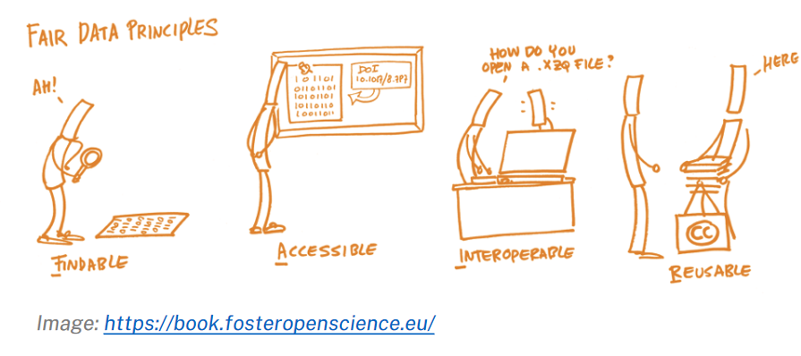
Findable, Accessible, Interoperable, Reusable
Decide which research data you want to deposit:
  Is the data needed to reproduce your work?
  Could the data be reused?
  How costly is a replication of the data?
  Is the data unique?
  In general: As open as possible, as closed as necessary.
Legitimate reasons for restricting data access to protect:
  Human rights, national security, and confidentiality.
  The right to privacy and respect for humans (GDPR).
  Intellectual property rights, sacred and secret indigenous knowledge.
  Rare, threatened, or endangered species.
Further reading: Looking after and sharing your data

Slide 23
Findable, Accessible, Interoperable, Reusable
Interoperability: Ability of data or tools from non-cooperating resources to integrate or work together with minimal effort.
Solution: Achieve consistent data scheme through ontologies.
Semantical interoperability is about interpreting data in a meaningful way.
Syntactical interoperability is about how the data is packaged.
Location | Temperature (°C)
Munich | 20
Berlin | 17
Hamburg | 25
City | Temp (°F)
Mun | 21
Ber | 18
Ham | 22
1st June, 2021
August, 2nd 2021
Further reading: Interact to Interoperate, The FAIR Guiding Principles for scientific data…
Notes:
Research data should be also interoperable.
What does that actually mean?
NEXT
Interoperability is the ability of data or tools from non-cooperating resources to integrate or work together with minimal effort.
important if you collect datasets from different sources and would like to combine them into a single dataset.
But this is not as easy as it sounds.
NEXT
simple example.
Temperature for different cities
NEXT
another table from a different source.
It provides the same information but not in the same way.
NEXT
The column headings are different,
NEXT
the temperature scale is different,
NEXT
the cities are encoded in a different way,
NEXT
and even the date format is different.
In theory, possible to merge them into a single file, manual work.
imagine we have hundreds of datasets and hundreds of different columns.
We also cannot simply use tools to merge these diverse datasets, because how should a tool know that Ham stands for Hamburg and not for food?
NEXT
The issue of interpreting data in a meaningful way is called semantical interoperability.
NEXT
Consequently, the FAIR principles on interoperability suggest using a formal, accessible, shared, and broadly applicable language for knowledge representation.
One example for such a knowledge representations is the Web Ontology Language, which can help to achieve consistency in a data scheme.

Slide 24
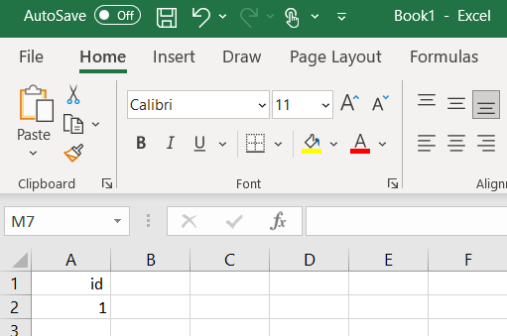
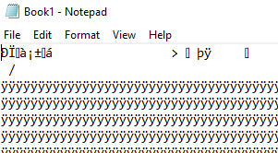
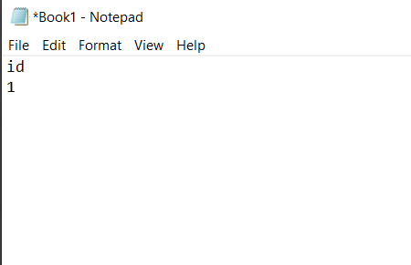
Findable, Accessible, Interoperable, Reusable
Saved as .xls (closed format)
Saved as .csv (open format)
Further reading: Dispelling common data sharing myths
Notes:
Simple example to illustrate the issue around syntactical interoperability

Slide 25
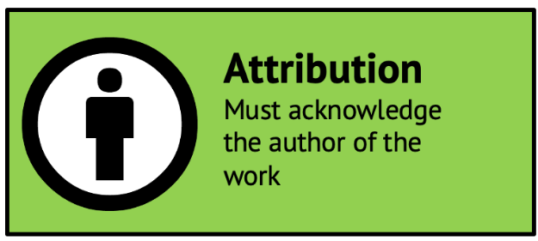
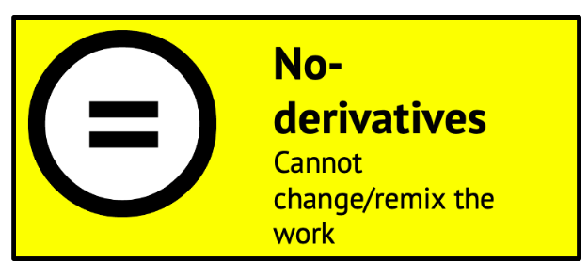


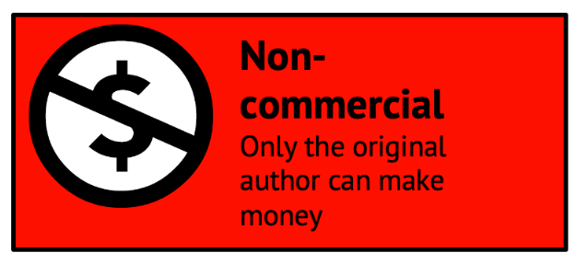


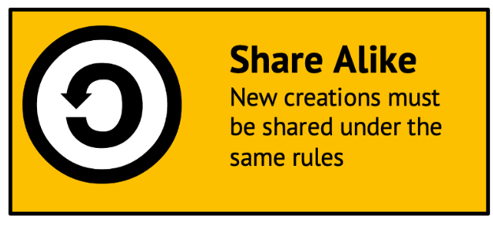

Findable, Accessible, Interoperable, Reusable
Creative Commons (CC) is one of the most common licenses for articles and data.
Further reading: Introduction to Creative Commons, Open by default: A proposed copyright license…, Licensing fair data for reuse, "Introduction to Creative Commons Licenses" by Amy Theobald is licensed under CC BY 4.0

Slide 26
"There is no re-usability of data without the code and the algorithms. The data itself does not speak.“
Gilberto Camara, 2022
Open source software and source code
Open Scientific Knowledge
Computational infrastructures
Open Science infrastructure
Open Reproducible Research
Repositories
Notes:
Problem: strong focus on data, not so much on algorithms, workflows etc.
"There is no re-usability of data without the code and the algorithms. The data itself does not speak.“

Slide 27
Same same, but different
Reproducible research refers to achieving the same results (e.g., tables, figures, numbers) as reported in the paper by using the same source code and data.
In Open reproducible research, these materials are publicly accessible.
Replicable research refers to coming to similar conclusions based on the same analysis, but newly collected data.
Replicability & reproducibility are essential for scientific work.
Further reading: Goodman et al. (2016)
Notes:
Reproducible Research refers to…
Reproducibility in literature, confusion, similar terms
Replicable research…
NEXT
Which refers to…

Slide 28
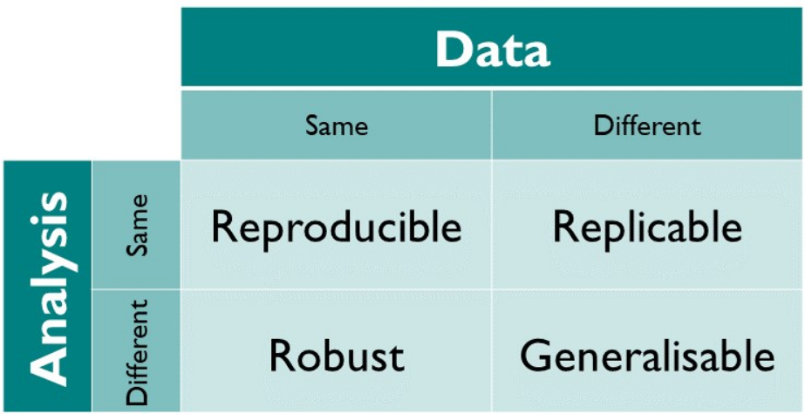
Same same, but different
Further reading: The Turing Way
Notes:
more complicated, more terms
The Turing Way project provides a nice overview of existing terms and what they mean.
NEXT
In this lecture we will focus on reproducibility.
Actually, it sounds like reproducibility is easier than replicability, right?
You just need to use the same data, the same code, run it, and your are done.
But is it really that easy?

Slide 29
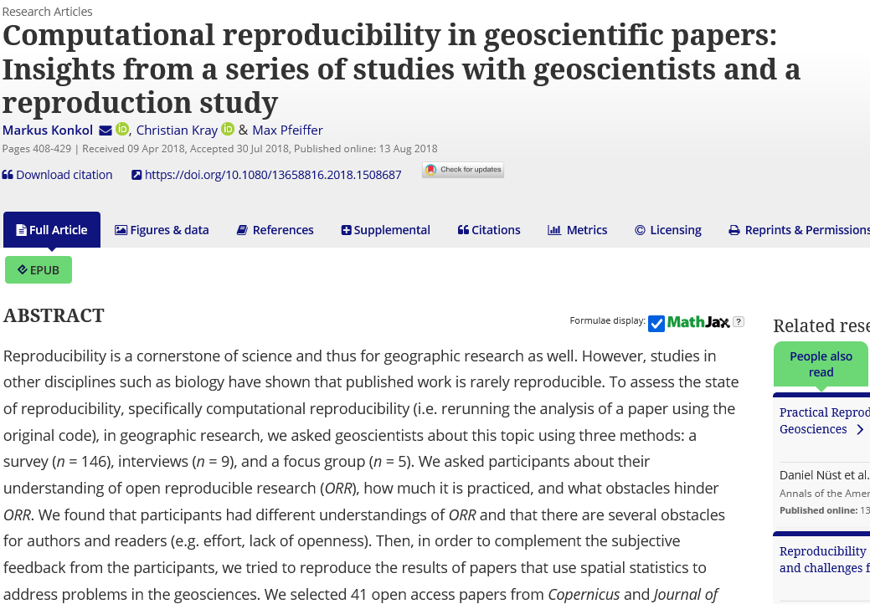
The Reproducibility Crisis
Checked 41 papers that had code and data attached for executability and reproducibility.
2 out of 41 papers were executable + reproducible.
Several technical difficulties.
Several content-related differences.
More on that later…
Further reading: Konkol et al. (2018)
Notes:
I did a study in the geosciences.
I investigated 41 geoscientific articles that had code and data attached and checked whether the results are reproducible, i.e., whether the code is executable and whether the output is the same as reported in the paper.
Only 2 out of 41 papers were reproducible.
The remaining papers were either not executable or produced different results.

Slide 30
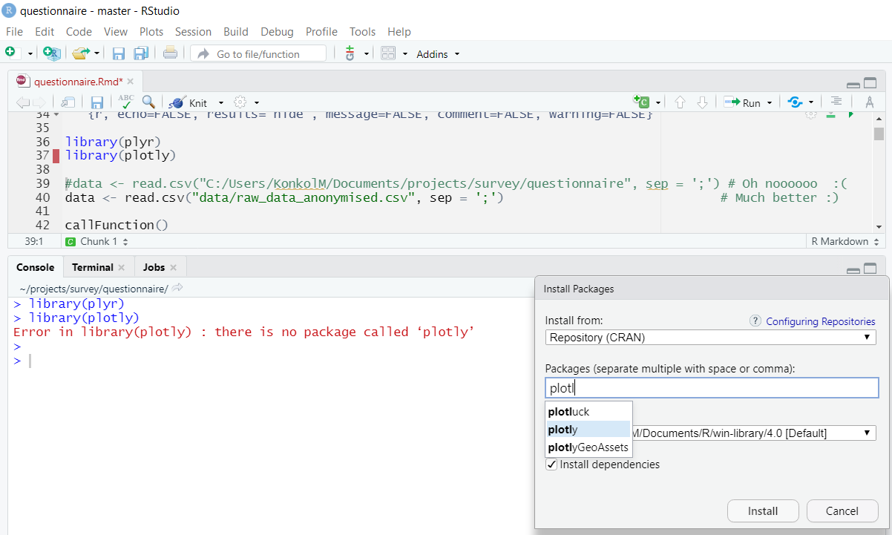
Technical obstacles impeding ORR
Three categories of technical issues.
Minor issues rather easy to solve.
Example: Library not found but available in repository.
Further reading: Konkol et al. (2018)
Notes:
Explain reprod study:
Search for paper with R code and data
Already great, not common
Executable + same results?
Downloaded materials, ran on my computer
Not easy as it sounds, only 2 out of 41 reprod
What happened to the rest?
NEXT
classified technical issues into several categories.
Minor issues
NEXT
…example
NEXT
The script throws an error because the library “plotly” is not installed.
NEXT
Not a big problem, takes just a few clicks
Many minor issues are also a big problem

Slide 31
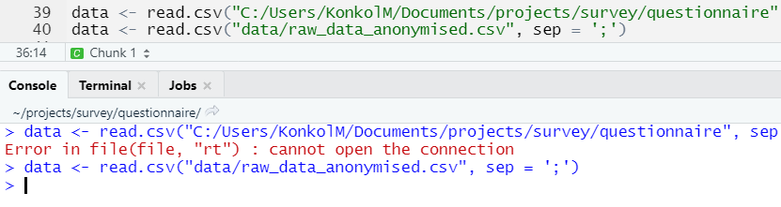
Technical obstacles impeding ORR
Substantial issues require more effort.
Example: Wrong file directory.
Solution: Use relative instead of absolute file paths.
Further reading: Konkol et al. (2018)
Notes:
also encountered…
…substantial issues, require more effort
For example, a wrong file directory that tried to load some data from a local folder.
NEXT
This source code line tries to load data from the file directory C:\Users\KonkolM\Documents and so on.
absolute file path will only work on my machine.
path is windows-specific due to the C colon at the beginning.
will not work on another system, for example, Ubuntu.
NEXT
It’s better to use relative instead of absolute file paths.

Slide 32

Technical obstacles impeding ORR
Severe issues require time, knowledge about the programming language, and understanding of the source code.
Example error: cannot open file dataABC.csv. No such file or directory.
  Was the file available in the folder? No
  Was the file created by the source code? No
  Contact author → get missing source code snippet that produced dataABC.csv.
Solution: Ask a colleague to run your analysis.
Further reading: Konkol et al. (2018)
Notes:
Most problematic: severe issues
NEXT
require quite some time to solve.
Understanding of how the code works
Figure out how to solve the error
Requires knowledge about programming language, not everyone has these skills
example:
NEXT
file could not be opened because there was no such file or directory.
NEXT
Checked if the file is in the folder - no
NEXT
Checked if code creates file - no
NEXT
contacted author and asked how to solve this issue.
a source code snippet was missing that produced this file.
NEXT
ask a colleague to run your source code.
Because if your analysis runs on someone else’s computer, it’s not unlikely that it will run on many other machines as well.

Slide 33
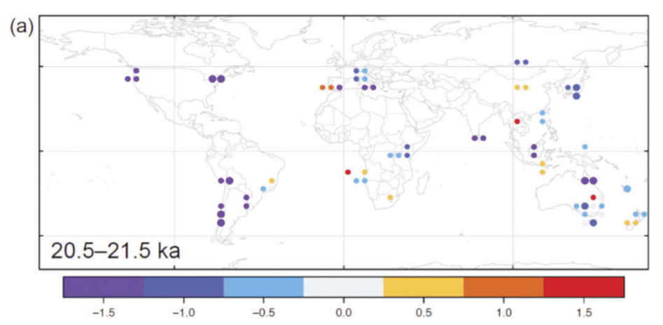
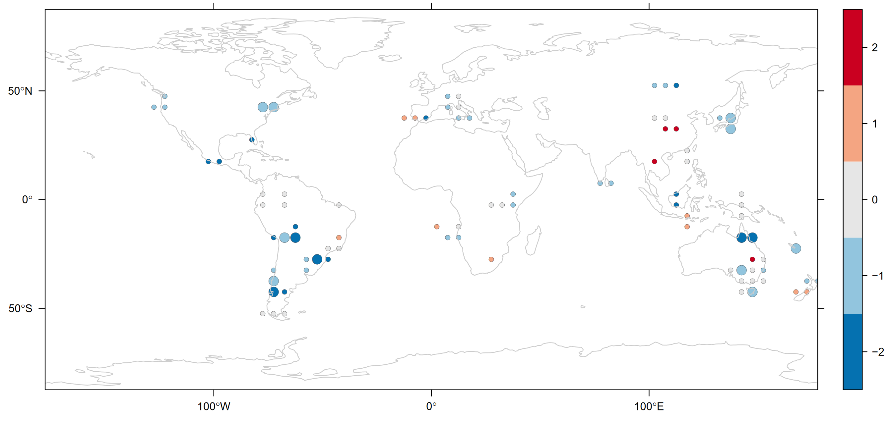
Technical obstacles impeding ORR
Original figure
Reproduced figure
Further reading: Konkol et al. (2018)
Notes:
Managed to get code running
Compared original/reprod figure in a side-by-side manner.
NEXT
example.
Left: screenshot of the original map from the paper.
Right: map that I got when I ran the code.
Highlighted some of the differences.
NEXT
orange rectangle: reproduced map does not have national borders
NEXT
Blue rectangle: scale bar is on the right and not below the map as in the original figure.
Am I too fussy? Maybe…
→ design-related differences.
Design not that important?
- difficult to check for reprod
NEXT
Yellow: The scale bar has only five classes whereas the original one has seven.
NEXT
Green: two points do not exist in the original map
actual numbers are also different.
Am I still too fussy? I don’t think so.
And this is where it is getting serious.
But why is that?
Any ideas?
Nobody knows what happened, contacted authors, were suprised
speculate:
played with the parameter settings and lost track
changed the code after they inserted the figure in the paper and forgot to update the figure?
changed the code after they published the paper and I downloaded a newer version of the code.

Slide 34
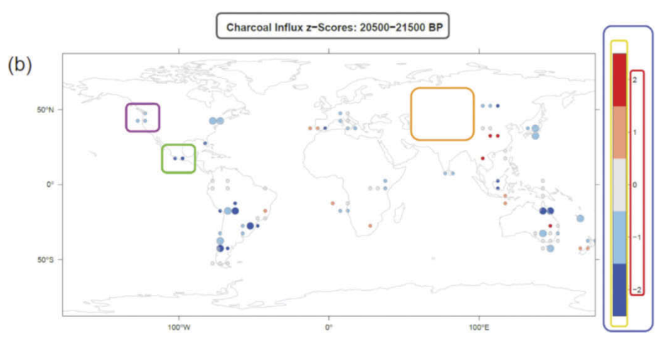
Technical obstacles impeding ORR
Original figure
Reproduced figure
Further reading: Konkol et al. (2018)
Notes:
Managed to get code running
Compared original/reprod figure in a side-by-side manner.
NEXT
example.
Left: screenshot of the original map from the paper.
Right: map that I got when I ran the code.
Highlighted some of the differences.
NEXT
orange rectangle: reproduced map does not have national borders
NEXT
Blue rectangle: scale bar is on the right and not below the map as in the original figure.
Am I too fussy? Maybe…
→ design-related differences.
Design not that important?
- difficult to check for reprod
NEXT
Yellow: The scale bar has only five classes whereas the original one has seven.
NEXT
Green: two points do not exist in the original map
actual numbers are also different.
Am I still too fussy? I don’t think so.
And this is where it is getting serious.
But why is that?
Any ideas?
Nobody knows what happened, contacted authors, were suprised
speculate:
played with the parameter settings and lost track
changed the code after they inserted the figure in the paper and forgot to update the figure?
changed the code after they published the paper and I downloaded a newer version of the code.

Slide 35










Five recommendations for ORR
Recommendation 1: Use open source software instead of commercial software.
Further reading: Hasselbring et al. (2020)

Slide 36
Five recommendations for ORR
Recommendation 2: Learn a scripting language.
Scripts describe every step of an analysis
Human-readable description of what the code does
Others can understand
  What has been done
  How it has been done
Not reproducible
No step-by-step description
No control over the algorithms
Further reading: Alston and Rick (2020), Lasser (2020)
Notes:
The second recommendation is…
NEXT
…learn a scripting language.
If you want to analyse data, you basically have the choice between two kinds of software…
NEXT
…scripting languages like R and Python and Point and click software like stata, SPSSS, and Excel.
tempted to use one of those commercial providers
- Easy to use, quick point and click software, no programming needed
But: Such tools cannot help you to publish open reproducible research.
switch to open source programming languages like python or R.
Both languages are platform-independent, which means you can run them on every computer.
NEXT
Great advantage of a source code scripts: contain every single step of the workflow, incl. data manipulation, processing, analysis, and output
With some effort in writing readable source code, such a script can be read as a human-readable description of what the source code is doing.
So, others can understand what has been done and how.
Other person can be also you in six months, since you will not remember what you did a few months ago.
You don’t have these advantages with point-and-click software
NEXT
This kind of software is not reproducible.
You cannot communicate effectively all the steps needed to reproduce the results.
You also cannot change the algorithms that calculate the statistics.
So, you also don’t have any control regarding the statistics.
NEXT
To conclude, scripting languages like R and Python are the preferred options when analysing data.

Slide 37


Five recommendations for ORR
Recommendation 3: Learn a computational notebook format.
Further reading: Data science in Python & Jupyter, R Markdown Introduction
Notes:
Learn a notebook format.
Computational notebooks are probably one of the most important tools to achieve reproducibility.
Easy to learn
The two most popular notebooks are Jupyter and R Markdown.

Slide 38
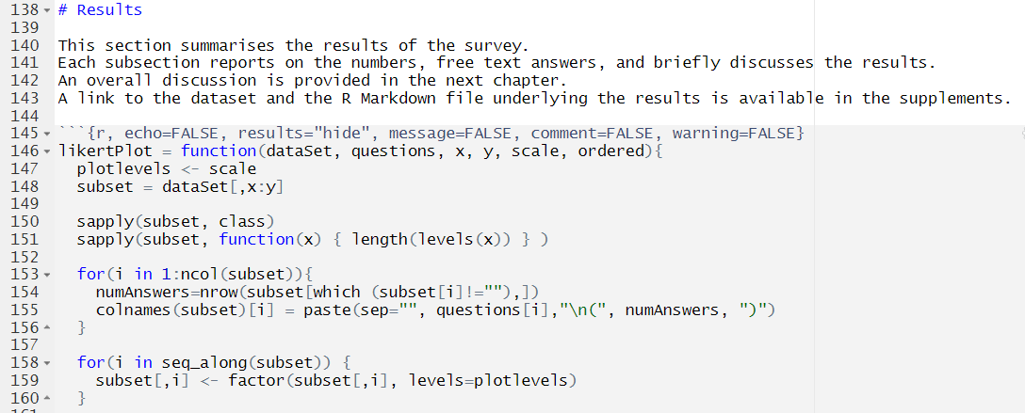
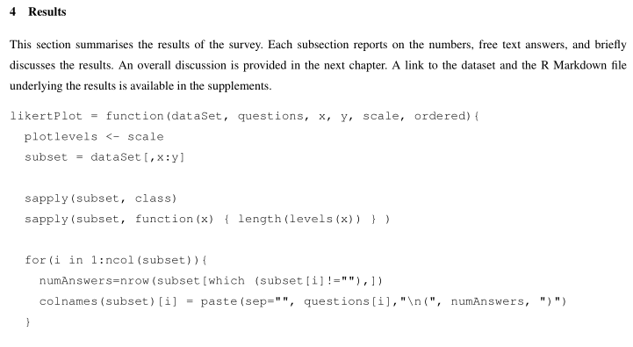
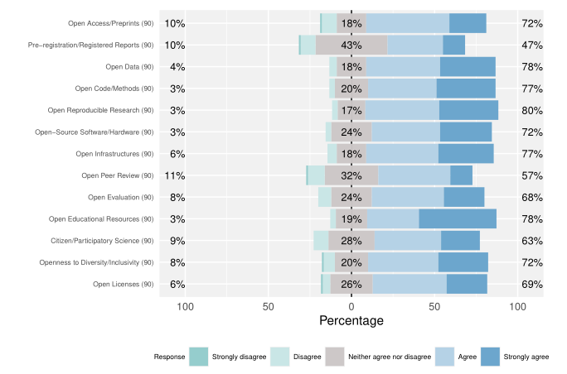
Five recommendations for ORR
Recommendation 3: Learn a computational notebook format.
Text
Code
Output
Further reading: Data science in Python & Jupyter, R Markdown Introduction
Notes:
Computational notebook: a computer file containing code and narrative text in a single reproducible and sharable file.
Example: R Markdown file in an RStudio programming environment.
NEXT
mixes source code and text in one file.
Markdown is a markup language that is pretty easy to learn and follows the what-you-is-what-you-get logic.
In RStudio, you can execute the R Markdown file and generate…
NEXT
…for example, a PDF document containing the text, the source code, and the outputs in a single document.
→ executable documents.

Slide 39



Five recommendations for ORR
Recommendation 4: Learn a collaborative software development tool.
Further reading: Version Control with Git (software carpentry)
Notes:
Recommendation 4: Learn a collaborative software development tool.
Yup will likely collaborate with others in the future
NEXT
Git is a collaborative software development tool and very popular.
NEXT
Two of the most common web applications that build on top of git are GitHub and GitLab.
provide features for software management.
easily organise tasks and assign specific tasks to certain persons.
see who has worked on what.
make your code open to the public and invite for collaborations.
git also provides versioning.
With every change, you create a new version of the source code.
useful when it comes to tracking changes.
Example: working on a piece of code, put it on GH, continue, modify, update code on GH
Error in the code, need to get back to previous version
Without having an older version tracked by git, you are lost.
with git, you can simply restore a previous version of the source code.

Slide 40
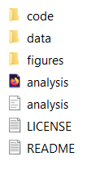
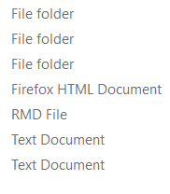
Five recommendations for ORR
Recommendation 5: Document your source code.
Create a clean workspace with a hierarchical folder structure and name files properly.
Include a README text file to explain the code.
  What does the software?
  How can I install it?
  Are there any computational requirements (e.g., operating system)?
  How can I use it?
  How long does the analysis take?
Add a LICENSE, e.g., MIT License, APACHE License, or GNU.
Further reading: Hettne et al. (2020)
Notes:
Recommendation 5: Document your source code.
software documentation is usually a very daunting task.
If you follow the first four recommendations, you are already on a very good way.
NEXT
start with a clean workspace.
hierarchical folder structure
See, for example, the workspace on the right.
folders
Central file…
NEXT
…in this case it is an R Markdown file called analysis.
Nice structure, happy, know immediately how to run
NEXT
name files properly, otherwise you end up with a bunch files called like that, nobody understands
NEXT
Include a README text file to explain the code.
What does the software?
How can I install it?
Are there any computational requirements (e.g., operating system)?
How can I use it?
How long does the analysis take?
NEXT
Add a LICENSE, e.g., MIT License, APACHE License, or GNU.
Take a closer look at licenses in a moment

Slide 41





Principles and best practices
Share the paper, data, source code, and details of the computational environment that generate published findings in open repositories.
Also known as Executable Research Compendium (ERC).
Open Access paper
ERC
Open Data
Open Code
Computational environment
Further reading: Nüst et al. (2017), Stodden et al. (2016), Sandve et al. (2013)
Notes:
If you follow the five recommendations, you are ready to share…

Slide 42
Horizon Europe AquaINFRA Project
Empowering Environmental Science and Policy through Open Data
Our goal is to advance water science by fostering cross-discipline collaboration, providing access to open and FAIR harmonised marine and freshwater data, enabling effective data management and analysis, contributing to the broader goals of achieving healthy oceans, seas, coastal, and inland waters.

Slide 43
The AquaINFRA research data infrastructure aims to help users…
Discover and access FAIR research outputs
Analyze and share digital research objects
Experiment with existing analytical workflows
Develop custom data analysis workflows
Enhance the reusability of AquaINFRA products
Transform how research outputs are created and shared
Notes:
The AquaINFRA research data infrastructure aims to help users…
Discover and access FAIR research outputs:
Analyze and share digital research objects:
Experiment with existing analytical workflows:
Develop custom data analysis workflows:
Enhance the reusability of AquaINFRA products:
Transforms how research outputs are created and shared:
Research outputs:
Existing data that can be analysed in the context of our project
Research outputs produced in our project
Not just data, but also source code, services, and workflows

Slide 44
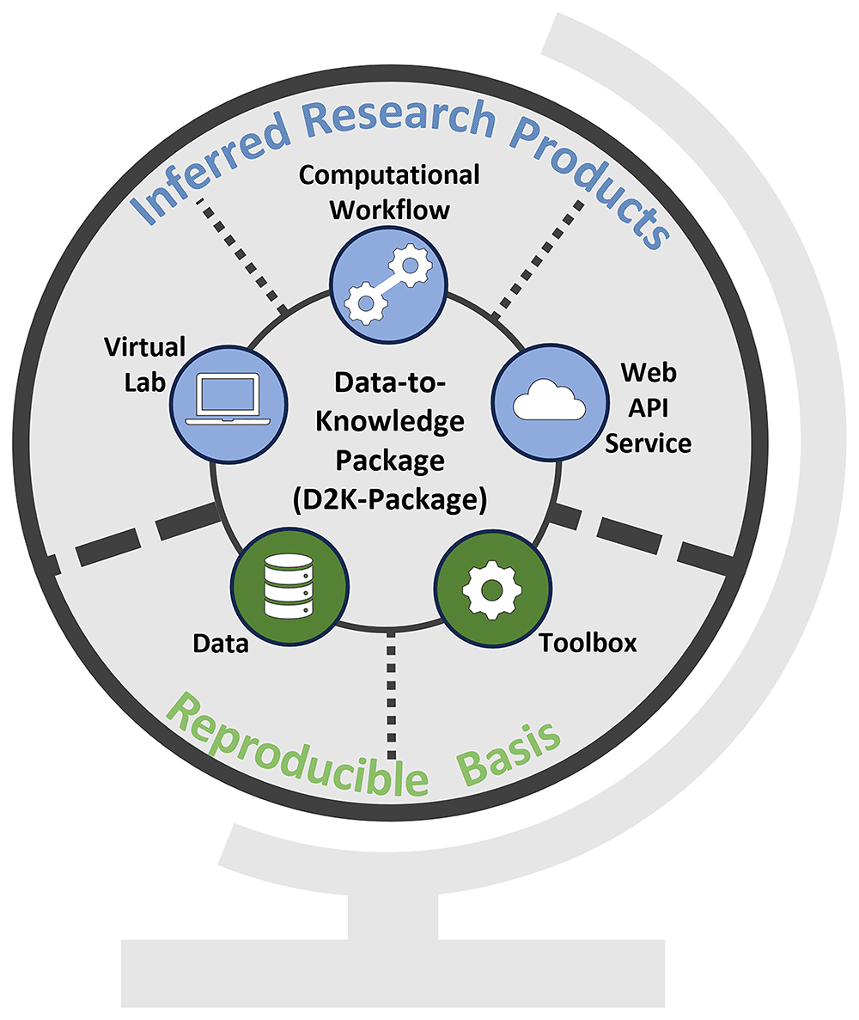
The Data-to-Knowledge Package
Further reading: Konkol et al., 2025 (Preprint)

Slide 45



The Data-to-Knowledge Package: Workflow
Function 1
Function 2
Function 3
Function A
Function B
Requirements:
Functions need to perform one specific task (e.g., data import, processing, analysis, and visualization)
Functions need to follow the input-processing-output logic
Functions need to be self-contained
A definition of the computational environment (runtime & libraries + versions) is required
Functions need to be encapsulated in a (Docker) container
Outcome:
Executable analysis
Reusable functions
Reproducible workflows
Shareable research results

Slide 46

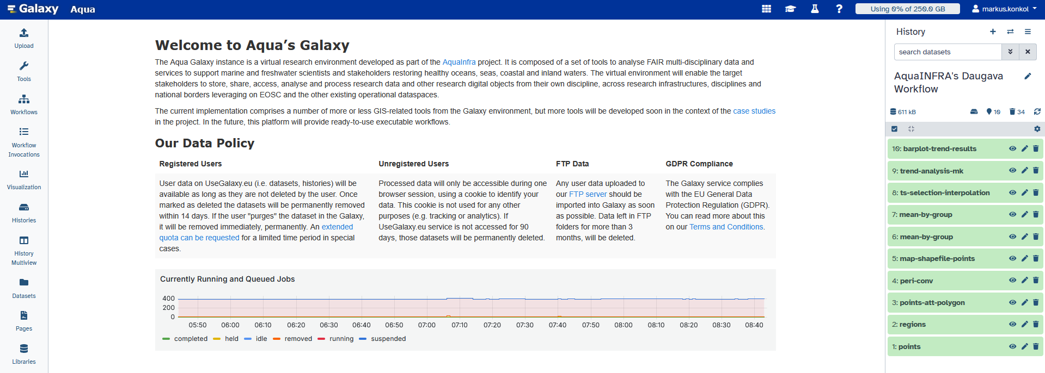
The Data-to-Knowledge Package: Workflow

Slide 47
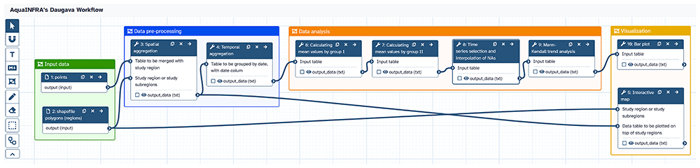
The Data-to-Knowledge Package: Workflow

Slide 48
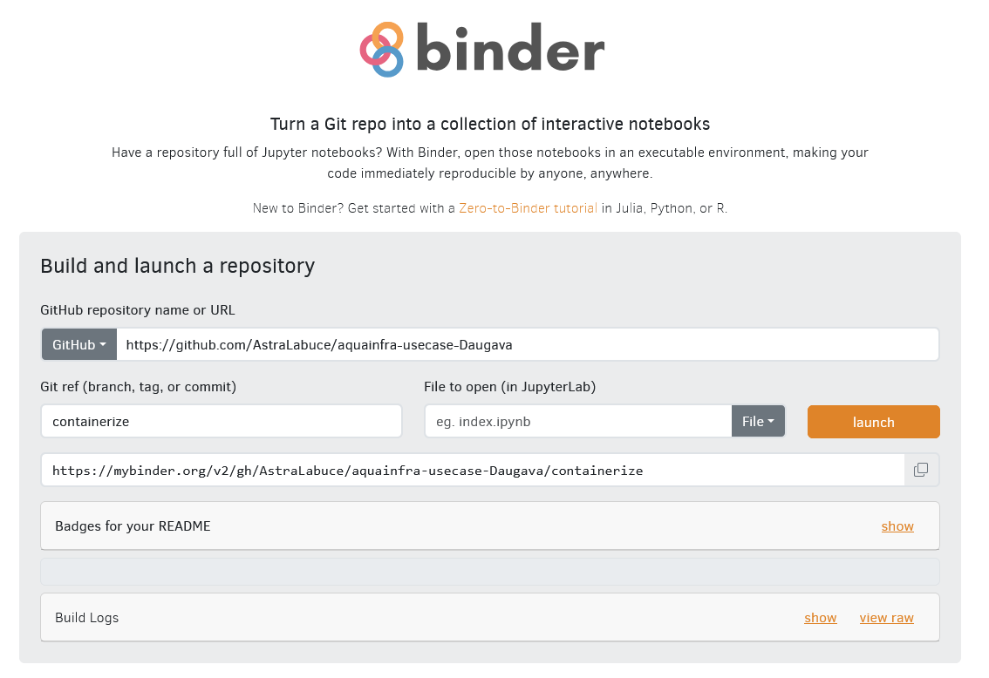
The Data-to-Knowledge Package: Virtual lab

Slide 49

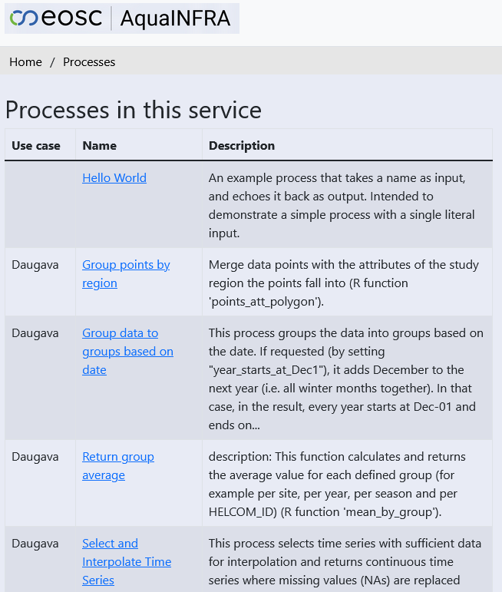
The Data-to-Knowledge Package: Web API

Slide 50
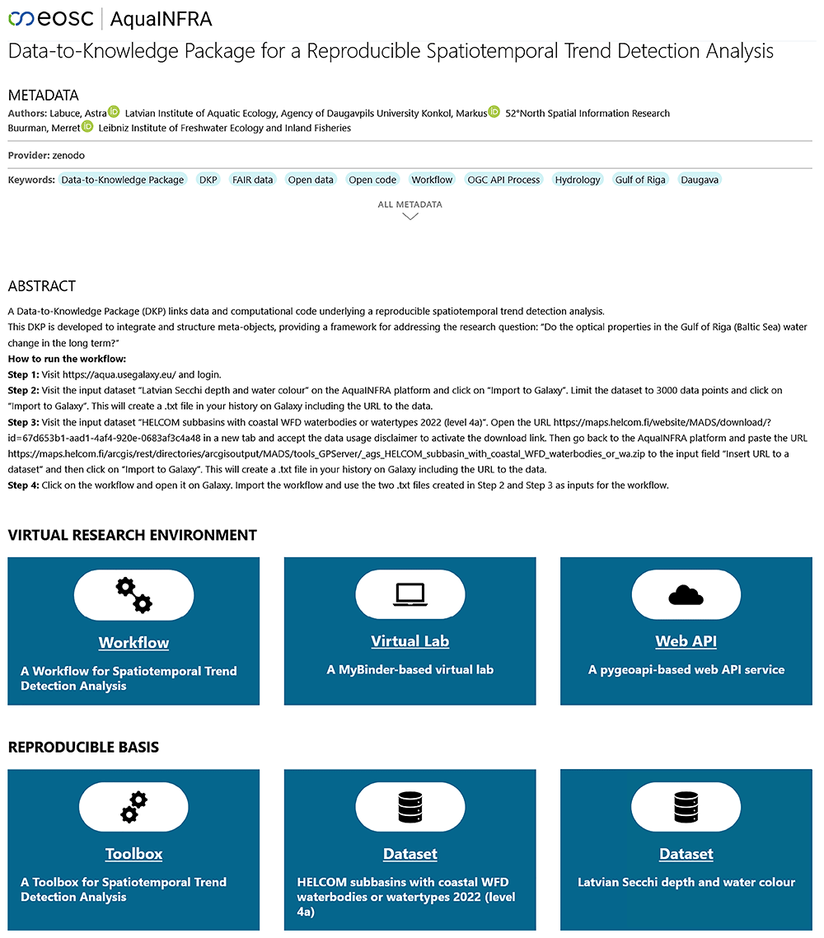

The Data-to-Knowledge Package
Demonstrator

Slide 51
Questions?
?
?
?
?
?
?
?
?
?
?
?
?
?
?

Slide 52
References
Alston, J. & Rick, J. (2020). A Beginner’s Guide to Conducting Reproducible Research. http://dx.doi.org/10.32942/osf.io/h5r6n
Banda, J. M., Tekumalla, R., Wang, G., Yu, J., Liu, T., Ding, Y., Artemova, K., Tutubalina, E., & Chowell, G. (2021). A large-scale COVID-19 Twitter chatter dataset for open scientific research - an international collaboration [Data set]. Epidemiologia, 2(3). https://doi.org/10.5281/zenodo.5595136
Braak, P., Jonge, H., Trentacosti, G., Verhagen, I. & Woutersen-Windhouwer, S. (2020). Guide to Creative Commons for Scholarly Publications and Educational Resources. https://doi.org/10.5281/zenodo.4090923
Gonzalez-Beltran, A. (2018). Interact to Interoperate. Software Sustainability Institute. https://software.ac.uk/blog/2018-12-06-interact-interoperate
Goodman, S. N., Fanelli, D. & Ioannidis, J.P.A. (2016). What does research reproducibility mean? Science Translational Medicine, 8(341). http://dx.doi.org/10.1126/scitranslmed.aaf5027
Hasselbring, W., Carr, L., Hettrick, S., Packer, H. & Tiropanis, T. (2020). Open Source Research Software. Computer, 53, 8, 84-88. https://doi.org/10.1109/MC.2020.2998235
Hettne, K., Proppert, R., Nab, L., Rojas-Saunero, L. P., & Gawehns, D. (2020). ReprohackNL 2019: how libraries can promote research reproducibility through community engagement. IASSIST Quarterly, 44(1-2), 1–10. https://doi.org/10.29173/iq977
Hrynaszkiewicz, I. & Cockerill, M. (2012). Open by default: a proposed copyright license and waiver agreement for open access research and data in peer-reviewed journals, BMC Res Notes, 5(494). https://doi.org/10.1186/1756-0500-5-494
Hufton, A. L. (2022). Dispelling common data sharing myths. https://alhufton.com/dispelling-common-data-sharing-myths/

Slide 53
References
Konkol, M., Kray, C., & Pfeiffer, M. (2018). Computational reproducibility in geoscientific papers: Insights from a series of studies with geoscientists and a reproduction study. International Journal of Geographical Information Science, 33:2, 408-429. https://doi.org/10.1080/13658816.2018.1508687
Labastida, I. & Margoni, T. (2020). Licensing FAIR Data for Reuse. Data Intelligence, 2(1-2). https://doi.org/10.1162/dint_a_00042
Lasser, J. (2020). Creating an executable paper is a journey through Open Science. Commun Phys 3, 143. https://doi.org/10.1038/s42005-020-00403-4
Nüst et al. (2017). Opening the Publication Process with Executable Research Compendia. D-Lib Magazine. http://www.dlib.org/dlib/january17/nuest/01nuest.html
Open Knowledge Foundation. Open Data Handbook. http://opendatahandbook.org/
RStudio (2020). R Markdown Introduction. URL: https://rmarkdown.rstudio.com/lesson-1.html
Sandve, G. K., Nekrutenko, A., Taylor, J., Hovig, E. (2013). Ten Simple Rules for Reproducible Computational Research. PLoS Comput Biol 9(10): e1003285. https://doi.org/10.1371/journal.pcbi.1003285
Science, Digital; Simons, Natasha; Goodey, Greg; Hardeman, Megan; Clare, Connie; Gonzales, Sara; et al. (2021). The State of Open Data 2021. Digital Science. Report. https://doi.org/10.6084/m9.figshare.17061347.v1
Stodden, V., McNutt, M., Bailey, D. H., Deelman, E., Gil, Y., Hanson, B., … & Taufer, M. (2016). Enhancing reproducibility for computational methods. Science, 354(6317), 1240–1241. https://doi.org/10.1126/science.aah6168
The Carpentries (2022). Version Control with Git. https://swcarpentry.github.io/git-novice/index.html

Slide 54
References
The Jupyter Book Community. UC Berkeley Data Science Modules. https://ds-modules.github.io/modules-textbook/introduction/ds-intro.html
The Turing Way Community, Arnold, B., Bowler, L., Gibson, S., Herterich, P., Higman, R. … & Whitaker, K. (2019). The Turing Way: A Handbook for Reproducible Data Science. Zenodo. http://doi.org/10.5281/zenodo.3233986
Theobald, A. Introduction to Creative Commons Licenses. https://uniofcam.libwizard.com/f/CreativeCommons
UNESCO (2021). UNESCO Recommendation on Open Science. URL: https://www.unesco.org/en/open-science/about
University of Cambridge. Research data - Looking after and sharing your data. https://www.data.cam.ac.uk/data-management-guide/looking-after-and-sharing-your-data#Selection
Wilkinson, M., Dumontier, M., Aalbersberg, I. et al. (2016). The FAIR Guiding Principles for scientific data management and stewardship. Scientific Data 3, 160018. https://doi.org/10.1038/sdata.2016.18

Slide 56
The German National Research Data Infrastructure (NFDI)
Federal-state program to create the NFDI (2018)
Funding for 10 years with € 90 million p.a.
Funding of up to 30 consortia in 3 rounds of calls – Managed by the German Science Foundation (DFG)
https://www.nfdi.de/
Further reading: Rat für Informationsinfrastr., Informationsinfrastrukturen/NFDI

Slide 57
The German National Research Data Infrastructure (NFDI)
Idea: Research results should be transparent, verifiable, reproducible, and reusable.
Challenges:
Store digital research outputs in a reusable way (RDM).
Diversity of data w.r.t. quality, size, licenses, semantics…
There is often no (standardized) metadata.
Missing tools & platforms to support the research process.
Many different stakeholders.
Goal: NFDI aims to connect stakeholders and increase the value of research outputs.
Further reading: Rat für Informationsinfrastr., Informationsinfrastrukturen/NFDI

Slide 58
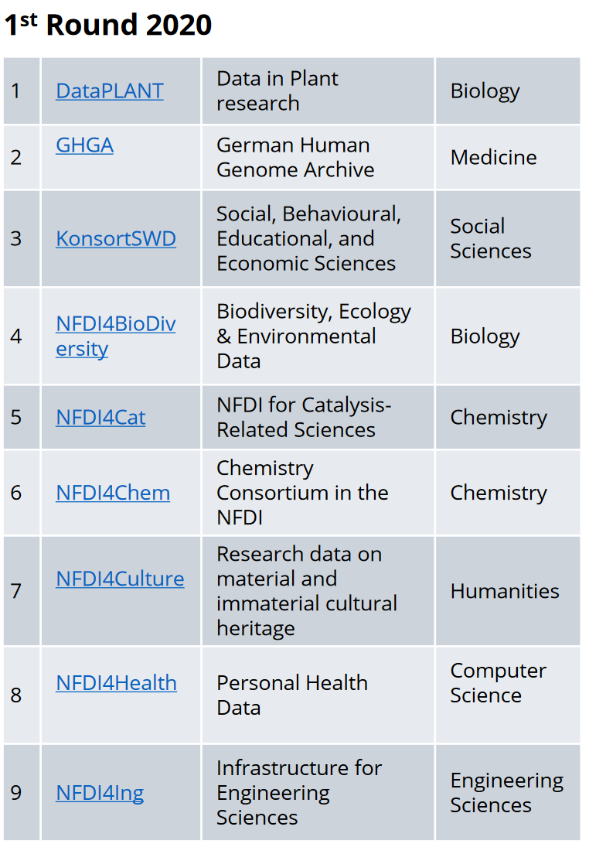
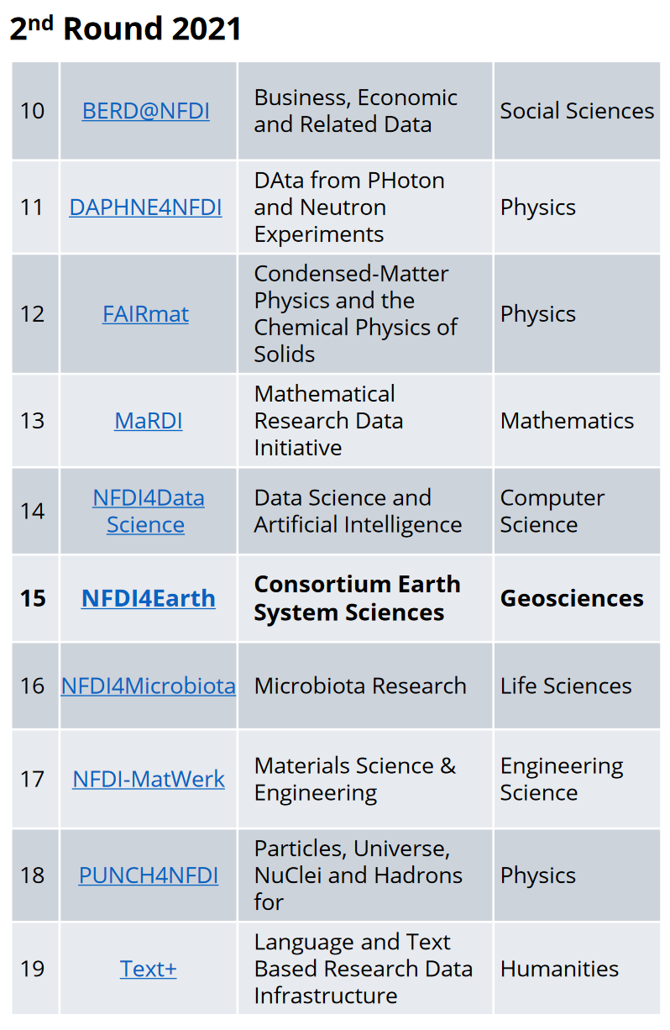
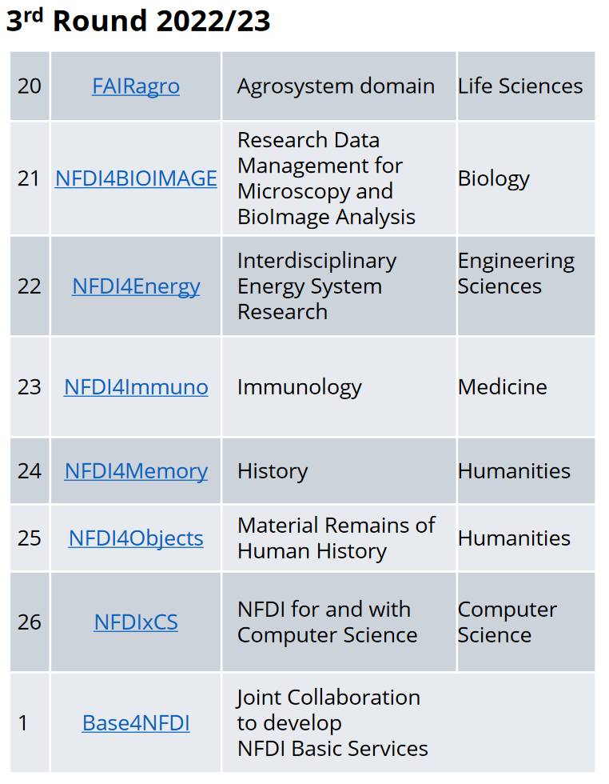
The German National Research Data Infrastructure (NFDI)
From: Bernard, Lars (2024). NFDI and NFDI4Earth.

Slide 59
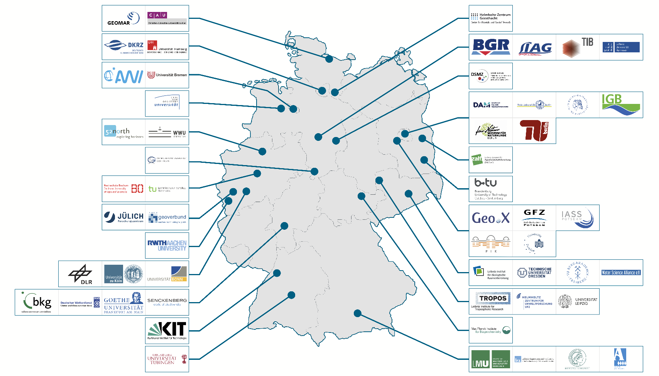
NFDI4Earth
- NFDI for the Earth System Sciences
61 institutions covering the breadth of
Earth System Sciences (ESS)
Universities
Research Organizations
Infrastructure Providers
Governmental Institutions
Scientific Associations/Networks
DFG-Funded 10/2021–9/2026; 16.5 Mio. Euro
Further reading: NFDI4Earth, picture taken from: https://www.nfdi4earth.de/about-us

Slide 60
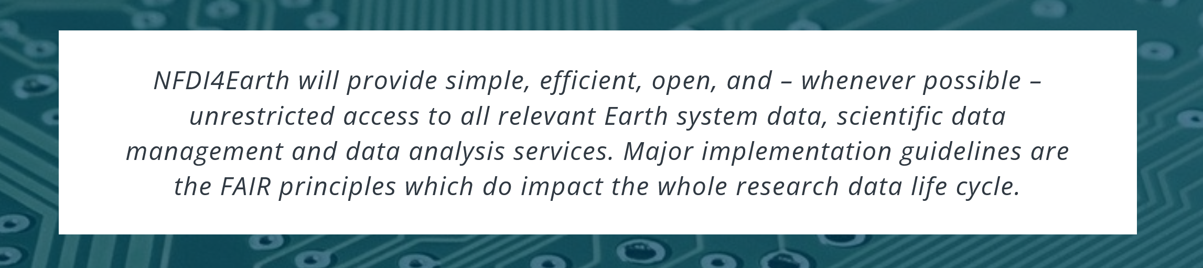
NFDI4Earth
- NFDI for the Earth System Sciences
?
?
?
?
?
?
From: https://www.nfdi4earth.de/about-us
Next:
Chapter 2: Open and FAIR Data
Chapter 3: Open Reproducible Research
Further reading: NFDI4Earth

